Slide 1
Multi-link mobility
Date: 2020-07-23
Authors:
Name | Affiliations | Address | Phone | email
Jonas Sedin | Ericsson | Torshamnsgatan 21, 16440, Stockholm, Sweden |  | Jonas.sedin@ericsson.com
Charlie Pettersson
Dennis Sundman
Sebastian Max

Slide 2
Introduction
Several scenarios require efficient mobility
In already existing use cases such as large public deployments
In future use-cases such as factory scenarios
FT protocol [1] is able to reduce the time to do roaming in a network, but will still incur transition delays

Slide 3
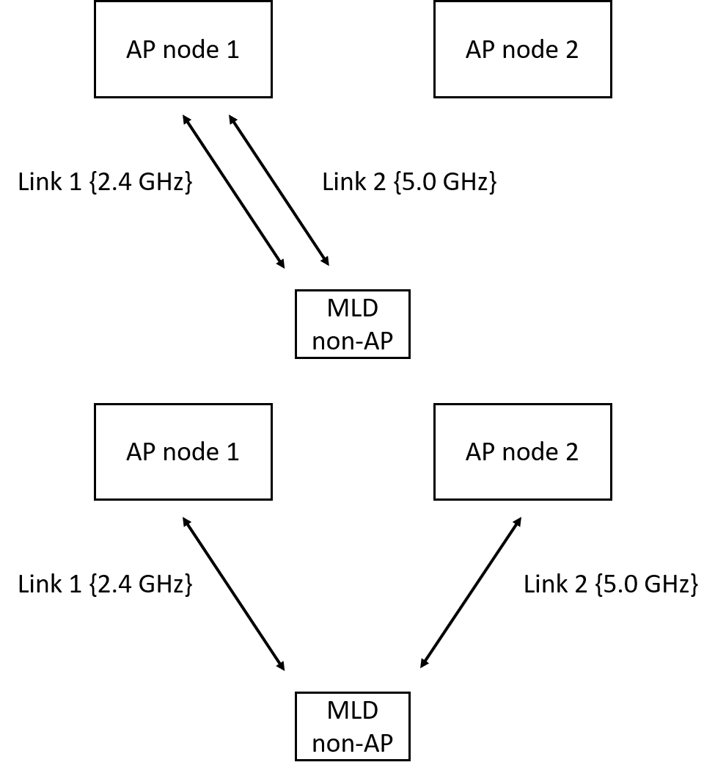
Introduction - Multi-link mobility
High-level idea:
In multi-link mobility at least one link with the target node is established before de-associating the MLD non-AP with the current node
This type of mobility could introduce mobility that could be robust, seamless and reduce the pingpong effect
In the following section we describe how already agreed features[2] of multi-link that would enable good performance for mobility

Slide 4
Introduction - Multi-link mobility cont.
Robustness
The reliability is increased due the reduced correlation in slow fading between two non-collocated nodes compared to collocated nodes as well as the diversity in the form of path loss
An example of signal strength changing is seen in the figure below when both links are on the same band but different channels

Slide 5
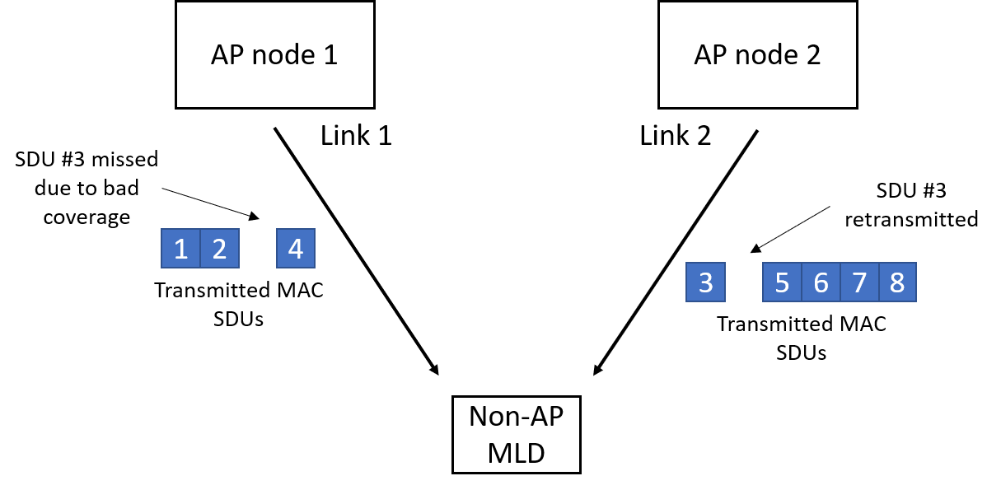
Introduction - Multi-link mobility cont.
Seamlessness
One could still receive data on one link while being connecting to another AP, and if packets are lost on one link, they could be retransmitted from/to another node.
This may partly enabled due to the fact that the BA agreement and TID is across multiple links.

Slide 6
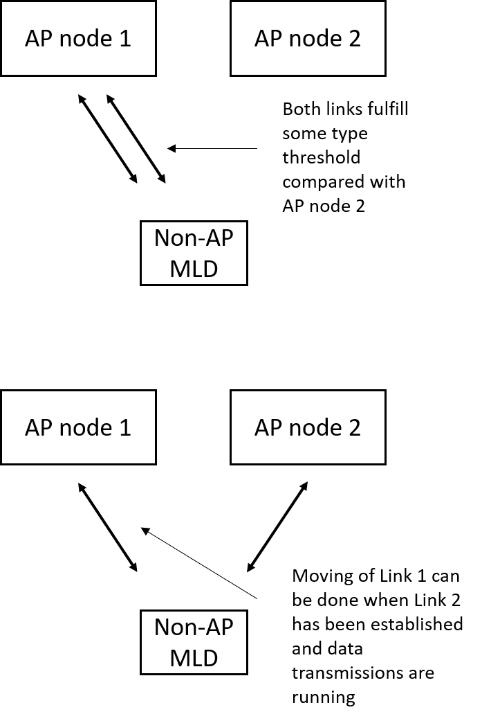
Introduction - Multi-link mobility cont.
Reduction of the ping-pong effect
Normally handovers are based on comparing signal strengths between BSS and neighbouring BSSs and making a decision when the signal strength is above/below a certain threshold
The above may cause ping-ponging due to spotty coverage even with techniques designed to limit this
In multi-link, since we would still be able to send data on another link, the STA could be allowed to be significantly more sticky on a specific link – this is also related to robustness aspect

Slide 7
Introduction – General robustness
The earlier mentioned potential pros of multi-link mobility naturally leads us to the question of whether this is only applicable and/or beneficial for handovers
Robustness could be improved regardless of mobility if an MLD non-AP is connected to multiple MLD APs

Slide 8
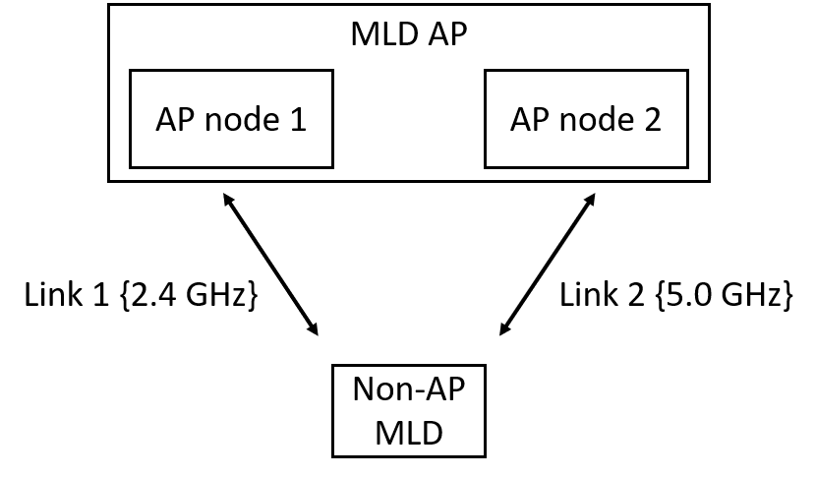
Proposal
On associating with multiple MLD APs:
The spec is clear “At any given instant, a STA is associated with no more than one AP.” [1]
Main idea:
Allow the establishment of a MLD AP entity that spans multiple nodes (from the perspective of the non-AP), let us call it multi-link multi-node operation
From the non-AP perspective is still connected to a single MLD AP

Slide 9
Proposal cont.
MLD entity spanning multiple nodes:
802.11be supports that if different affiliated APs of an AP MLD have different MAC addresses, then different affiliated non-AP STAs of a non-AP MLD with more than one affiliated STA have different MAC addresses. [Motion 112, #SP38, [9] and [86]] [1]
Question on the above is whether the affiliated APs are collocated or not – proposal is that it should not mean that the affiliated APs are collocated

Slide 10
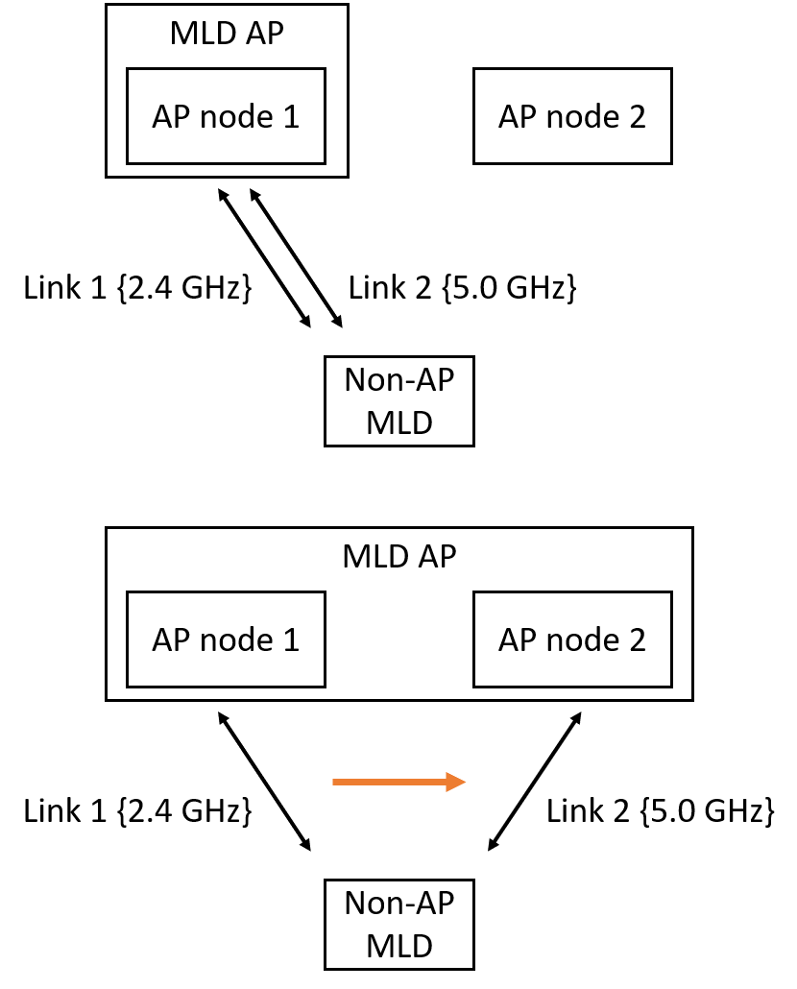
Proposal cont.
If non-AP MLD is establishing a new link it can request to establish a link at another node
If AP MLD is establishing a new link at a new AP node it would be not be visible for the non-AP MLD
Signalling example:
A field in multi-link setup that includes the address of the MLD AP that the non-AP MLD wants to established a multi-link multi-node connection with*
*given that both AP and non-AP is capable of this

Slide 11
Straw Poll 1
Do you believe that utilizing multi-link by establishing a MLD AP across multiple nodes for mobility purposes should be considered for either R1/R2?
Yes/No/Abstain:

Slide 12
References
[1] 802.11-2016 Wireless LAN Medium Access Control (MAC) and Physical Layer (PHY) Specifications
[2] https://mentor.ieee.org/802.11/dcn/19/11-19-1262-11-00be-specification-framework-for-tgbe.docx

