Slide 1
Synchronous Multi-link Transmission of Non-STR MLD
Date: 2020-08-05
Authors:

Slide 2
Recap: Multi-Link Device Architecture [1,2]
Multi-link device (MLD): A device that has more than one affiliated STA and has one MAC SAP to LLC, which includes one MAC data service.

Slide 3
Recap: Multi-Link Device Architecture [3]
TX
RX
ADDR_A
MAC SAP
MAC SAP
ADDR_X
AMSDU
RX
DEFRAG
DEAGG
REORDER
MACSEQ
AMPDU
FRAG
BACON
BACON
ADDR_B
EDCA0
EDCA1
ADDR_C
ADDR_Y
EDCA0
EDCA1
ADDR_Z
PHY0
PHY1
PHY0
PHY1

Slide 4
Recap: Multi-Link Device Architecture [4]
Single MAC SAP
Single MAC SAP
High MAC
High MAC
Traffic Steering
Multilink Management
Reordering Buffer
Multilink Management
Common Queues
Common Queues
Low MAC 1
Low MAC 2
Low MAC 1
Low MAC 2
Buffer Queues
Buffer Queues
RX Buffer
RX Buffer
EDCAF
EDCAF
Scoreboard
Scoreboard
PHY 1
PHY 2
PHY 1
PHY 2
TX 1
TX 2
RX 1
RX 2

Slide 5
Assumption
STAs affiliated to an MLD independently operate and follow the baseline EDCA procedure.
The MLD may have two type of queues.
  MLD queue: Before a transmitter among STAs affiliated to a MLD is determined, a MLD buffers the MPDUs to the MLD queue.
  STA queue: After a transmitter among STAs affiliated to a MLD is determined, a MLD buffers the MPDUs to the STA queue associated with the transmitter.
    NOTE- STA queue consists of transmit queues for each AC.

Slide 6
Synchronous Multi-Link Transmission Procedure
A MLD checks the RBO counter of each STA affiliated to the MLD.
If the RBO counter of a STA is equal to 0, the MLD may pass the MPDU from the MLD queue to the corresponding STA queue and the STA initiates a TXOP.
Synchronous multi-link transmission is not happened.
9 | 8 | 7 | 6 | 5
Busy (Interference leakage by STA1)
AIFS
4 | 3 | 2 | 1 | 0
TX A-MPDU
STA2 Queue
Empty
Nonempty
4 | 3 | 2 | 1 | 0
TX A-MPDU
Rx BA
AIFS
4 | 3
Busy
STA1 Queue
Empty
Nonempty
Empty
MLD

Slide 7
Synchronous Multi-Link Transmission Procedure
However, when the RBO counter of a STA1 is equal to 0, the MLD may decide to not pass the MPDU from the MLD queue to the STA1 queue. Because the RBO counter of a STA2 almost reaches to 0.
In a consequence, the STA1 does not initiates a TXOP according the baseline rule (see the next slide) and a STA2 continues the backoff procedure.
9 | 8 | 7 | 6 | 5
4 | 3 | 2 | 1 | 0
STA2 Queue
Empty
4 | 3 | 2 | 1 | 0
STA1 Queue
Empty
MLD

Slide 8
Synchronous Multi-Link Transmission Procedure
In P802.11md D3.0,
  On these specific slot boundaries, each EDCAF shall make a determination to perform one and only one of the following functions:
    Decrement the backoff counter(#189).
    Initiate the transmission of a frame exchange sequence.
    Invoke the backoff procedure due to an internal collision.
    Do nothing.
  At each of the above-described specific slot boundaries, each EDCAF shall initiate a transmission sequence if
    There is a frame available for transmission at that EDCAF, and [X]
    The backoff counter(#189) for that EDCAF has a value of 0, and [O]
    Initiation of a transmission sequence is not allowed to commence at this time for an EDCAF of higher UP. [O]
STA1 performs to do nothing because there is no frame available for transmission.

Slide 9
Synchronous Multi-Link Transmission Procedure
Then, when the RBO counter of the STA2 is equal to 0, the MLD passes the MPDU from the MLD queue to the STA2 queue and the STA1 queue.
Both the STA2 and STA1 can initiate a TXOP simultaneously.
  The STA1 does not invoke a new backoff procedure if the medium is not busy according the baseline rule (see the next slide).
9 | 8 | 7 | 6 | 5
4 | 3 | 2 | 1 | 0
TX A-MPDU
Rx BA
STA2 Queue
Empty
Nonempty
4 | 3 | 2 | 1 | 0
TX A-MPDU
Rx BA
STA1 Queue
Empty
Nonempty
MLD

Slide 10
Synchronous Multi-Link Transmission Procedure
In P802.11md D3.0,
  On these specific slot boundaries, each EDCAF shall make a determination to perform one and only one of the following functions:
    Decrement the backoff counter(#189).
    Initiate the transmission of a frame exchange sequence.
    Invoke the backoff procedure due to an internal collision.
    Do nothing.
  At each of the above-described specific slot boundaries, each EDCAF shall initiate a transmission sequence if
    There is a frame available for transmission at that EDCAF, and [O]
    The backoff counter(#189) for that EDCAF has a value of 0, and [O]
    Initiation of a transmission sequence is not allowed to commence at this time for an EDCAF of higher UP. [O]
STA1 performs to initiate a TXOP because a frame is available for transmission.

Slide 11
Synchronous Multi-Link Transmission Procedure
However, if the medium of the STA1 is busy, only STA2 initiates a TXOP.
The STA1 shall invoke a new backoff procedure when the medium is changed to idle according the baseline rule.
  But, the STA1 can dequeue the MPDU from the STA queue for retrying the synchronous multi-link transmission.
4 | 3 | 2 | 1 | 0
TX A-MPDU
Rx BA
STA2 Queue
Empty
Nonempty
Empty
1 | 0
Busy
AIFS
2 | 1 | 0
TX A-MPDU
STA1 Queue
Empty
Nonempty
MLD

Slide 12
Synchronous Multi-Link Transmission Procedure
In P802.11md D3.0,
  If a STA is permitted to begin a TXOP (as defined in 10.23.2.4 (Obtaining an EDCA TXOP)) and the STA has at least one MSDU pending for transmission for the AC of the permitted TXOP, the STA shall perform exactly one of the following actions:
    e) Restart the channel access attempt by invoking the backoff procedure as specified in 10.23.2 (HCF contention based channel access (EDCA)) as though the medium is busy on the primary channel as indicated by either physical or virtual CS and the backoff counter(#189) has a value of 0.
      NOTE 1—In the case of rule e), the STA selects a new random number using the current value of CW[AC], and the retry counts(#2431) are not updated (as described in 10.23.2.8 (Multiple frame transmission in an EDCA TXOP); backoff procedure invoked for event a)).

Slide 13
Observations
Single MAC SAP
Current backoff procedure can support a synchronous multi-link transmission.
A MLD only needs a queue management for passing the MPDU from the MLD queue to STA queue, which is based on the RBO counters of STAs affiliated to the MLD and is implementation specific.
High MAC
Traffic Steering
Multilink Management
MLD Queue
RBO counter
RBO counter
Low MAC 1
Low MAC 2
STA Queue
STA Queue
EDCAF
EDCAF
PHY 1
PHY 2
TX 1
TX 2

Slide 14
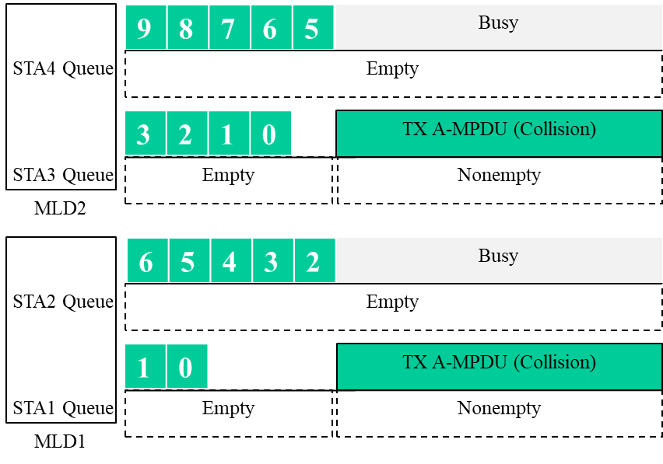
Observations
Issue
  While several MLDs are waiting that the RBO of a link 2 reaches to 0, if the medium of the link 2 is changed to busy, they may determine to initiate a TXOP on only the link 1. Then, it may cause a collision.

Slide 15
Observations
Solution
  If the backoff counter of the STA has a value of zero, the STA may perform a new backoff procedure.
6 | 5 | 4 | 3 | 2
Busy
STA4 Queue
Empty
3 | 2 | 1 | 0
1 | 0
TX A-MPDU
Rx BA
STA3 Queue
Empty
Nonempty
Empty
MLD2
8 | 7 | 6 | 5 | 4
Busy
STA2 Queue
Empty
1 | 0
3 | 2
AIFS
1 | 0
TX A-MPDU
STA1 Queue
Empty
Nonempty
MLD1

Slide 16
Conclusion
In our viewpoint of the spec, we think that current backoff procedure can support a synchronous multi-link transmission.
  When the backoff counter of a STA affiliated to a MLD reaches zero earlier than the backoff counter of other STA affiliated to the same MLD, the STA does not transmit a MPDU and keeps its backoff counter at zero. In that way, the MLD can make to align the start time of TXOPs on each link.
We just need to summarize a few key rules for the synchronous channel access based on such observation.

Slide 17
References
[1] https://mentor.ieee.org/802.11/dcn/19/11-19-0822-09-00be-extremely-efficient-multi-band-operation.pptx (Po-kai Huang, Intel)
[2] https://mentor.ieee.org/802.11/dcn/19/11-19-0823-00-00be-multi-link-aggregation.pptx, (Abhishek Patil, Qualcomm)
[3] https://mentor.ieee.org/802.11/dcn/19/11-19-1575-00-00be-multi-link-ba-operation.pptx (Matthew Fischer, Broadcom)
[4] https://mentor.ieee.org/802.11/dcn/19/11-19-1921-01-00be-multi-link-architecture.pptx (Ming Gan, Huawei)
[5] https://mentor.ieee.org/802.11/dcn/20/11-20-0993-00-00be-sync-ml-operations-of-non-str-device.pptx (Dmitry Akhmetov, Intel)

