Slide 1
MLD Link Transition Management
Date: 2020-08-24
Authors:
Name | Affiliations | Address | Phone | email
Chunyu Hu | Facebook Inc. | 1 Hacker way Menlo Park, CA |  | chunyuhu@fb.com
Payam Torab |  |  |  | torab@ieee.org

Slide 2
Introduction
TID-to-link mapping is an established MLO topic and expected to be developed under 11be MLO framework
Some multi-link scenarios require link-level management – see [20/0810]
Radio | processing core becoming available/unavailable (device centric)
Reachability/range changes (environment, mobility)
…
and all pre or post association (independent of association)
We investigate if all these scenarios are properly addressed in current MLO formulation
This leads to a framework discussion relating TID-to-link mapping, link enablement/disablement, dynamic link set and management mechanisms

Slide 3
MLD link level management scenarios Association time
References
[20/0865]
AP
MLD
2.4
Non-AP
MLD
References
[20/0741]
2.4
Capabilities for N₁ links
Capabilities for N₂ links
5⁺
Beacon, Probe Response,
MLD Query
------------------
Elements: RNR
Association Request,
MLD Response
------------------
Elements: ML
5⁺
5⁻
5⁻
6
Association
AP
MLD
Non-AP
MLD
2.4
2.4
N links (N ≤ N₁, N ≤ N₂)
5⁺
5⁺
5⁻
5⁻
6
Link level management at association time seems to have been adequately covered by current contributions

Slide 4
MLD link level management scenarios Load balancing | Link loss – MLD constraints (1)
Non-AP
MLD1
2.4
AP
MLD
5
6
Non-AP
MLD2
Non-AP STA with two radios
connecting to a different AP affiliated with the AP MLD
MLD1 (3 STAs) on 2.4, 5 and 6 GHz links
MLD2 (2 STAs) on 2.4 and 5 GHz links
MLD3 (2 STAs) using 2.4, 5 and 6 GHz links
Switching from
5 GHz to 6 GHz
2 affiliated STAs
Non-AP
MLD3
Non-AP STA disconnecting from an AP affiliated with the AP MLD
5 GHz congestion or link loss
MLD1 (3 STAs) on 2.4, 5 and 6 GHz links
MLD2 (2 STAs) on 2.4 and 6 GHz links
MLD3 (2 STAs) using 2.4 and 6 GHz links
References
[20/0412]
Non-AP STA connecting to a different AP STA when
Fewer non-AP STAs than AP STAs (no 1:1 mapping)
AP STA tied to certain bands/channels (switching constraint or tied (in use) radio)

Slide 5
MLD link level management scenarios Load balancing | Link loss – MLD constraints (2)
Non-AP
MLD1
AP STA connecting to a different non-AP STA affiliated with the non-AP MLD
2.4
AP
MLD
5
2 affiliated STAs
Non-AP
MLD2
Non-AP STAs with switching constraints
Operating only on 5 GHz
MLD1 (3 STAs) on 2.4 and 5 GHz links
MLD2 (3 STAs) on 2.4 and 5 GHz links
MLD3 (3 STAs) on 2.4 and 5 GHz links
Operating only on 6 GHz
Non-AP
MLD3
5 GHz congestion or link loss
MLD1 (3 STAs) on 2.4 and 6 GHz links
MLD2 (3 STAs) on 2.4 and 6 GHz links
MLD3 (3 STAs) on 2.4 and 6 GHz links
AP STA connecting to a different non-AP STA when
Fewer AP STAs than non-AP STAs (no 1:1 mapping)
Non-AP STA tied to certain bands/channels (switching constraints)

Slide 6
MLD link level management scenarios Other scenarios
Link reduction - multi-link operation is not always the best option
Efficiency, power save
Sticking with the dominant traffic component (e.g., sticking a TID with 5% of the traffic with the only other TID carrying 95% of the traffic in one link)
Simpler management: O(2^{LN}) complexity vs. O(2^{LMN})
L, M, N respectively number of links, number of TIDs per STA, and number of non-AP STAs
Link expansion
Increase in traffic
Changes in environment (soft AP for example)
See [20/810] (Dynamic Link Set) for more discussion

Slide 7
Summary | Switching scenarios
Similar to
BSS Transition Management
(BTM)
AP
MLD
Non-AP
MLD
AP
MLD
Non-AP
MLD
TID 1
(split between
two links)
Non-AP STA transition to new AP
TID switch (TID-to-link mapping)
Fewer affiliated non-AP STAs than affiliated AP STAs
Affiliated AP STAs having band/channel switch constraints
Links remain the same, mapping between TIDs and links changes
No
equivalent
AP
MLD
Non-AP
MLD
AP
MLD
Non-AP
MLD
AP STA transition to new non-AP
Channel switch (link-to-channel mapping)
Fewer affiliated AP STAs than affiliated non-AP STAs
Affiliated non-AP STAs having band/channel switch constraints
No change from MLO perspective;
same link (Link ID) operating on a different channel
These scenarios do not seem to have been addressed by current MLO framework
[19/1943], [20/0741]
AP
MLD
Non-AP
MLD
New AP and non-AP STAs taking over
Link enable | disable

Slide 8
Discussion
There are cases for non-AP connecting to a new AP or an AP connecting to a new non-AP within MLDs
Non-AP connecting to a new AP can be performed through a mechanism similar to BSS Transition Management (BTM)
AP connecting to a new non-AP can be performed through a generalized symmetric mechanism defined for both AP and non-AP, or through a different mechanism
In the context of link management, and given that an MLO link represents a 1:1 AP to non-AP connection, there may be little difference between an AP and non-AP STA in terms of authority to initiate a link switch
Traffic loss as a result of switching alone should be minimal
For example, a non-AP connecting to a new AP in an MLO framework should result in lower traffic loss compared to classic BSS Transition Management (BTM)
Design elements from BTM, Fast Session Transfer (FST) can be borrowed

Slide 9
Straw Poll 1
Do you agree with defining a mechanism for an AP STA affiliated with an AP MLD to recommend or request an associated non-AP STA in a non-AP MLD to associate with a different AP STA in the AP MLD?
Yes
No
Abstain
Note: This mechanism is separate from MLD-level BSS Transition Management, where a non-AP MLD is recommended or forced to transition to a different AP MLD [20/0669].

Slide 10
Straw Poll 2
Do you agree with defining a mechanism for a non-AP STA in a non-AP MLD to recommend or request an AP STA in an associated AP MLD to create association with a different non-AP STA affiliated with the non-AP MLD?
Yes
No
Abstain

Slide 11
References
[19/1943] 11-19-1943-09-00be-multi-link-management.pptx
[20/0412] 11-20-0412-01-00be-mlo-link-switching-method.pptx
[20/0669] 11-20-0669-00-00be-mld-transition.pptx
[20/0741] 11-20-0741-02-00be-indication-of-multi-link-information-follow-up.pptx [20/0751] 11-20-0751-01-00be-multi-link-setup-clarifications.pptx [20/0810] 11-20-0810-01-00be-dynamic-link-set.pptx [20/0908] 11-20-0908-00-00be-multilink-ts-operation.pptx

Slide 12
Backup slides

Slide 13
Existing relevant mechanisms BSS Transition Management (BTM) overview
AP recommending or requiring non-AP to transition to a new AP
Query, Request and Response frames
Neighbor Report element

Slide 14
Existing relevant mechanisms (3) Fast Session Transfer (FST) overview
FST is designed to transfer a session (defined as one or more TSs) from one band/channel to another band/channel
TCs should be able to use FST too; TS constraint is probably unnecessary
Equivalent of an MLO link is an independent association between the FST endpoints in each band/channel
For example, the endpoints network roles (AP | non-AP relationship) can be different in the new band/channel
Operating parameters of each FST association are generally unavailable across BSSs in the FST framework, which means they need to be signaled at transition (through the Multi-band element)
Architecturally, the two endpoints of an FST session do not manage their multiple MAC sublayers through a multiple MAC SME (MM-SME)
FST can switch one TID from one BSS to another BSS between two given multi-band devices
Multi-band definitions are general enough to apply to two channels in the same band.

Slide 15
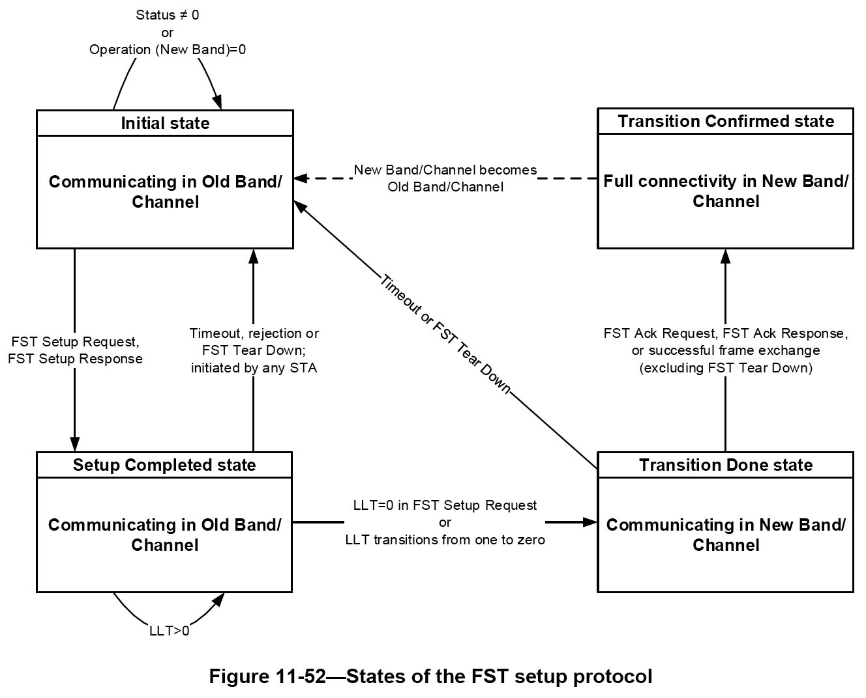
Existing relevant mechanisms (4) FST session transfer protocol
Session transfer can be initiated by either end (initiator end, the other end called responder)
State machine with 4 states (Initial, Setup Completed, Transition Done, and Transition Confirmed), and the following state transition logic,
“Initial” to “Setup Completed”: Successful exchange of FST Setup Request and FST Setup Response Action Ack frame; no timeout, retries left to initiator, MAC address-based arbitration between racing requests
“Setup Completed” to “Transition Done”: After a STA-based or stream-based (TS-based) countdown to 0; counter initially loaded to LLT × 32 μs, where link loss timeout (LLT) is specified in the FST Setup Request frame; counter reset to initial value every time an individually addressed frame for the STA or for the specific TS in the STA is received from the peer STA
“Transition Done” to “Transition Confirmed”: Successful exchange of FST Ack Request and FST Ack Response (both Action Ack frames) or other MPDUs in the new band/channel

