Slide 1
Coordinated Spatial Reuse: Extension to Uplink
Date: 2020-07-10
Authors:

Slide 2
Introduction
C-SR is a simple Multi-AP coordination scheme that can increase spectrum efficiency by reusing the same time/frequency resources among multiple BSSs
Several contributions propose C-SR procedure and investigate performance gain [1-5]
In our previous contribution, we investigated several issues regarding C-SR downlink transmissions [6]
In this contribution, we investigate the potential issues when extending C-SR procedure to cover uplink transmissions

Slide 3
Recap: Coordinated SR (C-SR)
Objective of C-SR
  Enabling simultaneous data transfer of entities of the both sharing BSS and shared BSS in the shared TXOP
Requirement of C-SR
  Protecting data transfer of the sharing BSS entities in the shared TXOP
DL C-SR procedure [6]
  Preparation phase
    STA estimates path loss based on the beacon signal and reports to associated AP
    AP collects path loss information to calculate Tx power limit of the shared AP
  Announcement phase
    AP transmits announcement frame including Tx power limit (TPL) of shared AP and the BA resource allocation of sharing/shared BSS to shared AP
  Transmission phase
    Data transmission of sharing AP and shared AP with adjusted power
    Simultaneous BA transmissions
Sharing BSS: BSS that sharing AP belongs to
Shared BSS: BSS that shared AP belongs to

Slide 4
Recap: C-SR Example of 2-BSS DL/DL [6]
AP1 obtains TXOP → sharing AP
AP2 obtains the shared TXOP → shared AP
Collecting
Capability/Path loss
AP1
C-SR-A
DL MU
BA
STA1-1
BA
STA1-2
DL MU
AP2
Measurement and
Collection of
Path loss
Report
BA
STA2-1
BA
STA2-2
Preparation Phase
Announcement Phase
Transmission Phase
Measurement
Report
* C-SR-A: C-SR announcement frame

Slide 5




C-SR Scenarios
Four C-SR scenarios
  Assumption: a single shared AP for simplicity
Case 1: DL/DL
  Protection of SIR of “AP1 to STA1”
  AP1 requires
    ${PL}_{AP1}^{STA1}$, ${PL}_{AP2}^{STA1}$
Case 2: UL/DL
  Protection of SIR of “STA1 to AP1”
  AP1 requires
    ${PL}_{STA1}^{AP1}$, ${PL}_{AP2}^{AP1}$
Case 1 and 2 can be covered by the path loss measurement at AP1 and the path loss report from STA1 (AP1 can derive TPL of AP2)
* Sharing BSS/Shared BSS
 | Sharing BSS: DL | Sharing BSS: UL
Shared BSS: DL | [Case1] DL/DL | [Case2] UL/DL
Shared BSS: UL | [Case3] DL/UL | [Case4] UL/UL
1
$${PL}_{AP1}^{STA1}$$
$${PL}_{AP2}^{STA1}$$
2
AP1
AP2
$${PL}_{AP2}^{AP1}$$
[Case 1 and Case 2]

Slide 6






C-SR Scenarios
Case3: DL/UL
  Protection of SIR of “AP1 to STA1”
  Sharing AP doesn’t know which STA associated with shared AP transmits
  STA-to-STA PL is difficult to obtain
Case4: UL/UL
  Protection of SIR of “STA1 to AP1”
  Sharing AP doesn’t know which STA associated with shared AP transmits
Case3 and case4 cannot be covered by the path loss measurement/report procedure proposed for DL C-SR operation (AP1 is not able to derive TPL of AP2)
1
$${PL}_{STA2}^{STA1}$$
$${PL}_{AP1}^{STA1}$$
2
$${PL}_{STA3}^{STA1}$$
AP1
AP2
3
[Case 3]
1
$${PL}_{STA2}^{AP1}$$
$${PL}_{STA1}^{AP1}$$
2
AP1
AP2
$${PL}_{STA3}^{AP1}$$
3
[Case 4]

Slide 7
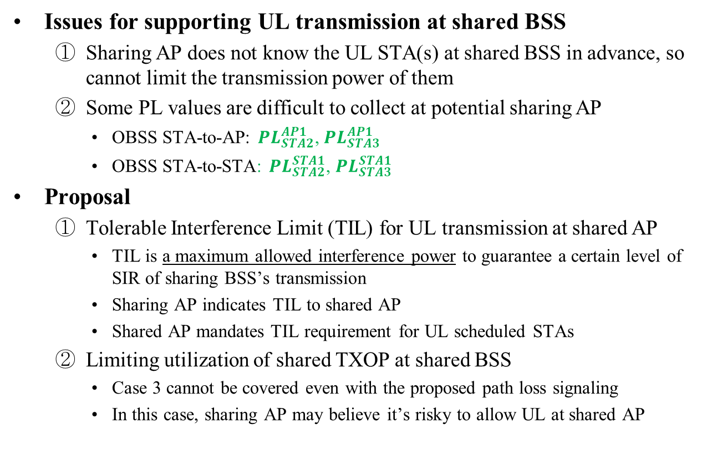
UL Issues and Proposal
Issues for supporting UL transmission at shared BSS
  Sharing AP does not know the UL STA(s) at shared BSS in advance, so cannot limit the transmission power of them
  Some PL values are difficult to collect at potential sharing AP
    OBSS STA-to-AP: ${PL}_{STA2}^{AP1}$, ${PL}_{STA3}^{AP1}$
    OBSS STA-to-STA: ${PL}_{STA2}^{STA1}$, ${PL}_{STA3}^{STA1}$
Proposal
  Tolerable Interference Limit (TIL) for UL transmission at shared AP
    TIL is a maximum allowed interference power to guarantee a certain level of SIR of sharing BSS’s transmission
    Sharing AP indicates TIL to shared AP
    Shared AP mandates TIL requirement for UL scheduled STAs
  Limiting utilization of shared TXOP at shared BSS
    Case 3 cannot be covered even with the proposed path loss signaling
    In this case, sharing AP may believe it’s risky to allow UL at shared AP

Slide 8
Proposal 1: TPL and TIL Signaling
Signaling for DL and UL at shared BSS
  Transmission Power Limit for DL at shared BSS
    Sharing AP indicates TPL for shared AP
    Sharing AP requires the following path loss values to calculate TPL
      Path loss report from associated STA(s)
      Path loss measurement from neighboring C-SR capable AP
  Tolerable Interference Limit for UL at shared BSS
    Sharing AP indicates TIL for potential UL STA(s) at shared BSS
    Shared AP requires the following path loss values to meet TIL requirement
      Path loss report from associated STA(s)
      Path loss measurement from neighboring C-SR capable AP
To cover the case3, shared AP may require additional operation
  ex. limiting UL STA’s power conservatively with the assumption of the worst case topology

Slide 9
Proposal 2: Limiting Utilization of Shared TXOP at Shared BSS
Objective
  Sharing AP can limit the shared TXOP utilization at shared BSS
Option 1: DL and UL selectively granted
  Sharing AP indicates whether the shared TXOP is able to be utilized DL or/and UL by shared AP
  The information can be included in the announcement frame
  TPL and TIL information can be selectively included
Option 2: DL allowed, UL prohibited
  Shared AP is allowed to use DL transmissions in the shared TXOP
  This option makes the C-SR procedure simpler, but less flexible
DL | UL | Utilization of shared TXOP at shared BSS
0 | 0 | Reserved
0 | 1 | Only UL allowed (TIL included)
1 | 0 | Only DL allowed (TPL included)
1 | 1 | Both DL and UL allowed
Notes:
Needs scenario for each option

Slide 10

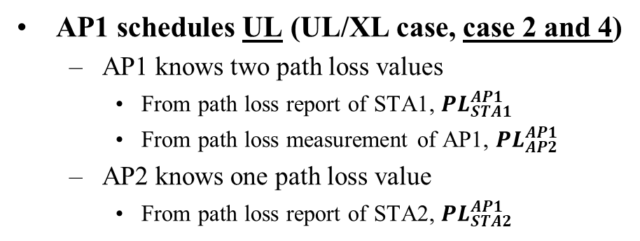


Operation Example with Proposal 1 and 2
AP1 schedules UL (UL/XL case, case 2 and 4)
  AP1 knows two path loss values
    From path loss report of STA1, ${PL}_{STA1}^{AP1}$
    From path loss measurement of AP1, ${PL}_{AP2}^{AP1}$
  AP2 knows one path loss value
    From path loss report of STA2, ${PL}_{STA2}^{AP1}$
1
$${PL}_{STA2}^{AP1}$$
$${PL}_{STA1}^{AP1}$$
2
AP1
AP2
$${PL}_{AP2}^{AP1}$$
  When AP1 obtains TXOP,
    AP1 knows that STA1 is going to be scheduled for UL, and also knows the transmission parameters associated with it in the obtained TXOP
    AP1 selects the AP2 to shared the obtained TXOP
    AP1 knows TPL for AP2 and TIL for the associated STA of AP2
  AP transmits an announcement frame comprised of
    Shared AP indication
    Shared TXOP info (AP can decide)
      DL/UL enable → TPL/TIL included used by DL/UL transmission. respectively.
      BW and duration

Slide 11
Proposal 3: Announcement/Trigger
Frame Integration
If sharing AP schedules UL transmission in shared TXOP, then C-SR announcement frame can integrate with Trigger frame of the sharing AP
This will reduce signaling overhead of trigger frame transmission
Collecting
Capability/Path loss
AP1
C-SR-A
BA
Trigger
UL
STA1-1
STA1-2
UL
Announcement
DL
AP2
Measuring and
Collecting
Path loss
Report
STA2-1
BA
STA2-2
Preparation Phase
Announcement Phase
Transmission Phase
Notes:
Announcement frame with A-control?

Slide 12
Summary
We investigate various C-SR scenarios according to the shared TXOP utilization of sharing/shared AP
We propose sharing AP indicates Tolerable Interference Limit to shared AP and shared AP needs to meet the requirement when shared AP schedules UL in the shared TXOP
We propose options of limiting TXOP utilization at shared BSS
We investigate Announcement/Trigger frame integration
Notes:
Inter-AP signaling for C-SR info is the issue in Preparation phase

Slide 13
Straw Poll #1
Do you agree that in 11be sharing AP may limit the shared AP’s TXOP utilization during the shared TXOP for C-SR operation?
  The way of limiting TXOP utilization of shared AP is TBD
  Shared AP’s TXOP utilization can be DL or UL

Slide 14
Straw Poll #2
Do you agree that in 11be sharing AP may indicate Tolerable Interference Limit (TIL) to shared AP in the announcement frame?
  TIL is a maximum allowed interference power to guarantee a certain level of SIR of sharing BSS’s transmission
  Shared AP shall follow the tolerable interference limit provided by sharing AP.
  If shared AP is not able to satisfy tolerable interference limit, the AP is not allowed to use UL transmission.
  The format of indicating Tolerable Interference Limit is TBD

Slide 15
Reference
[1] 802.11-20/0410r4
[2] 802.11-20/0576r0
[3] 802.11-20/0457r1
[4] 802.11-20/0107r1
[5] 802.11-20/0073r0
[6] 802.11-20/0590r4

Slide 16
Appendix

Slide 17
C-SR Example of 2-BSS UL/UL
Announcement/trigger frame integrated into C-SR-A
Collecting
Capability/Path loss
AP1
C-SR-A
Trigger
BA
UL
STA1-1
UL
STA1-2
Trigger
BA
AP2
Measuring and
Collecting
Path loss
Report
UL
STA2-1
UL
STA2-2
Preparation Phase
Announcement Phase
Transmission Phase

Slide 18

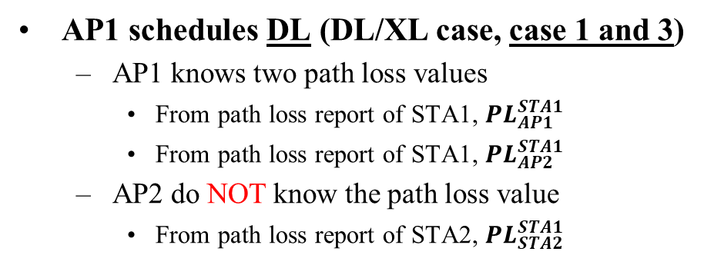


Operation Example with Proposal 1 and 2
AP1 schedules DL (DL/XL case, case 1 and 3)
  AP1 knows two path loss values
    From path loss report of STA1, ${PL}_{AP1}^{STA1}$
    From path loss report of STA1, ${PL}_{AP2}^{STA1}$
  AP2 do NOT know the path loss value
    From path loss report of STA2, ${PL}_{STA2}^{STA1}$
$${PL}_{STA2}^{STA1}$$
1
$${PL}_{AP1}^{STA1}$$
2
$${PL}_{AP2}^{STA1}$$
AP1
AP2
  When AP1 obtains TXOP,
    AP1 knows that STA1 is going to be scheduled for DL, and also knows the transmission parameters associated with it in the obtained TXOP
    AP1 selects the AP2 to shared the obtained TXOP
    AP1 knows TPL for AP2 and TIL for the associated STA of AP2
  AP transmits announcement frame comprised of
    Shared AP indication
    Shared TXOP info. (AP can decide)
      DL enable, UL disable (TPL included), AP may want to avoid case 3.
      BW and duration

