Slide 1
Experimental results for TGbb centre frequency discussion
July 2020
Date: 2020-07-10
Authors:

Slide 2
Abstract
This presentation aims to discuss our experimental validation on the centre frequency for the common mode mandatory PHY

Slide 3
Review (1)
In https://mentor.ieee.org/802.11/dcn/20/11-20-0572-00-00bb-proposed-center-frequency-mandatory-phy.pptx, we calculated the optimal center frequency for each BW.
BW [MHz] | fc* [MHz] | Δ* [MHz]
20 | 12.5 (-21.68 dBr) | 2.5
40 | 24 (-21.43 dBr) | 4
80 | 47 (-21.32 dBr) | 7
160 | 96 (-21.56 dBr) | 16
Note: Δ*=fc* - BW/2

Slide 4
Review (2)
However, we need one global center frequency for all BW configurations
In https://mentor.ieee.org/802.11/dcn/20/11-20-0572-02-00bb-proposed-center-frequency-mandatory-phy.pptx, we proposed the following global center frequency
BW [MHz] | fc* [MHz] | Δ* [MHz]
20 | 26 | 16
40 | 36 | 16
80 | 56 | 16
160 | 96 | 16

Slide 5
Experimental Setup
5 GHz band
5 GHz band
Laptop
Laptop
70 cm
eth0
Down-
conversion
fc
fc
eth0
802.11ac
OWC Front-end
OWC Front-end
Up-
conversion
CPU/host
802.11ac
CPU/host
SBC + RF down-conversion
PD
SBC + RF up-conversion
Oscilloscope

Slide 6
Experimental Setup video
https://photos.google.com/share/AF1QipNTcH1Fe5Yqsj92M-nTI-5Ks7mOoES7_cAVPSmrp2qGaZV5O4sW2eqUEnda-EbKwQ/photo/AF1QipNv5hXvyyJYri_C17R3GPwhMryHYtJgPiYyFurH?key=SXFPdkwwZldoNFFoQWlCNHRQWDNrRHNsTzFqckJn

Slide 7
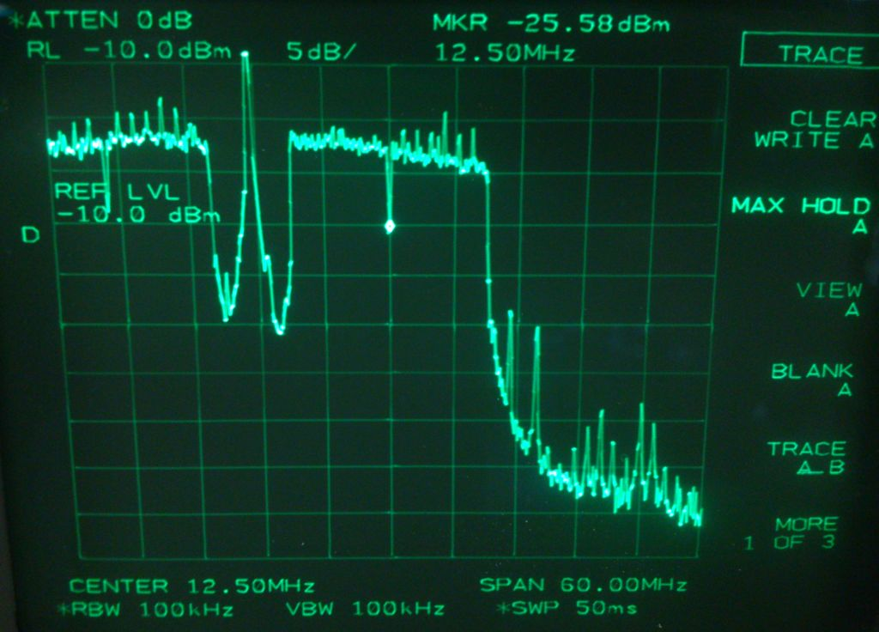
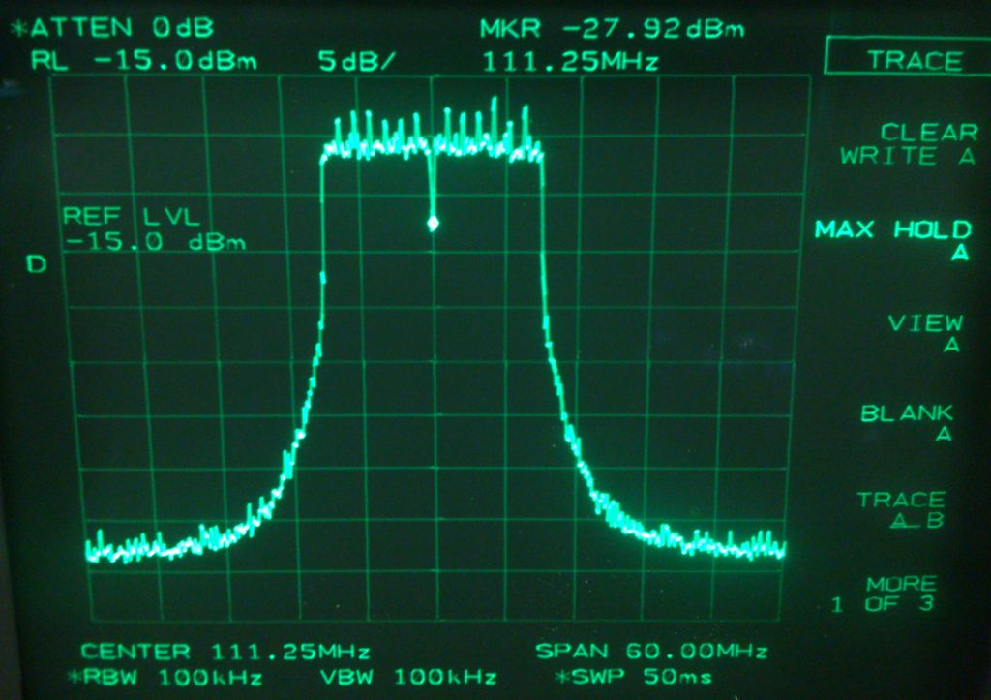
Initial Measurement
Using an 802.11ac chipset and a down-conversion, we obtain the following optical spectrum, for example, with fc =12.5 MHz and fc = 111.25 MHz, respectively

Slide 8
Experimental video for 21 MHz centre freq.
https://photos.google.com/share/AF1QipNTcH1Fe5Yqsj92M-nTI-5Ks7mOoES7_cAVPSmrp2qGaZV5O4sW2eqUEnda-EbKwQ/photo/AF1QipPX0cHX0Fjegiyonlfp2iP1PIEUOE8Pl01ld_g8?key=SXFPdkwwZldoNFFoQWlCNHRQWDNrRHNsTzFqckJn

Slide 9
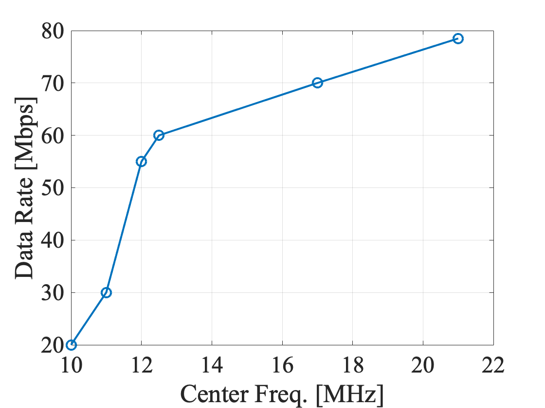
Measurements with BW = 20 MHz
fc [MHz] | Data rate [Mbps] (1 min measurement)
10 | 20-25
11 | 30
12 | 55
12.5* | 60-65
17 | 70
21 | 78.5
5.06 GHz (default) | 79.5
Note: Our simulation shows the optimum center frequency of 12.5 MHz based on the knee-point criterion.

Slide 10
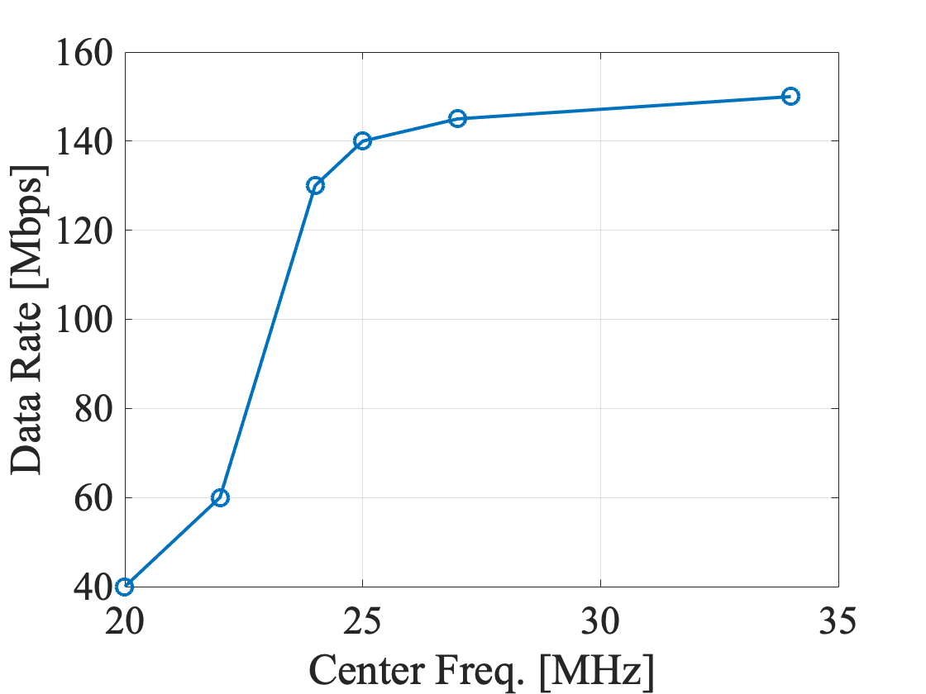
Measurements with BW = 40 MHz
fc [MHz] | Data rate [Mbps] (1 min measurement)
20 | 40
22 | 60
24* | 130-140
25 | 140-145
27 | 145-150
34 | 150-155
5.06 GHz (default) | 165
Note: Our simulation shows the optimum center frequency of 24 MHz based on the knee-point criterion.

Slide 11
Conclusions
The experiments and simulations match for BW = 20 MHz and 40 MHz.

Slide 12
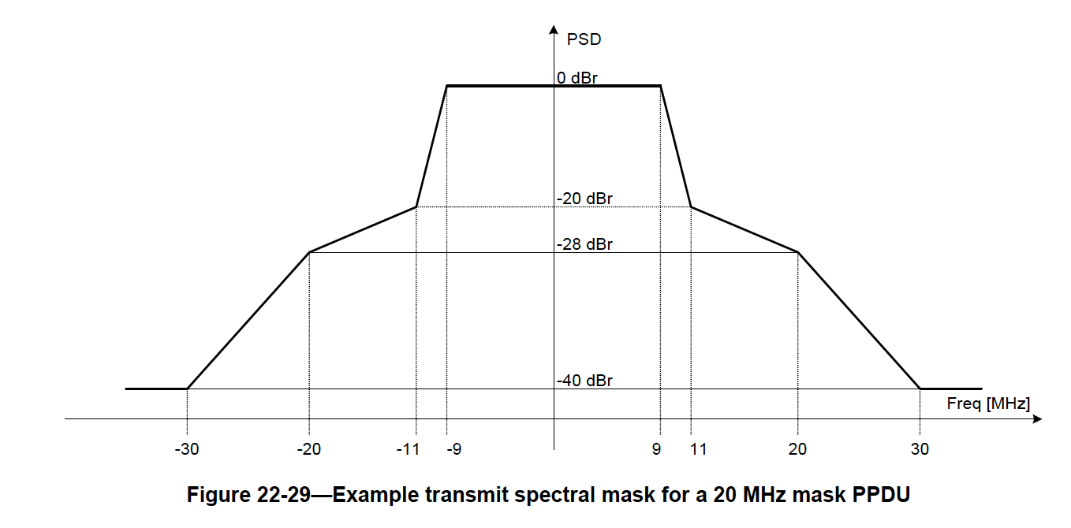
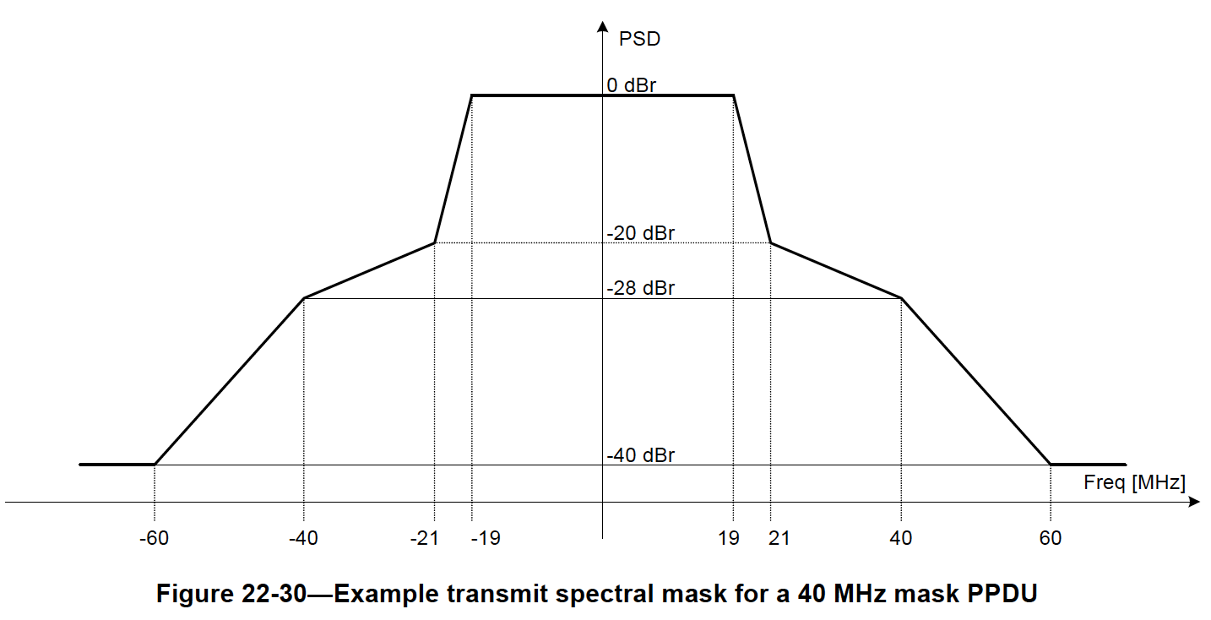
Appendix: Discussions
Spectrum masks for 802.11ac

Slide 13
Appendix
Another measurement
5.6 dB per div
10 MHz per div
≈-20 dBr

