Slide 1
Terminology for Soft AP MLD
Date: 2020-07-08
Authors:

Slide 2
Abstract
In this contribution, we propose several definitions to facilitate the future development for the use case that a Non-STR Non-AP MLD plays the role as a Soft AP based on passed Motion 125
“Move to define mechanisms to support the operation of a Non-STR AP MLD in R1? The mechanisms are limited to instantiate a Non-STR Non-AP MLD as a Soft AP that could utilize all its links under TBD conditions. The exact language to govern such scope is TBD. ”

Slide 3
Fact-checking
There is NO definition on the Soft AP in IEEE 802.11 Specification
However, it is a common understanding that Soft AP is the result of configuring Wi-Fi clients into an AP with limited functionality
It is not necessary to define Soft AP for pre-11be devices as the IEEE 802.11 society lives very well without it for past 3 decades
For Multi-Link Devices, the AP MLD are all STR! How about Soft APs instantiated by the Non-STR Non-AP MLDs?
We are not allowed to call them “Non-STR APs”
Solution: define a term “Soft AP MLD”

Slide 4
Definition of Soft AP MLD
Soft AP MLD is a non-AP MLD that can operate a subset of its affiliated STAs as APs
Limit the scope such that only a Non-AP MLD can act as a Soft AP
The Soft AP MLD operates the STAs insides a non-AP MLD as APs, rather than these Non-AP STAs are APs

Slide 5
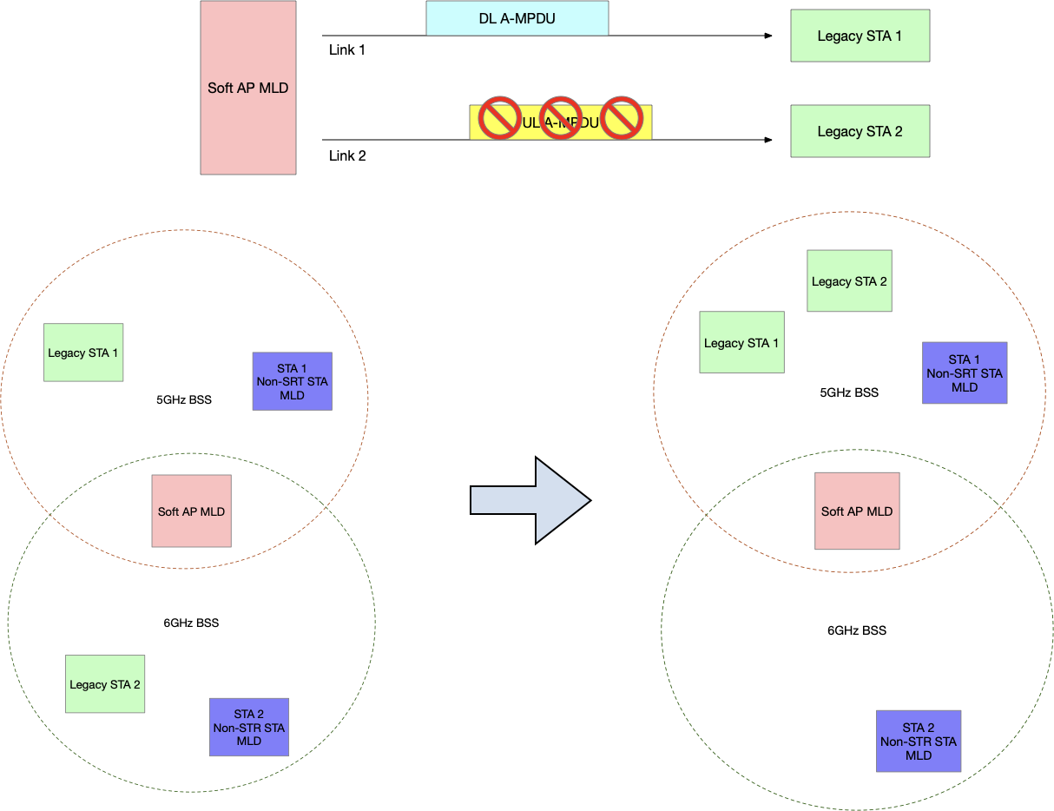
Communicating with Legacy STAs

Slide 6
When Non-STR Non-AP MLD operates as a Soft AP MLD
Basic Link Set: every pair of links in this set on which the Soft AP MLD can simultaneously transmit and receive frames with another MLD(s)
Ex: {2.4GHz Link, 5GHz Link} or {2.4GHz Link, 6GHz Link}
Conditional Link: the link on which the Soft AP MLD can NOT simultaneously transmit and receive frames with some links in the Basic Link Set
These links in the Basic Link Set are called the corresponding basic links for this conditional link
Ex: if {2.4GHz Link, 5GHz Link} is the basic link set, 6GHz Link is a conditional link corresponding to 5GHz Link

Slide 7
Straw Poll 1
Do you agree to define Soft AP MLD as the following:
Soft AP MLD: A Non-AP MLD that can operate a subset of its affiliated STAs as APs
Y
N
A

Slide 8
Straw Poll 2
Do you agree to define the Basic Link Set for a Soft AP MLD as the following:
Basic Link Set: every pair of links in this set on which the Soft AP MLD can simultaneously transmit and receive frames with another MLD(s)
Y
N
A

Slide 9
Straw Poll 3
Do you agree to define the conditional link for a Soft AP MLD as the following:
Conditional Link: the link on which the Soft AP MLD can NOT simultaneously transmit and receive frames with some links in the Basic Link Set
Y
N
A

Slide 10
Reference
[1] Non-STR AP Operation, 11-20-0755-01-00be-non-str-ap-operation.pptx
[2] IEEE 802.11-2016
[3] tgbe-spec-framework

Slide 11
Appedix: AP, Non-AP STA, AP MLD and Non-AP MLD [2][3]
AP: An entity that contains one station (STA) and provides access to the distribution services, via the wireless medium (WM) for associated STAs. An AP comprises a STA and a distribution system access function (DSAF).
STA: A logical entity that is a singly addressable instance of MAC and PHY interface to the wireless medium (WM)
Non-AP STA: A STA that is not contained within an AP
AP MLD: An MLD, where each STA affiliated with the MLD is an AP
Non-AP MLD: An MLD, where each STA affiliated with the MLD is a non-AP STA

