Slide 1
Channel Access for STR AP MLD with non-STR non-AP MLD
Date: 2021-01-18
Authors:
Name | Company | Address | Phone | Email
Liangxiao Xin | Sony Corporation |  |  | Liangxiao.Xin@sony.com
Mohamed Abouelseoud |  |  |  | Mohamed.Abouelseoud@sony.com
Yusuke Tanaka |  |  |  | Yusuke.YT.Tanaka@sony.com
Kosuke Aio |  |  |  | Kosuke.Aio@sony.com
Li-Hsiang Sun |  |  |  | Li-Hsiang.Sun@sony.com
Yongho Seok | MediaTek |  |  | Yongho.Seok@mediatek.com

Slide 2
Introduction
STR AP MLD and non-STR non-AP MLD are expected to be supported in R1[1]
For STR AP MLD and non-STR non-AP MLD:
Non-STR MLD is not able to receive on one link while transmitting on another link simultaneously due to the in-device coexistence interference
It is not decided yet how STR AP MLD contends the channel and reserves the TXOP on multiple links [2-9]
There are fairness issues regarding channel access among STR AP MLD and non-STR non-AP MLD that is needed to be discussed.
In this presentation, we discuss channel access and reservation for STR AP MLD and non-STR non-AP MLD
Updates in this revision: we consider using the same random backoff number on NSTR MLD for synchronized channel access.
Start from Slide 11

Slide 3
Motivation
Problem 1: How to launch transmission on multi-link?
Synchronized channel access on multiple links is attractive and easily can enable PPDU alignment but difficult to achieve.
Asynchronized channel access on multiple links is more practical but needs extra work to enable PPDU alignment
Problem 2: How to end transmission on multi-link?
There is no restriction on TXOP reservation on multiple links
When STR AP MLD and non-STR non-AP MLD coexists, channel access fairness issues can prevent non-STR non-AP MLD from accessing the channel
We propose to enable flexible channel access and TXOP reservation restriction in cases of STR AP MLD and non-STR non-AP MLD
STR AP MLD is flexible to start transmitting on multiple links at the same/different time depending on the channel condition
When accessing a new link, STR AP MLD should limit its TXOP reservation on the new link such that it does not exceed any active TXOPs on other links

Slide 4
Problem1: Fairness issue discussion
Non-STR MLD can’t gain channel access on multi-link when STR MLD always occupies at least one link. (as shown in the figure)
STR AP MLD has higher chance to gain channel access on one link when it occupies another link (Non-STR MLD are not competing)
STR AP MLD will have an advantage of reserving consecutive overlapping TXOPs on multiple links and blocking other non-STR MLD STAs from accessing the channel
Non-STR non-AP MLD should have fair chance to access the channel

Slide 5
Proposed solution
We propose to add restriction on the STR AP MLD reserving TXOPs with non-STR non-AP MLD.
When accessing a new link, STR AP MLD should limit its TXOP reservation on the new link such that it does not exceed any active TXOPs on other links
Example:
TXOP2 and TXOP3 do not exceed TXOP1.
When TXOP1 and TXOP3 end at the same time, non-STR non-AP MLD can immediately contend over both links.

Slide 6
Problem 2: Multi-link channel Access
JMPC has been discussed for synchronized channel access [9]
Contend for medium, access to the medium on another link by doing ED for PIFS time
Has regulatory restriction, chances to join medium are not high and has fairness issues
We propose using same random backoff number initialization for the ML channel access
AP MLD sets the random backoff counters of an AC in multiple links to one value using the same random number generator
The count down on each link is running at the same time independently
The EDCA backoff countdown procedure on each link is independent

Slide 7
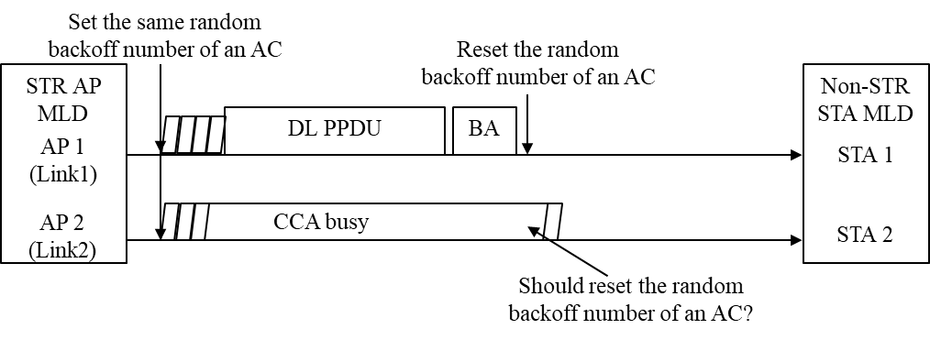
Examples of proposed solution
Example 1: When the two links are idle (no CCA busy), the backoff on Link 1 and 2 count down to zero at the same time
Example 2: When Link 2 experience CCA busy during count down, the backoff on Link 1 and 2 count down to zero at the different times
Example 3: If Link 2 failed to access the channel till the end of the active TXOP on link 1, the backoff timer of Link 2 may be reset ( to avoid fairness issues and make synchronized access easier)

Slide 8
Benefits of same random backoff number
The same random backoff number initialization enables the AP MLD to have easier channel access on multiple links depending on the channel condition
STR AP MLD has higher chance to gain access on multiple links at the same time when the channels are less busy
STR AP MLD is also allowed to gain access on multiple links at different times depending on channel conditions
The same random backoff number initialization does not violate any EDCA rule. There should be no fairness issues between the AP MLD and other devices (including legacy devices) accessing these links
There might be few updates needed to the current EDCA mechanism
How to setup the contention window is TBD
CW update could be the same as in the current standard
The same random backoff number initialization may be used when CWs of an AC on multiple links are the same.

Slide 9
Summary
In this presentation, in order to enable fair and dynamic channel access for an STR AP MLD that communicates with a non-STR non-AP MLD, we propose:
STR AP MLD should limit its TXOP reservation on a new link such that it does not exceed any active TXOPs on other links
STR AP MLD uses the same backoff number to contend the channel access on multiple links and independently count down on each link

Slide 10
SP1
Do you agree to add the following to 11be R1 SFD:
11be defines a mechanism to solve the following fairness issue in case of channel access between STR MLD and NSTR MLD
Fairness issue: the NSTR non-AP MLD does not gain channel access on any link of one of its NSTR link pairs for a long time because the STR AP MLD always occupies at least one link of the NSTR link pair to transmit DL QoS Data frames to the NSTR MLD
The solution is TBD

Slide 11
Same random backoff used by NSTR MLD
When the two links are idle (no CCA busy), the backoffs on Link 1 and 2 are initialized to the same randomly generated number and start counting down to zero at the same time independently
Example 1: If links are idle throughout the count down, UL synchronized transmission starts when counter =0
Example 2: If Link 2 experiences CCA busy during count down, STA1 counting down the backoff to zero can access Link1 by itself.
Example 3: If Link 2 experiences CCA busy during count down, STA1 counting down the backoff to zero can wait for synchronized channel access.
When one link is not idle, the backoffs on Link1 and 2 are initialized to two randomly generated numbers at different times.

Slide 12
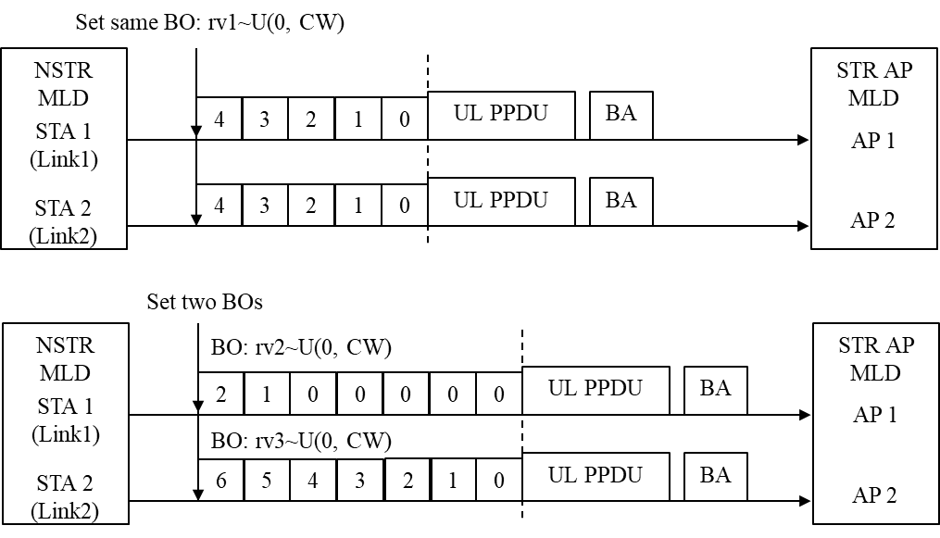
Same random backoff and waited EDCA
If links are idle, for UL synchronized transmission, same random backoff accesses the channel faster than waited EDCA
Contention time to access the channel using the same random backoff number is rv1
Contention time to access the channel using waited EDCA is max(rv2, rv3).
In average, rv1 < max(rv2, rv3).

Slide 13
Offline Discussions (1/2)
What is the purpose of NSTR MLD using same random backoff number?
The purpose of using same random backoff number is for the synchronized channel access.
Will same random backoff number mechanism cause fairness issue?
No. When using the same random backoff number, only one value will be generated by the random number generator, which is uniformly distributed between 0 and CW, for the backoff time on two links. In this way, the random distribution of the backoff time on each link will be the same as in the baseline.
What is the benefit of NSTR MLD using same random backoff number?
The same random backoff number can make it easier for NSTR MLD accessing multiple links at the same time when those links are idle by initializing the backoff counters to the same number on those links. If links are idle and MLD targets synchronized channel access, the same random backoff number can access the channel faster than the waited EDCA since the counters expire at the same time. See details in slide 12. Also, the same random backoff number can work together with waited EDCA during the same ML channel access. The same random backoff takes effect at the beginning of the backoff procedure and waited EDCA takes effect at the end of the backoff procedure. See example 3 in slide 11. Some simulation results of using same random backoff are provided in DCN0577r0.

Slide 14
Offline Discussions (2/2)
Will NSTR MLD use the same random backoff number all the time?
No, MLD can decide to use the same random backoff number or not at any time. Also, the same random backoff number can be used on some of links instead of all links. If MLD decides not to use same random backoff number when contending on multiple links, it could follow EDCA rules in the baseline.
Will the same random backoff number slow down the channel access of NSTR MLD?
It depends on the scenarios. If the MLD intends to access one of the links ASAP, then it will. But if the MLD intends to access multiple link resources at the same time, the same backoff number is helpful. That is the reason we give the flexibility of using the same random backoff number to MLD.
What is the CW update rule?
We can have further discussion on it. In SP2, CW can update following the baseline.
Is the backoff procedure on each link independent?
Yes, the same random backoff number mechanism uses one random backoff generator for backoff initializations on multiple links. After that, each STA counts down the backoff and accesses channel on each link independently.

Slide 15
SP2
Do you support to include the following in SFD?
A NSTR MLD STA may initialize the random back-off counter in multiple links to one value using the same random number generator when the CW of those links are same. The count down on those links is independent and depends on the channel condition

Slide 16
References
[1] 11-20/0566r20: Compendium of straw polls and potential changes to the Specification Framework Document
[2] 11-20/0275r2: MLO: Need for sync PPDUs
[3] 11-19/1305r4: Synchronous Multi-Link Operation
[4] 11-20/0106r4: Follow up of discussion on multi-link operation with leakage on non-AP MLD
[5] 11-20/0026r6: MLO: Sync PPDUs
[6] 11-20/0291r1: MLO asynchronize and synchronize operation discussions
[7] 11-20/0433r5: PPDU alignment in STR constrained multi-link
[8] 11-20/0081r2: MLO Synchronous Transmission
[9] 11-20/0455r2: Asynchronous multi-link operation for non-STR STA

