Slide 1
Attacks to Fully Random 64QAM Sounding Signal
Date: 2020-05-29

Slide 2
11az LB249 CID 3911
CID | Page/Line | Clause | Comment | Proposed resolution
3911 | 153.00 | 11.22.6.4.6 | The Secure LTF mechanism for TB and NTB ranging needs to be improved. A submission will be provided. | As in comment.

Slide 3
Background
.
In a previous presentation we demonstrated that the fully random QPSK LTF is vulnerable to Viterbi equalizer attacker [1].
The contribution [6] proposed fully random 64QAM LTF for secured ranging. The main reason is the prohibitive attack complexity.
In this submission, we present an attack method with a implementable complexity, which employs sphere decoding (SD) and successive interference cancellation (SIC) to efficiently decode the fully random 64QAM LTF.

Slide 4
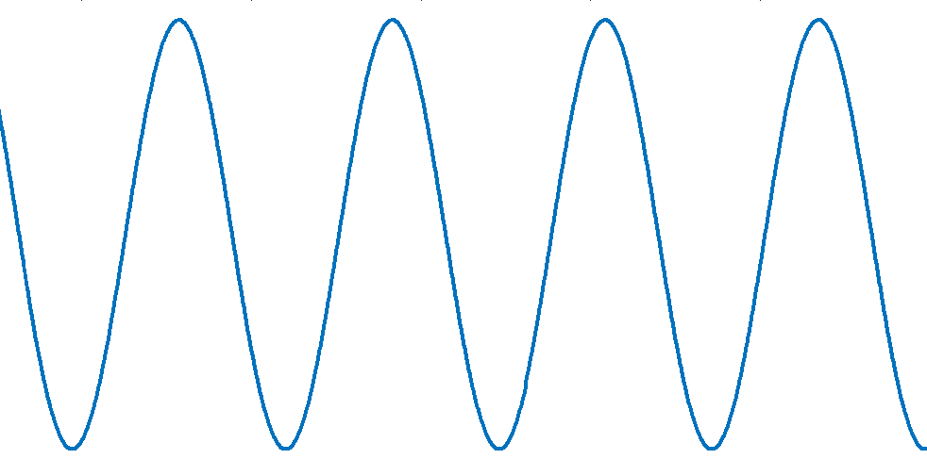
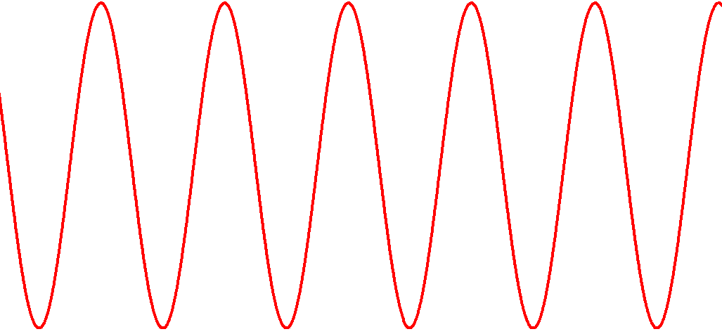
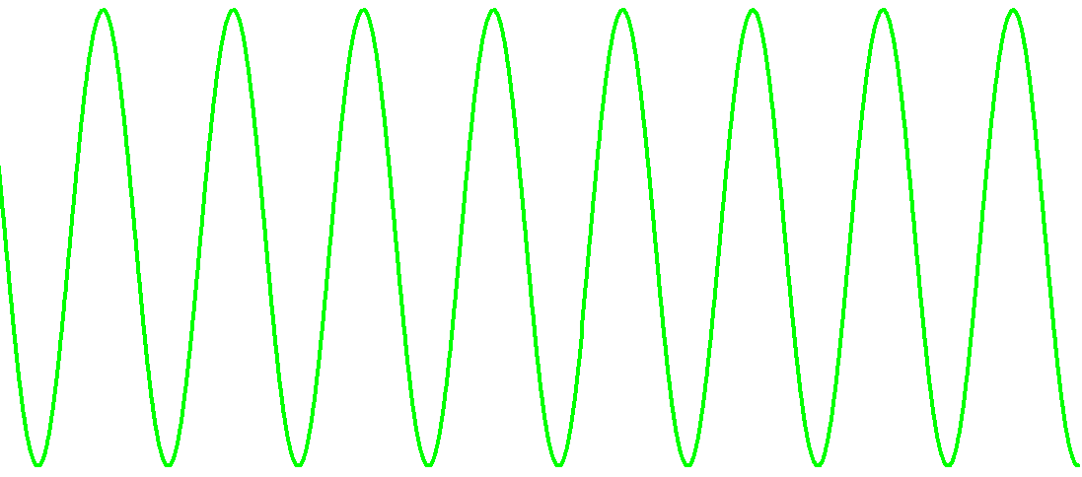
Observation Window
Attacker observes the beginning portion and detects the phases of the sinusoids for generating shifted attack signals
…
Observation window
Attack window
Slide 4

Slide 5
Windowed FFT (1/2)
Time-domain window is applied to weight the input signal and then FFT is performed on the weighted signal

Slide 6
Windowed FFT (2/2)
The longer the window in time, the fewer the significant taps in frequency

Slide 7
Windowing in Time, ICI in Frequency
The time-domain windowing introduces inter-carrier interferences in frequency domain

Slide 8
Signal Model
ISI channel in frequency domain
Conventional equalization methods such as Viterbi equalizer can be applied
Decision-feedback equalizer will be evaluated in this work
…
Freq

Slide 9
Principle
― Sequential Vector Detection and SIC
Starting from band edge, detect QAM symbols jointly within a sliding window
Remove the detected signal and move the sliding window toward the band center recursively
…
Freq
MIMO channel with 4 streams
…
Freq
Sliding window

Slide 10
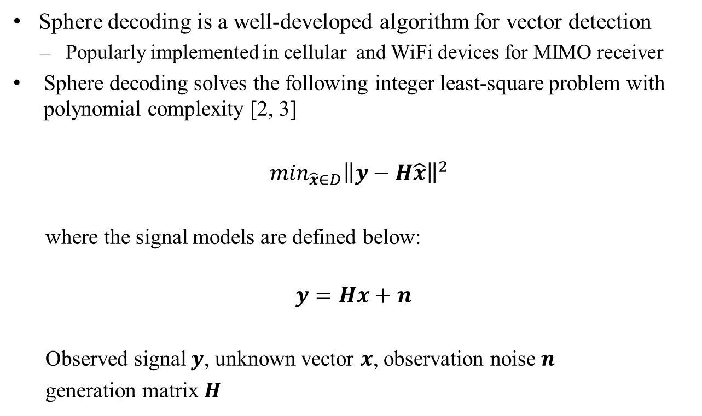
Sphere Decoding
Sphere decoding is a well-developed algorithm for vector detection
  Popularly implemented in cellular and WiFi devices for MIMO receiver
Sphere decoding solves the following integer least-square problem with polynomial complexity [2, 3]
$\min_{\hat{x}∈D}{\left\|y−H\hat{x}\right\|}^{2}$
where the signal models are defined below:
$$y=Hx+n$$
Observed signal $y$, unknown vector $x$, observation noise $n$
generation matrix $H$

Slide 11
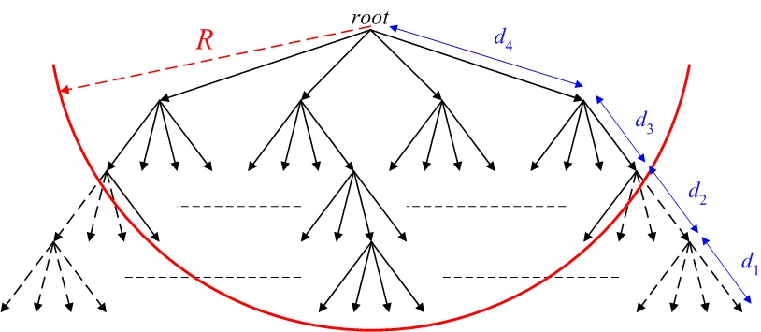
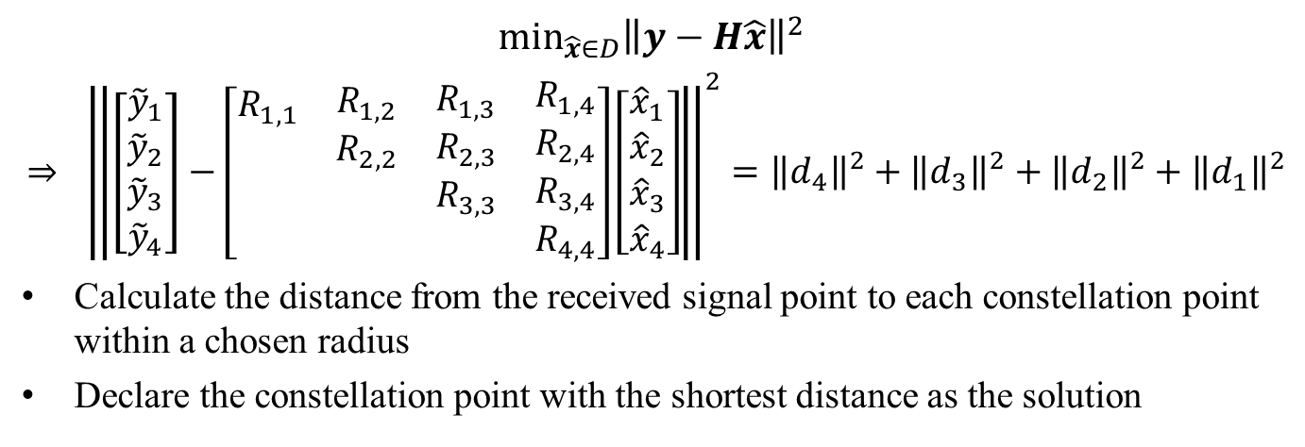


Sphere Decoding (Cont’d)
$$\min_{\hat{x}∈D}{\left\|y−H\hat{x}\right\|}^{2}$$
$⇒$ ${\left\|\left[\begin{matrix}\begin{matrix}{\tilde{y}}_{1} \\ {\tilde{y}}_{2}\end{matrix} \\ \begin{matrix}{\tilde{y}}_{3} \\ {\tilde{y}}_{4}\end{matrix}\end{matrix}\right]−\left[\begin{matrix}\begin{matrix}\begin{matrix}\begin{matrix}R_{1,1} \\ \end{matrix} \\ \begin{matrix} \\ \end{matrix}\end{matrix} & \begin{matrix}\begin{matrix}R_{1,2} \\ R_{2,2}\end{matrix} \\ \begin{matrix} \\ \end{matrix}\end{matrix}\end{matrix} & \begin{matrix}\begin{matrix}\begin{matrix}R_{1,3} \\ R_{2,3}\end{matrix} \\ \begin{matrix}R_{3,3} \\ \end{matrix}\end{matrix} & \begin{matrix}\begin{matrix}R_{1,4} \\ R_{2,4}\end{matrix} \\ \begin{matrix}R_{3,4} \\ R_{4,4}\end{matrix}\end{matrix}\end{matrix}\end{matrix}\right]\left[\begin{matrix}\begin{matrix}{\hat{x}}_{1} \\ {\hat{x}}_{2}\end{matrix} \\ \begin{matrix}{\hat{x}}_{3} \\ {\hat{x}}_{4}\end{matrix}\end{matrix}\right]\right\|}^{2}={\left\|d_{4}\right\|}^{2}+{\left\|d_{3}\right\|}^{2}+{\left\|d_{2}\right\|}^{2}+{\left\|d_{1}\right\|}^{2}$
Calculate the distance from the received signal point to each constellation point within a chosen radius
Declare the constellation point with the shortest distance as the solution
$$≤r^{2}$$
r
10
${\hat{x}}_{4}=$11
00
01
y

Slide 12
Recursive Detection and Cancellation
Attacker observes part of the time domain random LTF symbols and transform to frequency domain.
The frequency domain signal is the circular convolution of the frequency domain window function and the constellation symbol on each tone.
Assume attacker decodes the constellation symbol from edge tone, an equivalent MIMO channel can be built.
Attacker can sequentially apply sphere decoding and successive interference cancellation (SIC) in frequency domain to decode the symbols on each tone.

Slide 13
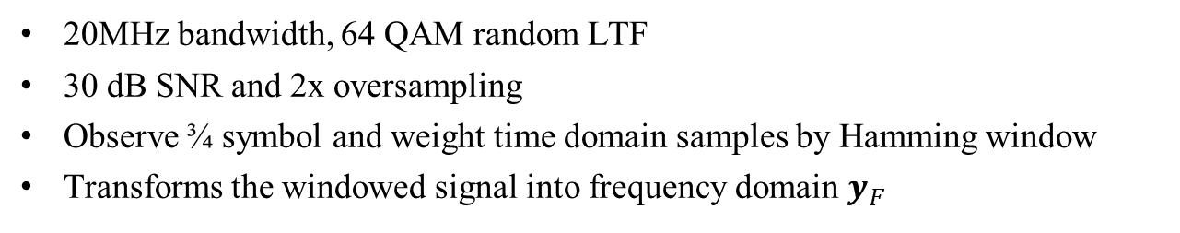
An Attacker Example
20MHz bandwidth, 64 QAM random LTF
30 dB SNR and 2x oversampling
Observe ¾ symbol and weight time domain samples by Hamming window
Transforms the windowed signal into frequency domain $y_{F}$

Slide 14
Sphere Decoding with Sliding Window
Assume the attacker utilizes 4x4 sphere decoder, the equivalent MIMO channel can be built on the spectrum of the Hamming window as
The corresponding observation signal is
The unknown vector is
H=[Hm(255) 0 0 0
Hm(256) Hm(255) 0 0
Hm(1) Hm(256) Hm(255) 0
Hm(2) Hm(1) Hm(256) Hm(255)]
y=[y_{F}(194) y_{F}(195) y_{F}(196) y_{F}(197)]^{T}
x=[LTF(68) LTF(69) LTF(70) LTF(71)]^{T}

Slide 15
Successive Interference Cancellation and Decoding
After attacker decoding the symbol LTF(68),the corresponding interference to the adjacent tones are cancelled and a second 4x4 sphere decoder is built
The observation signal is
y=[y_{F,IC}(195) y_{F,IC}(196) y_{F,IC}(197) y_{F,IC}(198)]^{T}
with y_{F,IC}(195)=y_{F}(195)-Hm(256)*LTF(68)
y_{F,IC}(196)=y_{F}(196)-Hm(1)*LTF(68)
y_{F,IC}(197)=y_{F}(197)-Hm(2)*LTF(68)
y_{F,IC}(198)=y_{F}(198)-Hm(3)*LTF(68)
The unknown vector is
x=[LTF(69) LTF(70) LTF(71) LTF(72)]^{T}
After solving the second sphere decoding, the symbol LTF(69) will be decoded
This sequential interference cancellation and decoding procedure can be iteratively applied until all the symbols are decoded.

Slide 16
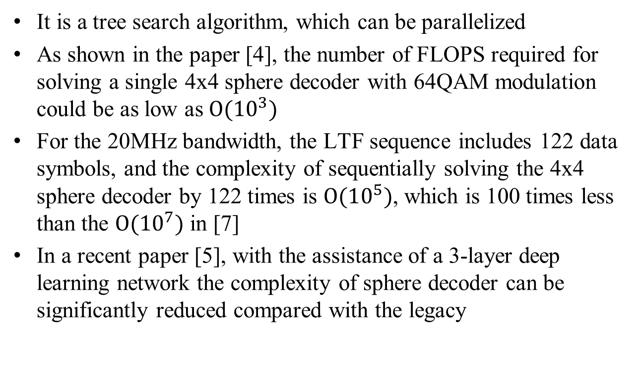
Complexity Analysis
It is a tree search algorithm, which can be parallelized
As shown in the paper [4], the number of FLOPS required for solving a single 4x4 sphere decoder with 64QAM modulation could be as low as $Ο(10^{3})$
For the 20MHz bandwidth, the LTF sequence includes 122 data symbols, and the complexity of sequentially solving the 4x4 sphere decoder by 122 times is $Ο(10^{5})$, which is 100 times less than the $Ο(10^{7})$ in [7]
In a recent paper [5], with the assistance of a 3-layer deep learning network the complexity of sphere decoder can be significantly reduced compared with the legacy

Slide 17
Simulation Settings
20 MHz bandwidth, 2x LTF
Single antenna Tx and Rx
AWGN channel between attacker and sounding transmitter with 30 or 45 dB SNR
3/4 or 11/16 LTF symbol is observed by attacker
Attacker oversamples time domain LTF by 2 and applies the window
Hamming, Han and Blackman windows are evaluated
The CDF of the cross correlation between the full length LTF and decoded LTF is plotted
For comparison purpose, the CDF of the cross correlation between the LTF in the attack window and the decoded signal in the attack window is also plotted

Slide 18
Simulation Results (1)
3/4 LTF observation and Hamming window
50% success rate

Slide 19
Simulation Results (2)
3/4 LTF observation and Hamming window
25% success rate
Notes:
Add 2 samples results

Slide 20
Simulation Results (3)
11/16 LTF observation and Han window
25% success rate

Slide 21
Simulation Results (4)
11/16 LTF observation and Han window
20% success rate

Slide 22
Simulation Results (5)
3/4 LTF observation and Hamming window

Slide 23
Simulation Results (6)
3/4 LTF observation and Hamming window

Slide 24
Simulation Results (7)
3/4 LTF observation and Blackman window
34% success rate

Slide 25
Simulation Results (8)
3/4 LTF observation and Blackman window
31% success rate

Slide 26
Conclusions
Our results showed that fully random 64 QAM signal is not secure enough against attacks.
Using a larger size sphere decoder e.g. 6x6 or 8x8, the attacker can improve the attack performance e.g. smaller observation windows and lower SNR.
Window functions other than the evaluated ones may also improve attack performance.

Slide 27
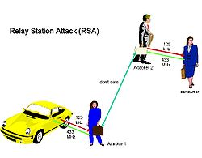
On Attack Window Size
Discussions in [6] assume a constraint that the fake path is within a certain dB e.g. 10 dB down from the main true path
This is impractical
  The true paths may not even be received by the intended receiver
  The attacker can pick up the weak sounding signal with directional antennas and then send the attack signal to the intended receiver

Slide 28
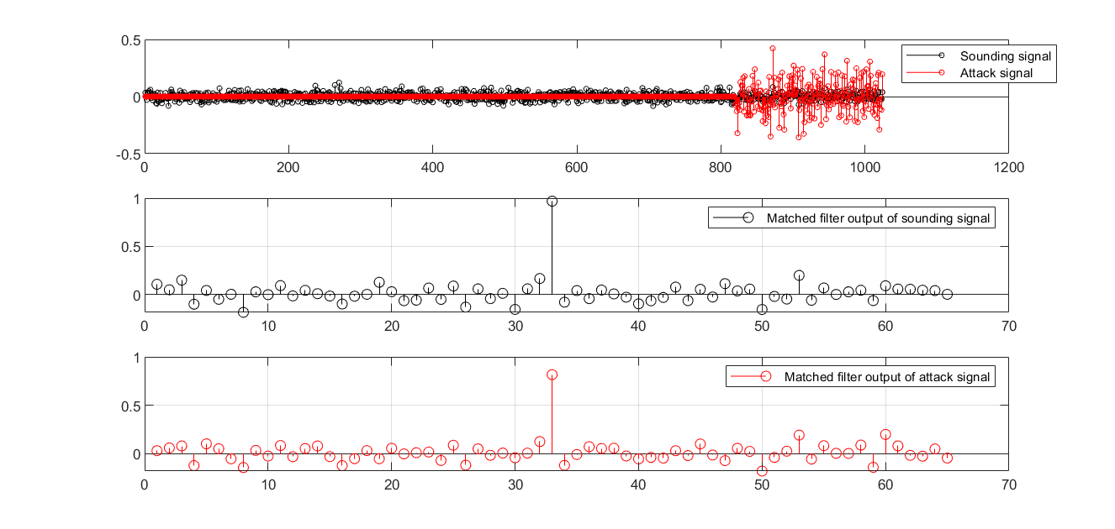
Example of Self-Interference
SNR -6 dB, BW 160 MHz, attack window 1/5
AWGN-like sounding signal
Matched filter is used as channel estimator
Similar SINR level

Slide 29
Remarks
The detection of the SINR degradation due to small attack window may not be reliable
It is hard to standardize the attack detection, which usually depends on the receiver implementation
The overall ranging security relies on both of the ranging parties instead one, where one party doesn’t have the full control of the other
It is desirable to have a secure ranging scheme that minimizes the requirement of attack detection

Slide 30
Reference
        [1] Q. Li, F. Jiang, X. Chen, and R. Stacey, “Attacks to Fully Random QPSK Sounding Signal,” doc: IEEE 802.11-20-0710r1.
        [2] U. Fincke and M. Pohst. Improved methods for calculating vectors of short length in a lattice, including a complexity analysis. Mathematics of Computation, 44 (170):463–471, April 1985.
        [3] T. Kailath, H. Vikalo, and B. Hassibi, “MIMO receive algorithms”, Space-Time Wireless Systems: From Array Processing to MIMO Communications, pp. 302-321. Cambridge: Cambridge University Press, 2006.
        [4] A. M. Chan and I. Lee, “A New Reduced-Complexity Sphere Decoder For Multiple Antenna Systems”, pp. 460-464, IEEE International Conference on Communications, May 2002.
        [5] M. Mohammadkarimi, M. Mehrabi, M. Ardakani, and Y. Jing, “Deep Learning-Based Sphere Decoding”, pp. 4368-4378, IEEE Transactions on Wireless Communications, vol. 18, no. 9, Sept. 2019.
        [6] B. Tian, et al., “11az Secure LTE Design,” doc: IEEE 802.11-20-0836r0.
        [7] J. Dogan, et al., “Computational Attacks on 11az PHY Secure Ranging,” doc: IEEE 802.11-19-0374r0.

Slide 31
Backup

