Slide 1
1x EHT-LTF sequence

Slide 2
Introduction
I suggested 1/2/4x EHT-LTF sequences for 320MHz PPDU[1]. But it has some concerns that
  it’s based on 1 stream, but many members want to consider multi-stream, too.
  in 1x EHT-LTF, it’s better to consider RU sizes for non-OFDMA transmission as 11ax [2].
  in 2x/4x EHT-LTF, the suggested sequences based on HE-LTF sequences didn’t catch BPSK data’s PAPRs.
Therefore I’d like to discuss 1x, 2x and 4x EHT-LTF sequences, separately.
Here I focus 1x EHT-LTF sequence with multi-stream in non-OFDMA transmission.

Slide 3
1x EHT-LTF sequences
There are two options
  Option1: 320MHz 1x EHT-LTF sequences are used for 320MHz non-OFDMA transmission and 240MHz non-OFDMA transmission together. That means, 3*996, 3*996+484, 4*996 RUs as well as 2*996, 2*996+484 RUs are considered.
  Option2: 320MHz 1x EHT-LTF sequences are used for 320MHz non-OFDMA transmission only. That means, 3*996, 3*996+484, 4*996 RUs are considered.
    If we choose option2, we need to define 240MHz 1x EHT-LTF sequence, too.
1x EHT-LTF sequence for 320MHz PPDU
  EHTLTF_{320MHz_1x} = {LTF_{80MHz_lower1_1x}, 23 zeros, LTF_{80MHz_upper1_1x}, 23 zeros, LTF_{80MHz_lower2_1x}, 23 zeros, LTF_{80MHz_upper2_1x}}
    LTF_{80MHz_lower1_1x} = {s(1)*LTF_{80MHz_left_1x}, 0, s(2)*LTF_{80MHz_right_1x}}
    LTF_{80MHz_upper1_1x} = {s(3)*LTF_{80MHz_left_1x}, 0, s(4)*LTF_{80MHz_right_1x}}
    LTF_{80MHz_lower2_1x} = {s(5)*LTF_{80MHz_left_1x}, 0, s(6)*LTF_{80MHz_right_1x}}
    LTF_{80MHz_upper2_1x} = {s(7)*LTF_{80MHz_left_1x}, 0, s(8)*LTF_{80MHz_right_1x}}
  s(1)~s(8)= [1 1 1 1 -1 -1 -1 -1] for option1, and [1 -1 1 1 1 1 -1 -1] for option2

Slide 4
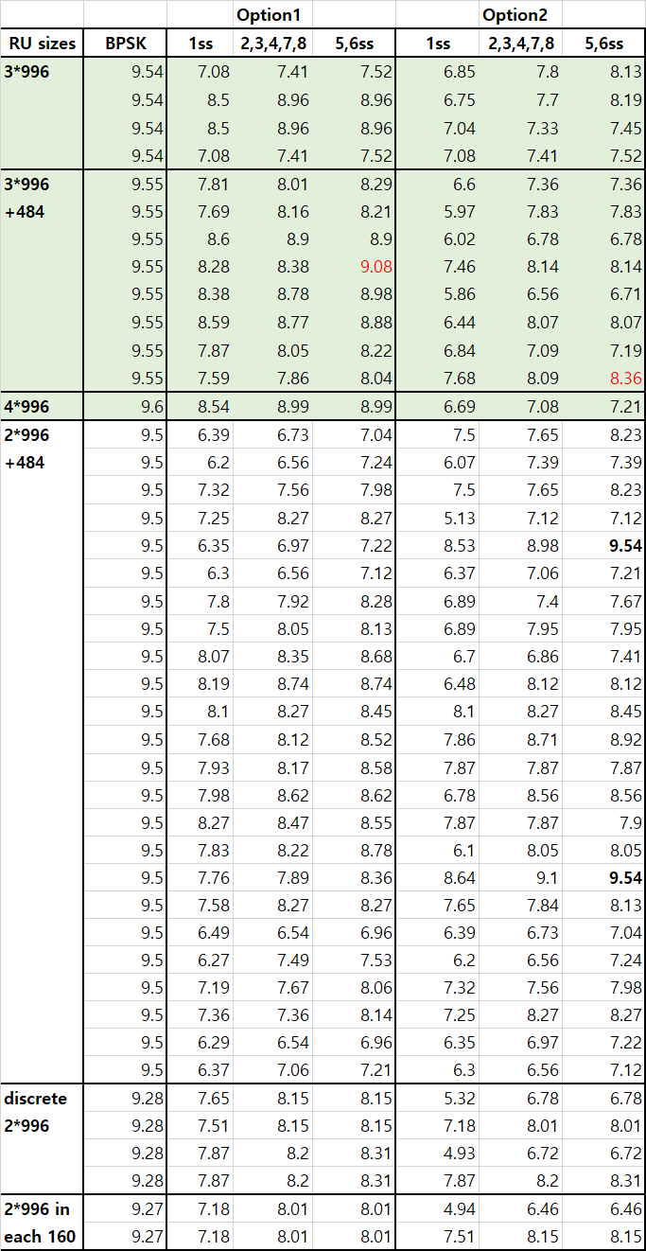
PAPR performance (1/2)
There are PAPR table of 1x EHT-LTF sequence for 320MHz transmission with multi-stream.
  For 320MHz transmission (green area), all sequences have under BPSK median’s PAPRs.
    But the worst PAPR of option 2 is lowest.
  For both of 240 and 320MHz transmission, only option 1’s PAPRs are under BPSK median’s.
    The bold PAPR values in option2 shows over BPSK median’s.
  [NOTE] PAPR table of 1x EHT-LTF for 160+160MHz transmission is in Appendix.

Slide 5
PAPR performance (2/2)
Based on the PAPR performance,
  If we define a 1x EHT-LTF sequence for 320MHz and 240MHz transmission, peak PAPR (option1) is 9. 08dB in 3*996+484 RU. And all PAPRs are under BPSK median’s.
  Or if we define two 1x EHT-LTF sequences, peak PAPR (option2) in 320MHz transmission is 8.36dB among RU sizes of option2. But we need another sequence for 240MHz transmission, and the worst PAPR is 9.08dB (The structure and sequence are in Appendix).
    The option2 is also suggested in [2].
PAPRs of option1 is under BPSK median, but it has somewhat higher PAPR than PAPRs of option2 among 3*996, 3*996+484, 4*996 RUs.

Slide 6
Conclusion
In this contribution, I suggest 1x EHT-LTF sequences for 320MHz transmission with two options.
  Option1: A unified 1x EHT-LTF sequence for both of 320MHz transmission and 240MHz transmission. All PAPRs with multi-streams are below BPSK median value.
  Option2: Two sequences for 320MHz transmission and 240MHz transmission, respectively. It shows lower PAPRs than option 1.

Slide 7
Reference
[1] IEEE802.11-20/0825r1, “EHT-LTF sequences in new tone plan”
[2] IEEE802.11-20/0926r0, “EHT-LTF sequences design”

Slide 8
Straw poll 1
Do you support to make 1x EHT-LTF sequences by reusing HE-LTF sequences as below in 320MHz BW PPDU of 11be?
  LTF_{80MHz_left_1x} and LTF_{80MHz_right_1x}
  The coefficient of the sequences are changed in 11be.
  Y/N/Abs

Slide 9
Straw poll 2
Which one do you support to be used for EHT-LTF sequences in 240MHz and 160+80MHz BW PPDU?
  Option1: some parts of EHT-LTF sequences of 320MHz
  Option2: other sequences for 240MHz and 160+80MHz specific
  Y/N/Abs

Slide 10
Straw poll 3
Do you agree to add the below text in 11be SFD?
  In a 320MHz transmission, 1x EHT-LTF sequence is given as below.
  EHTLTF_{-2036,2036}=
  {LTF_{80MHz_lower1_1x}, 23 zeros, LTF_{80MHz_upper1_1x}, 23 zeros, LTF_{80MHz_lower2_1x}, 23 zeros, LTF_{80MHz_upper2_1x}}
  Where
      LTF_{80MHz_lower1_1x} = {LTF_{80MHz_left_1x}, 0, LTF_{80MHz_right_1x}}
      LTF_{80MHz_upper1_1x} = {LTF_{80MHz_left_1x}, 0, LTF_{80MHz_right_1x}}
      LTF_{80MHz_lower2_1x} = {(-1)LTF_{80MHz_left_1x}, 0, (-)LTF_{80MHz_right_1x}}
      LTF_{80MHz_upper2_1x} = {(-)LTF_{80MHz_left_1x}, 0, (-)LTF_{80MHz_right_1x}}
  Y/N/Abs

Slide 11
Straw poll 3
Do you agree to add the below text in 11be SFD?
  In a 320MHz transmission, 1x EHT-LTF sequence is given as below.
  EHTLTF_{-2036,2036}=
  {LTF_{80MHz_lower1_1x}, 23 zeros, LTF_{80MHz_upper1_1x}, 23 zeros, LTF_{80MHz_lower2_1x}, 23 zeros, LTF_{80MHz_upper2_1x}}
  Where
      LTF_{80MHz_lower1_1x} = {LTF_{80MHz_left_1x}, 0, (-)LTF_{80MHz_right_1x}}
      LTF_{80MHz_upper1_1x} = {LTF_{80MHz_left_1x}, 0, LTF_{80MHz_right_1x}}
      LTF_{80MHz_lower2_1x} = {LTF_{80MHz_left_1x}, 0, LTF_{80MHz_right_1x}}
      LTF_{80MHz_upper2_1x} = {(-)LTF_{80MHz_left_1x}, 0, (-)LTF_{80MHz_right_1x}}
  In a 240MHz transmission, 1x EHT-LTF sequence is given as below.
  EHTLTF_{-1524,1524}=
  {LTF_{80MHz_lower_1x}, 23 zeros, LTF_{80MHz_middle_1x}, 23 zeros, LTF_{80MHz_upper_1x}}
  Where
      LTF_{80MHz_lower_1x} = {LTF_{80MHz_left_1x}, 0, LTF_{80MHz_right_1x}}
      LTF_{80MHz_middle_1x} = {(-)LTF_{80MHz_left_1x}, 0, LTF_{80MHz_right_1x}}
      LTF_{80MHz_upper_1x} = {(-)LTF_{80MHz_left_1x}, 0, (-)LTF_{80MHz_right_1x}}
  Y/N/Abs

Slide 12
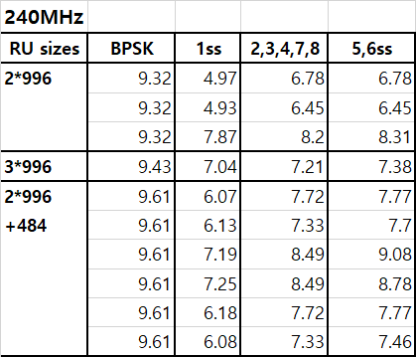
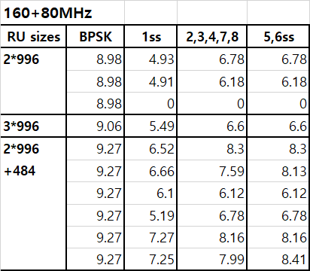
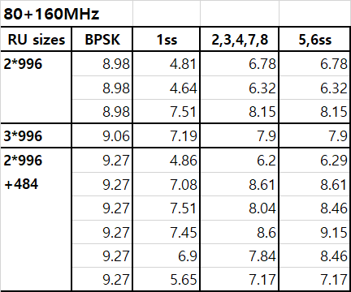
Appendix
1x EHT-LTF sequence for 240MHz transmission
  EHTLTF_{240MHz_1x} = {LTF_{80MHz_lower1_1x}, 23 zeros, LTF_{80MHz_upper1_1x}, 23 zeros, LTF_{80MHz_lower2_1x}}
    LTF_{80MHz_lower1_1x} = {s(1)*LTF_{80MHz_left_1x}, 0, s(2)*LTF_{80MHz_right_1x}}
    LTF_{80MHz_upper1_1x} = {s(3)*LTF_{80MHz_left_1x}, 0, s(4)*LTF_{80MHz_right_1x}}
    LTF_{80MHz_lower2_1x} = {s(5)*LTF_{80MHz_left_1x}, 0, s(6)*LTF_{80MHz_right_1x}}
  s(1)~s(6)= [1 1 -1 1 -1 -1]
PAPR table

Slide 13
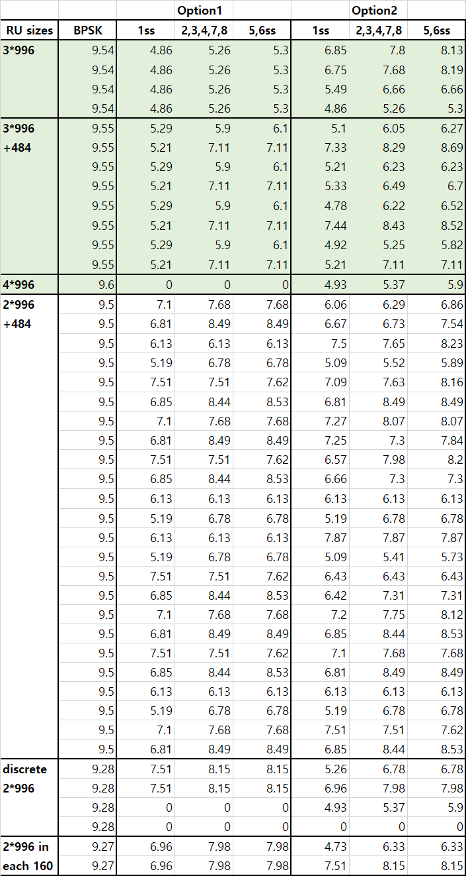
Appendix. PAPR table in 160+160MHz
Most of PAPRs are lower than the PAPRs of 320MHz transmission.
And all PAPRs are under the BPSK’s median.

