Slide 1
Partial Bandwidth Feedback for Multi-RU
Date: 2020-07-01
Authors:

Slide 2
Introduction
802.11be shall supports that
Wideband band and noncontiguous spectrum utilization
320/160+160MHz, 240/160+80MHz
Large size RU combination assigned to a single STA [1].
Maximum 16 spatial stream
Feedback overhead is significantly increased, compared to 11ax [2]
In order to reduce feedback overhead, the partial BW feedback is adopted in 11ax as an optional feature
Partial BW feedback
By choosing RU Start Index (S) and RU End Index (E) to cover the allocated RU only, feedback overhead can be reduced compared with full BW feedback
In this slide, we show a modified signaling for partial BW feedback for multi-RU combination in 802.11be

Slide 3
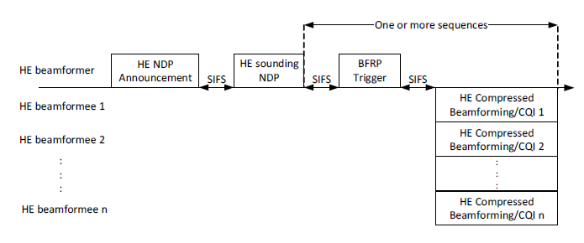
Recap: HE Trigger based Sounding Process
HE NDP-A is broadcasted to two or more STAs for initiation.
HE beamformer may request full bandwidth or partial bandwidth feedback in a STA Info subfield in the HE NDP Announcement (NDP-A) frame

Slide 4
Recap: HE NDP Announcement Frame
AP signals the partial BW info subfield in NDP-A

Slide 5
Recap: Partial BW feedback in 11ax
The Partial BW Info subfield
RU Start Index (S): the first 26-tone for which the beamformer is requesting feedback
RU End Index (E): the last 26-tone for which the beamformer is requesting feedback
STA feedbacks channel information (CSI) in the tones between RU Start Index (S) and RU End Index (E)
[0 – 8] if BW of HE NDPA is 20MHz
[0 – 17] if BW of HE NDPA is 40MHz
[0 – 36] if BW of HE NDPA is 80MHz
[0 – 73] if BW of HE NDPA is 80+80MHz, 160MHz

Slide 6
Update for EHT NDP-A
Based on the HE NDP-A, EHT NDP-A can be designed by updating following subfields:
Sounding Dialog Token
1: HE, 2: EHT, 3: Reserved
Disambiguation
Disambiguation subfield is set to 1 to prevent a VHT STA from wrongly identifying its AID in the HE/EHT NDP-A, which will be positioned in
B(16*n+11) for n=1,2… (i.e., B(27), B(43), B(59),…)
Partial BW Info
The value for [S, E] is increased from [0, 73] to [0, 147] for 320MHz
Bit width is increased from 14 to 16 bits
N_{c}
Maximum number of supported spatial stream is up to 16
Bit width is increased from 3 to 4 bits
“Feedback Type and Ng” and “Codebook Size”
TBD

Slide 7
Motivation for Proposal
If scheduling algorithm determines to allocates 484+2$×$996 RU for STA #1 and 484 RU for STA #2 with 240MHz OFDMA in 11be.
Wasteful to feedback entire 240MHz by STA #1
Proposal
AP signals separate indications for each non-adjacent subband (i.e., set of contiguous RUs) on which it would like to request feedback
No need to feedback the CSI on the 2nd 484 RU by STA #1
Can reduce ~2K Byte in CSI feedback (8x2, HE, SU, Fine codebook, Ng=4)
Can be reduced further for larger inter-subband width and number of streams
 | Partial BW Info
 | S | E
STA Info 1 | 0 | 111
STA Info 2 | 18 | 35
Feedback by STA #2
484
484
996
996
RU index
0 …
18 … 35
…
… 111
Feedback by STA #1

Slide 8
Option #1
Duplicated STA Info subfield for one STA
Have identical subfields except the Partial BW Info subfield
Each Partial BW Info subfield indicates [S, E] corresponding to each the non-adjacent subband respectively.
Following STA Info subfield is present if the Partial BW Info #2 Present subfield is equal to 1
B0 |  | B27 |  |  | B43 | B47
AID11 (11) | Partial BW Info #1 (16) | Disambiguation (1) | Nc (4) Feedback Type And Ng (TBD) Codebook Size (TBD) | Partial BW Info #2 Present (1) | Disambiguation (1) | Reserved (TBD)
Frame Control | Duration | RA | TA | Sounding Dialog Token | STA Info 1 | …. | STA Info n | STA Info n | FCS
Octets: 2 | 2 | 6 | 6 | 1 | TBD |  | TBD | TBD | 4
B0 |  | B27 |  |  | B43 | B47
AID11 (11) | Partial BW Info #2 (16) | Disambiguation (1) | Nc (4) Feedback Type And Ng (TBD) Codebook Size (TBD) | Partial BW Info #2 Present (1) | Disambiguation (1) | Reserved (TBD)

Slide 9
Option #2
Add one more “Partial BW info subfield” for the non-adjacent sub band.
Partial BW Info #2 subfield is present if the Partial BW Info #2 Present subfield is equal to 1
B0 |  | B27 |  | B43 |  |  | B59 | B63
AID11 (11) | Partial BW Info #1 (16) | Disambiguation (1) | Nc (4) Feedback Type And Ng (TBD) Codebook Size (TBD) | Disambiguation (1) | Partial BW Info #2 Present (1) | Partial BW Info #2 (16) | Disambiguation (1) | Reserved (TBD)

Slide 10
Example of Option #2
If scheduling algorithm determines to allocates 484+2$×$996 RU for STA #1 and 484 RU for STA #2 with 240MHz OFDMA in 11be
 | Partial BW Info #1 |  | Partial BW Info #2
 | S | E | S | E
STA Info 1 | 0 | 17 | 36 | 111
STA Info 2 | 18 | 35 | - | -
484
484
996
996
RU index
0 … 17
18 … 35
36 …
… 111
Feedback by STA #1
Feedback by STA #2
Feedback by STA #1

Slide 11
Option #3
Reuse the RU allocation map
RU allocation subfield along with bandwidth information can identify the size and the location of the RU, for which the beamformer is requesting feedback
In [3], proposed the 9-bit RU Allocation subfield for Trigger frame to indicate the multi-RU combinations in EHT.
Provide a table mapping (RU Start Index (S), RU End Index(E)) to the allocated RU, which is fed back by STA
[S, E] tones may lie outside the RU to avoid extrapolation
Can handle the center 26 RU in 20&80MHz
B0 |  |  | B27 |  | B31
AID11 (11) | RU allocation subfield (9) | … | Disambiguation (1) | Nc (4) Feedback Type And Ng (TBD) Codebook Size (TBD) | Reserved (TBD)

Slide 12
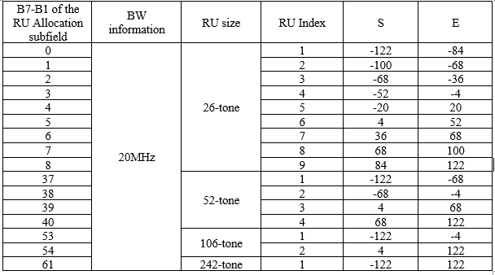
Option #3
Example of RU allocation subfield and [S,E] mapping for 20MHz

Slide 13
Example of Option #3
If scheduling algorithm determines to allocates 484+2$×$996 RU for STA #1 and 484 RU for STA #2 with 240MHz OFDMA in 11be
 | RU allocation subfield [X8-X0]
STA Info 1 | 001010111
STA Info 2 | 001000001
484
484
996
996
RU index
0 … 17
18 … 35
36 …
… 111
Feedback by STA #1
Feedback by STA #2
Feedback by STA #1

Slide 14
MIMO Control field
STA uses same indexing to indicate the tone [S, E] RUs in MIMO control field
2nd RU Start Index and 2nd RU End Index are present if the 2nd RU Start-End Index Present is equal to 1
RU Start Index | RU End Index | Sounding Dialog Token Number | Disallowed Subchannel Bitmap Present | 2nd RU Start-End Index Present | Reserved | Disallowed Subchannel Bitmap | 2nd RU Start Index | 2nd RU End Index | Reserved
8 | 8 | 6 | 1 | 1 | 2 | 16 | 8 | 8 | TBD

Slide 15
Pros. & Cons.
Our preference is Option #3, which has the shortest STA Specific Subfield
Option #1: 12 byte
Option #2: 8 byte
Option #3: 4 byte (same overhead as HE NDP-A)
 | Pros. | Cons.
Option #1 | Similar to the HE NDP-A structure | The Largest overhead (requiring 12 byte STA Info. subfield)
Option #2 | Flexible representation | Larger overhead than Option #3 (requiring 8 byte STA Info. subfield)
Option #3 | Same overhead as HE NDP-A (requiring 4 byte STA Info. subfield) | Reduced flexibility in representation

Slide 16
Summary
In this slide, we proposed a modified signaling for the partial BW feedback to reduce feedback overhead in multi-RU combination
Option #1
Duplicated STA Info subfield for one STA
Option #2
Add one more Partial BW info subfield to indicate [S, E] for non-adjacent subband
Option #3
Reuse the RU allocation subfield for which the beamformer is requesting feedback
Provide a table mapping [S, E] to the allocated RU

Slide 17
Reference
[1] 802.11-20/0566r23, Specification Framework for TGbe.
[2] 802.11-19/0828r4, Feedback Overhead Analysis for 16 Spatial Stream MIMO
[3] 802.11-20/0828r0, RU Allocation Subfield Design for EHT Trigger Frame

Slide 18
SP #1
Do you support that the STA Info. Subfield in the NDP-A frame will include separate partial BW feedback indications for each non-adjacent subband (i.e., set of contiguous RUs) in the multi-RU on which it would like to request feedback?
Y / N / Abstain

Slide 19
SP #2
For the separate indication of the partial BW feedback, which option do you support?
Option #1 /Option #2 / Option #3

Slide 20
Appendices

Slide 21
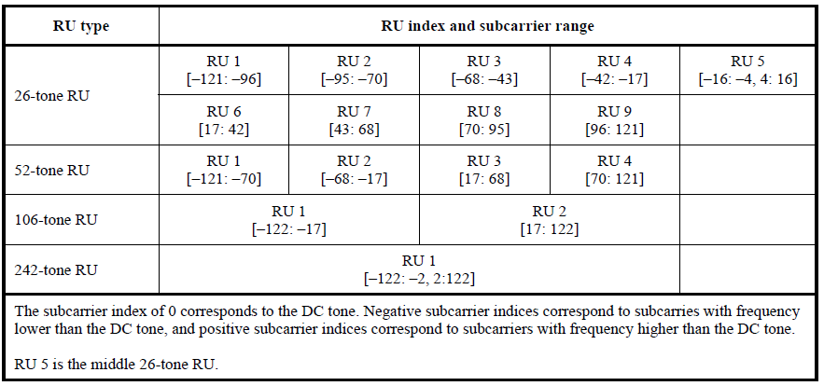
Data and pilot Subcarrier Indices for RUs in an 20 MHz HE PPDU and in a Non-OFDMA 20 MHz HE PPDU – Table 27-7 in 11ax

Slide 22
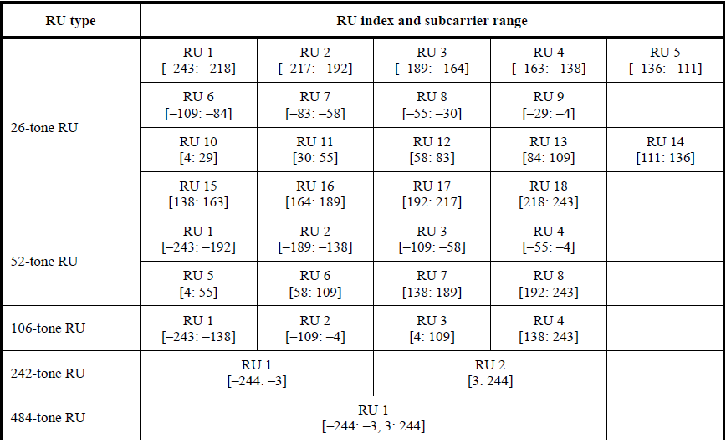
Data and pilot Subcarrier Indices for RUs in an 40 MHz HE PPDU and in a Non-OFDMA 40 MHz HE PPDU – Table 27-8 in 11ax

Slide 23
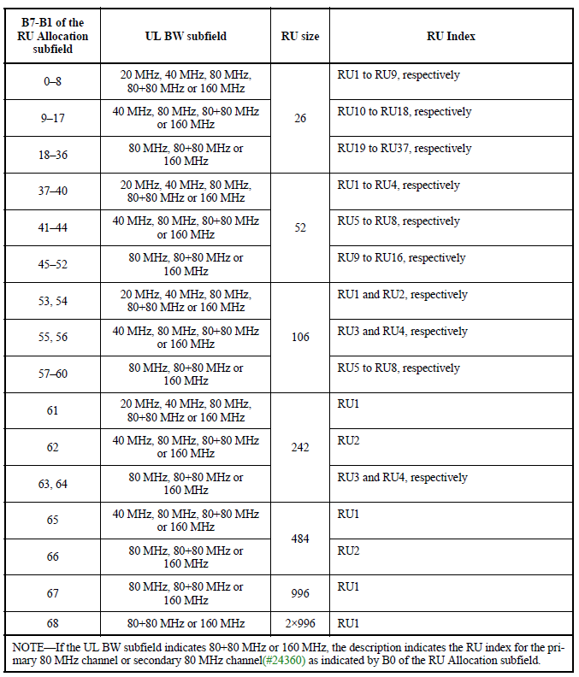
B7–B1 of the RU Allocation subfield

