Slide 1
Usage model terminology for WLAN sensing
Date: 2020-07-14
Authors:
Name | Affiliation | Address | Phone | Email
Yingxiang Sun | Huawei Technologies Co. Ltd | F3, Huawei Base, Shenzhen, China |  | sunyingxiang@Huawei.com
Danny Kai Pin Tan
Rui Du
Chenchen Liu
Meihong Zhang
Edward Au

Slide 2
Abstract
The purpose of this contribution is to serve as a starting point in preparing an usage model document for the future SENS TG.
Specifically, this contribution
refreshes the usage model terminology the other TGs are using in preparing the respective usage model documents,
proposes a few metrics that would facilitate the discussion on requirements for WLAN sensing, and
provides an illustrative example on an usage model with the proposed metrics.

Slide 3
Refresh: Usage model terminology
Yingxiang Sun (Huawei)

Slide 4
Usage model terminology
Usage Model – A usage model is the combination of the following 4 items below; not to be confused with a use case which is the specific set of steps to accomplish a particular task.
Pre-Conditions – Initial conditions before the use case begins.
Environment – The type of place in which the network of the use case is deployed, such as home, outdoor, hot spot, enterprise, metropolitan area, etc.
Use case – A use case is task oriented. It describes the specific step-by-step actions performed by a user or device. One use case example is a user starting and stopping a video stream.
Metrics and Requirements – The evaluated performance with specific metrics that are expected to achieve in the use case.
NOTE:
In the usage model documents of other TGs, “Applications” and “Traffic Models” may be included. Based on the nature of this project, we do not believe these two items are needed. Instead, a new item “Metrics and Requirements” is proposed.
Yingxiang Sun (Huawei)

Slide 5
Proposed metrics for discussion on requirements for WLAN sensing
Yingxiang Sun (Huawei)

Slide 6
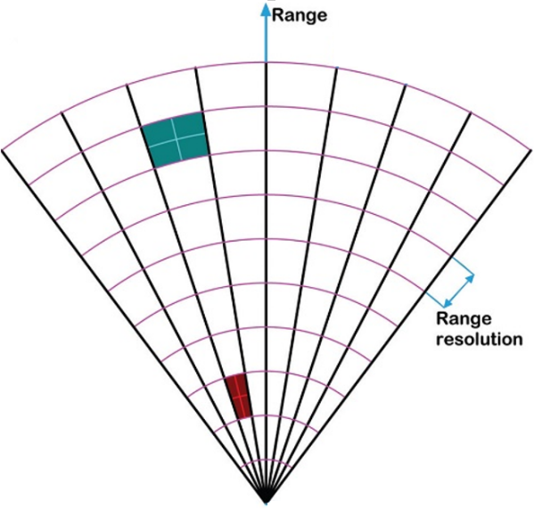
Proposed metrics & the respective definitions (1)
Range Coverage: The maximum allowable distance from a sensing device to the target. The SNR is above a pre-defined threshold (conventionally taken as 10dB or 13dB) within this distance, which enables targets to be detected.
E.g., < 5m@13dB would indicate that the maximum allowable distance from a sensing device to the target with a 13dB SNR threshold is within 5 meters.
Range Resolution: The ability of sensing device to distinguish between two or more targets on the same direction but at different ranges.
E.g., 50cm would indicate that two targets are distinguishable when the range difference between them is greater than 50cm.
Range Accuracy: The difference between
the estimated range and the actual range
of an object.
E.g., 10cm is a requirement that the estimated
range be within 10cm of the actual range.
https://polarresearch.net/index.php/polar/article/view/3382/10009#figures
Yingxiang Sun (Huawei)

Slide 7
Proposed metrics & the respective definitions (2)
Angular Resolution¹ (Azimuth / Elevation): The minimum angle between two targets at the same range² which sensing device is able to distinguish and separate from each other.
E.g., 10˚ would indicate that two targets with an angle between them that values greater than 10˚ are distinguishable.
Angular Accuracy (Azimuth / Elevation): The difference between the estimated angle and the actual angle of an object.
E.g., 1˚ is a requirement that the estimated angle be within 1˚ of the actual angle.
Note 1:
Angular Resolution [1]: The ability to distinguish between two targets solely by the observation of their angle, usually expressed in terms of the minimum angle separation by which two targets at a given range can be distinguished. The required separation should be specified for targets of given relative power level at the receiver. Equal powers are often assumed, but where resolution of targets of different powers is important it may be necessary to specify the separation at two or more power ratios.
Note 2:
In a physical space, range and angle (polar coordinates) are jointly used to indicate the position of an object. Velocity is not involved in such a context. Therefore, ‘at the same velocity’ is not used as a restriction in the definition of angular resolution.
Yingxiang Sun (Huawei)

Slide 8
Proposed metrics & the respective definitions (3)
Velocity Resolution^{1, 2}: The minimal velocity difference between two objects travelling before a sensing device detects two discrete reflections.
E.g., 0.1m/s would indicate that two or more targets that with velocity difference greater than 0.1m/s between each other are distinguishable.
Velocity Accuracy: The difference between the estimated velocity and the actual velocity of an object.
E.g., 0.2m/s is a requirement that the estimated velocity be within 0.2m/s of the actual velocity.
Note 1:
If two objects are very close to each other, and they are not distinguishable neither by range nor by angle, then velocity resolution is introduced to distinguish them from each other.
Note 2:
If two objects are moving in opposite directions at the same speed, they are distinguishable since the Doppler are opposite in sign. Therefore, the vector concept ‘velocity’ is used to depict the objects in speed and bearing.
https://polarresearch.net/index.php/polar/article/view/3382/10009#figures
Yingxiang Sun (Huawei)

Slide 9
Proposed metrics & the respective definitions (4)
Probability of Detection: The ratio of number of correct predictions to the number of all aimed samples in terms of gestures/activities/motions, which, e.g., can be one of the followings:
a) gesture detection where a pre-defined set of gestures and/or motions shall be identified;
b) presence detection;
c) a specific body activity detection like breathing;
d) real person detection distinguishing human beings from other objects.
E.g., >95% is a requirement that the percentage of correct detection is more than 95%.
Yingxiang Sun (Huawei)

Slide 10
Proposed metrics & the respective definitions (5)
Field of View (FOV): The angle through which the sensing device performs sensing, i.e., the FOV indicates the coverage area of a sensing device in terms of angle.
E.g., ±50˚ is a requirement that the coverage area of a sensing device is ±50˚.
Latency: Expected time taken to finish the related WLAN sensing process.
E.g., 10 ms latency would indicate that WLAN sensing process needs to be completed within 10 ms.
Refresh Rate: This defines how frequent the refresh takes place.
E.g., a refresh rate of 10 Hz would indicate that WLAN sensing results need to be refreshed 10 times in a second.
Number of Simultaneous Targets: This defines how many targets could be detected simultaneously within the sensing area.
E.g., a simultaneous targets number of 5 would indicate that 5 targets could be detected/localized/tracked/… simultaneously by WLAN sensing device within the sensing area.
Yingxiang Sun (Huawei)

Slide 11
Proposed metrics & the respective definitions (6)
Summary of proposed metrics
The proposed metrics can be grouped into 4 different categories.
Coverage |  | Resolution |  |  | Accuracy |  |  | Other performance
Range (m) | Field of view (˚) | Range (m) | Angle (˚) | Velocity (m/s) | Range (m) | Angle (˚) | Velocity (m/s) | Probability of detection (%) | Latency (ms) | Refresh rate (Hz) | No. of simultaneous targets
Yingxiang Sun (Huawei)

Slide 12
An example usage model
Yingxiang Sun (Huawei)

Slide 13
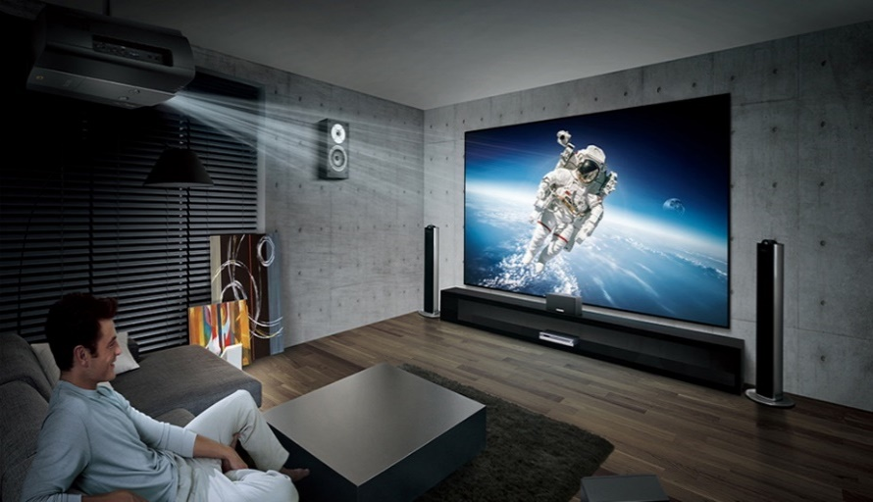
1. Audio with user tracking (Follow-me sound) (1/2)
Pre-Conditions
WLAN based audio system including various WLAN speakers.
WLAN is employed for sensing/positioning, but may or may not be employed for sound transfer.
Audio system calibration is done, i.e., speaker placement and position is automatically determined, and audio system adjusts the speaker settings for best sound experience.
Environment
Smart home with 802.11 coverage and mono-static/bi-static/multi-static architecture.
Immersive gaming room with 802.11 coverage and mono-static/bi-static/multi-static architecture.
Use Case
The user does not need to wear a WLAN device.
The user’s position is continuously monitored.
The audio system adjusts the speaker settings according to the user’s position and movement for immersive sound experience.
https://uppic-fd.zol-img.com.cn/g5/M00/0D/0A/ChMkJllWFZuIdf9SAAOoPtMQwRcAAdx4wF6HpAAA6hW306.jpg
Note: This usage model is modified based on the usage model No.2 for 11az [2], which require the user to wear a WLAN device.
Yingxiang Sun (Huawei)

Slide 14
1. Audio with user tracking (Follow-me sound) (2/2)
Requirement and attribute
Usage model # | Coverage |  | Resolution |  |  | Accuracy |  |  | Other performance
 | Range (m) | Field of view (˚) | Range (m) | Angle (˚) | Velocity (m/s) | Range (m) | Angle (˚) | Velocity (m/s) | Probability of detection (%) | Latency (ms) | Refresh rate (Hz) | No. of simultaneous targets
1. Audio with user tracking | <10 @13dB | ±60 | 0.1 | 2 | 0.05 | 0.05 | 0.5 | 0.01 | >95 | <10 | >10 | <= 5
Yingxiang Sun (Huawei)

Slide 15
Summary
Relevant terminologies required to describe the usage models for WLAN sensing have been defined.
An example usage model is presented and additional usage models are expected to be added in the future.

Slide 16
References
[1] IEEE Std 686-2017: IEEE Standard for Radar Definitions.
[2] 11-16-0137-04-00az-ngp-use-case-document.pptx
Yingxiang Sun (Huawei)

Slide 17
SP 1
Do you agree that the proposed metrics as summarized in slide 11 of this contribution should be considered as the baseline metrics for usage models of SENS SG (or the future TG)?
Yes:
No:
Abstain:
Yingxiang Sun (Huawei)

