Slide 1
Cyclic Shift Values for NGV
Date: 2020-06-10
Authors:

Slide 2
Introduction
11bd supports up-to two spatial streams [1]
The cyclic shift value, T_{CS,NGV} for the NGV modulated fields is TBD in the spec

Slide 3
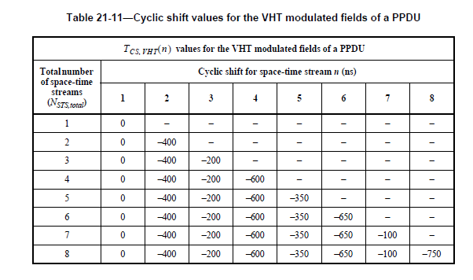
Cyclic Shift for NGV
Propose T_{CS,NGV} to use the same values as defined for VHT SU PPDU
Table 21 -11 (Cyclic shift values for the VHT modulated fields of a PPDU)
Only use rows corresponding to N_{STS,total} = 1 and 2

Slide 4
Reference
[1] Rui Cao and etc., “NGV MIMO Simulations”, 11-19/1070r0

Slide 5
Straw Poll 1
Do you agree that 11bd PPDU defines T_{CS,NGV} , the same as T_{CS,VHT} as in Table 21 -11 (Cyclic shift values for the VHT modulated fields of a PPDU), for the NGV modulated fields?
Note: Only use rows for N_{STS,total} = 1 and 2, corresponding to N_{SS} = 1 and 2 respectively.
Y:
N:
A:

