Slide 1
AP MLD Beaconing and Discovery
Date: 2020-06-08
Authors:

Slide 2
Motivation
The existing beaconing and discovery schemes need to be extended to allow:
  Fast discovery and multi-link setup between an AP MLD and a Non-AP MLD, while maintaining the support for legacy STAs to discover and associate to the AP MLD
  The multi-link maintenance (multiple associations maintenance) with AP MLD

Slide 3
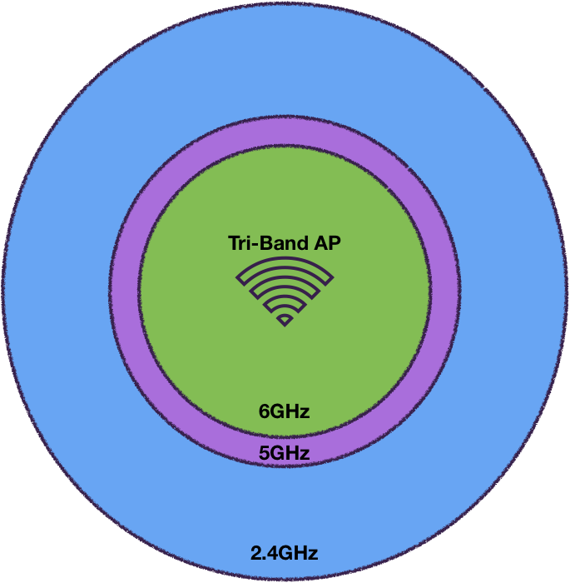
Background, AP discovery
Scanning STA likely starts scanning at the 2.4 GHz band
  Least number of 20 MHz channels
  APs operate in this band for legacy support
  Large transmission coverage enables APs discovery over large area
The scanning STA selects the 5 & 6 GHz scanned channels based on Out-of-Band Discovery, i.e. Reduced Neighbor Report (RNR)

Slide 4
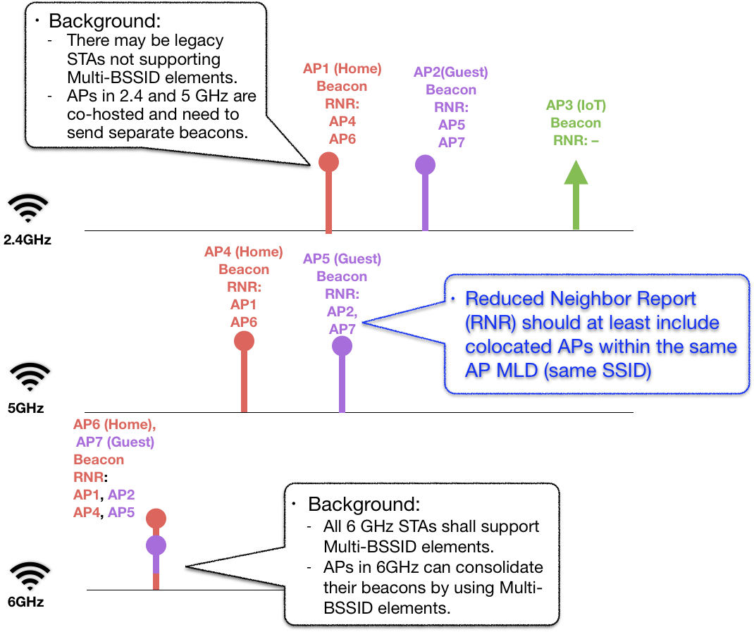
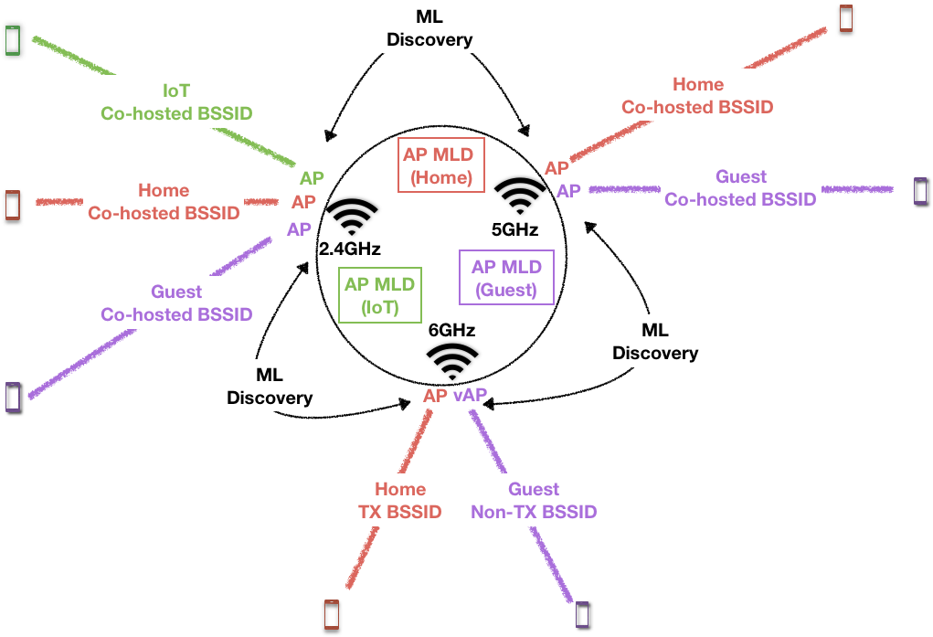
Example AP MLD and its beacon transmission

Slide 5
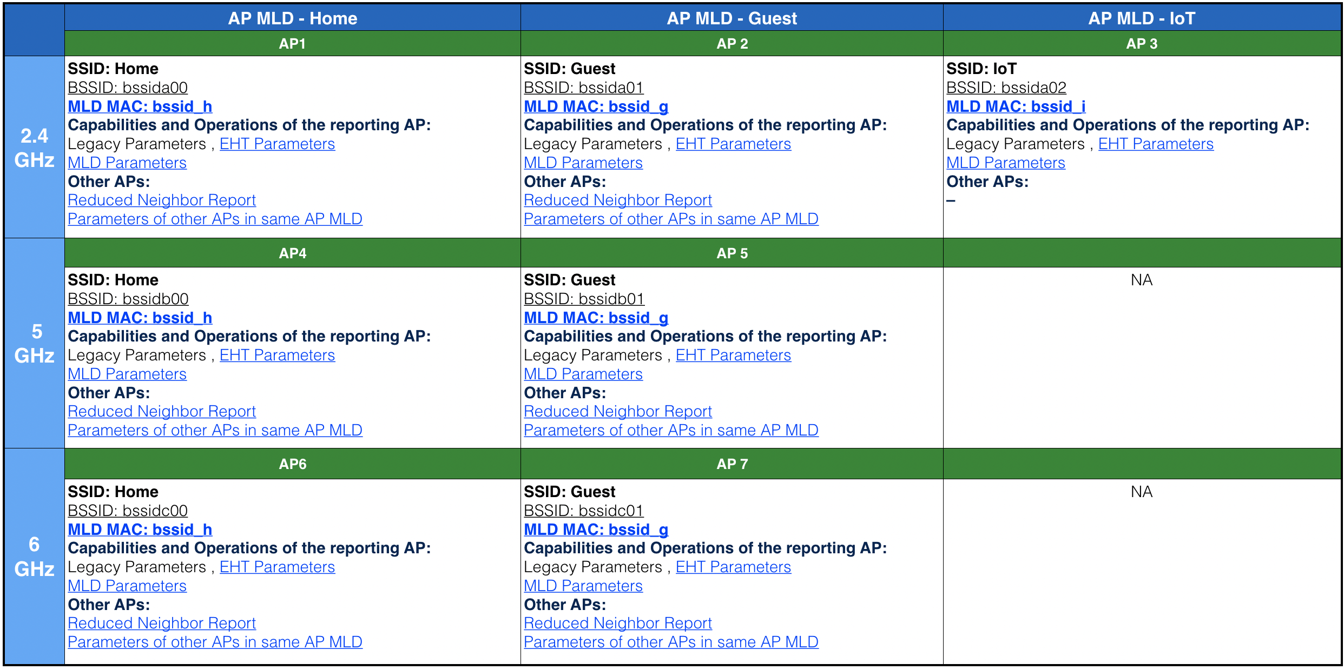
Example of Beacon Content

Slide 6
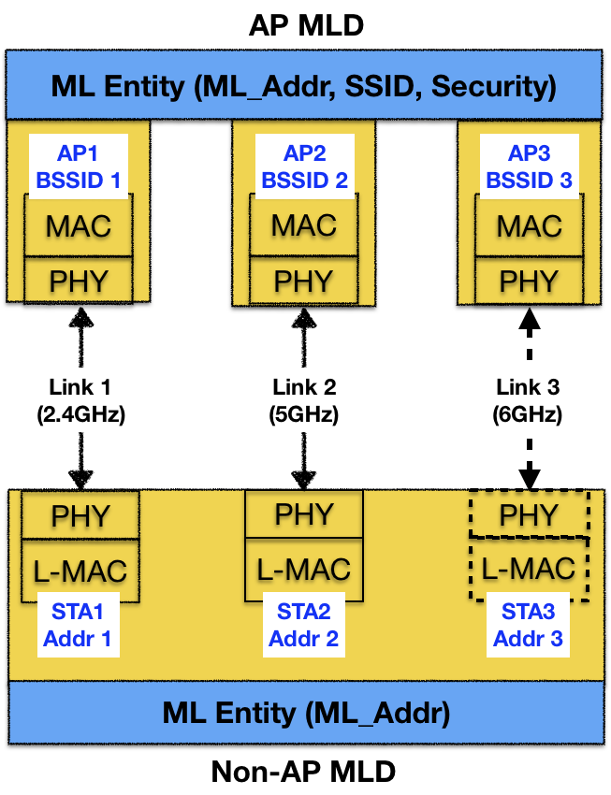
AP Discovery
STA needs to find an AP to be able to establish MLD setup with the AP MLD
  STA needs to discover at least one AP in AP MLD to initiate authentication and MLD Setup
The MLD link setup creates multiple links
  The MLD link setup signalling is transmitted over a single link

Slide 7
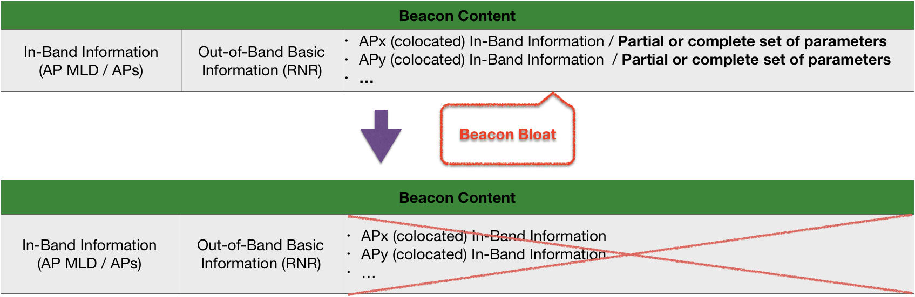
Concern: AP MLD discovery over one link?
A Non-AP MLD may scan all links anyway to evaluate link quality
  To accelerate connection setup, the Non-AP MLD may start authentication and association on the first discovered link while evaluating other links
Once a Non-AP MLD discovers an AP MLD on one link, it may transmit a unicast ML Query management frame to the AP MLD to collect the co-located APs’ detailed capability and operation information

Slide 8
Proposal: Address Hierarchy for AP MLD

Slide 9
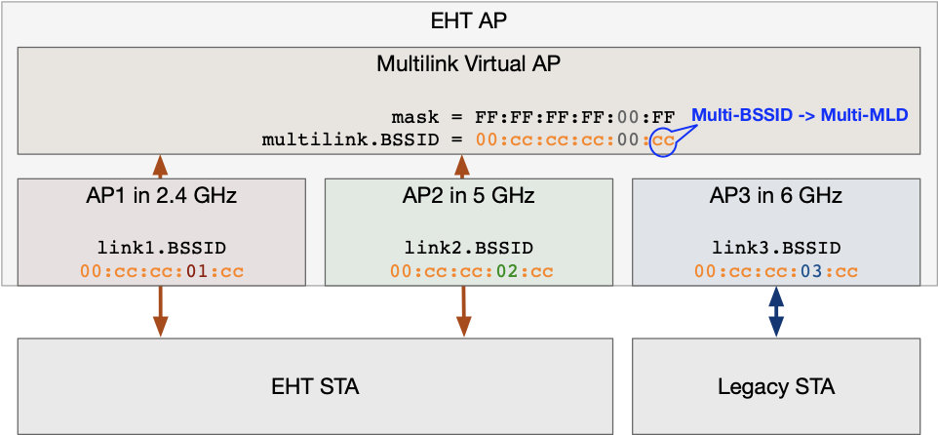
Proposal: Address Hierarchy for AP MLD
Beacon includes the address mask or linkID mask length (M), e.g. 0<M≤8
M=3

Slide 10
Proposal: Address Hierarchy for AP MLD

Slide 11
Reduced Neighbor Report
RNR includes all AP in other channels that belong to the same AP MLD.
AP in MLD AP field is set to 1 if the reported AP belongs to AP MLD.

Slide 12
Parameters of other APs in AP MLD
Alternatives for other AP information in Beacon:
  A single Beacon carries a complete set of parameters of other APs in the same AP MLD
  A single Beacon carries a partial set of parameters of other APs in the same AP MLD
  A single Beacon carries basic info (e.g. RNR) and Check Beacon of other APs in the same AP MLD.
A Non-AP MLD may send additional query or scan other links to obtain detailed parameters of other APs.

Slide 13
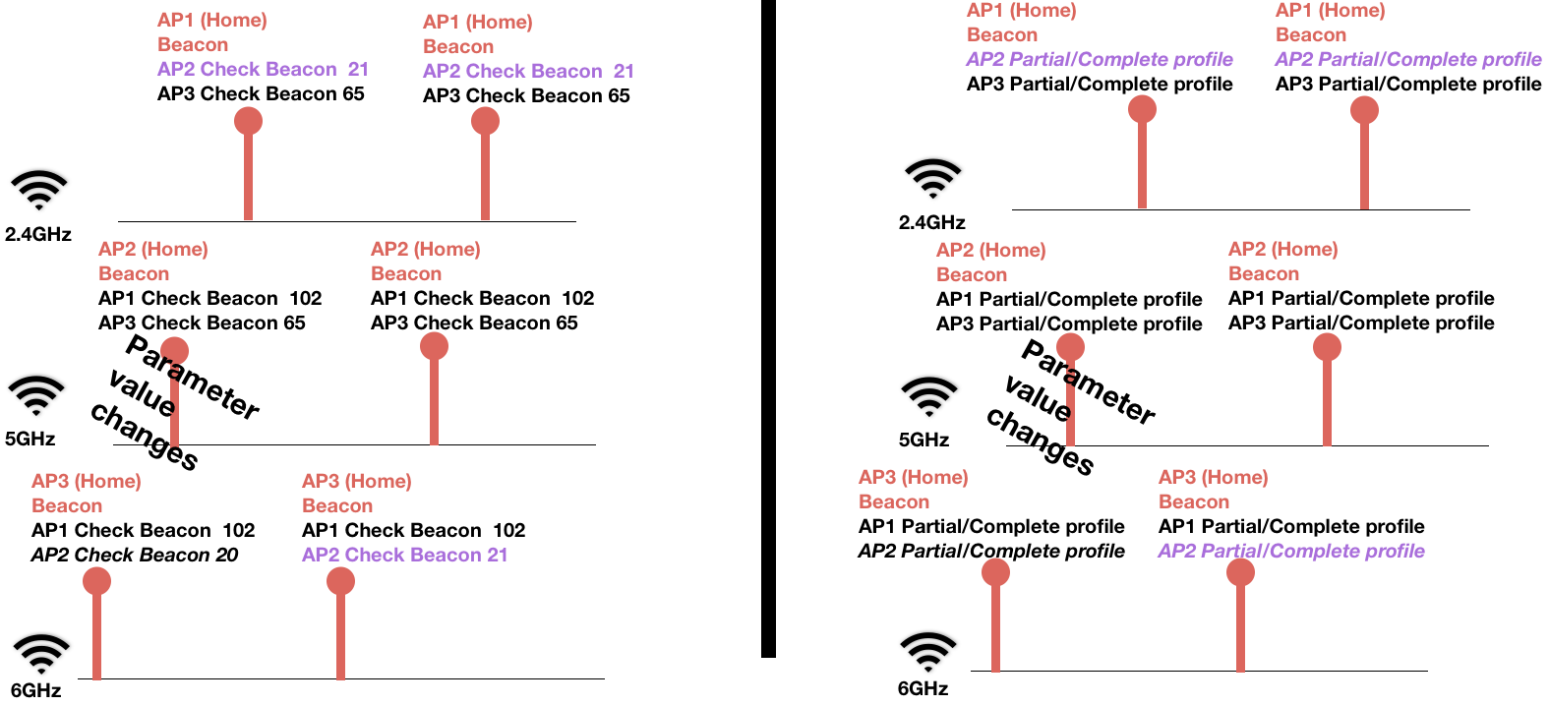
Proposal – Check Beacon
Check Beacon is one octet long field that is updated if a critical link specific AP parameter value changes

Slide 14
Parameters of other APs in AP MLD

Slide 15
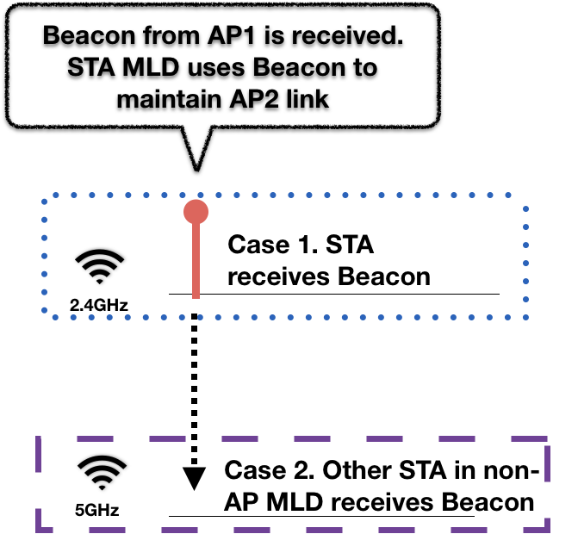
Links maintenance

Slide 16
Unavailable AP in AP MLD
The STA MLD needs to detect if an AP in another link becomes unavailable
  An AP in AP MLD may be unavailable, if the AP has sent Quiet element or Channel Switch Mode = 1
A STA MLD have STAs in power save and it may receive Beacons only from a single AP
  STA must avoid transmissions to the unavailable AP
  The STA needs to detect if some AP is not available also through other links
  The scanning STAs needs to avoid transmissions to unavailable AP

Slide 17
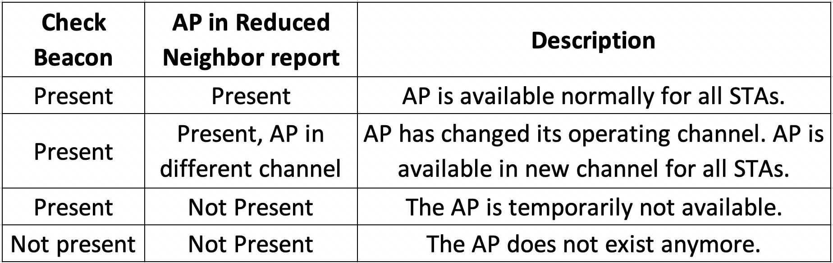
Detecting AP Availability on other link
The Reduced Neighbor Report (RNR) indicates whether AP is available to receive transmissions from STAs
  STA that is in long term power save or does not intent to use an AP may not need to actively receive Beacons from all APs
Check Beacon field may be used to detect that AP exists

Slide 18
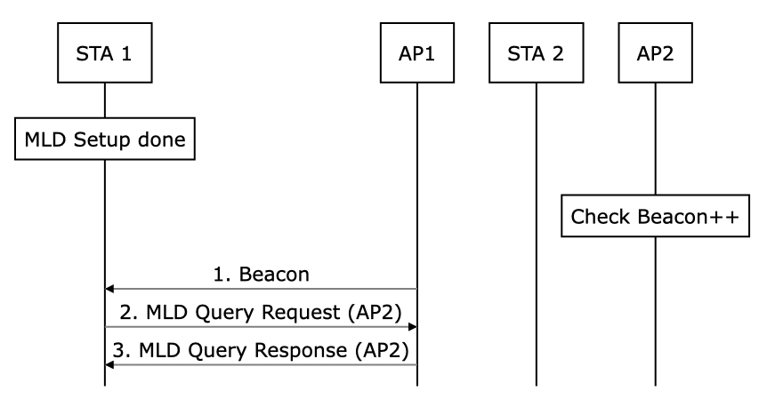
Secure MLD Query
MLD Query is used by EHT STAs to obtain securely the parameters of the APs in AP MLD
  MLD Query Response provides AP link/BSS specific operating parameters and BSS Load/AP performance parameters

Slide 19
Secure MLD Query
Unprotected AP parameter queries (Probe Request, etc.) to query AP parameters in other link should be avoided
The requests have privacy concerns
  Probe Requests may reveal STA capabilities and STA may be tracked
The responses may not be secure
  Probe Responses are not encrypted and they do not have integrity protection

Slide 20
Example of MLD Query use in fast MLD Setup
The STA needs to get service from the AP immediately
  No time to setup Pre-Association Secure Negotiation (PASN)
STA MLD may simultaneously scan other channels while it is doing MLD Setup
  Multiple STAs may allow simultaneous link specific operations
STA may query AP parameters in other links after the MLD Setup
  Query frames are transmitted as protected management frames (PMF)
  STA gets service from the associated AP

Slide 21
Summary
Only small changes are needed to legacy discovery to support AP MLD discovery and link maintenance
Due to large number of transmitted Beacon frames, the beacon size should be minimized
  The MAC Address hierarchy enables BSSID fields to carry MLD MAC Address and LinkIDs
  The Check Beacon indicates whether STA should obtain the link specific AP parameters
  The Reduced Neighbor Report indicates other APs availability
Secure MLD Query is used to maintain the parameters of APs in AP MLD

Slide 22
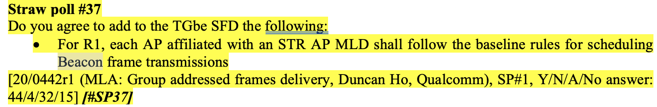
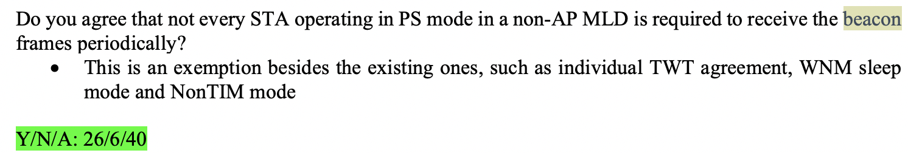
Recap of Beacon related strawpolls in 20/566r24
Approved / Strong support
Approved / Strong support

Slide 23
Straw Poll 1
Are you in favor of adding to 802.11be:
An EHT AP includes APs in other links of the AP MLD to the Reduced Neighbor Report transmitted in Beacon and Probe Response frames.

Slide 24
Straw Poll 2
802.11be shall define address hierarchy for EHT AP MAC Addresses as shown in slide 9:
- LinkId is included in the Octet 4 of the AP link specific addresses
- The AP MLD MAC address can be punctured from the link specific MAC addresses

Slide 25
Straw Poll 3
802.11be shall define a request and response signaling that uses Protected Management Frame (PMF) frames to query AP link specific parameters or AP MLD parameters.
Note: The exact frame formats are TBD.

