Slide 1
Backward compatible EHT trigger frame
Date: 2020-06-01
Authors:

Slide 2
Background
In 802.11ax, trigger frame was proposed to solicit the uplink MU PPDU (HE TB PPDU)
Synchronize the stating time of all the uplink sub-PPDUs
Align the ending time of all the uplink sub-PPDUs
Provide the transmission parameters for each uplink sub-PPDU, e.g., RU allocation, MCS
802.11 be introduces new bandwidth, new stream number
All of these new factors may change the trigger frame
In this contribution, we discuss a possible backward compatible EHT trigger frame design

Slide 3
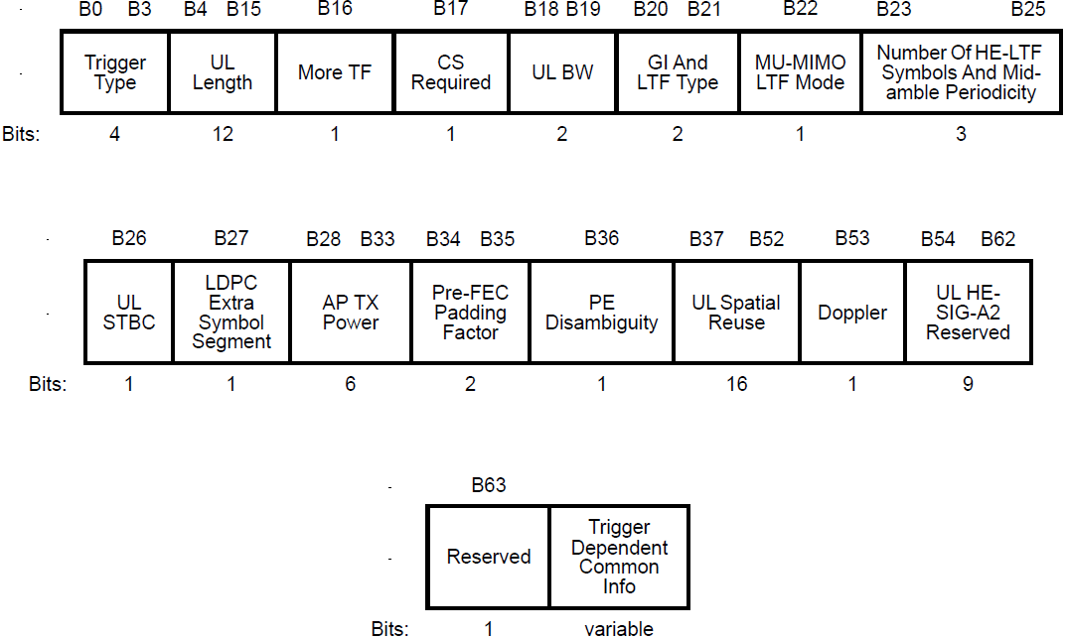
Recap
HE trigger frame is shown as below
Common Info field and a list of User Info fields

Slide 4
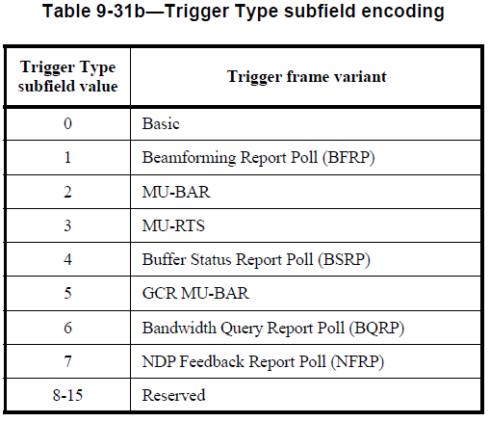
Backward compatible
In 802.11ax, we already have the following trigger types
For the same trigger function, it is better to reuse the exiting trigger types
No need to add the new trigger types just because of new bandwidth and new stream number
Can be used to solicit the mixed UL PPDU from HE STA and EHT STA
We will discuss the backward compatible design from
Common Info field in the trigger frame
User Info field in the trigger frame

Slide 5
Common Info field in trigger frame
The following subfields in the Common Info field need extension because of the new features in EHT
UL Bandwidth
Number of EHT-LTF Symbols And Midamble Periodicity extension
UL Spatial Reuse…
The following fields may be added to the Common Info field for the mixed transmission
EHT/HE indication per segment
Puncture info
All of the above fields could be put in a special User Info field，like special STA Info field of puncture info in NDP announcement frame
Transparent to HE STA
Or we can reuse reserve bits in the Common Info field
But some of them may already be used for implementation
The reserved bits may not be enough

Slide 6
User Info field in trigger frame
The following subfields in the User Info field may be impacted by the new features in EHT
RU allocation subfield
SS allocation subfield
However, there is only one reserved bit in User Info field. From the philosophy of design, it is better to keep it.
We propose to have a special User Info field to divide the User Info fields into two categories
Keep the existing 8-bit RU allocation subfield, and add MRU mode and large RUs to 7-bit table (refer to appendix)
RU allocation subfield in the 1st part indicates a RU within or larger than primary160 MHz
RU allocation subfield in the 2nd part indicates a RU within or larger than second 160 MHz
User Info 1
User Info 2
…
User Info X
Special User Info
User Info X+1
User Info X+2
…
User Info X+n
The first part, the assigned RU is within or larger than primary 160 MHz
The second part, assigned RU is within or larger than second 160 MHz

Slide 7
Summary
We propose a backward compatible EHT trigger frame by adding a special User Info field
No need double the existing trigger types
Can be used to solicit UL mixed PPDU transmission from HE STA and EHT STA

Slide 8
References
[1] 11-20-0416-00-00be-mru-signaling-in-trigger-frame
[2] 11-20-0413-01-00be-discussion-on-eht-trigger-based-ul-mu

Slide 9
SP 1

Slide 10
Appendix
B8-B2 | Description | Number of entries
0-36 | 26-tone RU in 80MHz | 37 (18 is reserved)
37-52 | 52-tone RU in 80MHz | 16
53-60 | 106-tone RU in 80MHz | 8
61-64 | 242-tone RU in 80MHz | 4
65-66 | 484-tone RU in 80MHz | 2
67 | 996-tone RU in 80MHz | 1
68 | 2*996-tone RU | 1 (can be either 160MHz full BW or one kind of large M-RU)
69-84 | Small M-RU | 16
85-120 | Large M-RU | 26
121 | 4*996-tone RU | 1
…

