Slide 1
Trigger Frame for Frequency-domain A-PPDU Support
Date: 2020-05-20
Authors:

Slide 2
Background
Frequency-domain (FD) A-PPDU will be included in 11be SFD
We need MAC protocol to support it
Announcement/Trigger frame are the core elements
Intel’s contribution provides MAC requirements to support it
[Downlink] Using enhanced downlink (DL) announcement frame
[Uplink] Using enhanced uplink (UL) trigger frame
In this contribution, we propose several designs options for trigger frame to support FD A-PPDU in MAC level

Slide 3
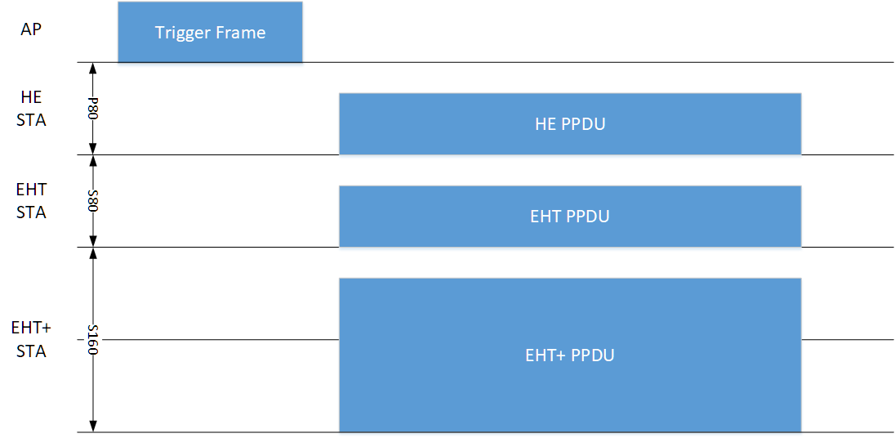
Expected UL Operation
Trigger frame allocates the 80MHz segment(s) to use for UL
HE STA will be assigned to use P80 (backward compatibility)
EHT and EHT+* STA will be assigned to use secondary segments
* EHT+: the amendments after EHT

Slide 4
Design Principles for Trigger Frame
MAC requirements
New design should support any combination of HE, EHT and EHT+ PPDUs for FD A-PPDUs
New design should incorporate “EHT and EHT+ specific” fields
ex) UL BW, RU allocation, etc.
Backward compatibility
HE STA shall not be affected by the new design
Forward compatibility
New design should be easily extendable for EHT+

Slide 5
Design Options for Trigger Frame
[Option1] Aggregated-MPDU design
Define EHT+ variant of the trigger frame
To trigger HE, EHT and EHT+ STAs with one PPDU, AP should use the A-MPDU
E.g., Trigger frame (for HE STA) and new trigger frame (for EHT and EHT+ STA) are aggregated
[Option2] Single-MPDU design
[Option 2-1] Extend common/user info of the trigger frame by using reserved AID
Assign a specific AID to indicate the extended common/user info fields for EHT+ STAs
[Option 2-2] Extend common/user info of the trigger frame by setting AID subfield to 4095
Use AID 4095 (Start of padding field) to indicate the presence of the extended common/user info fields for EHT+ STAs

Slide 6
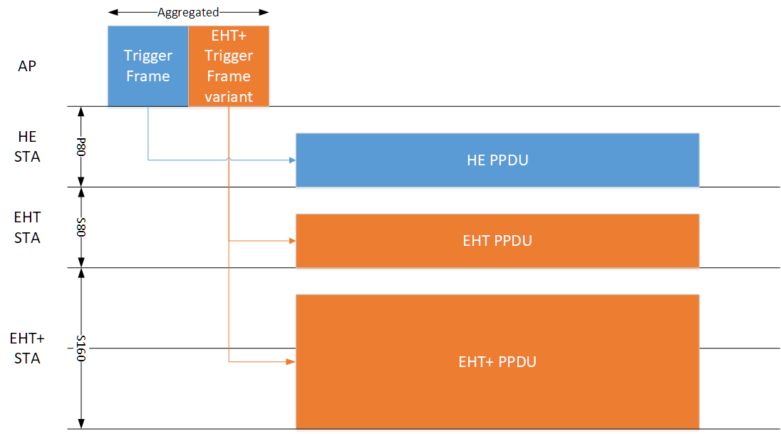
Option 1: Aggregated-MPDU Design
Operation example

Slide 7
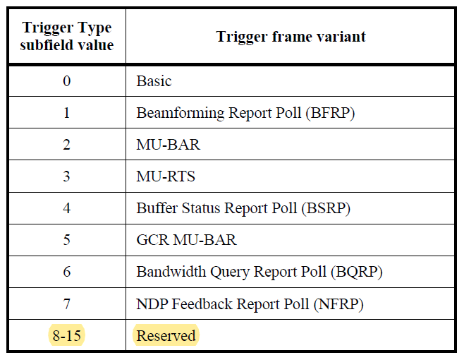
Option 1: Aggregated-MPDU Design
Trigger type subfield encoding
Trigger type subfield is 4-bit in the trigger frame
MSB of trigger type subfield is currently reserved
Candidate options for indicating EHT and EHT+ amendment
[1-bit] Use MSB 1-bit as a indication ex) 0000: HE Basic, 1000: EHT+ Basic
[1-subtype] Use one subfield value. ex) 8: EHT+, 9-15: Reserved

Slide 8
Option 1: Aggregated-MPDU Design
Common info field
If trigger type is EHT+ variant (ex. trigger type=8), then the rest of common info field can be re-defined to support EHT features
E.g., UL BW field can be extended to support BW of 240/320MHz
We should include “protocol subfield” to indicate exact amendment
ex) 00: EHT, 01:EHT+, 10:EHT++, …

Slide 9
Option 1: Aggregated-MPDU Design
User info field
If trigger type is EHT+ variant (ex. trigger type=8), then User info field can also be re-defined
E.g., RU allocation can be extended to support multi-RU

Slide 10
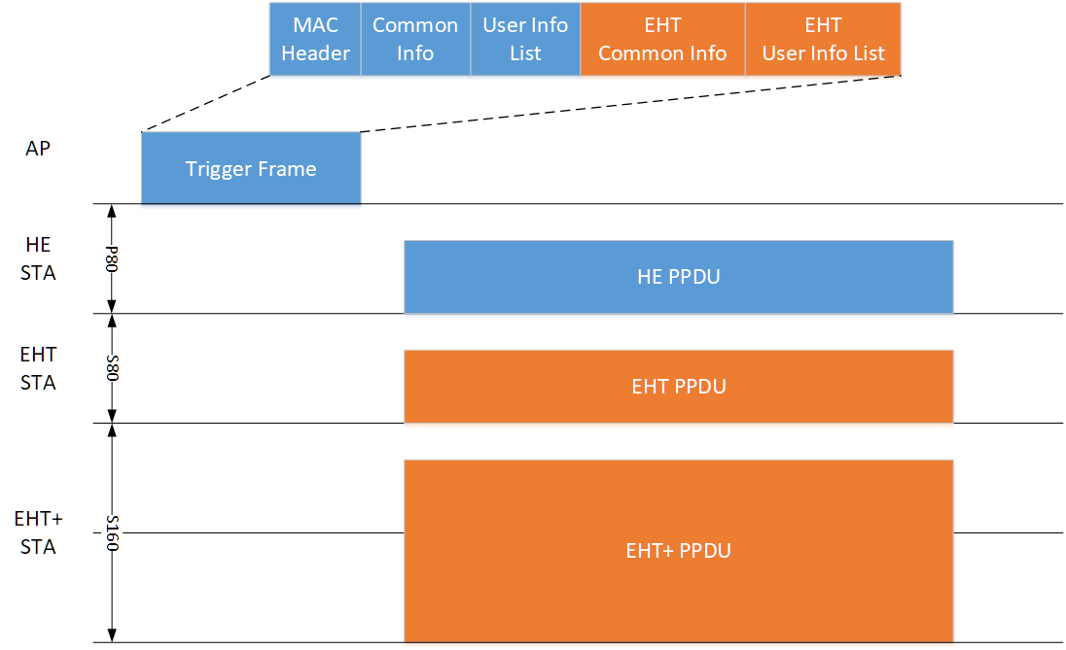
Option 2-1: Single-MPDU Design w/ Reserved AID
Operation example

Slide 11
Option 2-1: Single-MPDU Design w/ Reserved AID
Trigger type subfield encoding
Stays the same
Common info field
Also stays the same
EHT and EHT+ STAs can obtain the common info field and additionally obtain “EHT and EHT+ specific” common info
How to include “EHT and EHT+ specific” common info?
Assign one of the reserved AID (2008-2044) to “EHT(+) common info”
Example of “EHT(+) common info” field
EHT STAs obtain EHT-specific common information from the user info field with AID 2008 while HE STAs ignore it
EHT STAs can combine EHT UL BW field with the UL BW field
Length of “EHT(+) common info” should be the same with that of the user info field since this field reuses the existing user info field format (5-bytes)
AID (2008) | EHT UL BW | Other EHT-specific parameters

Slide 12
Option 2-1: Single-MPDU Design w/ Reserved AID
How to include “EHT and EHT+ specific” user info?
Assign one of the reserved AID (2008-2044) to “EHT(+) user info”
Example
EHT STAs will recognize the user info field with AID 2010 as EHT user info
Additional (EHT) AID field is required to specify EHT STA
RU allocation field includes multi-RU feature
HE STAs ignore this user info field with AID 2010
Length of “EHT(+) user info” should be the same with that of the user info field since this field reuses the existing user info field format (5-bytes)
Only 2-bytes are free to use per user info field
We may need to integrate multiple user info fields for the same AID
We need to assign another AID of “Start of padding field” for EHT
12-bit
12-bit
16-bit
AID (2010) | (EHT) AID | RU allocation | Other EHT user-specific parameters

Slide 13
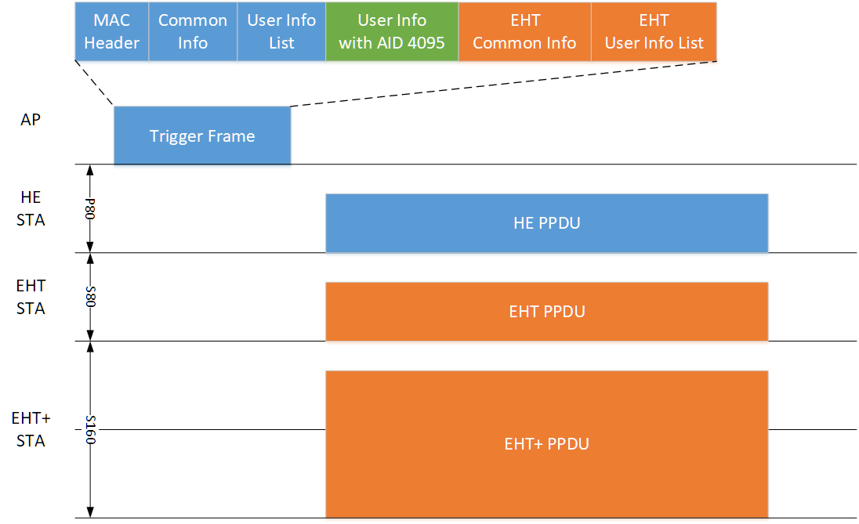
Option 2-2: Single-MPDU Design w/ AID 4095
Operation example
Notes:
byte alignment

Slide 14
Option 2-2: Single-MPDU Design w/ AID 4095
Trigger type subfield encoding
Stays the same
Common info field
Also stays the same
The user info field with AID 4095 (Start of padding field)
Padding is optionally present to give the recipient STAs enough time to prepare a response
EHT+ specific common info and user info will be followed by the user field with AID 4095
HE STAs will not decode after AID 4095
EHT STA shall decode after AID 4095, since all EHT+ specific information will be followed after it
EHT+ specific common info and user info format can be re-designed

Slide 15
Pros and Cons of Candidates
Summary table
Candidates | Pros | Cons
[Option 1] Aggregate-PPDU | Doesn’t require any change of the existing trigger frame | Cannot use non-HT duplicate format
[Option 2-1] Single-PPDU with the reserved AID | Can use non-HT duplicate format | EHT user info overhead Requires a change of trigger frame
[Option 2-2] Single-PPDU with the AID 4095 | Can use non-HT duplicate format High flexibility (no limitation of duration or format at all) | Requires a change of trigger frame

Slide 16
Summary
New trigger frame design options to support FD A-PPDU in UL
Aggregate-PPDU approach
Single-PPDU approach
Using the user field with reserved AIDs
Using the user field with AID 4095
We investigate pros and cons of each option

Slide 17
Straw Poll
Do you support assigning one or more reserved AID(s) for EHT or EHT+ specific information in 11be to support FD A-PPDU?
Detailed EHT or EHT+ specific information format is TBD

