Slide 1
Proposed Center Frequency for the Common Mode Mandatory PHY
Date: 2020-05-23
Authors:

Slide 2
Abstract
This presentation aims to propose the optimal center frequency for the common mode mandatory PHY of TGbb

Slide 4
Background
The next question is:
“What is the optimal center frequency for the common mode mandatory PHY of TGbb?”

Slide 5
Review
In https://mentor.ieee.org/802.11/dcn/20/11-20-0572-02-00bb-proposed-center-frequency-mandatory-phy.pptx, we proposed the following center frequency
BW [MHz] | fc* [MHz] | Δ [MHz]
20 | 26 | 16
40 | 36 | 16
80 | 56 | 16
160 | 96 | 16
BW = 160 MHz
fc=96 MHz
BW = 80 MHz
fc=56 MHz
BW = 40 MHz
fc=36 MHz
BW = 20 MHz
fc=26 MHz

Slide 6
Review
However, the huge frequency loss near DC is due to the spectrum mask with BW=160 MHz is wide.
Top-down approach
BW = 160 MHz
BW = 80 MHz
BW = 40 MHz
BW = 20 MHz

Slide 7
Improvement
Use the measured spectrum from datasheet instead of the worst case spectrum, for example, datasheets from Qualcomm (SAW Components B8857).

Slide 8
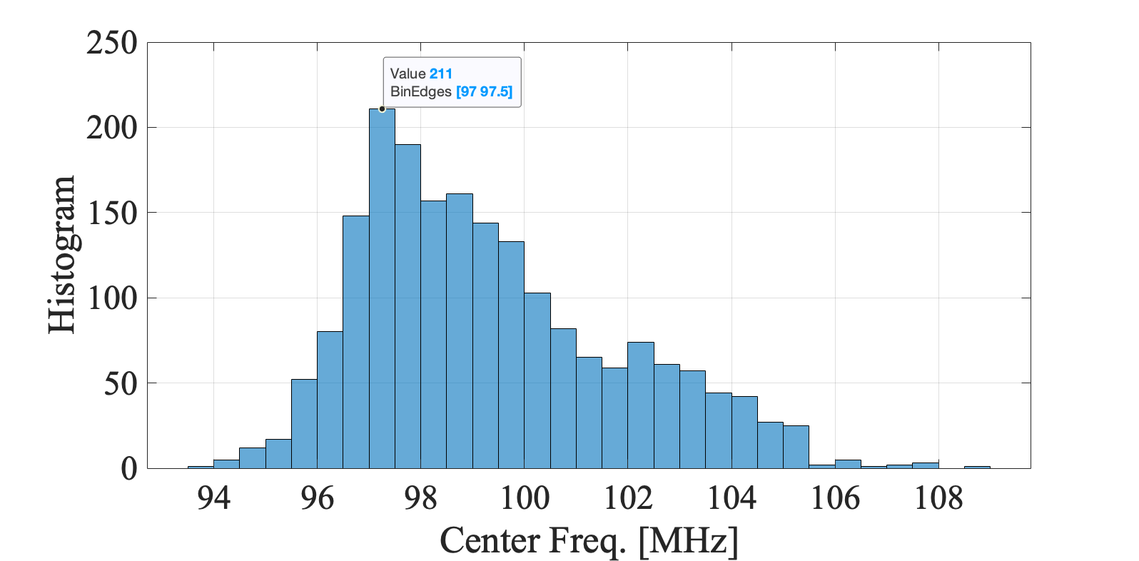
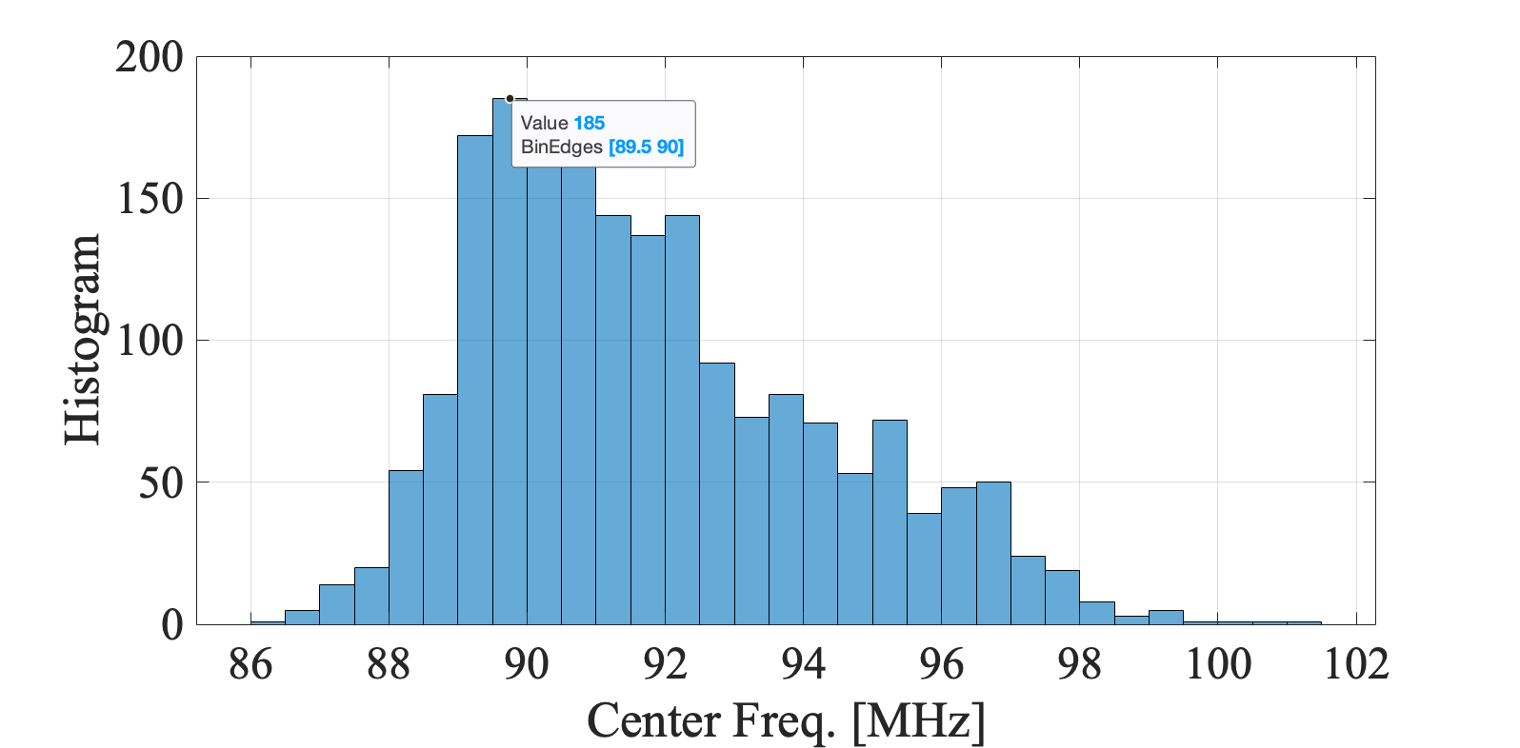
Snapshot
97 MHz
Old mask
89 MHz
New mask

Slide 9
Problem Formulation
Given that we are confident with the EVM values, then we can find the optimal frequency as follows:
i.e., it is an exhaustive search over CIRs and MCS index values, but the EVM value must be lower than the allowed EVM values that are defined in the 802.11ax document and BW = 160 MHz.
fc* = arg min (EVM) for each CIR and MCS index values s.t. the EVM does not exceed the allowed EVM values and BW=160 MHz

Slide 10
Final Results
BW [MHz] | fc* [MHz] | Δ [MHz]
20 | 17 | 7
40 | 27 | 7
80 | 49 | 7
160 | 87 | 7

Slide 11
Straw Poll
Should TGbb adopt the center frequencies as shown in the table below for the mandatory, common mode of TGbb.
Result (Y / N / A): / /
BW [MHz] | fc* [MHz] | Δ [MHz]
20 | 17 | 7
40 | 27 | 7
80 | 49 | 7
160 | 87 | 7

