Slide 1
WLAN Sensing Definitions
Date: 2020-05-26
Authors:
Name | Affiliations | Address | Phone | Email
Cheng Chen | Intel |  |  | cheng.chen@intel.com
Claudio da Silva |  |  |  | claudio.da.silva@intel.com
Bahareh Sadeghi |  |  |  | bahareh.sadeghi@intel.com
Carlos Cordeiro |  |  |  | carlos.cordeiro@intel.com
Notes:
September 2012

Slide 2
Abstract
This contribution proposes definitions related to WLAN sensing that could be adopted by SENS SG/TG”).

Slide 3
Background
WLAN sensing implementations can be roughly divided into one of the two following categories:
Same device transmits and receives a “sensing” PPDU
Like traditional radar systems (monostatic), such as those based on FMCW.
Example: Gesture recognition.
Sensing is performed by tracking changes on a wireless channel through the reception of multiple PPDUs over time
Time-variations of the channel are usually classified into events/activities/… through signal processing and/or ML/AI.
Example: Home security and smart buildings.

Slide 4
WLAN Sensing Measurements
One of the main areas of focus of the WLAN Sensing amendment will be the definition of procedures that enable efficient and reliable channel measurement (or “sampling”).
Measurements used by WLAN sensing could be obtained:
By the same STA that supports WLAN sensing
Often referred to as opportunistic or “implicit” [1]
Feedback sent by a different STA
Referred to as “explicit” in [1].
Note: Each of the two approaches defined above have advantages/disadvantages, and may be required for specific use cases. This analysis is beyond the scope of this presentation, and will be considered in future contributions.

Slide 5
WLAN Sensing Measurements: Implementation 1
The STA that supports WLAN sensing (STA 1 in the figure below) obtains measurements itself/directly using PPDUs transmitted by a peer STA (STA 2).
The PPDUs used to obtain measurements could be received, for example, during a data/management exchange (including Beacon frames) or as a result of a ping-like procedure.
STA 1
PPDUs
STA 2
STA that supports WLAN
sensing

Slide 6
WLAN Sensing Measurements: Implementation 2
The STA that supports WLAN sensing (STA 1) uses feedback of measurements obtained by a peer STA (STA 2).
Example: Beamforming sounding procedure:
STA 1 transmits an NDP Announcement followed by an NDP
STA 2 estimates the MIMO channel, compresses the feedback, and sends it to STA 1
STA 1
NDPA + NDP
STA 2
Feedback
STA that supports WLAN
sensing
The fact that sensing measurements may or may not be taken by the same STA that supports WLAN sensing creates confusion at times.

Slide 7
Definition of sensing roles
A sensing procedure allows a STA to perform WLAN sensing and obtain measurement results. A sensing session is an instance of a sensing procedure with the associated scheduling if applicable, and operational parameters of that instance.
Sensing initiator and sensing responder(s)
Depends on which STA initiates a WLAN sensing session and obtains and/or requests measurements
Sensing initiator: a STA that initiates a WLAN sensing session
Sensing responder: a STA that participates in a WLAN sensing session initiated by a sensing initiator
Sensing transmitter(s) and sensing receiver(s)
Depends on who transmits the PPDUs used to obtain measurements
Sensing transmitter: a STA that transmits PPDUs used for sensing measurements in a sensing session
Sensing receiver: a STA that receives PPDUs sent by a sensing transmitter and performs sensing measurements
In some scenarios, the different roles could collapse to one device.
In the last two slides, assuming STA 1 is the sensing initiator and STA 2 is the sensing responder.
Case 1
Case 2
STA 1
Sensing Transmissions
STA 2
STA 1
Sensing Transmissions
STA 2
…
…
Sensing Receiver
Sensing Transmitter
Sensing Transmitter
Sensing Receiver
Sensing Measurement Report

Slide 8
Relationship between different sensing roles
Which STA requests WLAN sensing measurements?
The sensing initiator.
Which STA obtains measurements?
The sensing receiver.
During a sensing procedure, either the sensing initiator or sensing responder(s) transmits PPDUs used to obtain WLAN sensing measurements.
Therefore, if the sensing initiator is also the sensing transmitter, it needs to get the measurement results from the sensing responder(s).
Otherwise if the sensing initiator is the sensing receiver, there is no need to feedback measurements results.

Slide 9
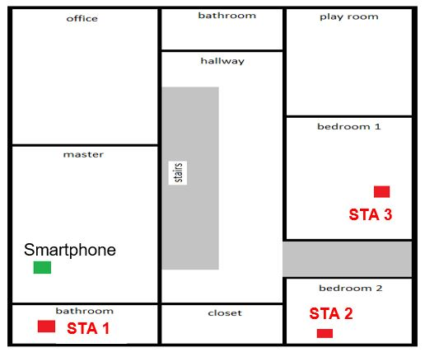
Multiple-device scenarios
When there are multiple STAs involved in a WLAN sensing session:
Sensing initiator: Should only be one device in one sensing session
If multiple devices would like to initiate different sensing procedures, they should be separated into different sensing sessions, instead of combined into one session.
Sensing responder(s): Can be multiple
Sensing transmitter(s): Can be multiple
Sensing receiver(s): Can be multiple
It is shown in [5] that TX and RX STA diversity could improve sensing performance.

Slide 10
Conclusions
In this contribution, we illustrated the fact that devices involved in WLAN sensing can take on different sensing roles.
We proposed definitions related to the different roles a STA can assume in WLAN sensing.

Slide 11
Straw Poll 1
Do you agree with the following definitions?
A sensing procedure allows a STA to perform WLAN sensing and obtain measurement results. A sensing session is an instance of a sensing procedure with the associated scheduling if applicable, and operational parameters of that instance.

Slide 12
Straw Poll 2
Do you agree with the following definitions?
Sensing initiator and sensing responder(s)
Sensing initiator: a STA that initiates a WLAN sensing session
Sensing responder: a STA that participates in a WLAN sensing session initiated by a sensing initiator
Sensing transmitter(s) and sensing receiver(s)
Sensing transmitter: a STA that transmits PPDUs used for sensing measurements in a sensing session
Sensing receiver: a STA that receives PPDUs sent by a sensing transmitter and performs sensing measurements
Note: In a sensing session, there is one sensing initiator, one or more sensing responders, one or more sensing transmitters, and one or more sensing receivers.
Note: A STA can assume multiple roles in one sensing session.

Slide 13
References
[1] 19/1769r1, "CSI-based Wi-Fi Sensing: Results and Standardization Challenges
[2] Wi-Fi sensing: Usages, requirements, technical feasibility and standards gaps, IEEE 802.11-19/1293r0.
[3] Wi-Fi sensing in 60GHz band, IEEE 802.11-19/1551r1.
[4] Usage models for WLAN sensing, IEEE 802.11-19/1725r0.
[5] Wi-Fi sensing: Cooperation and standard support, IEEE 802.11-19/1416r0.
[6] 802.11 sensing: Applications, feasibility, standardization, IEEE 802.11-19/1626r1.

