Slide 1
ML fragmentation
Date: 2020-05-11
Authors:
Name | Affiliations | Address | Phone | Email
Po-Kai Huang | Intel
Ouzieli Ido
Bravo Daniel F
Danny Alexander
Danny Ben-ari
Amir Hitron
Robert Stacey
Laurent Cariou
Notes:
September 2012

Slide 2
Background
ML BA has basically settled down. We discuss how to handle fragmentation in this presentation.

Slide 3
Overview of Existing fragmentation
Rough description of existing fragmentation
  Level 0 (pre 11ax): Without BA, fragmentation based on fragmentation threshold with fixed length except last one. Fragments are sent in order.
  Level 1: With or without BA, allow dynamic length of fragments.
  Level 2: Allow fragment to be aggregated with other MPDUs in A-MPDU.
  Level 3: less interests
Level 0 to Level 2 require fragments to be sent in order

Slide 4
Consideration on Fragmentation
We are not keen to enable fragmentation for MLD in R1 due to the following reasons
  Transfer fragment information across links is considered to be difficult
  In generally, dynamic fragmentation only has performance gain for MU case to fit in the remaining allocated resource, but the gain is not huge in practice
  Baseline fragmentation is used to increase reliability, but low MCS is generally enough to increase reliability
  Refragmentation is hard to do for scenarios of different links and we need additional schemes
We think a capability bit to indicate support of receiving fragmentation from peer MLD will be helpful
We think enable fragmentation between MLDs can be done in R2 due to no strong justification for the gains
We think we should avoid creating additional reasons that force fragmentation in multi-link

Slide 5
Current MPDU length limit may Force Fragmentation
For HE PPDU and (if no change) EHT PPDU , there is a MPDU size difference based on Table 9-25 for 2.4 GHz and 5/6 GHz
  MPDU length limit in 5/6 GHz: 3895, 7991, or 11454
  MPDU length limit in 2.4 GHz: constrained by 3839 or 7935 A-MSDU size limit
If we do A-MSDU fragmentation up to 11k in 5/6 GHz, then retransmit the frame in 2.4 GHz requires fragmentation
  A situation that may force fragmentation or limit usage of different links
If we want to avoid potential fragmentation in 2.4, then aggregation above 7935 is not possible, usefulness of 11k size limit is then gone

Slide 6
Proposal
Between two MLDs, no fragmentation for R1
For a MLD, there should be common MPDU length limit across links link
  Fragmentation is then not forced due to different MPDU length limit
For HE/EHT PPDU, indication is required to indicate maximum MPDU length for HE and EHT PPDU with the following values across links:
  3895, 7991, 11454

Slide 7
Conclusion
We propose the following:
  Have a bit to indicate if MLD supports reception of fragmentation
  Define the functionality of enabling fragmentation between two MLDs in R2
  Have common MPDU length limit across links
  For HE/EHT PPDU, indicating the following values for maximum MPDU length across links:
    3895, 7991, 11454

Slide 8
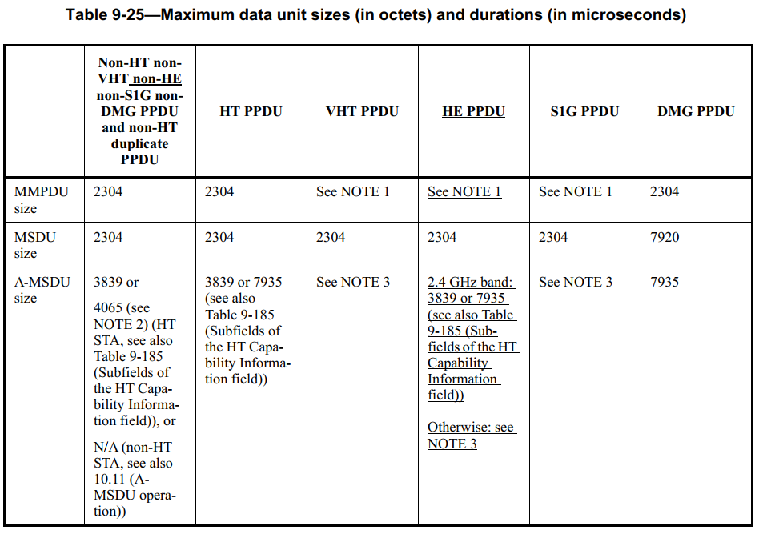
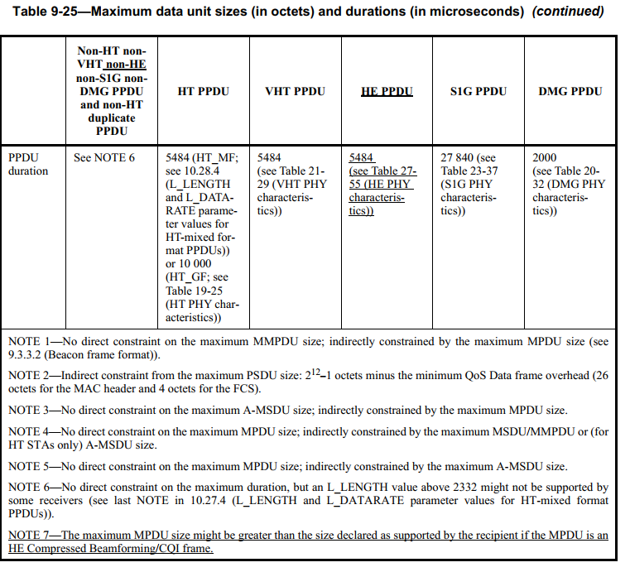
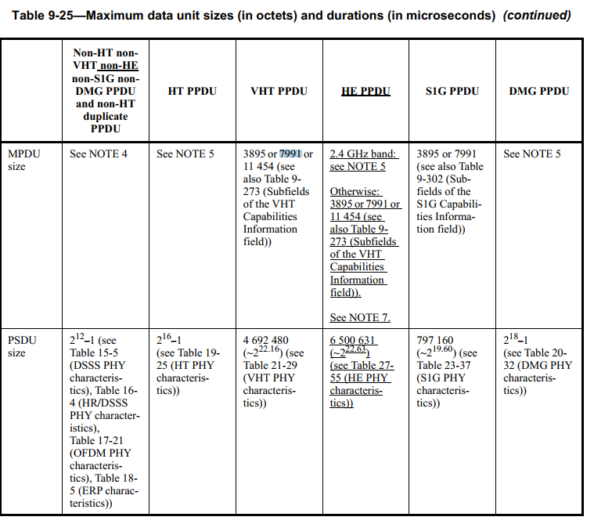
Backup

Slide 9
SP #1
Do you support to add the following to 11be SFD?
  Between 2 MLDs, no fragmentation for R1

Slide 10
SP #2
Do you support to add the following to 11be SFD?
  Each STA in a MLD has common capabilities for the maximum MPDU length, and the capability for the maximum MPDU length of HE and EHT PPDU across links includes the following values?
    3895, 7991, 11454
    Note - Signaling for the indication is TBD

