Slide 1
Indication of Multi-link Information: Follow-up
Date: 2020-05-11
Authors:
Name | Affiliation | Address | Phone | Email
Insun Jang | LG Electronics | 19, Yangjae-daero 11gil, Seocho-gu, Seoul 137-130, Korea |  | insun.jang@lge.com
Jinsoo Choi |  |  |  | js.choi@lge.com
Jeongki Kim |  |  |  | jeongki.kim@lge.com
Taewon Song |  |  |  | taewon.song@lge.com
Namyeong Kim |  |  |  | namyeong.kim@lge.com

Slide 2
Introduction
We have agreed with many parts for multi-link (ML) discovery and setup [1], e.g.,
Single ML Setup on a link
Providing partial (basic) or complete information of links through RNR and/or ML element during ML discovery and setup
Reusing existing frames (e.g., Probe Req./Rep., Beacon, Association Req./Rep.)
In this contribution, we first clarify the set of links and then discuss the indication of ML information to enable ML setup

Slide 3
Clarification on Set of Links
Set of Setup links
Set of links Non-AP MLD setups with AP MLD
Non-AP MLD may not need to setup with some APs of AP MLD (e.g., not capable, bad quality)
Set of Enabled links* [1]
Set of links Non-AP MLD actually operates (exchanges frames) with AP MLD
All setup STAs of non-AP MLD may not be able to operate on all of setup links at a time
*A link, that is setup as part of a multi-link setup, is defined as Enabled if that link can be used for frame exchange and at least one TID is mapped to that link

Slide 4
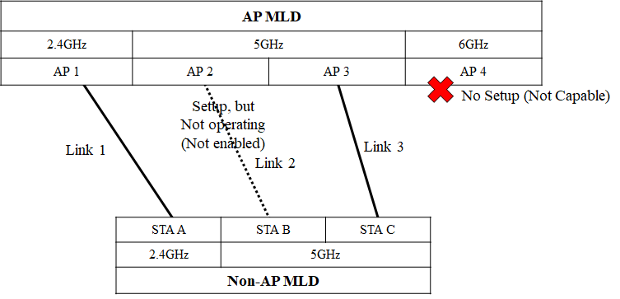
Example
Set of Setup links: {Link 1, 2, 3}
Set of Enabled links: {Link 1, 3}

Slide 5
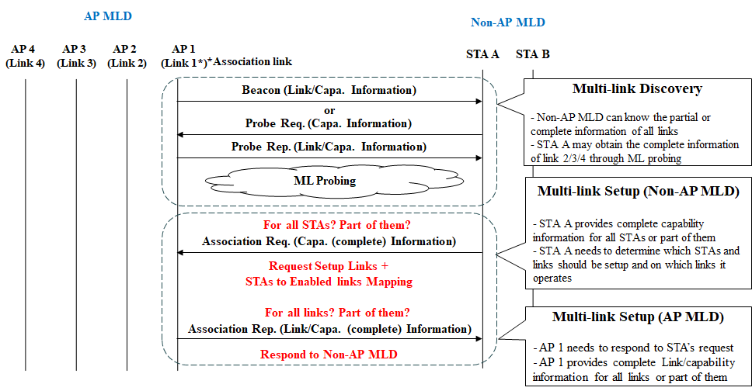
ML Discovery and Setup
NOTE: Authentication procedure is omitted

Slide 6
Association Request for MLD
In the MLD context, an STA of non-AP MLD would transmit the following information in addition to existing IEs
1) Complete information of other STAs of non-AP MLD in ML Element
2) Set of (Preferred) links to be ML Setup (maybe removed)
3) STA-to-Enabled link Mapping
Which STA will be operating on which link
2), 3) may be included in ML Element
Complete information of other STAs of non-AP MLD in ML IE
Option 1 (Explicit): indicates the complete information of All of other STAs (regardless of setup) + Indication
Option 2 (Implicit): indicates the complete information of affiliated non-AP STAs corresponding to the links requested for setup => Preferred option due to the signaling overhead
STA-to-Enabled link Mapping (e.g., Link ID)
TID-to-link mapping can indicate enabled links; however, doesn’t indicate that which non-AP STA will be operating on which link after ML setup

Slide 7
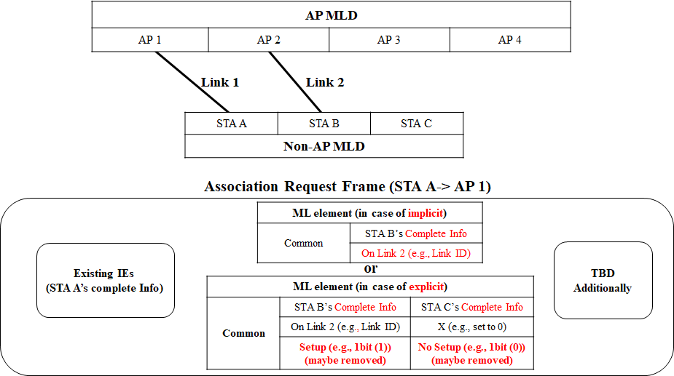
Association Request for MLD: Example

Slide 8
Association Response for MLD
An AP of AP MLD receiving would transmit the complete information of Setup links in addition to existing IEs if the AP MLD accepts the Association Request
Complete information of other APs of AP MLD in ML element
According to Status Code, additional information (e.g., modifications to setup) may be included
In MLD context, some status codes may be newly defined
Complete information of other APs of AP MLD in ML Element
Option 1 (Explicit): indicates the complete information of all APs/links (regardless of setup) + Indication
Option 2 (Implicit): indicates the complete information of each affiliated AP corresponding to the link that is accepted by the AP MLD and requested by the non-AP MLD
We prefer Option 2 since Option 1 has higher signaling overhead

Slide 9
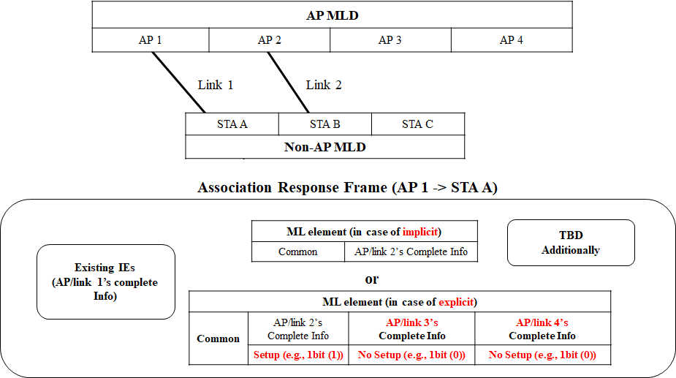
Association Response for MLD: Example

Slide 10
Summary
In this contribution, we clarified the set of links, i.e., Set of Setup links, and Set of Enabled links
Also, we discussed the indication of ML information to enable ML setup. Specifically,
In Association Request frame, the following information can be included
Complete information of affiliated non-AP STAs corresponding to the links requested for setup in ML Element
Set of (Preferred) links to be ML Setup (maybe removed)
STA-to-Enabled link Mapping (e.g., Link ID)
In Association Response frame, the following information can be included, when an AP MLD accepts the association request of a non-AP MLD
Complete information of each affiliated AP corresponding to the link that is accepted by the AP MLD and requested by the non-AP MLD in ML element

Slide 11
SP #1
Do you support to add to the 11be SFD in R1 that a non-AP MLD may initiate multi-link setup with an AP MLD to setup more than one link with subset of APs affiliated with the AP MLD?
Y/N/A: 48/7/15 (Passed)

Slide 12
SP #2
Do you support to add to the 11be SFD in R1 that during multi-link setup a non-AP MLD includes, in a multi-link element included in Association Request frame, the complete information of affiliated non-AP STAs corresponding to the links requested for setup?
Y/N/A

Slide 13
SP #3
Do you support to add to the 11be SFD in R1 that during multi-link setup, when an AP MLD accepts the association request of a non-AP MLD, the AP MLD provides, in a multi-link element included in Association Response frame, the complete information of affiliated APs corresponding to the links that are accepted by the AP MLD and requested by the non-AP MLD?
Y/N/A

Slide 14
SP #4
Do you support to add to the 11be SFD in R1 that during multi-link setup a non-AP MLD includes a Link ID in each STA profile subelement of a multi-link element included in Association Request frame?
Link ID is used to identify the link on which non-AP STAs corresponding to the STA profile subelements will be operating after multi-link setup
NOTE: Link ID is the same as the non-AP MLD obtains from the associated AP MLD during the discovery before multi-link setup
Y/N/A

Slide 15
References
[1] 802.11-19/1262r11 Specification Framework for TGbe

Slide 16
Related Motions #1
802.11be defines a directional-based TID-to-link mapping mechanism among the setup links of a MLD.
By default, after the multi-link setup, all TIDs are mapped to all setup links.
The multi-link setup may include the TID-to-link mapping negotiation.
TID-to-link mapping can have the same or different link-set for each TID unless a non-AP MLD indicates that it requires to use the same link-set for all TIDs during the multi-link setup phase
NOTE – Such indication method by the non-AP MLD is TBD (implicit or explicit).
The TID-to-link mapping can be updated after multi-link setup through a negotiation, which can be initiated by any MLD.
Format TBD
NOTE – When the responding MLD cannot accept the update, it can reject the TID-to-link mapping update
At any point in time, a TID shall always be mapped to at least one link that is set up, unless admission control is used

Slide 17
Related Motions #2
A link, that is setup as part of a multi-link setup, is defined as Enabled if that link can be used for frame exchange and at least one TID is mapped to that link
If a TID is mapped in UL to a set of enabled links for a non-AP MLD, then the non-AP MLD can use any link within this set of enabled links to transmit data frames from that TID.
If a TID is mapped in DL to a set of enabled links for a non-AP MLD, then:
The non-AP MLD can retrieve buffered BUs corresponding to that TID on any links within this set of enabled links.
The AP MLD can use any link within this set of enabled links to transmit data frames from that TID, subject to existing restrictions for transmissions of frames that apply to those enabled links.
An example of restriction is if the STA is in doze state.

