Slide 1
Further discussion on RU allocation subfield in EHT-SIG
Date: 2020-04-16
Authors:
Name | Affiliations | Address | Phone | email
Ross Jian Yu | Huawei |  |  | ross.yujian@huawei.com
Mengshi Hu | Huawei
Ming Gan | Huawei
Oded Redlich | Huawei
Shimi Shilo | Huawei
Genadiy Tsodik | Huawei

Slide 2
Introduction and recap
Several contributions have talked about MRU indication using RU allocation subfield in EHT-SIG:
https://mentor.ieee.org/802.11/dcn/20/11-20-0578-00-00be-on-ru-allocation-singling-in-eht-sig.pptx (Jianhan Liu, Mediatek)
https://mentor.ieee.org/802.11/dcn/20/11-20-0373-01-00be-ru-allocation-subfield-design-for-multi-ru-support.pptx (Myeongjin Kim, Samsung)
https://mentor.ieee.org/802.11/dcn/20/11-20-0403-00-00be-signaling-of-multiple-ru-aggregation-in-ofdma.pptx (Dongguk Lim, LGE)
https://mentor.ieee.org/802.11/dcn/20/11-20-0400-00-00be-multi-ru-combination-and-signaling-for-ofdma-transmission.pptx (Mengshi Hu, Huawei)
The contributions have merged a solution to use an enhanced table for RU allocation for both single RU and multi-RU.
This contribution further discusses several aspects regarding the detailed signaling, and talks about the pro and con.

Slide 3
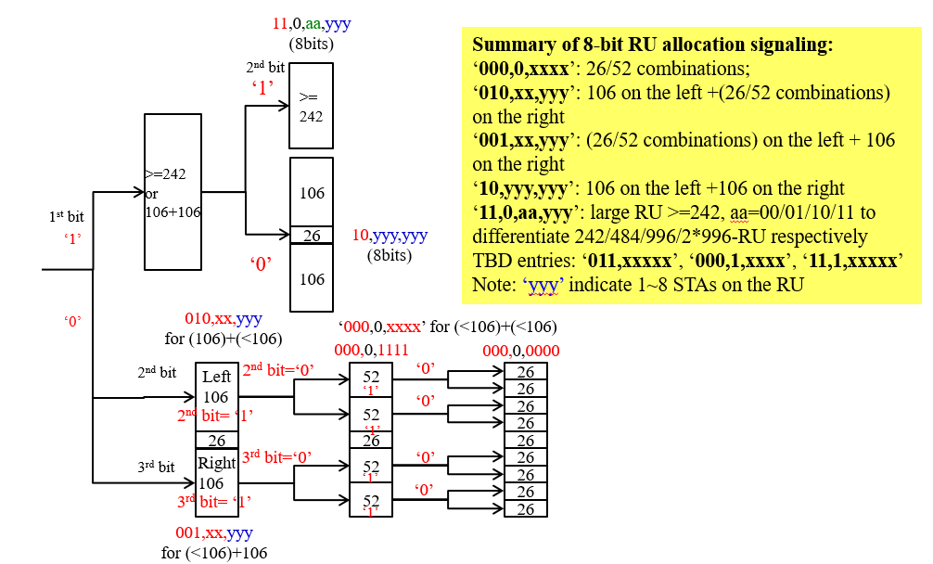
Recap of 11ax RU allocation subfield
The RU allocation subfield in 11ax spec is an 8-bit look-up table. Whilst it can also be indicated through Hierarchical Indication RU allocation signaling without referring to a 8-bit look-up table (15-1335r2)
52 reserved entries so far

Slide 4
Feasibility of an 8-bit table for 11be
There was concern about an even bigger RU allocation table for 11be. This proposal wants to discuss the feasibility of an 8-bit table also for 11be.
Several aspects are considered:
MU-MIMO support for small and big single RU/MRU respectively
Number of entries needed if MU-MIMO is supported for MRU
An high efficient way to support MU-MIMO for big MRU

Slide 5
MU-MIMO support for single RU
For single RU, the number of entries needed for different size are shown below:
Considering the applicable scenario, the entries overhead and the benefits, it is proposed to keep 106-tone RU with up to 8 entries.
Single RU size | Number of entries needed
 | MU-MIMO with 8 entries | MU-MIMO with 16 entries | Gap
106 | 10*8 | 10*16 | 80
106+26+106 | 64 | 256 | 192
242, 484, 996, | 3*8 | 3*16 | 24
2*996 | 8 | 16 | 8
106 - 106 | Support up to 4 users per 106 so far to reduce number of entries, not considered to expand so far

Slide 6
MU-MIMO support for single RU
For large RUs that are larger than 242-tone RU, two ways can be used for supporting up to 16 MU-MIMO users
Opt1: 8 entries per RU allocation subfield: as 11ax, the number of MU-MIMO users is the sum of the user fields indicated in two RU allocation subfields within two CCs, for example:
RU allocation subfield 1 indicates 484 (6) in CC1 and RU allocation subfield 2 indicates 484 (7) in CC2. The number of MU-MIMO users is 13 in the 484-tone RU.
Pro: fewer number of entries needed
Con: cannot support more than 8 MU-MIMO users for 242-tone RU; cannot support full flexibility regarding EHT-SIG CC load balance.
Opt2: 16 entries per RU allocation subfield
Pro: can support more than 8 MU-MIMO users for 242-tone RU, full flexibility regarding EHT-SIG CC load balance
Con: larger number of entries needed
Considering the applicable scenario, the entries overhead and the benefits, it is preferred to have 8 entries (up to 16 users) for RUs that are larger than 242-tone RU. 242-tone RU case is open for discussion.

Slide 7
MU-MIMO support for small MRU
For small MRUs, the number of entries needed for MRU are shown as follows:
Considering the applicable scenario, the entries overhead and the benefits, it is preferred to not support MU-MIMO for small RU when small MRU exists within one 242-tone RU.
MRU size | Number of entries needed
 | without MU-MIMO in both single RU and MRU | MU-MIMO with 8 entries | MU-MIMO with 16 entries
52+26 | 8 | 8 | 8
52+26 and 52+26 | 1 | 1 | 1
52+26 and 106 | 2 | 16 | 32
52+26 and 106+26 | 2 | 16 | 32
106+26 | 8 | 64 | 128
106+26 and 106 | 2 | 128 | 512
Total | 23 | 233 | 713

Slide 8
RU allocation subfield Entries for Small MRU
RU Allocation subfield ( B7 B6 B5 B4 B3 B2 B1 B0) | #1 | #2 | #3 | #4 | #5 | #6 | #7 | #8 | #9 | Number of entries
232 | 26 | 26 | 26 | 26 | 26 | 52+26 multi-RU |  |  | 26 | 1
233 | 26 | 26+52 multi-RU |  |  | 26 | 26 | 26 | 26 | 26 | 1
234 | 26 | 26+52 multi-RU |  |  | 26 | 26 | 26 | 52 |  | 1
235 | 26 | 26+52 multi-RU |  |  | 26 | 52 |  | 26 | 26 | 1
236 | 26 | 26 | 52 |  | 26 | 52+26 multi-RU |  |  | 26 | 1
237 | 26 | 26+52 multi-RU |  |  | 26 | 52+26 multi-RU |  |  | 26 | 1
238 | 26 | 26 | 52 |  | 26 | 52 |  | 52 |  | 1
239 | 26 | 26+52 multi-RU |  |  | 26 | 52 |  | 52 |  | 1
240 | 52 |  | 26 | 26 | 26 | 52+26 multi-RU |  |  | 26 | 1
241 | 52 |  | 52 |  | 26 | 52+26 multi-RU |  |  | 26 | 1
242 | 26 | 26 | 26 | 26 | 26+106 multi-RU |  |  |  |  | 1
243 | 26 | 26+52 multi-RU |  |  | 26 | 106 |  |  |  | 1
244 | 26 | 26 | 52 |  | 26+106 multi-RU |  |  |  |  | 1
245 | 26 | 26+52 multi-RU |  |  | 26+106 multi-RU |  |  |  |  | 1
246 | 52 |  | 26 | 26 | 26 | 106 |  |  |  | 1
247 | 52 |  | 26 | 26 | 26+106 multi-RU |  |  |  |  | 1
248 | 52 |  | 52 |  | 26+106 multi-RU |  |  |  |  | 1
249 | 106+26 multi-RU |  |  |  |  | 26 | 26 | 26 | 26 | 1
250 | 106+26 multi-RU |  |  |  |  | 26 | 26 | 52 |  | 1
251 | 106+26 multi-RU |  |  |  |  | 52 |  | 26 | 26 | 1
252 | 106 |  |  |  | 26 | 26+52 multi-RU |  |  | 26 | 1
253 | 106+26 multi-RU |  |  |  |  | 26+52 multi-RU |  |  | 26 | 1
254 | 106+26 multi-RU |  |  |  |  | 52 |  | 52 |  | 1
23 entries in total

Slide 9
MU-MIMO support for large MRU
For large MRUs, the number of entries needed for MRU are shown as follows if assuming the exact MRU combinations can be indicated through a single RU allocation subfield:
MU-MIMO support can be more useful for large MRU compared with small MRU. It is preferred to support MU-MIMO for large MRU. Whilst the overhead is pretty big, which would lead to a larger table.
MRU size (OFDMA case) | Number of entries needed
 | without MU-MIMO in both single RU and MRU | MU-MIMO with 9 entries (including zero user fields) | MU-MIMO with 17 entries (including zero user fields)
242+484 | 4 | 36 | 68
484+996 | 4 | 36 | 68
3*996 | 4 | 36 | 68
Total | 12 | 108 | 204

Slide 10
Large MRU indication with 9 entries
108 or 204 entries are consumed by large RU combinations shown in the previous slide assuming one RU allocation subfield itself is enough for the exact location of MRU.
An alternative way for large MRU indication was introduced in 400r0, which needs only 9 or 17 entries, only 1/12 overhead of the above cases.
113 | 242-tone RU empty (with zero users) | 1
114 | 484-tone RU; contributes zero User fields to the User Specific field in the same EHT-SIG content channel as this RU Allocation subfield | 1
115 | 996-tone RU; contributes zero User fields to the User Specific field in the same EHT-SIG content channel as this RU Allocation subfield | 1
116 | 2*996-tone RU; contributes zero User fields to the User Specific field in the same EHT-SIG content channel as this RU Allocation subfield | 1
117 | Belongs to an MRU; contributes zero User fields to the User Specific field in the same EHT-SIG content channel as this RU Allocation subfield | 1
192-199 | 242 | 8
200-207 | 484 | 8
208-215 | 996 | 8
216-223 | 2*996 | 8
224-231 | Belongs to an MRU; contributes 1~8 User fields to the User Specific field in the same EHT-SIG content channel as this RU Allocation subfield | 8
9 new entries for single RU 2*996
9 new entries for MRU

Slide 11
Large MRU indication with 9 entries
The RU allocation subfields fall within any MRU combinations in an OFDMA transmission shall be set to one of the 9 values.
The Rx knows the location and size of the MRU by counting all the RU allocation subfields with the 9 values.
113 | 242-tone RU empty (with zero users) | 1
114 | 484-tone RU; contributes zero User fields to the User Specific field in the same EHT-SIG content channel as this RU Allocation subfield | 1
115 | 996-tone RU; contributes zero User fields to the User Specific field in the same EHT-SIG content channel as this RU Allocation subfield | 1
116 | 2*996-tone RU; contributes zero User fields to the User Specific field in the same EHT-SIG content channel as this RU Allocation subfield | 1
117 | Belongs to an MRU; contributes zero User fields to the User Specific field in the same EHT-SIG content channel as this RU Allocation subfield | 1
192-199 | 242 | 8
200-207 | 484 | 8
208-215 | 996 | 8
216-223 | 2*996 | 8
224-231 | Belongs to an MRU; contributes 1~8 User fields to the User Specific field in the same EHT-SIG content channel as this RU Allocation subfield | 8
11 reserved entries left: 118-119, 120-127, 255

Slide 12
Some Examples
N(x) to indicate the newly added entries with x user fields. Different colors mean different combinations for large RU.
After Reading all the RU allocation subfields of the same color, the STA knows the RUs of the same color are assigned
484+996 has to be within one 160Mhz boundary
242+484 has to be within one 80MHz boundary
2 MU-MIMO users
1 user
Example A
Enhanced RU
allocation subfields
CC1 | else | N(1) | N(0) | N(0) | else | N(0) | else | else
CC2 | else | N(1) | N(0) | N(0) | N(1) | N(0) | else | else
2 MU-MIMO users
1 user
1 user
Example B
CC1 | else | N(1) | N(0) | N(0) | N(1) | N(0) | N(0) | N(0)
CC2 | else | N(1) | N(0) | N(0) | else | N(0) | N(1) | else

Slide 13
Summary
Feasibility of an 8-bit table for 11be is proved in this proposal.
52 reserved entries in 11ax. Among them, 23 are used for small MRU, 9 for 2*996 single RU, 9 for large MRU. 11 reserved entries are for other purposes.
The proposal analyzes the tradeoff between supporting MU-MIMO for different RU sizes. The proposed method enables MU-MIMO for MRU with only 9 few entries.

Slide 14
Straw Poll #1
Do you agree to use an RU allocation subfield in the common field of an EHT-SIG for single RU and multi-RU indication in a PPDU sent to multiple users for a DL OFDMA transmission?
Yes/No/Abstain

Slide 15
Straw Poll #2
Do you agree that when MRU exists within a 242-tone RU range, MU-MIMO shall not be supported within the 242-tone RU range?

Slide 16
Straw Poll #3
Do you agree that when no MRU exists within a 242-tone RU range, if there exists one or two 106-tone RU within the 242-tone RU range, up to 8 MU-MIMO users is supported within one 106-tone RU?
Yes/No/Abstain

Slide 17
Straw Poll #4
Do you agree that for RU484 or RU996, in the RU allocation table, 9 entries per RU size will be used to indicate: contributes 0~8 User fields to the User Specific field in the same EHT-SIG content channel as this RU Allocation subfield?
Yes/No/Abstain

Slide 18
Straw Poll #5
Do you agree that for RU 2*996, in the RU allocation table, 9 entries per RU size will be used to indicate: contributes 0~8 User fields to the User Specific field in the same EHT-SIG content channel as this RU Allocation subfield?
Yes/No/Abstain

Slide 19
Straw Poll #6
Do you agree that for RU242, in the RU allocation table, 9 entries per RU size will be used to indicate: contributes 0~8 User fields to the User Specific field in the same EHT-SIG content channel as this RU Allocation subfield?
Yes/No/Abstain

Slide 20
Straw Poll #7
Do you agree that for large multi-RU, 9 entries will be used to indicate: belongs to an MRU, contributes 0~8 User fields to the User Specific field in the same EHT-SIG content channel as this RU Allocation subfield?
Yes/No/Abstain

Slide 21
Straw Poll #8
Do you agree that one RU allocation subfield is 8 bit in the common field of an EHT-SIG for single RU and multi-RU indication in a DL OFDMA transmission?
Yes/No/Abstain

Slide 22
References
https://mentor.ieee.org/802.11/dcn/20/11-20-0578-00-00be-on-ru-allocation-singling-in-eht-sig.pptx (Jianhan Liu, Mediatek)
https://mentor.ieee.org/802.11/dcn/20/11-20-0373-01-00be-ru-allocation-subfield-design-for-multi-ru-support.pptx (Myeongjin Kim, Samsung)
https://mentor.ieee.org/802.11/dcn/20/11-20-0403-00-00be-signaling-of-multiple-ru-aggregation-in-ofdma.pptx (Dongguk Lim, LGE)
https://mentor.ieee.org/802.11/dcn/20/11-20-0400-00-00be-multi-ru-combination-and-signaling-for-ofdma-transmission.pptx (Mengshi Hu, Huawei)
https://mentor.ieee.org/802.11/dcn/15/11-15-1335-02-00ax-he-sig-b-contents.pptx (Le Liu, Huawei)

