Slide 1
Coordinated Spatial Reuse: Focus on Downlink
Date: 2020-05-07
Authors:

Slide 2
Recap: Coordinated SR (C-SR)
C-SR is a simple Multi-AP coordination scheme that can increase spectrum efficiency by reusing the same time/frequency resources among multiple BSSs
C-SR procedure
C-SR procedure with unsolicited method [1]
General C-SR procedure [2]
C-SR performance gain
Compared to OBSS-PD and TDD [3]
Compared to EDCA and complete control [4]
Compared to C-OFDMA and OBSS-PD [5]
In this contribution, we divide the downlink (DL) C-SR procedure into 3 phases and investigate several issues of C-SR operation

Slide 3
Issue 1: C-SR Coordination Policy
AP
STA
[Option 1]
DL TX
C-SR gain comes from appropriate Tx power management
Option 1: bi-directional coordination
Sharing AP and shared AP negotiate the appropriate Tx power combination
Could be better in terms of sum throughput
Additional signaling overhead
Option 2: one-way coordination (Preferred)
Sharing AP determines Tx power without a coordination process and limits the Tx power of shared AP to protect transmissions of sharing AP
Sharing AP does not need to sacrifice its performance
Less overhead
Sharing AP
Shared AP
Negotiated power
Negotiated power
Enough power
Sharing AP
Shared AP
Less power
[Option 2]

Slide 4
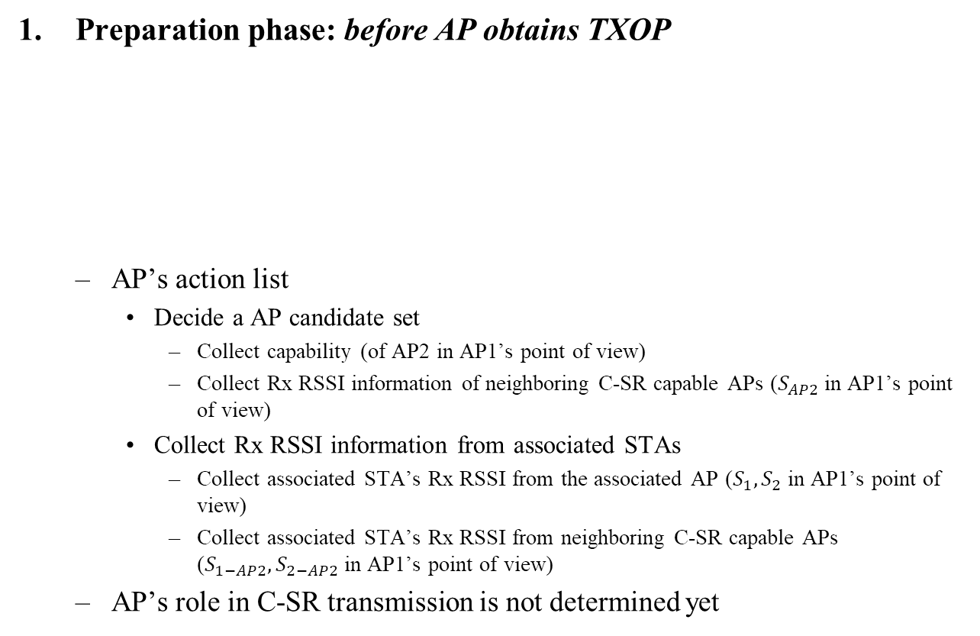
C-SR Procedure into 3 Phases
Preparation phase: before AP obtains TXOP
AP’s action list
Decide a AP candidate set
Collect capability (of AP2 in AP1’s point of view)
Collect Rx RSSI information of neighboring C-SR capable APs ($S_{AP2}$ in AP1’s point of view)
Collect Rx RSSI information from associated STAs
Collect associated STA’s Rx RSSI from the associated AP ($S_{1},S_{2}$ in AP1’s point of view)
Collect associated STA’s Rx RSSI from neighboring C-SR capable APs ($S_{1−AP2},S_{2−AP2}$ in AP1’s point of view)
AP’s role in C-SR transmission is not determined yet
1
$$S_{1}$$
$$S_{1−AP2}$$
3
AP
AP1
$$S_{AP2}$$
AP2
STA
$$S_{2}$$
$$S_{2−AP2}$$
Signal
2
4

Slide 5
C-SR Procedure into 3 Phases
Announcement phase: after AP obtains TXOP
If the AP is willing to share the obtained TXOP, it becomes a sharing AP
Sharing AP’s action list
Select the shared AP from the AP candidate set
Considering DL STA’s SINR of sharing AP
Trigger the shared AP’s transmission using announcement frame
Essential information: AP ID, Tx power limit
Transmission phase: after the potential shared AP obtains the shared TXOP
If an AP receives the announcement frame successfully and is willing to participate in the C-SR transmission, the AP becomes a shared AP
Shared AP’s action list
Set Tx power based on the guide obtained from the announcement frame
C-SR transmissions (including block acknowledgement) of the sharing/shared APs occur simultaneously in the shared TXOP
Assumption: start/end time of C-SR transmissions are aligned

Slide 6
C-SR Procedure Example: 2-BSS DL/DL
AP1 obtains TXOP → sharing AP
AP2 obtains the shared TXOP → shared AP
Collecting
Capability/RSSI
AP1
C-SR-A
DL MU
BA
STA1-1
Collecting
Measurement
Report
BA
STA1-2
DL MU
AP2
BA
STA2-1
BA
STA2-2
Preparation Phase
Announcement Phase
Transmission Phase
* C-SR-A: C-SR announcement frame

Slide 7
Issue 2: Contents of Announcement Frame
Function of Announcement frame
Indicating the start of C-SR procedure
Medium reservation (Setting NAV)
Soliciting transmission of shared AP(s)
Essential contents of announcement frame
Common info
Multi-AP coordination type (C-SR)
Duration of C-SR procedure triggered by announcement frame
Per-AP info for each shared AP
AP identifier
Tx power limit of the shared AP
Non-overlapping frequency resource allocation for block acknowledgement info (to be explained in the following slides)

Slide 8
Issue 3: Block Acknowledgement (BA) Separation
Problem
BA transmissions of STAs simultaneously occur in the shared TXOP
Shared AP may transmit DL MU PPDU in the shared TXOP
Tx power limit applies to shared AP’s transmission
Options for BA separation
[Option 1] Non-overlapping resources for BA (preferred)
Allocate non-overlapping frequency resources for BAs of sharing/shared BSS*
Non-overlapping frequency resource allocation for BA is determined by the sharing AP and included in the announcement frame
Pros: less time overhead
Cons: non-overlapping resource allocation required, UL power control required
[Option 2] Implicit BA for sharing BSS, and delayed BA for shared BSS
Pros: simple
Cons: time overhead
* Sharing BSS: BSS that sharing AP belongs to * Shared BSS: BSS that shared AP belongs to

Slide 9
Issue 3: Block Acknowledgement (BA) Separation
[Option 1] Non-overlapping resources for BA in detail
Two-level BA separation
Level 1: BA separation among sharing/shared APs
E.g. upper 40MHz for sharing AP, lower 40MHz for shared AP
Level 2: BA separation between DL STAs in each BSS (DL MU PPDU case)
STAs send the immediate response according to the resource allocation information that is carried in the TRS control subfield
frequency
C-SR Transmission of sharing AP (DL MU PPDU)
BA of STA1
BA of STA2
3
80MHz
SIFS
Shared AP
same 80MHz
1
frequency
time
C-SR Transmission of shared AP (DL MU PPDU)
Sharing AP
4
80MHz
BA of STA3
BA of STA4
2
time

Slide 10
Summary
We divide C-SR procedure into 3 phases according to TXOP acquisition status of sharing/shared AP and investigate the list of things to do in each phase
We believe that one-way coordination is an appropriate policy to manage the Tx power of sharing/shared AP in C-SR operation
We propose two options for BA separation

Slide 11
Reference
[1] 802.11-20/0410r4 “Coordinated Spatial Reuse Procedure”, Sungjin Park
[2] 802.11-20/0576r1 “Coordinated Spatial Reuse Protocol”, Yongho Seok
[3] 802.11-20/0457r1 “Discussion on Coordinated Spatial Reuse Operation”, Kosuke Aio
[4] 802.11-20/0107r1 “Multi-AP coordination for spatial reuse”, Dmitry Akhmetov
[5] 802.11-20/0073r0 “On Coordinated Spatial Reuse in 11be”, Jianhan Liu

Slide 12
Straw Poll #1
Do you agree that in 11be sharing AP can limit the shared AP’s transmission power during the shared TXOP for C-SR operation?

Slide 13
Straw Poll #2
Do you agree that in 11be sharing AP allocates non-overlapping frequency resources of block acknowledgements for each sharing AP and shared AP(s) for C-SR operation?
Allocating non-overlapping frequency resource shall be determined by sharing AP
The way of indicating non-overlapping frequency resources for block acknowledgement is TBD

