Slide 1
RTS and CTS Procedure in
Synchronous Multi-link Operation
Date: 2020-07-27
Authors:

Slide 2
Recap: Constrained Multi-Link Device (MLD)
A Constrained MLD is a MLD with which in-device coexistence (IDC) interference occurs when more than one STA within the MLD simultaneously transmits and receives frames on multiple links.
  When simultaneous Tx and Rx occur on 2.4 GHz band and 5 GHz links, the IDC interference is probably negligible.
  But, the IDC interference caused by simultaneous Tx and Rx on 5 GHz band and 6 GHz band links may be significantly worse depending on some implementation factors such as RF filter performance.

Slide 3
Recap: Constrained Multi-Link Device (MLD)
Synchronization requirement [1]
  A difference between the ending times of PPDU transmissions shall be less than SIFS - (10%×aSlotTime).
    Because a minimum inter-frame space is not less than SIFS, Tx and Rx are not overlapped.
      A margin of 10%×aSlotTime considers the SIFS accuracy of the IEEE 802.11-2016 spec.
Difference between the ending times of the transmissions is less than
SIFS - (10%×aSlotTime).
AP
Data
MAC Padding
PHY Padding
PE
6GHz
STA
SIFS
Ack
MAC Padding
PHY Padding
PE
AP
Data
MAC Padding
PHY Padding
PE
5GHz
STA
SIFS
Block Ack

Slide 4
RTS and CTS procedure for DL Synchronous MLO
When an AP MLD initiates a TXOP on multiple links with the RTS and CTS frames in a non-HT (duplicated) PPDU format, the ending time alignment of the transmissions may not be possible.
  Because the non-HT (duplicated) PPDU does not support any MAC padding mechanism.
AP
RTS
6GHz
STA
No CTS
Interference
leakage
AP
RTS
A-MPDU
5GHz
STA
SIFS
CTS

Slide 5
RTS and CTS procedure for DL Synchronous MLO
The solution is to use the MU-RTS and CTS frames, where the MU-RTS frame has the Padding field.
  The Padding field in the first MU-RTS frame is used to meet the ending times requirement. So, the CTS response of the first MU-RTS frame is delayed until the second RTS/MU-RTS frame on other link is received.
AP
RTS/MU-RTS
A-MPDU
6GHz
STA
SIFS
CTS
AP
MU-RTS
Padding
A-MPDU
5GHz
STA
SIFS
CTS

Slide 6
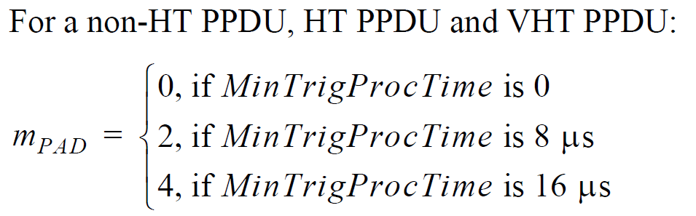
RTS and CTS procedure for DL Synchronous MLO
The solution is to use the MU-RTS and CTS frames, where the MU-RTS frame has the Padding field.
  In 11ax, the Padding field supports only 8 μs and 16 μs which is based on the MinTrigProcTime indicated by the non-AP STA.
  When the Padding field is used to meet the ending times requirement, the Padding field should support other combination (e.g., 4 μs etc).

Slide 7
RTS and CTS procedure for DL Synchronous MLO
Simulation Setup
  Topology
    1 EHT AP and 1 EHT STA.
    The distance between AP and STA is 10m.
  Parameters:
    Each UDP packet is 1460B. Each UDP packet burst is 14.6KB (10 UDP packets).
    PPDU time is 5.484ms for MCS9 (390Mbps) and 3ms for MCS2 (87.8Mbps).

Slide 8
RTS and CTS procedure for DL Synchronous MLO
Simulation Setup
  EHT AP Mode
    MPC: Multiple Primary Channel (It supports the STR).
  EHT STA Mode
    Single Link.
    AP not aligned: No ending time alignment.
    AP aligned: The ending times of PPDUs carrying Data frames are aligned.
    AP/RTS aligned: Besides the ending times of PPDUs carrying Data frames are aligned, the ending times of PPDUs carrying RTS and CTS frames are aligned.

Slide 9
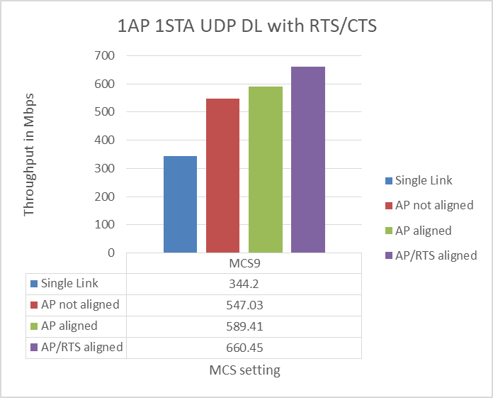
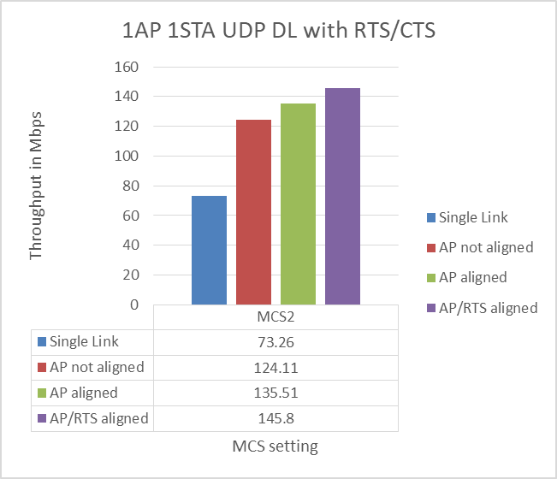
RTS and CTS procedure for DL Synchronous MLO
Simulation Results

Slide 10
Conclusion
When the AP MLD simultaneously transmits frames on multiple links to the constrained MLD, the ending time alignment of the DL transmissions always provides the best performance.
  The MU-RTS frame with has the Padding field can support the ending time alignment for the RTS and CTS procedure.

Slide 11
References
[1] https://mentor.ieee.org/802.11/dcn/19/11-19-1305-00-00be-synchronous-multi-link-operation.pptx

Slide 12
Straw Poll 1
Do you support that APs affiliated to an AP MLD that simultaneously transmit the Trigger frames (e.g., MU-RTS) in the non-HT (duplicate) PPDU format may reuse the Padding field to follow the ending times requirement of the PPDUs carrying Trigger frames?

