Slide 1
Preamble Puncturing for PPDUs Transmitted to Multiple STAs
Date: 2020-03-15
Authors:

Slide 2
Outline
Recap
Channel utilization improvement
Suggested options
Conclusions
SPs

Slide 3
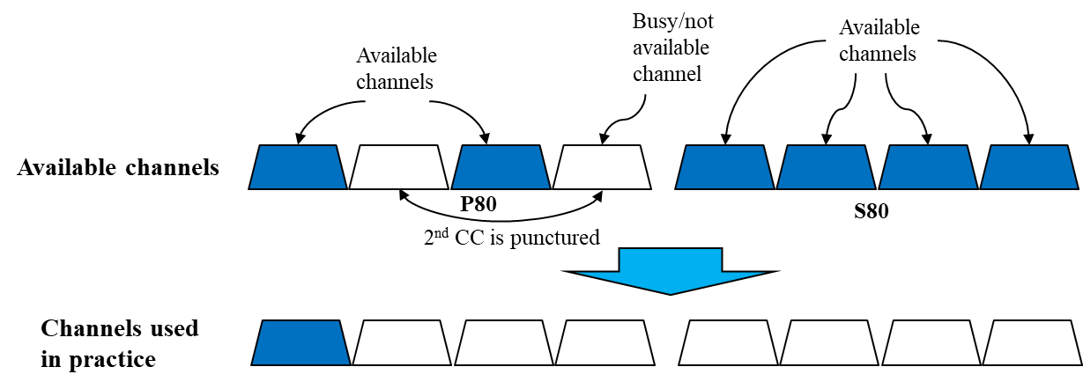
Recap: Preamble Puncturing in 11ax
  Reminder to 802.11ax puncturing:
    Puncturing indication exists for P80 only
  If within P80 only the 40MHz BW corresponding to the content-channel that includes P20 is available, the BW is reduced to 20MHz

Slide 4
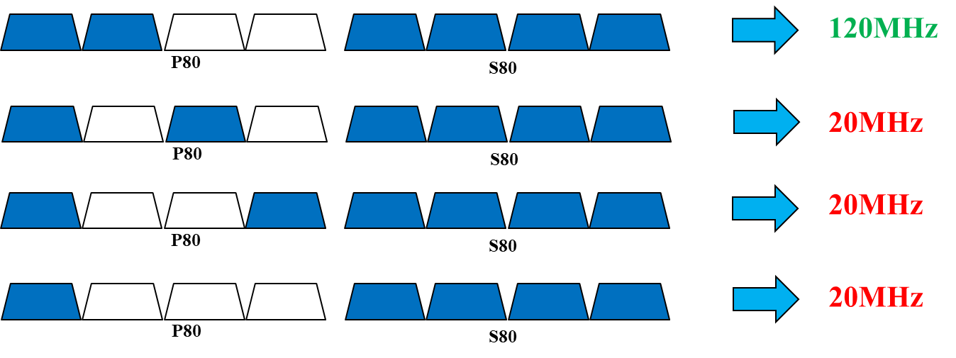
Recap: Preamble Puncturing in 11ax
  Moreover, referring to the figure below and assuming PPDU transmitted to multiple STAs: we see that in scenario 1 40MHz in P80 are available and at the same time any non-punctured 20MHz sub-channel in S80 may be used (BW field =‘111’)
  However in the other scenarios although 40MHz (scenarios 2-3) or 20MHz (scenario 4) in P80 are available as well, S80 is not.
  In other words: if we support scenario #1 below, why won’t we support scenarios 2-4 as well?
1
2
3
4

Slide 5
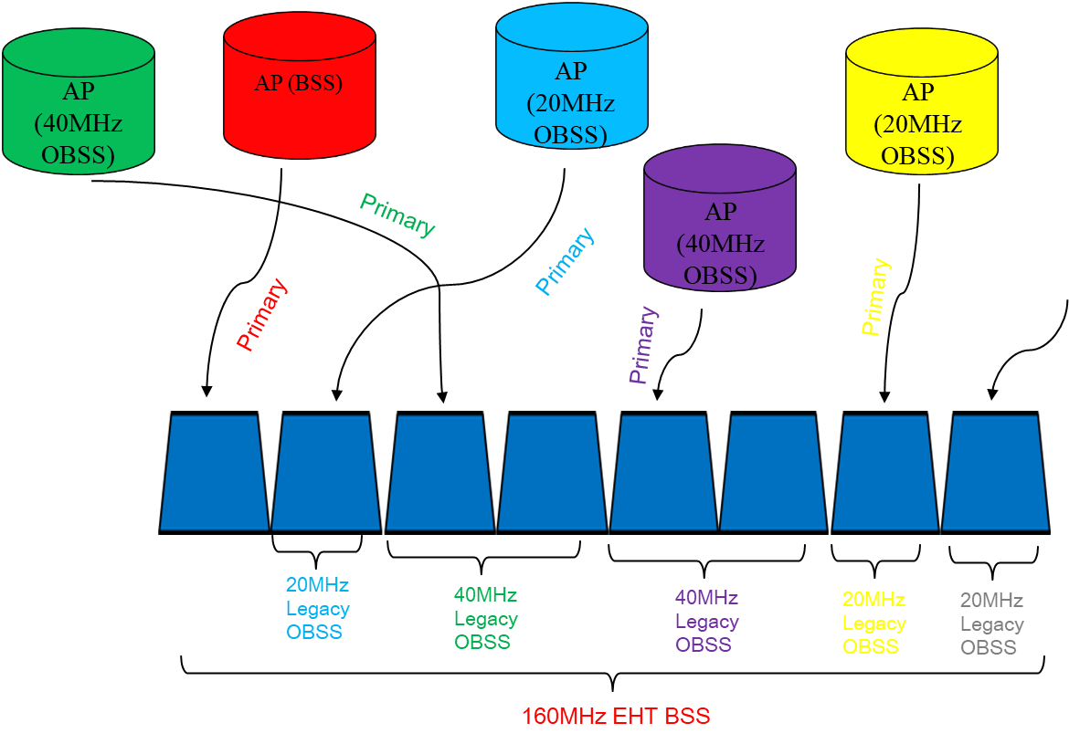
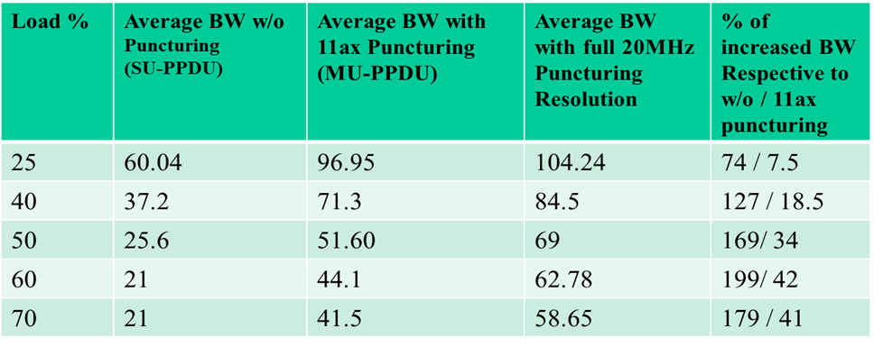
Recap: Channel Utilization Potential Gain
  Overcoming the above limitation yields significant channel utilization improvement as shown in [1] and [2]
  Simulation Results
  Up to 42% improvement in channel utilization for MU transmission
  The simulation results show the BW utilization gain when allowing using BW that is not allowed in 802.11ax due to puncturing restrictions

Slide 6
Channel Utilization Improvement
In order to improve the channel utilization we suggest the following modifications
  Add support to ‘1001’ puncture structure
  Expand the BW field size to accommodate entries to define and signal more puncturing structures
  Allow preamble reception and decoding over 160MHz
We suggest 2 options to support the above, by maintaining the puncturing signaling principle of 802.11ax
  Expand the BW field to 4 bits (respective to the 3 bits size used 802.11ax)
  Expand the BW field to 5 bits
We assume that 2 content channels will be supported similarly to 802.11ax

Slide 7
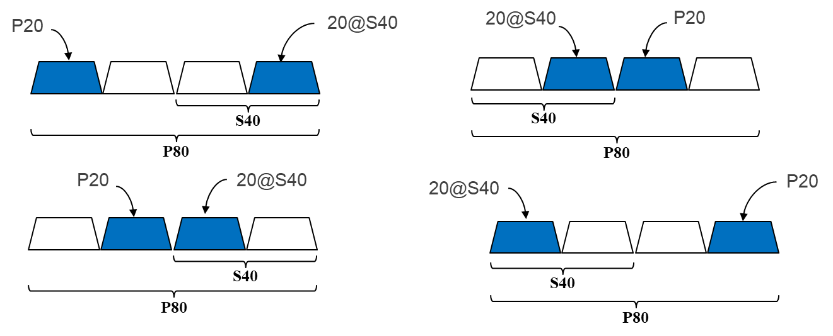
Support ‘1001’ structure
  ‘1001’ structure occurs when the only available 20MHz sub-channel apart from P20 is
    Located in S40 and
    corresponds to the CC that doesn’t correspond to P20
  Although both CCs exist in P80, 802.11ax doesn’t support this structure, so in this case the BW reduces to 20MHz
  Assuming BW field size in U-SIG is increased, we suggest to add support for this structure

Slide 8
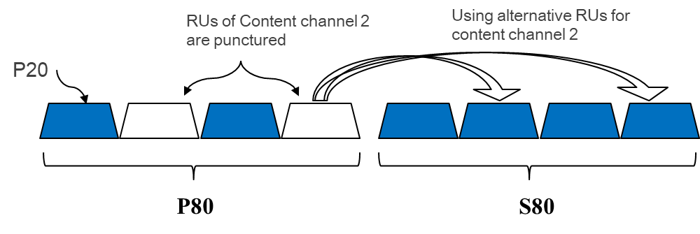
Unavailability of the 2nd CC
  Assuming U-SIG is duplicated in all 20MHz channels (similar to HE-SIG-A in 802.11ax), we suggest to add puncturing indication about S80 (within P160) to it
  In this case, when the 2nd CC in P80 is unavailable, the corresponding CC in S80 may be used for signaling the allocation map in the 2nd CC
  This will require reception over 160MHz instead of 80MHz as required in 802.11ax (when puncturing is supported)

Slide 9
Puncturing Signaling
  Option 1: Expand the BW field to 4 bits
    Overcome the limitations exist in 802.11ax
    Support BW of 320MHz with all puncturing structures
    In this case, there is no signaling for BW=240MHz. Instead 240MHz may be implicitly defined by signaling BW=320MHz with indicating “Empty RU996” in EHT-SIG.
  Option 2: Expand the BW field to 5 bits
    Overcome the limitations exist in 802.11ax
    Support BW of 320MHz with all puncturing structures
    Allow more entries to explicitly signal BW=240MHz with all possible puncturing structures

Slide 10
160MHz Rx Implications
  There were some claims regarding the requirement for reception over 160MHz, mostly saying that it would significantly increase the power consumption.
  More specifically, there were concerns that a STA Rx would have to operate digitally over 160MHz to decode EHT-SIG (and all preceding fields as well) only to realize that in most cases the PPDU is destined to different STAs
  After thoroughly reviewing this issue we came to the conclusion that the increase of power consumption is negligible
  The Power-Save mechanism (see appendix for further explanation) ensures that a STA opens its digital reception circuits to 160MHz (or any other BW) only when a PPDU of such BW may be transmitted to it, otherwise it operates either in sleep mode or in 20MHz (the primary channel) – similar to how it is done in 802.11ax.
  This means that a STA shall not process any PPDU with BW>20MHz unless it has received a specific indication from the AP that the following PPDUs include payload destined to it using a higher BW

Slide 11
Conclusions
We introduced a puncturing method for 802.11be that is based on 802.11ax
The 2 main motivations:
  Overcome some restrictions in 802.11ax that limit the channel BW utilization
  Support for BW>160MHz
We suggested the following modifications for signaling puncturing to PPDUs transmitted to MU:
  Using 4 bits BW field with no explicit signaling about 240MHz
  Using 5 bits BW field with explicit signaling about 240MHz
  Add support to ‘1001’ puncture structure
The additional overhead in U-SIG is minimal: only 1 (or 2) additional bit respective to 802.11ax, which yields significant gain in channel utilization
  This additional overhead is anyway required in order to support BW>160

Slide 12
Straw Poll 1
Do you agree that for PPDUs transmitted to multiple STAs at BW>80MHz: when one content channel in P80 is punctured the other 80MHz segments may be allowed to be used
  This is not defined in 802.11ax therefore the BW drops to 20MHz
Y/N/A xx/xx/xx

Slide 13
Straw Poll 2
Do you agree that U-SIG may include puncturing signaling/info about S80 in addition to P80?
  Note: In 802.11ax puncturing signaling/info exists about P80 only
  STAs that shall support this will be able to process and decode the received PPDU preamble over 160MHz
Y/N/A xx/xx/xx

Slide 14
Straw Poll 3
Do you agree to support preamble puncture structure ‘1001’ for PPDUs transmitted to multi STAs?
  In such case, BW>=80MHz shall be supported
  This is not supported in 802.11ax
Y/N/A xx/xx/xx

Slide 15
References
[1] 11-19-1190-00-00be-improved-preamble-puncturing-in-802-11be (Oded Redlich et al, Huawei)
[2] 11-19-1606-00-00be-Preamble Puncturing and SIG-B Signaling (John Son et al, Wilus Inc)

Slide 16
Appendix
How Power save works?
Power-management schemes places a client in sleep mode when no activity occurs
The PS mode includes the following steps:
  Before a STA goes into the doze state, it request PS from the AP by sending a frame (usually NDP)
  Once STA indicate PS, the AP buffers all frames destined to the station
  When the STA change to awake state, it sends a frame to the AP to indicate it is active and ready to receive DL frames
  Prior to sending data to the STA, the AP sends a management frame over the primary 20MHz (e.g. RTS) to the STA indicating (among other) the BW that will be used for further data transmission
  Only at this point, the STA changes its reception BW to the required one (e.g. 160MHz)
  When AP has finished sending data to the STA, the STA returns to doze state

