Slide 1
Method for Handling Constrained MLD
Date: 2020-03-16
Authors:
Name | Affiliation | Address | Phone | Email
Insun Jang | LG Electronics | 19, Yangjae-daero 11gil, Seocho-gu, Seoul 137-130, Korea |  | insun.jang@lge.com
Jinsoo Choi |  |  |  | js.choi@lge.com
Jeongki Kim |  |  |  | jeongki.kim@lge.com
Sungjin Park |  |  |  | allean.park@lge.com
Taewon Song |  |  |  | taewon.song@lge.com
Namyeong Kim |  |  |  | namyeong.kim@lge.com

Slide 2
Introduction
Some contributions [1]-[4] have handled the operation of Non-AP MLD with constraints
The constraints mean that simultaneous transmission and reception (STR) is restricted over multiple links
We call the constraints non-STR
In this contribution, we propose methods which can prevent non-AP MLD from experiencing constraint-related issues on the non-AP MLD side
Assumes that an AP MLD does not have the constraints

Slide 3
Recap: Non-AP MLD’s Operation with Constraint
Constraint-related issue
If STA 2 transmits any frame on link 2 while RX (DL) on a link 1, the DL frames on link 1 cannot be received correctly
For example, if a non-AP MLD can ensure that a receiving frame is intended to itself on a link, the non-AP MLD does not transmit a frame on the other link; Otherwise, the STA can transmit a frame on its link
Several proposals have addressed the issues
Sharing Information and/or Suspending EDCA to identify a receiving frame [1], [2]
Aggregating multiple links or frame end alignment [3], [4]

Slide 4
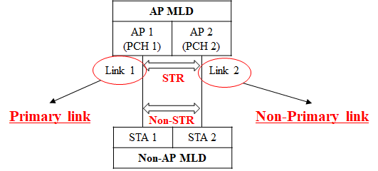
Another Approach
We can consider another approach not to make such situations in the first place
While an AP MLD (with STR) performs Async. channel access on enabled links [5], a non-AP MLD with non-STR considers one link of its operating links as a primary link performing EDCA back-off
We call Links not primary link non-primary link

Slide 5
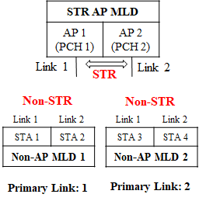
Primary Link on Non-AP MLD Side
Basically, a primary link is assigned to each non-AP MLD
An AP MLD does not have any primary link
Primary link of each non-AP MLD can be different
Non-AP MLD performs EDCA back-off on the assigned primary link only

Slide 6
Channel Access Rules for AP MLD
Basically, an AP MLD performs independent EDCA channel access on each link while it follows a rule
Rule #1: When obtaining on a TXOP on any links
It does not transmit (schedule) a frame to a constrained non-AP MLD of which primary link is not the link
Rule #2: After obtaining on a TXOP on at least a link for a constrained non-AP MLD
If an AP MLD obtains a TXOP and intends to transmit (schedule) a frame to the constrained non-AP MLD on the other link(s), it aligns the end of frame with the end of transmitting frame

Slide 7
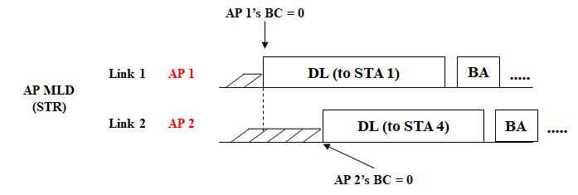
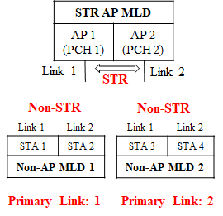
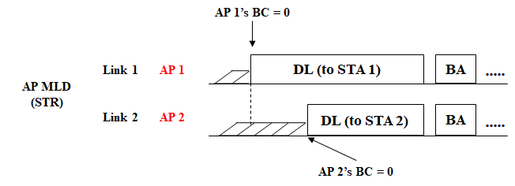
Example
Rule #1: Including primary link for each non-AP MLD
Rule #2: End alignment for the same non-AP MLD
STA 3 is not scheduled

Slide 8
Channel Access Rules for Non-AP MLD
Basically, a non-AP MLD transmits performs EDCA channel access on a primary link only while it follows a rule
However, non-AP MLD needs to use links not primary link for efficient ML operations
We can have two methods 1) Non-AP initiated 2) AP-assisted
If a non-AP MLD cannot the non-AP initiated method, it can use the AP-assisted
Non-AP initiated method uses xIFS-based aggregation, motivated by wide channel access [5] in legacy system

Slide 9
AP-assisted Method
Basically, AP doesn’t have the constraints; therefore a non-AP MLD can utilize the STR capability of AP MLD
In other words, a non-AP MLD may trigger the assistance of AP MLD in order to transmit frames on the other link(s) not the primary link
Example
Non-AP MLD triggers the assistance of AP MLD including links it wants to use
AP MLD responds to the request

Slide 10
Summary
We proposed methods which can prevent non-AP MLD from experiencing constraint-related issues on the non-AP MLD side
The concept of primary link on non-AP MLD side not to happen constraint-related issues
In terms of channel access
AP MLD schedules proper non-AP MLDs in DL frames and aligns the end frames in case of transmitting frames to a non-AP MLD with constraints on multiple links
Non-AP MLD performs an EDCA channel access on the primary link only; Instead, for the efficient operation, it can use non-AP initiated (e.g., xIFS based) and/or AP-assisted, i.e., utilizing AP’s STR capability

Slide 11
SP #1
Do you agree that 11be shall allow the following multi-link operation?
When STAs of a non-AP MLD have constraints to simultaneously transmit and receive over a pair of links and each link has its own primary channel, the non-AP MLD set one of the links to a primary link on which it performs EDCA channel access
Y/N/A

Slide 12
SP #2
Do you agree that 11be shall allow the following multi-link operation?
When a non-AP MLD can obtain a TXOP on a primary link, it can request an AP MLD the use of other link(s) not primary link
Detailed procedure of request is TBD
Y/N/A

Slide 13
References
[1] 802.11-19/1405r7 Multi-Link Operation Channel Access Discussion
[2] 802.11-20/0014r1 Operation of Non-AP MLD with Constraints
[3] 802.11-20/0026r0 MLO: Sync PPDUs
[4] 802.11-20/0081r1 MLO-Synch-Transmission
[5] IEEE P802.11REVmd/D3.0

