Slide 1
MLO: Information Exchange for Link switching
Date: 2020-03-16
Authors:
Name | Affiliations | Address | Email
Namyeong Kim | LG Electronics | LG Seocho R&D Campus, Korea | namyeong.kim@lge.com
Jeongki Kim |  |  | jeongki.kim@lge.com
Insun Jang |  |  | insun.jang@lge.com
Taewon Song |  |  | taewon.song@lge.com
Sungjin Park |  |  | allean.park@lge.com
Jinsoo Choi |  |  | js.choi@lge.com

Slide 2
Overview
We agreed that 802.11be defines a multi-link setup signaling exchange executed over one link initiated by a non-AP MLD with an AP MLD as follows [1]:
  Capability for one or more links can be exchanged during the multi-link setup.
After multi-link setup, a STA may request an AP to switch the operating link to improve the performance.
  For example, there are the cases where the STA is to avoid channel congestion or interference, and so on.
  In this contribution, we does not focus on link switching process (e.g. the detail of link switching operation may be replaced with TID-to-link mapping procedure).
To select a suitable switching link, the STA should know current information of other APs.
For this, the STA needs the method to obtain up-to-date information.

Slide 3
The constraints on obtaining information
A STA can periodically acquire the information of other APs from Beacon frame, but there may be some constraints on link switching in the following cases.
Case 1: the lack of information
  Beacon frame can provide partial information of other APs to avoid bloating, which may not provide information needed for link switching.
Case 2: the out-of-date information
  A STA can have too long listen interval to get the latest information about link.
    Note that the STA which supports constrained battery may have long beacon interval.
  The previously obtained link information from the beacon frame may be different from the current link information
In this contribution, we propose the method for a STA to obtain additional information (e.g., other AP’s capability, BSS parameters, etc.) after multi-link setup.

Slide 4
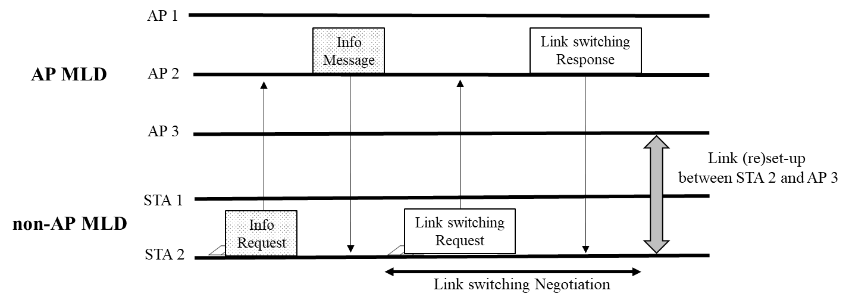
Proposal 1: The solicited method to obtain additional information
A STA of non-AP MLD can request an AP of AP MLD the specific information of one or more APs of AP MLD after multi-link setup.
  On receiving the request frame, the AP sends a response frame including the information required by the STA.
  For example, when STA 2 requests the BSS load of all APs affiliated with AP MLD, the AP 2 sends a response frame including BSS load of AP 1, 2, 3 to STA 2.

Slide 5
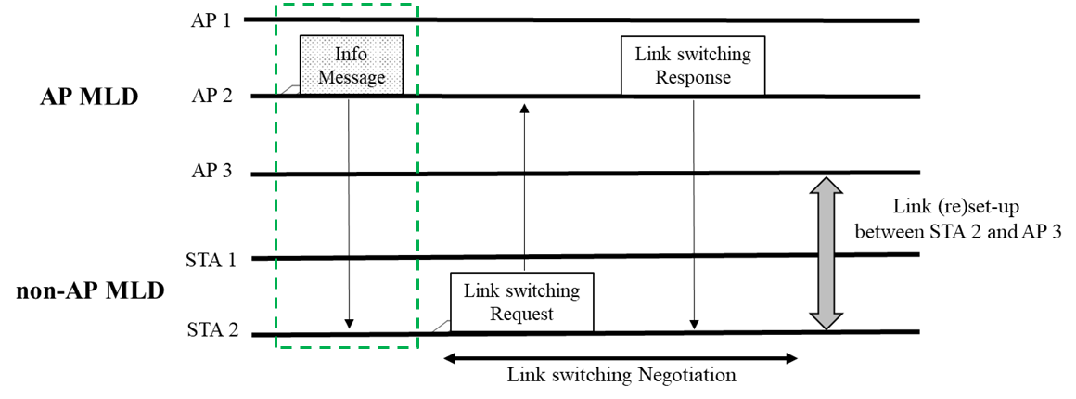
Proposal 2: The unsolicited method to obtain additional information
An AP can provide information of other APs affiliated with AP MLD to a STA without requesting by the STA.
  An AP of AP MLD can send a STA of non-AP MLD a frame to provide information (e.g. updated other AP’s capabilities, operation element, BSS parameters) after multi-link setup.
    The signaling for notifying specific information is TBD (e.g., FILS Discovery frame, Broadcast Probe response, etc.).
    The AP may send this information periodically (e.g., 20 us).
  For example, an AP 2 announces a message to STA 2 to provide changed STR capability information of AP MLD.

Slide 6
Conclusion
Considering the cases where a STA of non-AP MLD does not have enough information to determine the suitable switching link, we propose the method for the STA to obtain additional information.
A STA of non-AP MLD can request specific information of one or more APs not acquired through a beacon to associated AP MLD.
  For example, the information can be BSS load of other APs of the associated AP MLD.
Also, an AP of AP MLD can provide the updated information of APs affiliated with AP MLD to STA which is associated with the AP MLD without request from STA.
  For example, the information can be STR capability of the associated AP MLD.

Slide 7
Reference
[1]: 11-19-1262-08-00be-specification-framework-for-tgbe
[2]: 11-19-1526 Multi-link power save

Slide 8
SP #1
Do you support that 802.11be allows the following operation :
  A STA of non-AP MLD can send an AP of AP MLD a request frame to obtain information of other APs of associated AP MLD after multi-link setup.
    NOTE 1: The detail in the information is TBD (e.g., other AP’s capabilities, operation element, BSS parameters).
    NOTE 2: The request frame is TBD (e.g., Probe request or new frame).
  On receiving the request frame from the STA, the AP can send the STA a response frame including the information.

Slide 9
SP #2
Do you support that 802.11be allows the following operation :
  A STA of non-AP MLD can request the peer AP of AP MLD additional information of one or more APs of AP MLD after multi-link setup.
    NOTE 1: The additional information can be information which didn’t obtain from beacon frame or to be updated by change sequence field. The detail of additional information is TBD (e.g., other AP’s capabilities, operation element, BSS parameters).
    NOTE 2: The signaling for requesting the additional information is TBD.
    NOTE 3: The request frame is TBD (e.g., Probe request or new frame).
  On receiving the request frame from the STA, the AP can send the STA a response frame including the requested information.

Slide 10
SP #3
Do you support that 802.11be allows the following operation :
  An AP of AP MLD can send a STA an announcement frame* including updated information after multi-link setup.
    NOTE 1: The detail in the information is TBD (e.g., other AP’s capabilities, operation element, BSS parameters)
    NOTE 2: The announcement frame is TBD (e.g., FILS Discovery frame, Broadcast Probe response, etc.).
      The AP may send this information with shorter period (e.g., 20 us).

