Slide 1
Multi-Link Block Ack Mechanism
Date: 2020-12-02
Authors:

Slide 2
Background
Multi-Link operation is discussed in various presentation for 11be and considered as key feature to achieve higher throughput
Following Motion have been adopted in SFD [5]
[Motion 20]: 802.11be shall allow the following asynchronous multi-link channel access:
Each of STAs belonging to a MLD performs a channel access over their links independently in order to transmit frames.
Downlink and uplink frames can be transmitted simultaneously over the multiple links.
[Motion 9]: 802.11be define mechanism(s) for multi-link operation that enables the following
An operational mode for concurrently exchanging frames on more than one link for one or more TID(s).
An operational mode for restricting exchanging frames of one or more TID(s) to be on one link at a time.
[Motion 37]: Sequence numbers are assigned from a common sequence number space shared across multiple links of a MLD, for a TID that may be transmitted to a peer MLD over one or more links.

Slide 3
Motivation
Multi link device [1][2][4]
Concurrently exchange frames on more than one link for one or more TID(s)
Can have single Block Ack negotiation for multiple link
This allow Multi-Link Device to operate in following class
MLD with independent TID on each link (MLD-Independent-TID) ^{ø}
MLD with same TID concurrently on more link (MLD-concurrent-TID) ^{ø}
This presentation discusses
Challenges for Block Ack mechanism for Multi-Link Devices
Proposal for efficiently addressing above challenges for Multi-Link Devices
footnote:
Ø : the name is suggestive and can change

Slide 4
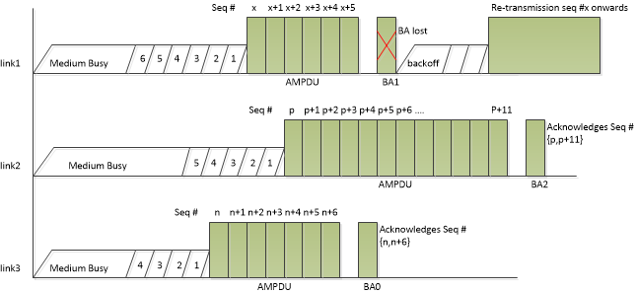
MLD-independent-TID STA/AP operation
Each link is independent
Proposal
Follow 11ax Block Ack negotiation and frame exchange sequence. No change suggested
Use 11ax Block Ack to acknowledge frames on each link independently

Slide 5
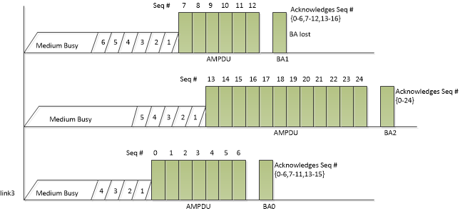
MLD-Concurrent-TID STA/AP operation (1/2)
Sequence number is shared across link.
Each BA contains bitmap for all successfully received frame till time instance of BA transmission
This acts as recovery in case of BA failure
Retransmission due to loss of BA over any link can be averted
Loss of BA1 in figure below is covered in BA2
What if BA for link which has last ending AMPDU is resulted in error (BA2 in figure below)?
BA on other link will cover for part of MPDU in longest MPDU
Thus reducing number of re-transmitted frames
In the figure even though BA2 is lost
Frames upto seq #16 are covered in BA0/BA1
Require retransmission seq #17-24
Thus minimizes re-transmission. Save medium time

Slide 6
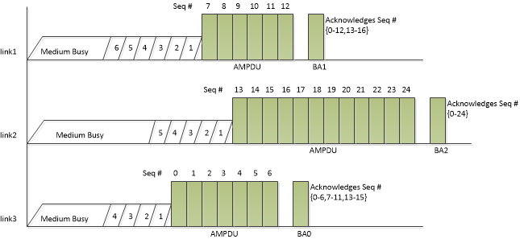
MLD-Concurrent-TID STA/AP operation (2/2)
11be should support at least one mode where
BA over each link should indicate successful reception of MPDU across all links where single TID is transmitted over multiple links
This leads to
BA bitmap to be increased from 256 → 512 → 1024 → 2048 bits to cover max aggregation possible across links
A bit in AMPDU to indicates the expected BA behavior for present ongoing frame exchange over multi-link

Slide 7
Straw Poll 1
Should 11be include one such mode for multi-link operation which supports the mechanism of transmitting block ack over multiple link?

Slide 8
Straw Poll 2
Should 11be support a mode for asynchronous MLD operation where
if block ack is transmitted over multiple link (i.e. answer to straw-poll-1 is yes), should Block Ack on respective link includes aggregated BA bitmap for all frames transmitted for a TID over multi-link?

Slide 9
Straw Poll 3
Mechanism to ask Block Ack over multiple link
(A) Negotiated during association
All frame exchange shall use this mode
(B) Option given to transmitter to request such Block Ack as part of frame exchange.
Non-AP MLD would indicate such as capability during association
AP-MDL AP would indicate this in IE as part of beacon
Actual utilization is decided at the time of frame exchange
(C) Allow both mode of operation
11be should support which one of above options?

Slide 10
Straw Poll 4
Do you support the following:
802.11be amendment shall add a new definitions as follows:
MLA-independent-TID: MLD device which send same TID over only one link
MLA-concurrent-TID: MLD which send one TID concurrently over multiple links and share sequence number space

Slide 11
References
[1] 11-19-1291r3: Performance aspects of Multi-link operations
[2] 11-22-823/r2 - Multi-Link Operation: Design Discussion
[3] 11-19-1512/r6: Multi-link Block Acknowledgment
[4] 11-19-1082/r4: multi-link operation
[5] 11-19-1262/r6: Specification framework for tbge

