Slide 1
Virtual Carrier Sense in Multi-Link
Date: 2020-01-13
Authors:
Name | Affiliations | Address | Phone | email
Thomas Handte | Sony Corporation |  |  | thomas.handte (at) sony.com
Dana Ciochina |  |  |  | dana.ciochina (at) sony.com

Slide 2
Introduction
Multi-link is key feature of EHT
Allows exchange of frames over multiple links concurrently or non-concurrently
Multi-link enhances throughput and/or latency
Several submissions analyzed operation of multi-link [1, 2, 3]
Asynchronous or quasi-/semi-asynchronous operation provides higher gains than synchronous
Asynchronous operation requires multiple contention channels [4]
Contention is performed independently on each link
This presentation addresses virtual carrier sense (CS) in context of multiple links
How to determine NAV in asynchronous multi-link
Throughout this presentation, we assume that multiple links are formed by different channels

Slide 3
Advantages of NAV specific to asynchronous multi-link
Avoid hidden node problem
As in single link
Advantages of multi-link arise because of fast link switching
Waiting for a NAV setting frame in the recently switched link is often not acceptable
Multi-link NAV helps to switch from asynchronous to synchronous or quasi synchronous operation
NAVs getting zero at same time is a necessary condition for successful synchronous operation

Slide 4
Primary channel in single link and multi-link
Single link (today’s operation)
Primary/ secondary channel concept
Full backoff on primary channel, PIFS backoff on secondary channels
A STA maintains NAV based on observation of primary channel
Multi-link
Assume straight forward application of single link concept to multi-link
Each link has its own primary channel
i.e. multi-link has multiple primary channels
Each STA needs to observe the primary channel of each link to maintain NAV information for that particular link

Slide 5
Virtual CS implications of multiple primary channels
Drawbacks
Power efficiency
STA needs to listen to multiple primary channels (i.e. listen to each primary channel of each link)
A STA may even maintain two NAVs for each link (e.g. basic and intra-BSS NAV)
Restrictions on simultaneous transmit or receive operation may disallow to observe multiple primary channels at all times [3]
E.g. STA is transmitting on 1st link but needs to listen on primary channel of 2nd link at same time
Single radio STAs, i.e. STAs that can listen to only one link at a time, can’t do simultaneous reception on multiple primary channels

Slide 6
Proposal
Sharing of NAV information
On each primary channel the NAV information of the other primary channel(s) of other link(s) is shared
Note: The definition of a multi link primary channel where NAV information of all links is shared may be envisioned as well [5]
NAV sharing should preferably be done by AP MLLE
AP has likely best multi-link hardware capabilities in BSS
It may access all channels of multi-link setup
It may have least restrictions regarding simultaneous transmit or receive operation
AP has reliable NAV information of all links at all times
Example for sharing NAV(link1) over link2

Slide 7
Proposal
Envisioned AP operation
Once AP obtains NAV information of a link, it shares on the other link(s) as soon as possible
AP could enforce restrictions on max. PPDU or TXOP length to limit sharing delay
AP doesn’t share if sharing delay exceeds NAV time that is to be shared
Implementation of NAV sharing
Frame of CTS-type (“multi-link CTS”)
Pros: simple, well-known
Cons: rare update if long TXOPs present, detection MCS depended
Include multi-link NAV information in 11be PHY preamble (preferred)
Pros: update every time an AP transmits 11be preamble, detection MCS independent
Cons: need to compress NAV info, need BSS identifier in PHY preamble (could reuse BSS Color)

Slide 8
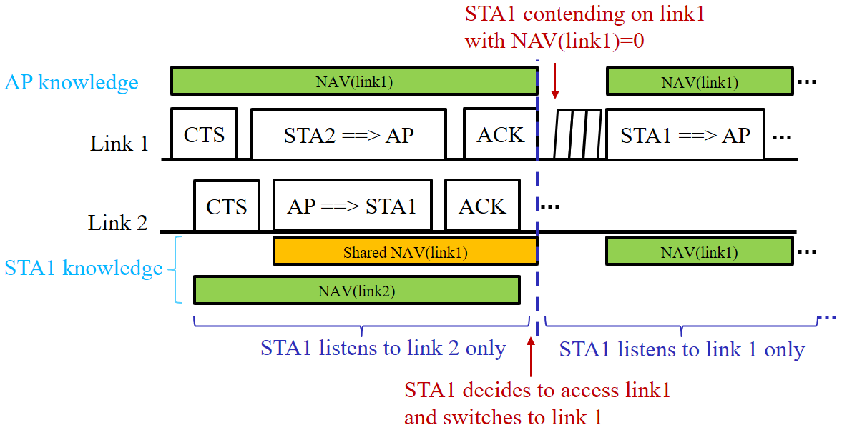
Proposal
Envisioned STA operation
STA listens on the primary channel of a link or on the multi-link primary channel
STA obtains NAV for this link as usual
STA obtains NAV for all other links based on shared NAV
Once shared NAV of a link reaches zero, a STA shall either
switch to that link and determine NAV as usual
or
stay on the current link and await new shared NAV information
If STA decides to transmit on a link that doesn’t include the currently observed primary channel, it should switch to that channel before shared NAV of that link reaches zero

Slide 9
Benefits
Proposal avoids reception on multiple links at same time for NAV maintenance
Power efficiency
No impact of joint transmission and reception restrictions
Single radio STAs may participate in and benefit from multi-link operation
Robust NAV detection in frames that are transmitted in non-duplicate format
AP can demodulate any PPDU format
If AP has restrictions for responding independently on different links [6,7], it may implement restrictions via shared NAV
AP may alter shared NAV such that restrictions are fulfilled

Slide 10
Summary
Virtual carrier sense is important in multi-link
Maintaining NAV from multiple primary channels of multiple links has drawbacks
Low power efficiency
Restrictions on simultaneous transmit or receive operation may disallow for some STAs
Proposal: Share NAV information among links
On each primary channel of a link the NAV information of the other primary channel(s) of other link(s) is shared
Sharing can be implemented via NAV information within PHY preamble
Main benefits
High power efficiency, no restrictions on simultaneous transmit/ receive operation

Slide 11
References
[1] 11-19/1291r3 Performance aspects of Multi-link operations
[2] 11-19/1405r7 Multi-Link Operation Channel Access Discussion
[3] 11-19/1541r1 Performance aspects of Multi-link operations with constraints
[4] 11-19/1144r6 Channel Access for Multi-link Operation
[5] 11-19/1526r1 Multi-Link Power-save
[6] 11-19/1836r1 Multi-link Channel Access Discussion Follow-up
[7] 11-19/1548r1 Channel access design for synchronized multi-links

