Slide 1
January 2020
Trustworthy Multipurpose Remote Identification:
Date: 2020-01-13
Authors:
Name | Affiliations | Address | Phone | Email
Robert Moskowitz | HTT Consulting | USA | 248-968-9809 | rgm@labs.htt-consult.com
Slide 1
Robert Moskowitz (HTT Consulting)
Notes:
doc.: IEEE 802.11-yy/xxxxr0
Month Year
John Doe, Some Company
Page 1

Slide 2
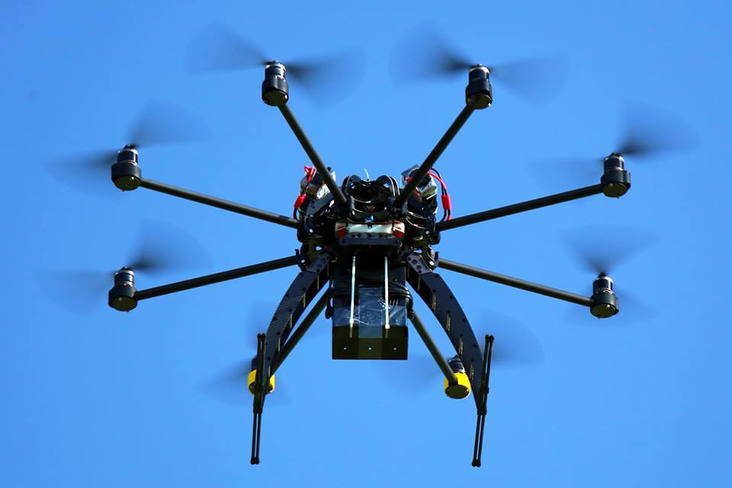
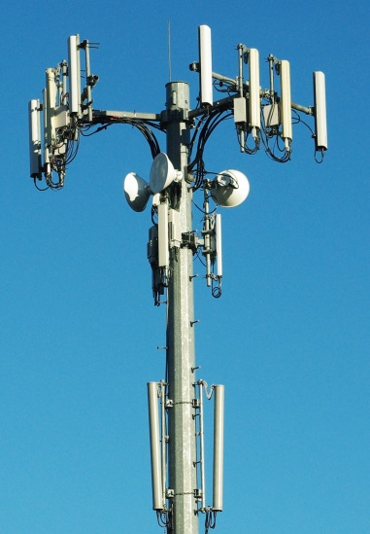



January 2020
Abstract
Introduction to Unmanned Aircraft (UA) Remote ID
Slide 1
Robert Moskowitz (HTT Consulting)
Notes:
doc.: IEEE 802.11-yy/xxxxr0
Month Year
John Doe, Some Company
Page 1

Slide 3
January 2020
Why of Interest to 802.11bc?
Might 802.11bc be a transmission media for UAS?
  I am on a fishing expedition
Might the security model proposed here be of value to others in 802.11?
  There is some “new” cryptography herein
Slide 1
Robert Moskowitz (HTT Consulting)
Notes:
doc.: IEEE 802.11-yy/xxxxr0
Month Year
John Doe, Some Company
Page 1

Slide 4

January 2020
Unmanned Aircraft System (UAS) Remote Identification (RID)
Need means to identify nearby observed Unmanned Aircraft (UA)
  complicated by small size, hi speed (relative to size), remote operation, autonomy…
US FAA Notice of Proposed Rule Making (NPRM) Dec 31, 2019
  www.govinfo.gov/content/pkg/FR-2019-12-31/pdf/2019-28100.pdf
  comment period ends on 2 March 2020, with an expectation for a final rule in the summer of 2021.
Slide 1
Robert Moskowitz (HTT Consulting)
Notes:
doc.: IEEE 802.11-yy/xxxxr0
Month Year
John Doe, Some Company
Page 1

Slide 5
January 2020
Unmanned Aircraft System (UAS) Remote Identification (RID)
ASTM F38.02 WK65041 new standard: OpenDroneID messages / multi transports
  Broadcast: Bluetooth 4 / 5 & WiFi beacons (short packets!) direct to observer phone [w/o Internet]
  Network: from UAS (e.g. via LTE) or proxy (e.g. operator phone) via Internet to local observer phone
Slide 1
Robert Moskowitz (HTT Consulting)
Notes:
doc.: IEEE 802.11-yy/xxxxr0
Month Year
John Doe, Some Company
Page 1

Slide 6
January 2020
Unmanned Aircraft System (UAS) Remote Identification (RID)
Initial ASTM standard falls short in making UAS RID information immediately actionable
  trustworthy
  show whether operator is trusted, even if observer lacks Internet
  enable instant O2P & M2M secure comms, if endpoints have Internet
Adding Host Identity Tags (HITs, RFC7401) as RemoteID addresses these shortcomings
  draft-card-tmrid-uas
Slide 1
Robert Moskowitz (HTT Consulting)
Notes:
doc.: IEEE 802.11-yy/xxxxr0
Month Year
John Doe, Some Company
Page 1

Slide 7
January 2020
HIP Addendums for RemoteID
Add Hierarchy to HITs (HHITs) plus registration service
  draft-moskowitz-hip-hierarchical-hit
  draft-moskowitz-hip-hhit-registries
New cryptography
  EDDSA25519 and SHAKE128
    draft-moskowitz-hip-new-crypto
    draft-moskowitz-orchid-cshake
    RFC 8032, FIPS 202, NIST SP800-185, SP800-56Cr1
Slide 1
Robert Moskowitz (HTT Consulting)
Notes:
doc.: IEEE 802.11-yy/xxxxr0
Month Year
John Doe, Some Company
Page 1

Slide 8
January 2020
Hierarchical HITs (HHIT)
Valid IPv6, non-routable, addresses
  28 bit IPv6 prefix
  4 bit HIT crypto Suite ID
  32 bit Hierarchy ID
    14 bit Registered Assigning Authority (RAA)
    18 bit Hierarchical HIT Domain Authority (HDA)
  64 bit ORCHID Hash
Slide 1
Robert Moskowitz (HTT Consulting)
Notes:
doc.: IEEE 802.11-yy/xxxxr0
Month Year
John Doe, Some Company
Page 1

Slide 9
January 2020
Hierarchical HITs (HHIT) Collision Risk
Within a HDA
  0.01% in a population of 66 Million
  1% in a population of 663 Million
p = 1 – e^{-k^2/(2n)}
  P Collision Probability
  n Total possible population
  k Actual population
Slide 1
Robert Moskowitz (HTT Consulting)
Notes:
doc.: IEEE 802.11-yy/xxxxr0
Month Year
John Doe, Some Company
Page 1

Slide 10
January 2020
HIP Addendums for RemoteID
Use ASTM Authentication Message for signed proofs
  draft-wiethuechter-tmrid-auth
    Basic signed block is 84 bytes
    “Hierarchy certificate” ~200 bytes
      With whom is the UA registered?
    All this fits into extended Authentication message (255 bytes)
Slide 1
Robert Moskowitz (HTT Consulting)
Notes:
doc.: IEEE 802.11-yy/xxxxr0
Month Year
John Doe, Some Company
Page 1

Slide 11
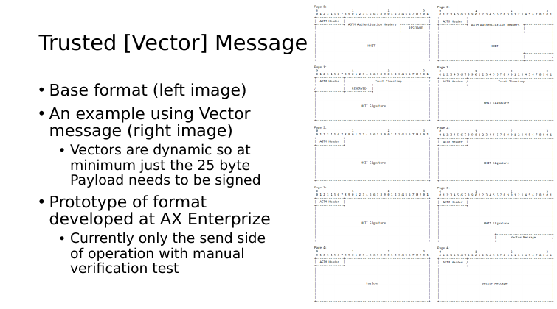
January 2020
Slide 1
Robert Moskowitz (HTT Consulting)
Notes:
doc.: IEEE 802.11-yy/xxxxr0
Month Year
John Doe, Some Company
Page 1

Slide 12
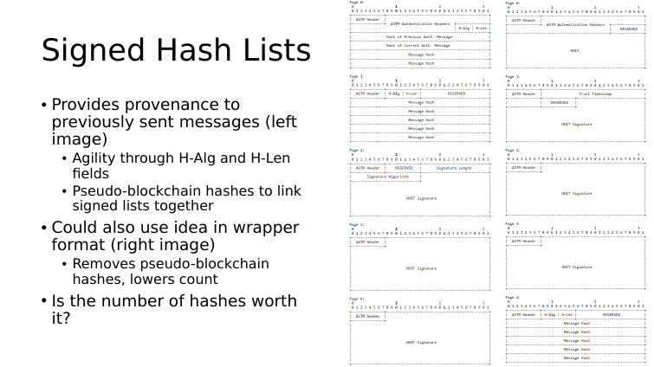
January 2020
Slide 1
Robert Moskowitz (HTT Consulting)
Notes:
doc.: IEEE 802.11-yy/xxxxr0
Month Year
John Doe, Some Company
Page <number>

Slide 13
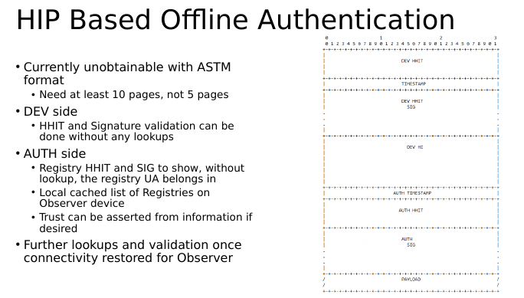
January 2020
Slide 1
Robert Moskowitz (HTT Consulting)
Notes:
doc.: IEEE 802.11-yy/xxxxr0
Month Year
John Doe, Some Company
Page <number>

Slide 14
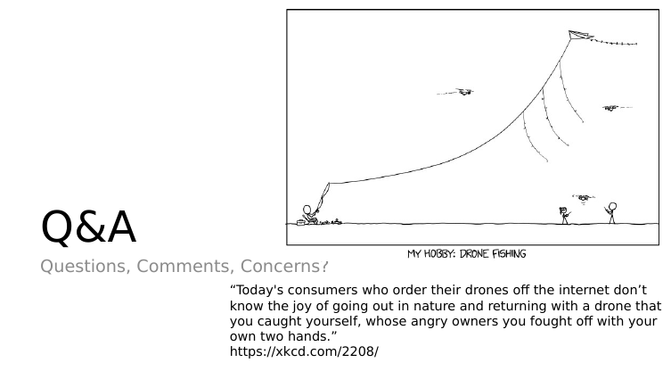
January 2020
Slide 1
Robert Moskowitz (HTT Consulting)
Notes:
doc.: IEEE 802.11-yy/xxxxr0
Month Year
John Doe, Some Company
Page <number>

