Slide 1
Follow-Up on PHY Signaling for Adaptive Repetition of 11p PPDU
Date: 2020-01-13
Authors:
Notes:
Introduction:
In motion #19, the TGbd has agreed that “ 11bd shall support adaptive repetition of 11p PPDU when operating on OCB broadcast mode in 10MHz bandwidth. The signaling of the adaptive repetition is TBD. The time between repeated 11p PPDUs is TBD.”
In this contribution, we propose a PHY scheme for signaling the repetition
Motivation
In 802.11ax, RL-SIG (repeat L-SIG) is introduced
RL-SIG field is not just simply a repetition of L-SIG field. It has “extra subcarrier insertion” at subcarrier {-28, -27, 27, 28} for channel estimation purpose and the value on these four extra subcarriers are {-1, -1, -1, 1}, respectively.
802.11ax allows 3 dB power boost to those subcarriers if transmission an HE ER SU PPDU.
(including a picture showing different size in frequency between {L-STF, L-LTF and L-SIG} and RL-SIG
PHY signaling for repetition Tx
Methods of using extra tones
Which fields could have extra tones
Benefits
Why it is better to signaling the repetition in PHY?
?
Impact to 11p receiver
Design criteria
Allow Non-coherent detection
Pros and Cons
Miss detection level
Pros and Cons
False alarm level
Pros and Cons
Design options
Allocation of extra tones
Power level of extra tones
?
Simulation
Simulation assumptions
Simulation setup
Simulation results
Discussion
Conclusion
SP

Slide 2
Introduction
TGbd has agreed that [1]
  “ 11bd shall support adaptive repetition of 11p PPDU when operating on OCB broadcast mode in 10MHz bandwidth. The signaling of the adaptive repetition is TBD. The time between repeated 11p PPDUs is TBD.”
Since this agreement, several methods have been proposed
  No PHY/MAC signaling [2]
  MAC layer signaling [3]
  PHY layer signaling [4]
In this document we provide additional simulation results for PHY layer signaling and possible ways to use it for the adaptive repetition of 11p PPDU

Slide 3
Comparison of Different Methods
Direct method without additional PHY/MAC signaling [2]
  Detect repetition directly from received signal
  Repeated PPDUs need to be transmitted sequentially, separated by SIFS
  Need for channel equalization – Performance and reliability depend on accuracy of channel estimation
    Channel fading and interference will create degradation
MAC layer signaling [3]
  Using Duration/ID field in MAC header to signal repetition related information
  Does not need SIFS separation between the consecutive PPDUs
  Cannot obtain combining gain, which is the original purpose of repetition transmission
PHY layer signaling [4]
  Can be used to indicate repetition related information and detect if the PPDU was transmitted from an 11p device or a 11bd device
  Repeated PPDUs need to be transmitted sequentially, separated by SIFS
  Provide flexible and robust design

Slide 4
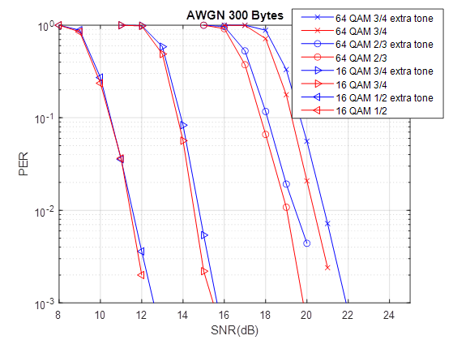
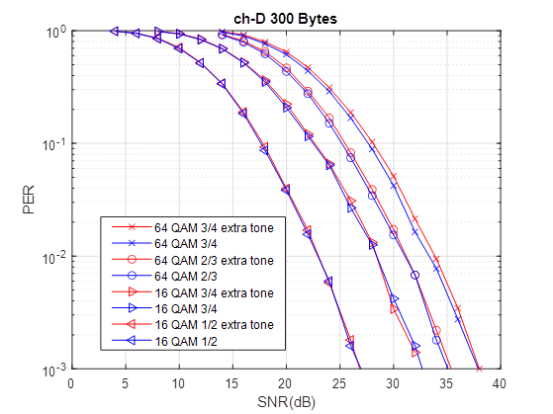
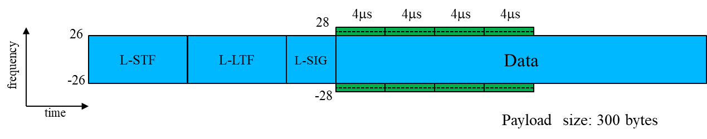
PHY Layer Signaling: Using Extra Tones in Frequency Domain
Using tones [-28, -27, 27, 28] in some OFDM symbols to indicate, for example,
  Received 11p PPDU was transmitted from an 11bd device by using energy detection
  Repetition state (e.g., first PPDU or last PPDU) by using simple sequence detection
Using those extra tones in data field may slightly impact data demodulation performance, but that can be mitigated by using lower power on those tones or by having more symbols with those extra tones
In [4], we used four OFDM symbols in data field and same power for all tones

Slide 5
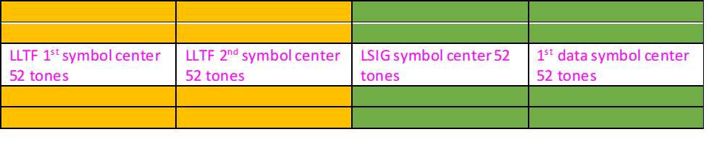



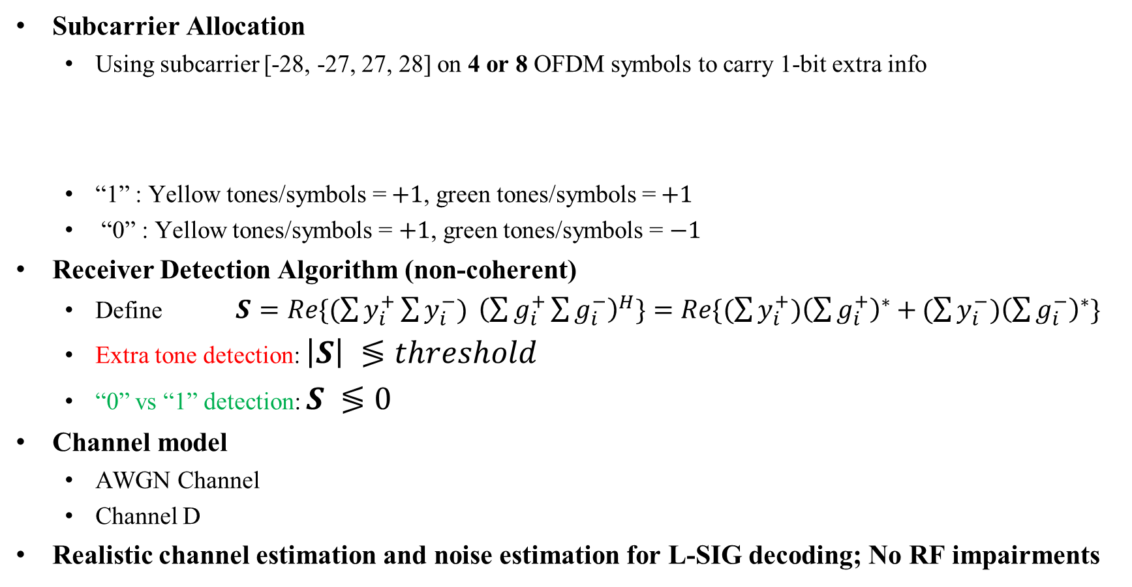


Simulation Assumptions and Setup
Subcarrier Allocation
  Using subcarrier [-28, -27, 27, 28] on 4 or 8 OFDM symbols to carry 1-bit extra info
  “1” : Yellow tones/symbols =$+1$, green tones/symbols =$+1$
  “0” : Yellow tones/symbols = $+1$, green tones/symbols = $−1$
Receiver Detection Algorithm (non-coherent)
  Define $S=Re\{(\sum{y_{i}^{+}}\sum{y_{i}^{−}) }{\left(\sum{g_{i}^{+}}\sum{g_{i}^{−}}\right)}^{H}\}=Re\{(\sum{y_{i}^{+}){\left(\sum{g_{i}^{+}}\right)}^{∗}+}(\sum{y_{i}^{−}){\left(\sum{g_{i}^{−}}\right)}^{∗}}\}$
  Extra tone detection: $\left|S\right| ≶threshold$
  “0” vs “1” detection: $S ≶0$
Channel model
  AWGN Channel
  Channel D
Realistic channel estimation and noise estimation for L-SIG decoding; No RF impairments
$$y_{i}^{−}$$
$$g_{i}^{−}$$
Preamble
Data Field
$$y_{i}^{+}$$
$$g_{i}^{+}$$
$$i=1,2,3,4$$

Slide 6
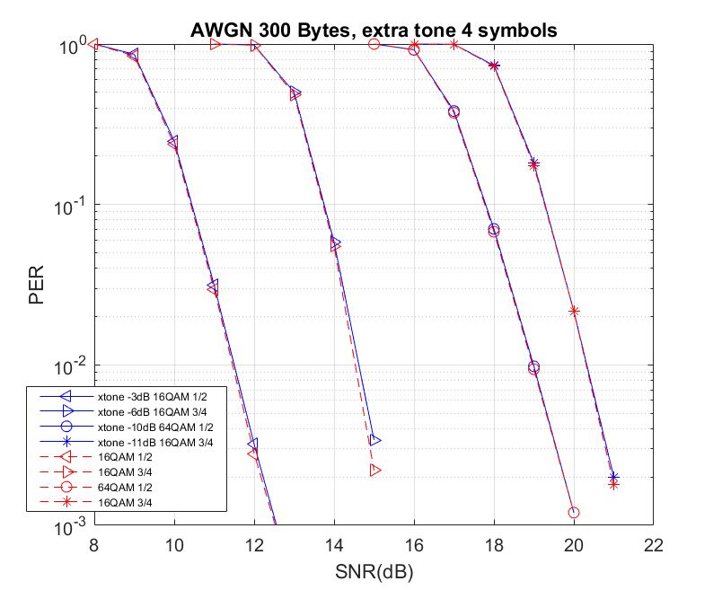
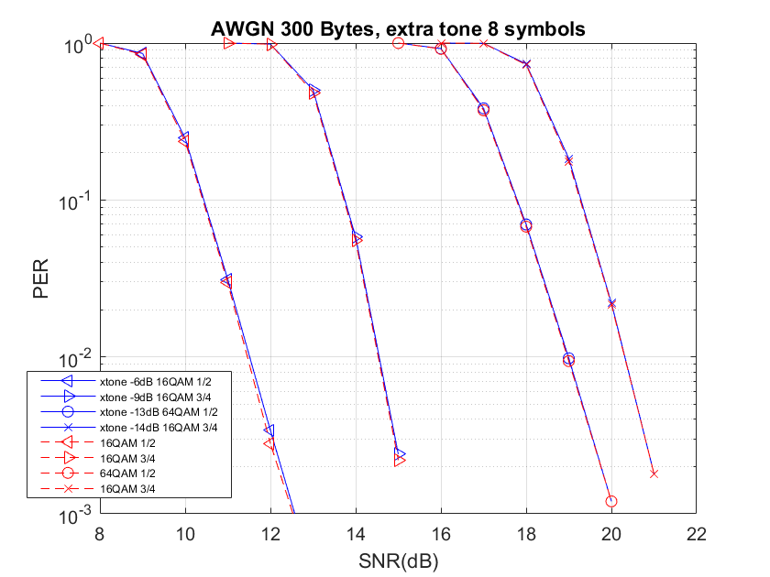
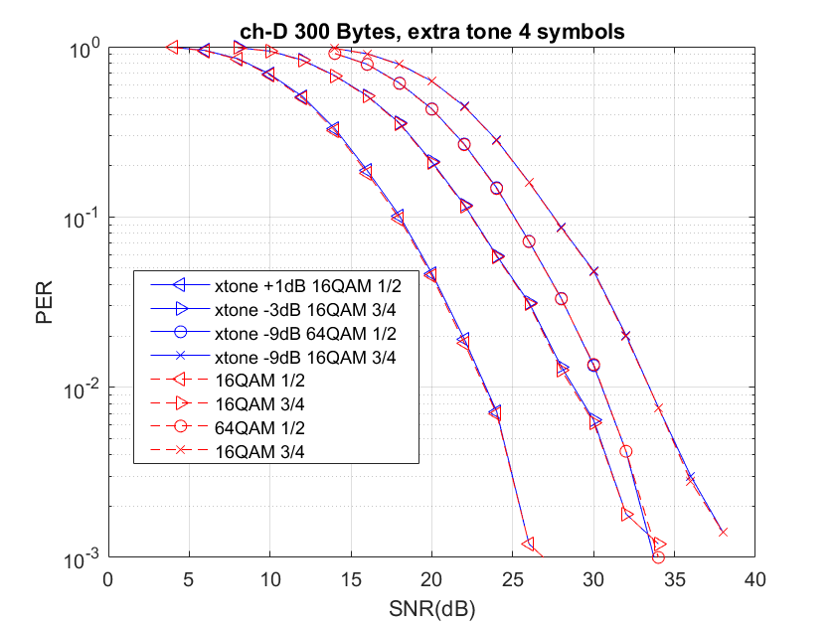
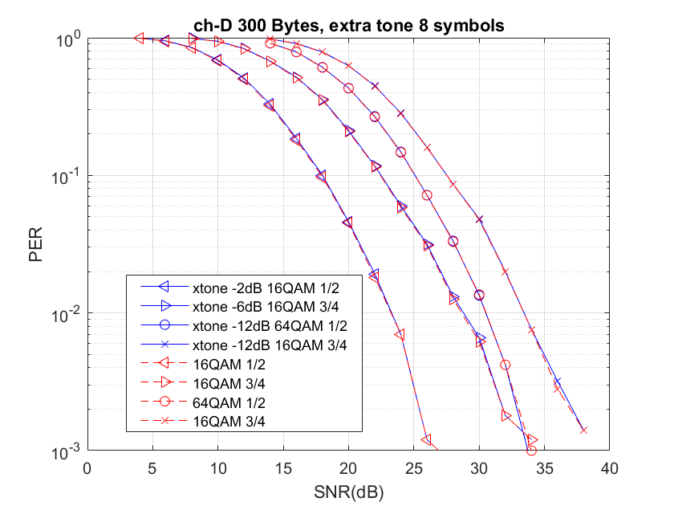
Additional Simulation Results (1/2)
Results with different number of symbols and power for the extra tones
  A fixed ratio between the powers of an extra tone and a data tone is used for given (MCS, # of extra tone symbols, channel type) tuple,
    e.g. -3dB for (16QAM ½, 4symbols, AWGN)
  The ratio chosen provides extra tone with SNR > xdB for the entire range of data PER for the given MCS and channel.
    x=5 for 4 symbols and x=2 for 8 symbols
    The worst-case miss and false probabilities are shown in the next page
  The extra tones have very negligible negative effects on Data PER

Slide 7
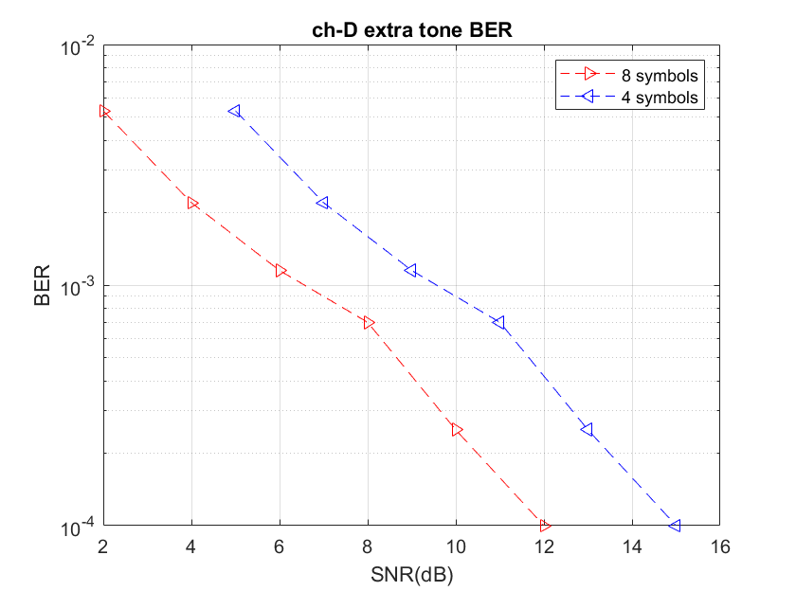
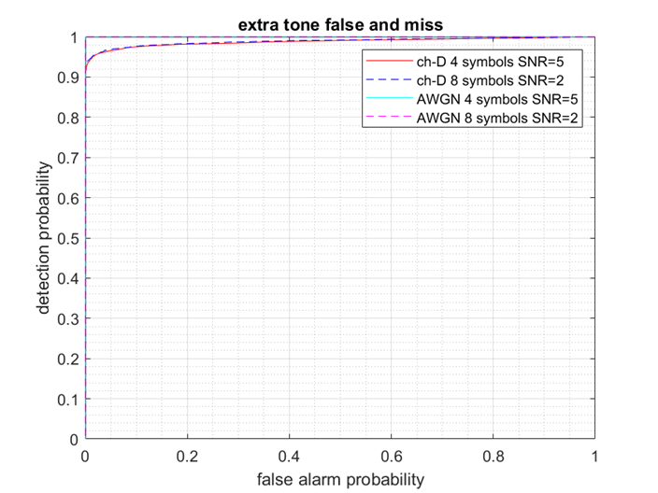
Additional Simulation Results (2/2)
1-bit Detection Error Rate using Extra Tones
False Alarm vs Detection for detecting legacy 11p PPDU
The BER of the 1-bit info is shown for different number of symbols carrying extra tones
  Total energy is the same for achieving the same reliability
  AWGN BER is ~0 (not shown)
Using more symbols with extra tones can improve the 1-bit detection performance
The false alarm and detection probabilities (ROC curve) are bounded (to the upper-left corner) by the curves shown for the simulated MCS’s and channels

Slide 8
Possible Repetition Transmitting and Receiving Procedures
Transmitting Procedure
PPDUs are transmitted sequentially, separated by SIFS
Extra tones are used to indicate if this PPDU is the last one in the PPDU sequence
  Define a flag “isLastTx”: = 0 means this PPDU is not the last one; = 1 means this PPDU is the last one
Two groups of repetition transmissions are separated by a duration larger than SIFS
Receiving Procedure
Received PPDU may be any one in the sequence
Always decode the received PPDU first – decode the combined PPDU if necessary
If a PPDU is decoded successfully, there is no need to decode the rest of received PPDUs
Decoding of any PPDU doesn’t depend upon the detection of extra tones – the two operations can run in parallel
Start-of-PPDU (SOP) detection is needed in the procedure
isLastTx
0
0
0
1
0
1
PPDU
PPDU
PPDU
PPDU
PPDU
PPDU
SIFS
SIFS
SIFS
>SIFS
SIFS

Slide 9
A Receiving Procedure
If a PPDU is decoded successfully, no need to decode the rest of received PPDUs of the PPDU sequence
Always decode the received PPDU first. Decode the combined PPDU if necessary.

Slide 10
Conclusion
In this contribution we provided addition simulation results for adaptive repetition transmission of 11p PPDUs based on PHY layer signaling using extra tones in data field to mitigate the impact on data demodulation
  Using lower power in the extra tones
  Using more symbols with extra tones
Proposed procedures for transmission and reception of repeated 11p PPDUs
The results show that PHY signaling using extra tones is a simple (in terms of signal processing), flexible and robust method, and able to obtain combining gain

Slide 11
References
[1] 11-19/514r12, 802.11bd FRD SFD motion booklet
[2] 11-19/1946r0, Detection of adaptive repetitions
[3] 11-19/1847r4, Discussion on PHY/MAC Signaling for Adaptive Repetition of 11p PPDU in 11bd
[4] 11-19/1596r2, PHY Signaling for Adaptive Repetition of 11p PPDU

Slide 12
SP
Do you support using extra edge subcarriers of 11p PPDU transmitted from 11bd devices as a way to signal adaptive repetition?
- Specific location of those extra subcarriers and the meaning of the signal are TBD
Y/N/A:

