Slide 1
Multi-link BA
Date: 2020-01-10
Authors:
Name | Affiliations | Address | Phone | Email
Po-Kai Huang | Intel
Alexander Danny
Dan Bravo
Laurent Cariou
Arik Klein
Danny Ben-ari
Ofer Schreiber
Ghosh Chittabrata
Notes:
September 2012

Slide 2
Background
Multi-link framework has been agreed [1]
We have also agreed to have one BA setup and shared SN space across links [3]
We provide our view for multi-link BA in this presentation.
AP MLD
Non-AP MLD
AP1
STA1
AP2
STA2
AP3
STA3

Slide 3
Multi-link Transmit Buffer Control and Receive Reordering Buffer Control
Based on the existing block ack architecture, to have data continuity across links, it makes sense to have
  One SN space per TID across links to enable the data continuity [3]
    each <Recipient MLD MAC address, TID> to have one SN space (agreed)
  Have one transmit buffer control per recipient MLD MAC address/TID
  Have one receive reordering buffer control per originator MLD address/TID (agreed)
Originator
Receipint
Receive Reordering Buffer
Transmit Buffer Control
Control per
Originator
MLD address
/
per
Recipient MLD
TID
(
WinStartB
,
WinSizeB
address
)
/
TID
(
WinStartO
,
WinSizeO
)
Multi
-
link
ScoreBorad
Context Control
Aggregation Control
Deaggregation Control

Slide 4
Why One Transmit Buffer Control
Transmit buffer control is just a logical representation to deliver MPDUs to the peer.
Existing spec texts essentially describes only the following for transmission buffer control and can be easily extended to multi-link
Proposal: simply have one transmit buffer control in the spec for the BA agreement between two MLDs
Transmission window
WinStartO
WinSizeO
May transmit SN within transmission window in any order
May transmit SN beyond transmission window and transmission window is moved in this case
Should not transmit SN < WinStartO

Slide 5
Why not Multiple Transmit Buffer Controls
Per link transmit buffer control, i.e., per link winStartO and WinSizeO, does not align with the fact that MPDUs can be moved across links for transmission at any time based on specific implementation and performance requirement.
MPDUs scheduling should be left to implementation and does not see the need to standardize per link transmit buffer control

Slide 6
BA Bitmap/Buffer Size
The current peak data rate that can be supported by 11ax under 160 MHz, 2/8 spatial stream, and 1024 QAM is 2.4/9.6 Gbps.
We think that the common use case is 2 spatial stream for non-AP MLD
  With 320 MHz, 2 spatial stream, 4096 QAM, and one radio non-AP MLD, we expect that the peak throughput can potentially increase by 2.4 folds with a peak throughput of 5.76 Gbps
  With 320 MHz, 2 spatial stream, 4096 QAM, and two radios non-AP MLD, we expect that the peak throughput can potentially increase by 4.8 folds with a peak throughput of 11.52 Gbps
We evaluate MAC efficiency in the next slide

Slide 7

MAC efficiency evaluation
4ms TXOP
Preamble_overhead = (36+7.2*2)*10^-6; % 2xHE-LTF and 0.8 us GI
SIFS = 16*10^-6;
BA_Duration = 20*10^-6+(24*8+BA_bitmap)/BA_data_rate; % non-HT PPDU 6 Mbps or 24 Mbps
MSDU_size = 1500 bytes
if(MSDU==1)
MPDU_size = MSDU_size;
else
MPDU_size = MSDU*(14+MSDU_size+2);
end
MPDU_duration = (32+34*8+MPDU_size*8)/Data_Rate; % 4 bytes delimiter 34 bytes MAC header
MAC efficiency = (delivered_MSDU*1500*8)/TXOP*Data_Rate
HE SU PPDU Preamble
A-MPDU with max Y MPDUs based on BA size X, Y$≤$X
SIFS
BA with X bits bitmap
Repeat to fill the TXOP if possible

Slide 8
MAC efficiency Results with 6 Mbps BA Rate
No MSDU per A-MSDU
2 MSDUs per A-MSDU
Rate (Gbps) | 256 BA | 512 BA | 1024 BA
2.4 | 0.8448 | 0.8713 | 0.9038
5.76 | 0.7198 | 0.8000 | 0.8302
11.52 | 0.5906 | 0.6667 | 0.7552
Rate (Gbps) | 256 BA | 512 BA | 1024 BA
2.4 | 0.8925 | 0.9250 | 0.9050
5.76 | 0.8073 | 0.8729 | 0.9063
11.52 | 0.7208 | 0.8000 | 0.8313
4 MSDUs per A-MSDU
8 MSDUs per A-MSDU
Rate (Gbps) | 256 BA | 512 BA | 1024 BA
2.4 | 0.9400 | 0.9300 | 0.9100
5.76 | 0.9000 | 0.9313 | 0.9104
11.52 | 0.8125 | 0.8792 | 0.9083
Rate (Gbps) | 256 BA | 512 BA | 1024 BA
2.4 | 0.9400 | 0.9300 | 0.9100
5.76 | 0.9458 | 0.9333 | 0.9125
11.52 | 0.9000 | 0.9333 | 0.9083

Slide 9
MAC efficiency Results with 24 Mbps BA Rate
No MSDU per A-MSDU
2 MSDUs per A-MSDU
Rate (Gbps) | 256 BA | 512 BA | 1024 BA
2.4 | 0.89 | 0.9138 | 0.9413
5.76 | 0.8000 | 0.8505 | 0.9042
11.52 | 0.6667 | 0.7865 | 0.8292
Rate (Gbps) | 256 BA | 512 BA | 1024 BA
2.4 | 0.9200 | 0.9475 | 0.9425
5.76 | 0.8625 | 0.9167 | 0.9427
11.52 | 0.8000 | 0.8521 | 0.9063
4 MSDUs per A-MSDU
8 MSDUs per A-MSDU
Rate (Gbps) | 256 BA | 512 BA | 1024 BA
2.4 | 0.9550 | 0.9500 | 0.9450
5.76 | 0.9271 | 0.9542 | 0.9479
11.52 | 0.8667 | 0.9208 | 0.9458
Rate (Gbps) | 256 BA | 512 BA | 1024 BA
2.4 | 0.9600 | 0.9500 | 0.9500
5.76 | 0.9583 | 0.9542 | 0.9500
11.52 | 0.9250 | 0.9500 | 0.9500
Combined with A-MSDU, 512/ 1024 is needed for single radio or dual radio aggregation.
Open for discussion about larger size due to AP-AP backhaul or 3 link aggregation

Slide 10
Expansion of Table 26 -1
Negotiated buffer size | Bitmap in compressed BA | Bitmap in multi-STA BA
1-64 | 64 | 32 or 64
65-128 | 64 or 256 | 32, 64, 128
129-256 | 64 or 256 | 32, 64, 128, or 256
257 – 512 | 64 or 256 or 512 | 32, 64, 128, 256, 512
513 - 1024 | 64 or 256 or 512 or 1024 | 32, 64, 128, 256, 512, or 1024
Add
Add

Slide 11
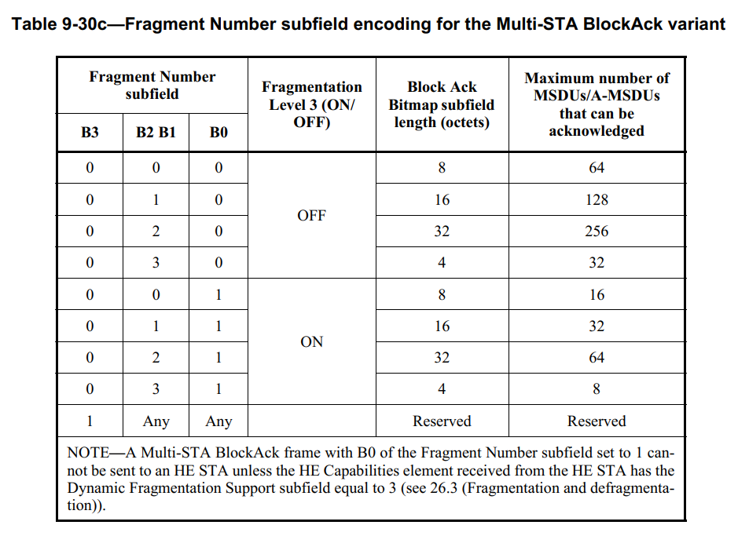
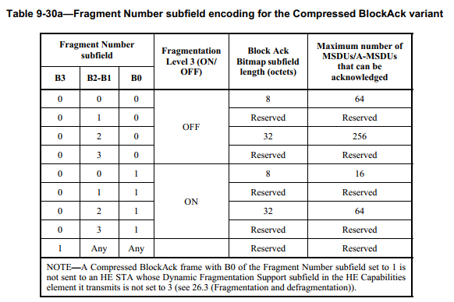
Indication of 512/1024 BA bitmap
In Multi-STA BA and compressed BA, two entries when B3=1 for 512 or 1024 indication
Add
Add

Slide 12
Conclusion
We propose to have only one transmit buffer control for negotiated BA between two MLDs
We think 512/1024 BA is needed for single radio or dual radio aggregation under EHT data rate considering common 2 spatial stream use case.
Propose signaling to expand table 26-1 and indication in compressed BA and Multi-STA BA for 512 and 1024.

Slide 13
Straw Poll #1
Do you support that for each block ack agreement between two MLDs, there exists one transmit buffer control to submit MPDUs for transmission across links?

Slide 14
Straw Poll #2
Do you support to extend the negotiated Block Ack buffer size to be smaller than or equal to 1024 and define 512-bits and 1024-bits BA bitmap in R1?

Slide 15
Straw Poll #3
Do you support to extend table 26-1 as shown below?
Negotiated buffer size | Bitmap in compressed BA | Bitmap in multi-STA BA
1-64 | 64 | 32 or 64
65-128 | 64 or 256 | 32, 64, 128
129-256 | 64 or 256 | 32, 64, 128, or 256
257 – 512 | 64 or 256 or 512 | 32, 64, 128, 256, 512
513 - 1024 | 64 or 256 or 512 or 1024 | 32, 64, 128, 256, 512, or 1024

Slide 16
Straw Poll #4
Do you support to use two entries that have B3 equal to 1 in FN field to indicate 512 BA bitmap length and 1024 BA bitmap length in compressed BA and individually addressed multi-STA BA?

Slide 17
Reference
[1] 19/0822r4 Extremely efficient multi-band operation
[2] 19/0773r7 Multi-link operation framework
[3] 19/1262r6 Specification framework for TGbe

Slide 18
Spec texts of transmit buffer control
The originator contains a transmit buffer control that uses WinStartO and WinSizeO to submit MPDUs for transmission and releases transmit buffers upon receiving BlockAck frames from the recipient.
The originator may transmit QoS Data frames with a TID matching a block ack agreement(#2608) in any order provided that their sequence numbers lie within the current transmission window. The originator may transmit an MPDU with a sequence number that is beyond the current transmission window (SN > WinStartO +WinSizeO – 1), in which case the originator’s transmission window (and the recipient’s window) is moved forward. (#2496)The originator should not transmit an MPDU with a sequence number that is before the current transmission window (i.e., SN < WinStartO).

Slide 19
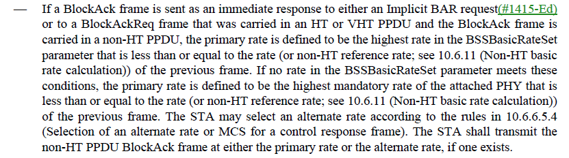
Texts for format and rate selection
A Control frame sent by an HE STA as a response to an HE SU PPDU or a non-HT PPDU that does not contain a Trigger frame or frame carrying a TRS Control field should be carried in a non-HT PPDU unless the most recently received PPDU sent by a recipient of the HE SU PPDU to the HE STA after association was an HE ER SU PPDU in which case the Control frame should be carried in an HE ER SU PPDU.

Slide 20
Why One Receive Reordering Buffer Control
Under shared SN space of a TID, it makes sense to reorder them together rather than separately to move MPDUs to the upper layer in order.
Having multiple receive reordering buffers create confusion on how to move MPDUs to the upper layer in order and require further complicated design.
SN 2
SN 4
SN 2
SN 4
SN 1
SN 3
SN 1
SN 3
Common receive reorder
receive reorder 1
receive reorder 2
In order delivery
How to do in order delivery?

