Slide 1
TGaz Next Generation Positioning
Intro to 11az Feature Set
Date: 2020-12-12
Authors:

Slide 2
Abstract
On January 2015 the Next Generation Positioning Study Group (NGP SG) a study group within the IEEE 802.11 started its activity to address the needs of a Station to identify its absolute and relative position.
The NGP SG has successfully developed a PAR and CSD and project 802.11az initiated its work on Sep. of 2015.
This submission is an overview of P802.11az Next Generation Positioning with focus on the 2.4/5GHz band support.

Slide 3
Content
Project timelines.
What usages does 11az bring?
Top level 11az feature set for infrastructure and P2P.
Adaptation to Next Gen. Mainstream Wi-Fi (802.11ax)
Adaptation to P2P Next Gen. Mainstream Wi-Fi (802.11ax)
MIMO Operation for improved NLOS Performance
Secure FTM Session Management in associated and unassociated mode
Pre-Association Security Negotiation (PASN)
MAC & PHY Level Protection

Slide 4
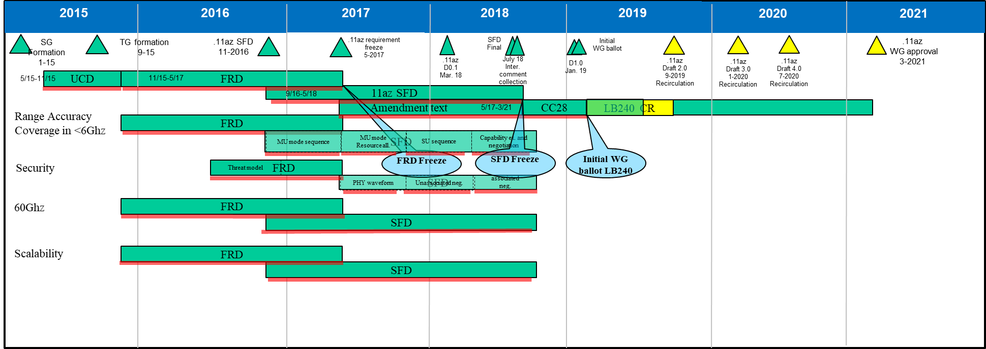
Timelines

Slide 5
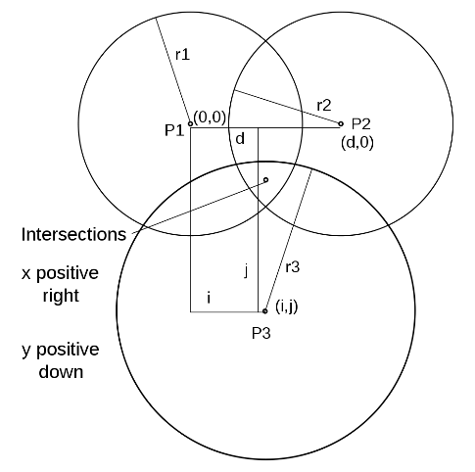
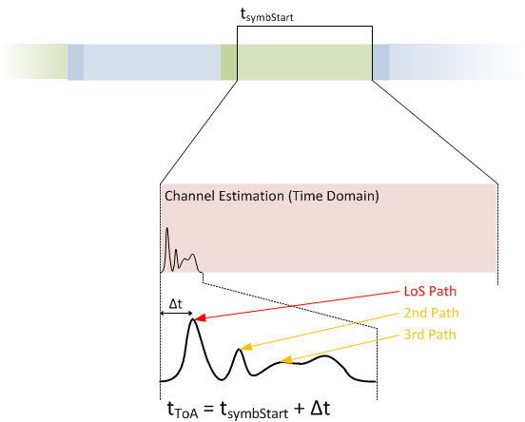
Fine Timing Measurement - Recap
What is it?
  A protocol which enables range measurement from an Initiating STA (ISTA) to a Responding STA (RSTA) by measuring Time Of Flight (TOF).
  Predominant usage (indoor navigation) require a <10nsec accuracy level, which suggest MUSIC (MUltiple SIgnal Classification) processing of channel estimates.
  FTM (Fine Timing Measurement) Protocol initially introduced as part of REVmc as fix to the location services and extension of the TM (Timing Measurement) protocol.
  Protocol is now available in the market in various Android and other devices and was certified by the WFA as Wi-Fi Location CertificationTM and under the Wi-Fi Aware 2.0 CertificationTM
STA
AP
ToF = [(t4-t1) – (t3-t2)]/2
Range = C * ToF
t1 = TOD (M1)
M1
t2 = TOA (M1)
t4 = TOA (M2)
M2
t3 = TOD (M2)
Calculate range
M1
M2
Calculate range

Slide 6
What did we have till now and what to expect?
Highlights:
A simple negotiation supports associated and unassociated.
Management and control frames plays a dual rule (signaling and measurement/sounding).
Measurement rate is fixed and scheduling is RSTA centric, potentially at the expense of power efficiency, medium efficiency and data service.
Fixed measurement windows and limited ability to negotiate time brings.
Sounding is performed over the L-LTF, HT-LTF or VHT-LTF.
Negotiation
Measurement
exchange
Termination

Slide 7
What usages does 11az bring?
Evolutionary roadmap for AP to STA location:
Evolutionary roadmap for P2P range measurement and proximity:
Find your product on the shelf in a store - higher accuracy indoor navigation (sub 1m).
Enhanced always located experience via Improved power consumption, medium efficiency and adaptation to dense environments.
Authenticated location - prevent spoofing and sniffing via protection of FTM procedure.
Allow for analytics and contextual language processing by infrastructure.
Passive location – fixed accuracy independent of number of locating STAs.
Open laptop when seating next to it, open car’s door you’re standing next to - higher accuracy proximity (sub 1m).
Power efficient range measurement scheme for P2P (NAN) environments (x10 or more).
PHY secured proximity – prevent falls sense of distance: open car door/open laptop.

Slide 8
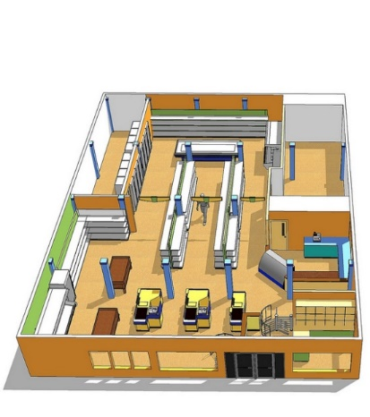
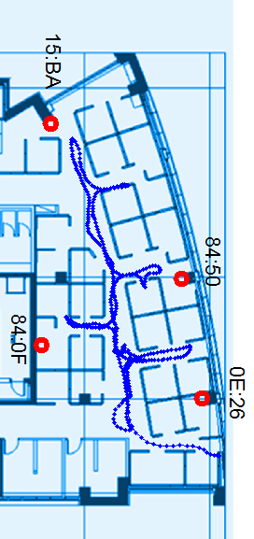


What usages does 11az bring?
Public domain:
Find your way to a shelve/store
Analytics (e.g. flow of people)
Authenticated location
Enterprise usages:
Indoor navigation
Smart office services
Asset tracking
Document rights access
Home usages:
Contextual information (turn on lights – which?)
Multi-AP handover
Proximity usages:
Open car door
Open computer when seated in front it.
Proximity as additional layer of security.

Slide 9
How are those usages supported? (11az feature set)
Evolutionary roadmap for Indoor location usages:
Evolutionary roadmap for P2P proximity usages:
Adaptation to Next Gen. Wi-Fi (802.11ax) Trigger Based operation.
MIMO operation for improved accuracy in NLOS.
Adapt 11ax waveforms and frame structures to 11az range and angle measurement.
Improved PWR using MIMO and single Tx OP operation using Trigger Based 11ax operation.
MAC Security – PASN allows for protection of negotiation and measurement results without association.
Optional PHY security for prevention of false sense of distance as the symbol level.
Angle measurement.
P2P (e.g. TDLS, Wi-Fi NAN) optimized client centric (ISTA) scheduling
MIMO operation for improved accuracy non-TB operation (NAN).
MAC Security – PASN allows for protection of negotiation and measurement results without association.
Optional PHY security allow for prevention of false sense of distance at the symbol level.
Angle measurement.
Infrastructure
P2P

Slide 10
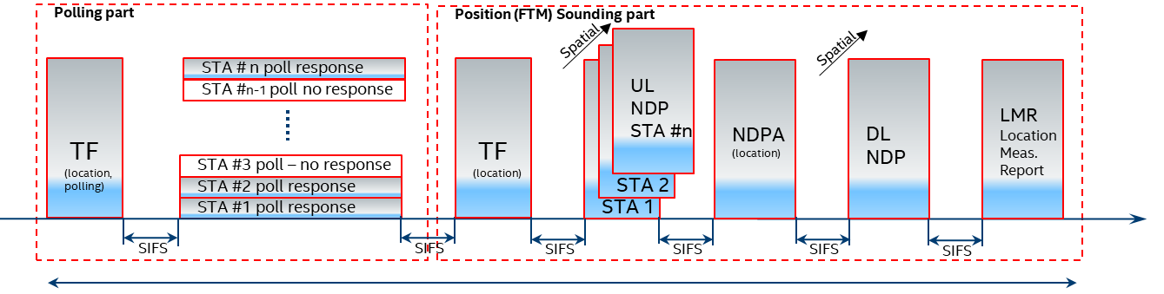
Adaptation to Next Gen. Mainstream Wi-Fi (802.11ax)
Trigger Based coupled with TWT like operation to align to 802.11ax scheduling.
Move to the standard 11ax NDP based sounding mechanism.
Separate PHY and MAC operation to avoid cross layer requirements limitations.
Make use of on-platform sensors (e.g. gyro) and changing channel conditions – dynamic measurement rate.
Substantial improvement of client STA power consumption (single TxOP operation) vs. REVmc FTM.
Single Tx OP

Slide 11
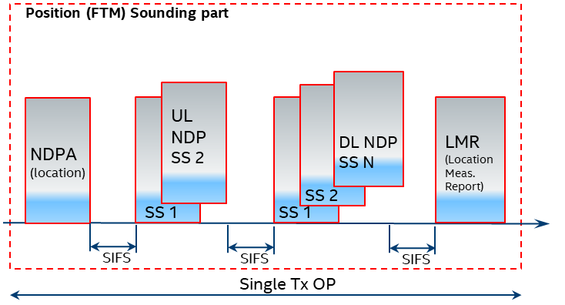
Adaptation to P2P Next Gen. Mainstream Wi-Fi (802.11ax)
SU operation with MIMO support.
Allows to make use of on-platform sensors (e.g. gyro) and changing channel conditions – dynamic measurement rate.
Move to standard 11ax NDP based sounding mechanism.
Substantial improve non-AP STA power consumption (single TxOP operation) and enable optional immediate response (not possible for REVmc) by changing the measurement sequence.
Shares waveforms of TB Ranging operation (HE PPDUs).

Slide 12
MIMO Operation for improved NLOS Performance
Main properties:
Evolution of HE NDP PPDU and the HE MU PPDU, uses same PPDU headers, modulation, symbols length (subset of 11ax), SC spacing to allow for ease of adaptation.
Support for repetition for SNR and increased statistics (medium efficiency improvement).
Allow for spatial reuse for HE TB operation.
HE SU Ranging NDP and HE TB Ranging NDP

Slide 13
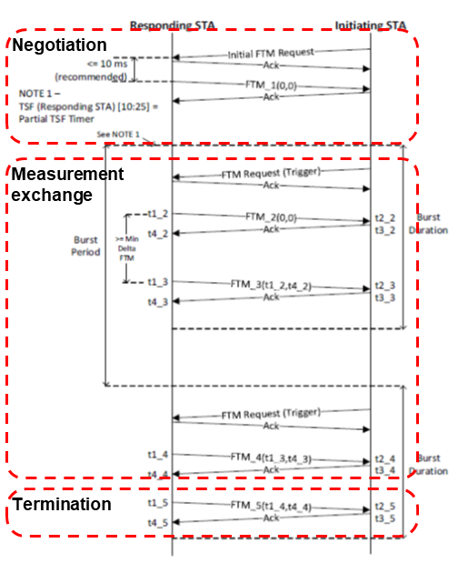
Secured FTM session management
What is it:
REVmc FTM susceptible to eavesdropping and impersonation attacks:
  Wrong sense of range by providing misleading measurement results.
  Wrong sense of RSTA (AP) location by providing misleading CIVIC and LCI information.
  Unwilling Terminate.
Reasons for using Public Action frames for REVmc :
  Allowed to dual purpose the FTM management and control frames for both signaling and sounding while encrypting the management frames creates a timing constraint bottle neck.
  Encrypted action frame category causes implementation issues.
  Allowed for operation in the unassociated mode, i.e. prior to security context establishment (required for trilateration hence for location).

Slide 14
PASN and secured FTM session management
What is it:
A protocol to establish security context in the unassociated mode.
After security context is established FTM session is PMF protected.
Leverages existing AKMs and PMK Caching
Main properties
Moves the security context established prior or without association.
Allow for secured FTM session negotiation and secured transfer of RSTA (AP) location (Civic and LCI information).
Protection of Location Measurement Results (LMR) frames used for signaling of range and angle measurement results.

Slide 15
PHY Level Protection
How does it work?
Derivative of the PTK a new key (HLTK) is derived for generating a continuously changing LTF symbol sequence while the PTK is used for session management protection.
MAC level signaling is used to synchronize the RSTA and ISTA.
In both TB and NTB, the RSTA is the code generator (LTF_GEN_SAC).
The pseudo random sequence is implemented to the HE LTF symbols of the HE TB Ranging NDP and HE Ranging NDP.

Slide 16
PHY Level Protection
How does it work?
Derivative of the PTK a new key (HLTK) is derived for generating a continuously changing LTF symbol sequence while the PTK is used for session management protection.
MAC level signaling is used to synchronize the RSTA and ISTA.
In both TB and NTB, the RSTA is the code generator (LTF_GEN_SAC).
The pseudo random sequence is implemented to the HE LTF symbols of the HE TB Ranging NDP and HE Ranging NDP.
1) Per session @RSTA and ISTA:
Secure-LTF-Key-Seed = HMAC-Hash(HLTK, “Secure LTF key seed”)
2) Per measurement:
@RSTA and ISTA:
SAC || Secure-LTF-bits-R2I = KDF-Hash-Length(Secure-LTF-Key-Seed, “Secure LTF Expansion”, Secure-LTF-Counter)

Slide 17
PHY Level Protection

Slide 18
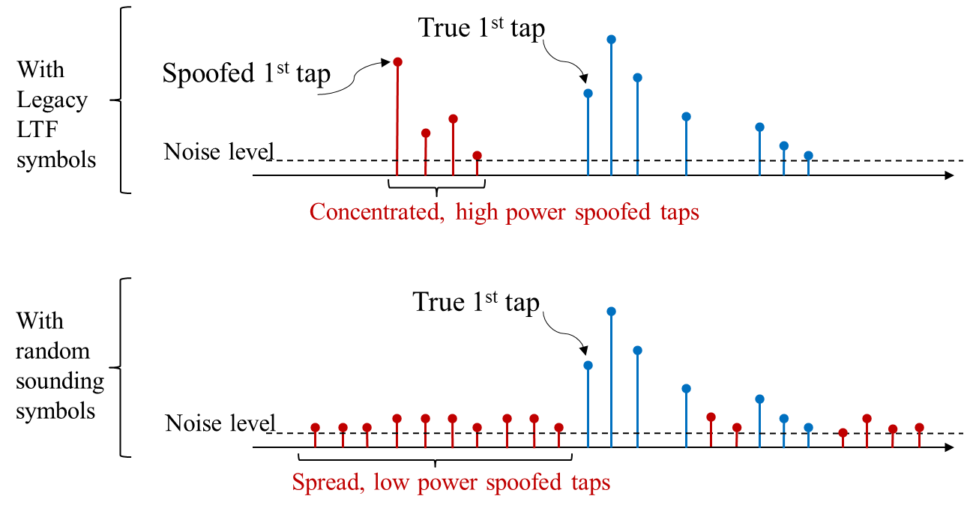
PHY Level Protection
How does it work?
Derivative of the PTK a new key (HLTK) is derived for generating a continuously changing LTF symbol sequence while the PTK is used for session management protection.
MAC level signaling is used to synchronize the RSTA and ISTA.
In both TB and NTB, the RSTA is the code generator (LTF_GEN_SAC).
The pseudo random sequence is implemented to the HE LTF symbols of the HE TB Ranging NDP and HE Ranging NDP.

Slide 19
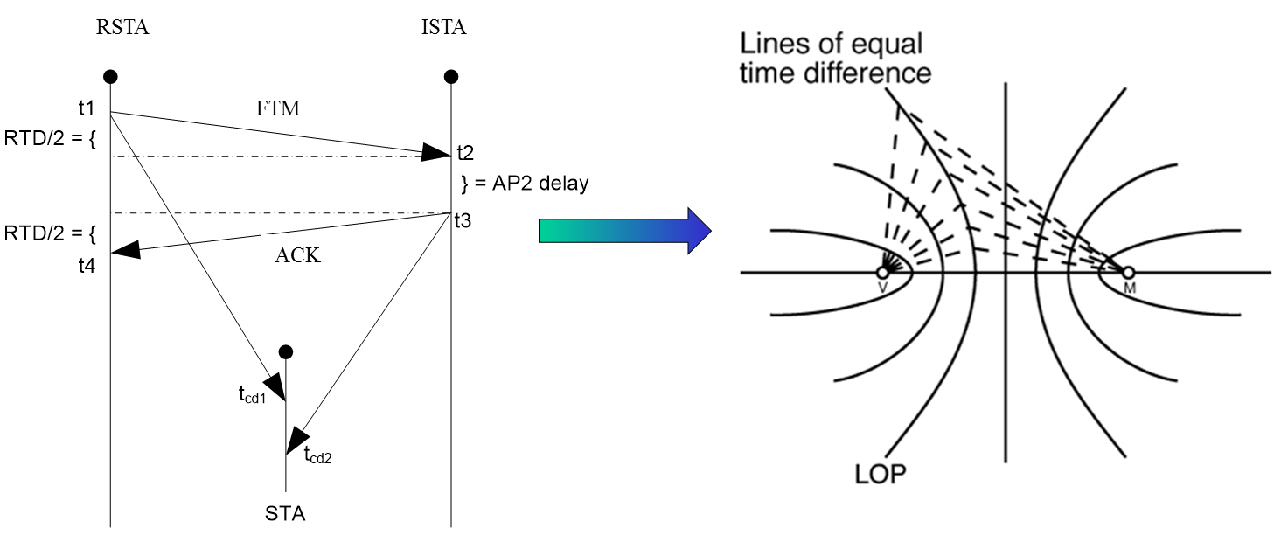
Passive Location
How does it work?
  3 or more AP pairs exchange a known FTM measurement sequence (known as RSTA and Anchor STAs).
  Client STA are in a receive only mode, by that protecting their privacy from network and adversaries.
  By calculating the line of equal time difference, can derive a set of hyperboles.

Slide 20
Passive Location
How does it work?
  Usage include high density deployments.
  Preservation of privacy via receive only mode.
UL
NDP
TF
UL
NDP
TF
rSTA to
iSTA
LMR
iSTA to rSTA
LMR
TF
LCI, DL LMR
UL LMR
Poll
TF
DL
NDPA
DL
NDP
RSTA
iSTA to rSTA
LMR
PR
UL
NDP
ISTA 1
UL
NDP
iSTA to rSTA
LMR
PR
ISTA 2

Slide 21
Summary
The REVmc FTM protocol is seeing commercial market adoption with both AP/Client and P2P deployment models.
802.11az is the natural evolution of this technology by adopting FTM to next generation mainstream Wi-Fi while augmenting it with improved accuracy, power and security/privacy.
802.11az is now at the comment resolution status and consider for market intercept.

Slide 22
Thank you for listening

