Slide 1
Service Discovery Advertisement
Authors:

Slide 2
Service discovery requirements
Within the requirements document there is the explicit need for service discovery:
R3.5.3: The 802.11bc amendment shall have a mechanism for eBCS APs to advertise their eBCS capabilities and eBCS services provided.
Current discussion on SFD assumes use of ANQP for service discovery
ANQP is a pre-association Request/Response based protocol
The use of ANQP leaves out the possibility for STAs not willing to transmit to obtain service description
We propose a new broadcast discovery mechanism for 11bc that complements the ANQP-based one, for listening-only STAs
Service distribution may be based on periodic frame transmission, e.g., beacons or any other periodic frame

Slide 3
Proposal
We propose service discovery can be done based on 3 mechanisms:
Beacon frame/periodic frame transmission
eBCS Service frame request/response
ANQP

Slide 4
Service discovery information
The information provided may consist on a list of services, including:
ID of the service,
Indication if the service requires association
Indication of the negotiation method (eBCS request/response, ANQP, etc.)
ID for the service
Human readable description
Indication of restrictions for the service (e.g., it is a pay-per view service)
URL for registration or information

Slide 5
Identification of Services
In order to advertise a service an identifier is needed.
Services can be identified through the following elements:
MAC Address (maybe use of per-service multicast addresses)
IPv4 Address
IPv6 Address
Higher layer identifier (e.g., 5-tuple, MPEG Transport stream identifier)

Slide 6
Periodic Framing
Mechanisms for providing services available in the network, without requiring request/response dialogues are needed to support different use cases
The best way of doing this will be to have service discovery information in the beacon frame
In case the beacon frame cannot be extended with this information, a periodic frame transmission should be added to cover the service information distribution.
eBCS Service Advertisement

Slide 7
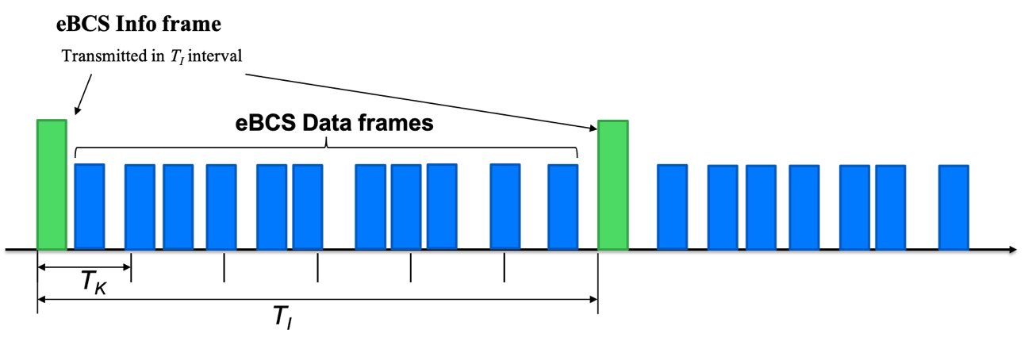
Ways of providing the service discovery
For STAs not willing or able to transmit, the AP should broadcast periodically the information about the eBCS services available.
This can be done in several ways:
Periodic transmission of a frame with the services description.
Piggyback it on a periodic frame, e.g., such as the eBCS Info frame discussed in [1].
Service information can be added to the
periodic frames carrying the Origin Authentication
key

Slide 8
Straw Poll
Should 802.11bc amendment enable a mechanism to provide service information through periodic frame transmissions?
Yes
No
Abstain

Slide 9
References
[1] 11-19-1802-00-00bc-tesla-improvement

