Slide 1
Multi-link Policy Framework
Date: 2019-11-11
Authors:
Name | Affiliations | Address | Phone | Email
Cheng Chen | Intel |  |  | cheng.chen@intel.com
Laurent Cariou |  |  |  | laurent.cariou@intel.com
Das Dibakar |  |  |  | das.dibakar@intel.com
Chittabrata Ghosh |  |  |  | chittabrata.ghosh@intel.com
Carlos Cordeiro |  |  |  | carlos.Cordeiro@intel.com
Notes:
September 2012

Slide 2
Abstract
Multi-link operation is a feature agreed in EHT PAR.
  Multi-link/multi-channel aggregation and operation.
Multi-link operation is applicable to address many different use cases. Depending on the specific characteristics and requirements of these use cases, we need to configure different rules for Multi-link operation.
In this presentation, we call this set of rules the Multi-link policy, and propose the fundamental framework for Multi-link policy.

Slide 3
Multi-link framework as shown in [1]
Example 1
Example 2

Slide 4
Multi-link operations
Multi-link operations between a multi-link AP logical entity and STAs can be divided into several aspects:
  Pre-association
  Post-association management plane
  Post-association data plane
For each aspect, depending on the requirements of use cases, different Multi-link operation rules need to be enforced to regulate the behaviors of AP and STA.
In the following, we use two specific use cases, load balancing and traffic separation & prioritization, to show how Multi-link operation rules vary with different scenarios.

Slide 5
Load Balancing
AP MLLE
AP MLLE moves associated
STAs across links for load balancing
AP MLLE
STA1
STA1
AP1 operating on 2.4 GHz
AP1 operating on 2.4 GHz
STA2
STA2
STA3
AP MLLE implements admission control
for unassociated STAs in each link to
avoid congestion
STA3
AP2 operating on 5 GHz
STA4
AP2 operating on 5 GHz
X
STA4
No !
AP3 operating on 6 GHz
STA5
Yes
AP3 operating on 6 GHz
STA5
STA6
STA6
Main requirements for Multi-link operations for load balancing:
Should enable frequent link transitions
Maintain balanced load across multiple links and avoid congestion in any link
Admission control may be enforced if one link is already heavily loaded
We therefore need to define the following rules:
Link transition: A way to enable the AP MLLE to initiate link transitions for STA MLLEs.
Pre-association: A way to enable the AP MLLE to control and designate specific links for performing Multi-link setup and association.

Slide 6
Traffic Separation & Prioritization
AP MLLE
2.4/5 GHz links serve
STAs with voice traffic
New STAs associate to links
based on their traffic type
STAs with mainly
Voice traffic
STA1
AP1 operating on 2.4 GHz
STAs with mainly
Video traffic
STA2
STA7
AP2 operating on 5 GHz
STA3
STA8
STA4
STA9
AP3 operating on 6 GHz
STA5
6 GHz link serves
STAs with video
traffic
STA6
Main requirements for Multi-link operations for traffic separation and prioritization:
TID-to-link mapping: different TIDs are separated to different links
Admission control can be enforced based on traffic types of unassociated STAs
Restrictions on link transition and aggregation due to TID-to-link mapping
EDCA parameters can be adjusted to prioritize certain types of traffic in certain links (for example, use Trigger-based only channel access)
We therefore need to define the following rules:
TID-to-link mapping: A way to enable AP MLLE to split TIDs across different links
EDCA parameters: A way to enable AP MLLE adjusts EDCA parameters in certain link(s) and may use trigger-based only access in certain link(s)
Pre-association: A way to allow the AP to restrict pre-association traffic on certain links

Slide 7
Multi-link policy
As shown, different use cases require Multi-link operations be used in different manners, therefore a set of operating rules between the AP MLLE and STA MLLEs need to be determined and imposed to regulate AP/STA behaviors based on specific requirements of use cases . We call this set of rules the Multi-link policy.
We propose to define a way to specify and advertise the Multi-link policy enforced by a Multi-link AP logical entity, which STAs have to comply with.
  The Multi-link Policy is included in broadcast frames like Beacon frame and Probe Response frame, or unicast frames addressed to each STA MLLE individually.
  AP MLLE can dynamically adjust certain parameters of Multi-link Policy according to specific use cases it currently focuses, by simply updating the Multi-link Policy and advertising it to STAs.
  This Multi-link Policy could be signaled by a separate element, or part of other elements, as long as the functions are covered.
We therefore establish a unified framework that is flexible enough to apply multi-link operations to address different use cases.

Slide 8
Example of Multi-link Policy element
If defined as a separate element, we can introduce a new Multi-link Policy element.
Since some aspects of the Multi-link policy apply across different links (like band transition and aggregation), while some can be link-dependent (like TIDs allowed, channel access), we propose to define the Multi-link Policy element as follows:
  The Common Policy subelement defines the policy applied across all enabled links.
  Each Link Specific Policy subelement defines the policy that only applies to one specific link.
  This is similar to the 11ax Trigger frame which consists of a Common Info field and several User Info fields.
Element ID | Length | Element ID Extension | Common Policy | Link Specific Policy | Link Specific Policy | … | Link Specific Policy
1 | 1 | 1 | TBD | TBD | TBD | … | TBD

Slide 9
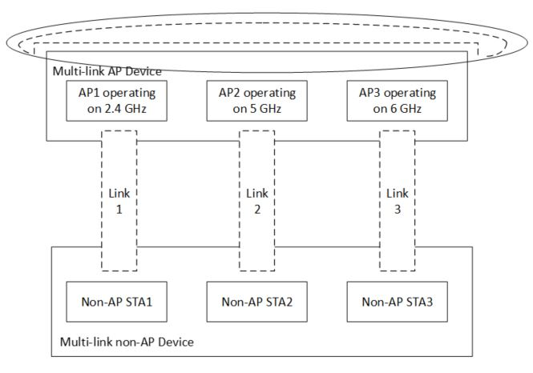
Illustration of Multi-link Policy element
Common Policy | Link Specific Policy (Link 1, 2.4 GHz) | Link Specific Policy (Link 2, 5 GHz) | Link Specific Policy (Link 3, 6 GHz)
TBD | TBD | TBD | TBD

Slide 10
Conclusions
We proposed the concept of Multi-link policy, which is a set of rules regulating multi-link operations between an AP MLLE and STA MLLEs.
The Multi-link policy enables a unified framework that is flexible to apply multi-link operations to address different use cases.

Slide 11
References
[1] 11-19-0773-07-00be-multi-link-operation-framework

