Slide 1
Influence of Delay-close Multi Path Components on FTM-RTT
Date: 2020-01-14
Authors:

Slide 2
Abstract
[1], [2] present results on RTT ranging performance for 11bd NGV 10 and 20 MHz modes in 5.9 GHz band
Optimistic performance results due to selected channel models
This contribution:
Influence of delay-close Multi Path Components (MPCs) on FTM-RTT due to ground reflection (GR)
For safety critical applications requirements on ranging accuracy cannot be met with high probability
➔ Larger bandwidth for improved ranging accuracy needed

Slide 3
Influencing Factors for RTT Ranging
Bandwidth ➔ Resolution in distance and delay
Operation frequency f and distance d ➔ Signal to Noise Ration (SNR) [1]
$P_{Rx}=P_{Tx}{\left(\frac{c}{4πdf}\right)}^{2}$ ➔$SNR\left(d\right)=\frac{P_{Tx}G_{Tx}G_{Rx}}{N_{F}k_{B}T_{N}BW}{\left(\frac{c}{4πdf}\right)}^{2}$
Bandwidth / [MHz] | Distance Resolution / [m] | Delay Resolution/ [ns]
0010 | 30.00 | 100
0020 | 15.00 | 50
1000 | 0.3 | 1
Notes:
If we divide both side (P_Rx, P_Tx) by the noise power you get the relationship between the SNR to distance and frequency. Basically, SNR is inversely proportional to d^2 and f^2.
Please note that we didn’t take this relationship in consideration in our simulations. We randomly combined different distance and SNR values without considering the relationship.

Slide 4
One-Path Model
Tx
LOS
Rx
Tx …Transmitter LOS … Line of Sight
Rx … Receiver

Slide 5
Two-Path Model
Tx
LOS
Rx
MPC
Tx height
Rx height
Reflecting Surface
Depending on phase of MPC constructive or destructive interference
➔ Worst case scenario MPC out-of-phase to LOS
Tx …Transmitter LOS … Line of Sight
Rx … Receiver MPC … Multi Path Component
Notes:
At small distances: maximum MPC delay => MPC delay > LOS delay
At large distances: MPC delay == LOS delay

Slide 6
Simulation Settings (1)
Single range simulations: 10 000 packets simulated
Tx, Rx height = 1.5 m or 4 m
Tx-Rx distance random between 10 to 100 m
Channel models
AWGN
UA-LOS
Ground reflection on LOS with 3 or 10 dB relative path power
Path estimation:
Coarse
Fine
SAGE (space-alternating generalized expectation-maximization) algorithm
Notes:
SAGE is an Expectation-Maximization (EM) based method. The main difference to the classic EM is that we estimate each of the parameters separately to decrease complexity. First, we estimate the delay coarsely using correlation between the LTF (Long Training Field) with the received signal. Afterwards, we maximize the expectation by searching around the coarse estimate with a higher resolution until we get the maximum correlation value.

Slide 7
Simulation Settings (2)
Label | LOS model | MPC |  |  | SNR / [dB] | Path estimation | BW / [MHz]
 |  | Presence | Noise | Power / [dB]
Channel 1 | AWGN | No |  |  | 10/20 | 1-5 paths | 10/20
Channel 2 | UA-LOS | No
Channel 3 | AWGN | Yes | AWGN | 3, 10, 20
Channel 4 | UA-LOS | Yes | AWGN | 3, 10, 20
Notes:
SAGE is an Expectation-Maximization (EM) based method. The main difference to the classic EM is that we estimate each of the parameters separately to decrease complexity. First, we estimate the delay coarsely using correlation between the LTF (Long Training Field) with the received signal. Afterwards, we maximize the expectation by searching around the coarse estimate with a higher resolution until we get the maximum correlation value.

Slide 8
Simulation Results
Take into account non detected packets (coarse sync on STF failed)
Compare LOS, LOS + ground reflection (GR), UA-LOS and UA-LOS + GR with different relative path powers
Ranging method:
Packet detection and coarse estimation
Fine estimation
SAGE (space-alternating generalized expectation-maximization)
Cumulative distribution function (CDF) of absolute error
Notes:
CDF shows how much errors fall below a certain value. x-axis is distance error in meter and y-axis is the percentage. For example: 70% of errors are less than 2m.

Slide 9
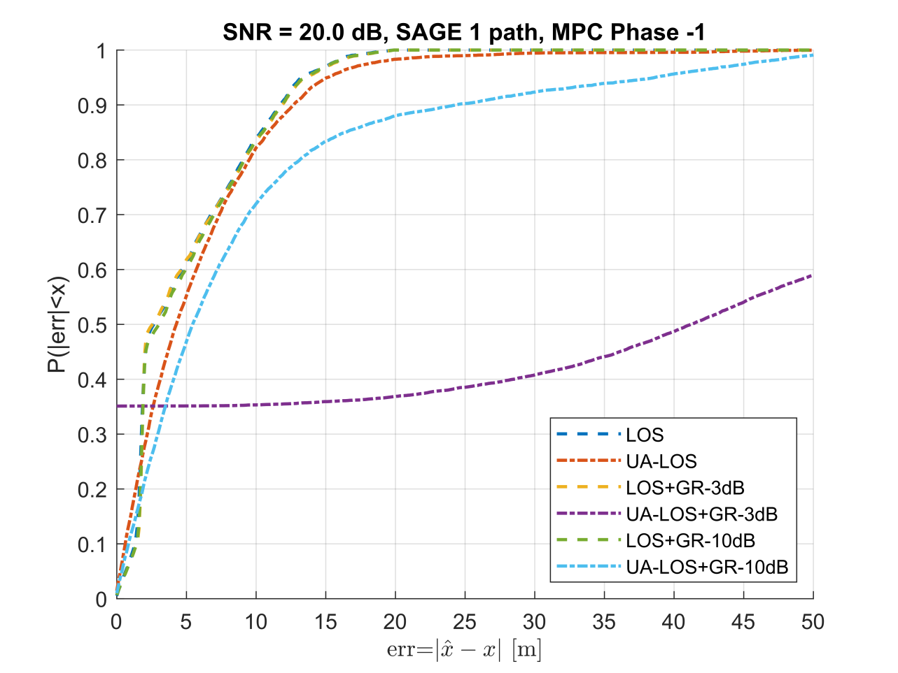
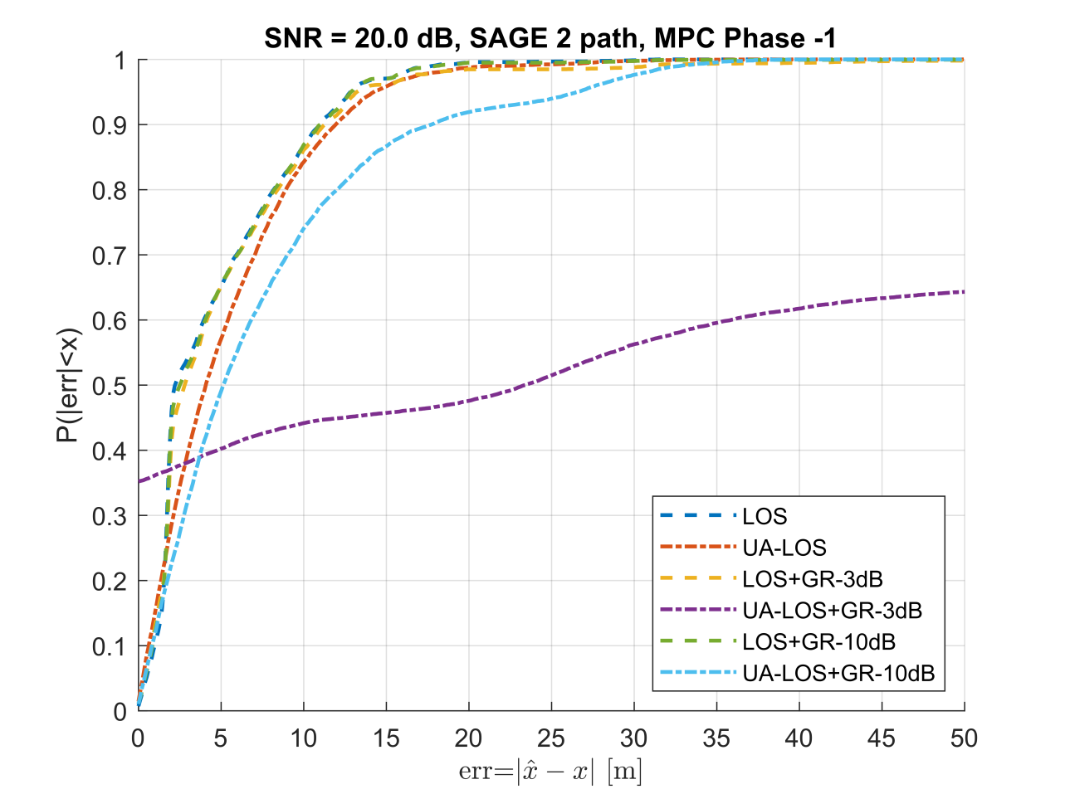
BW=10MHz, Out-of-Phase MPC, Antenna Height 1.5 m, SNR 20 dB

Slide 10
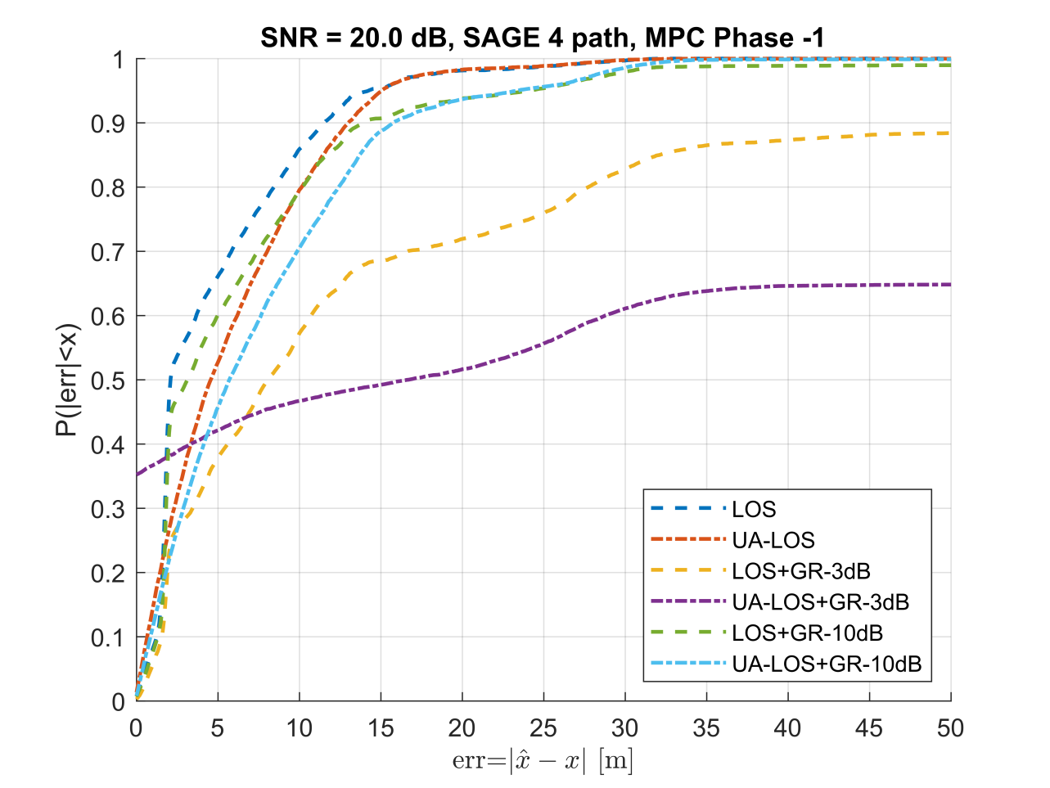
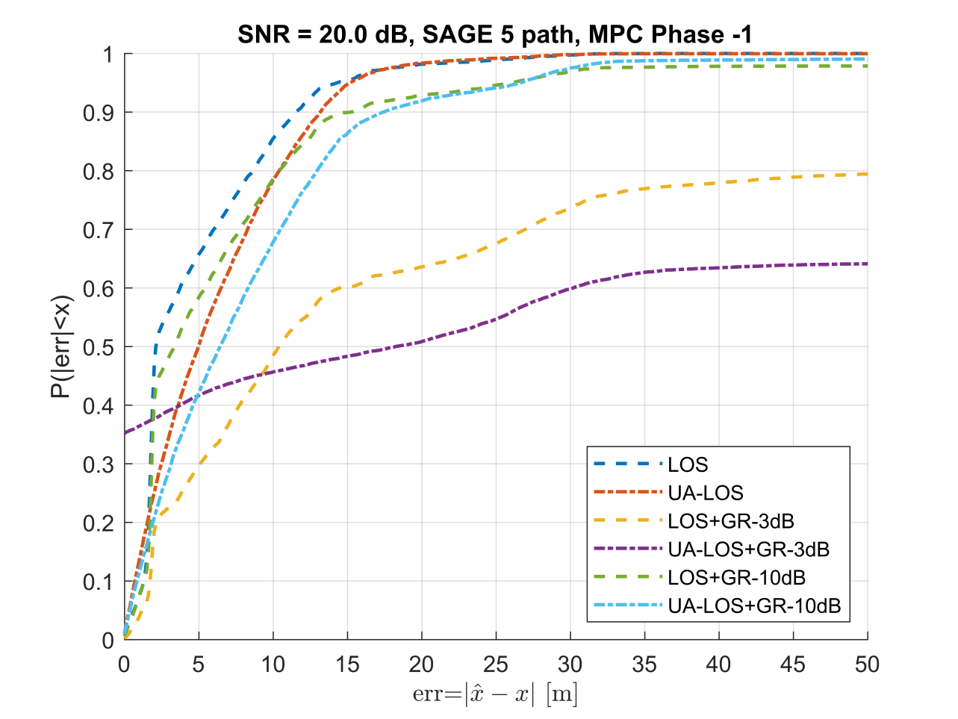
BW=10MHz, Out-of-Phase MPC, Antenna Height 1.5 m, SNR 20 dB

Slide 11
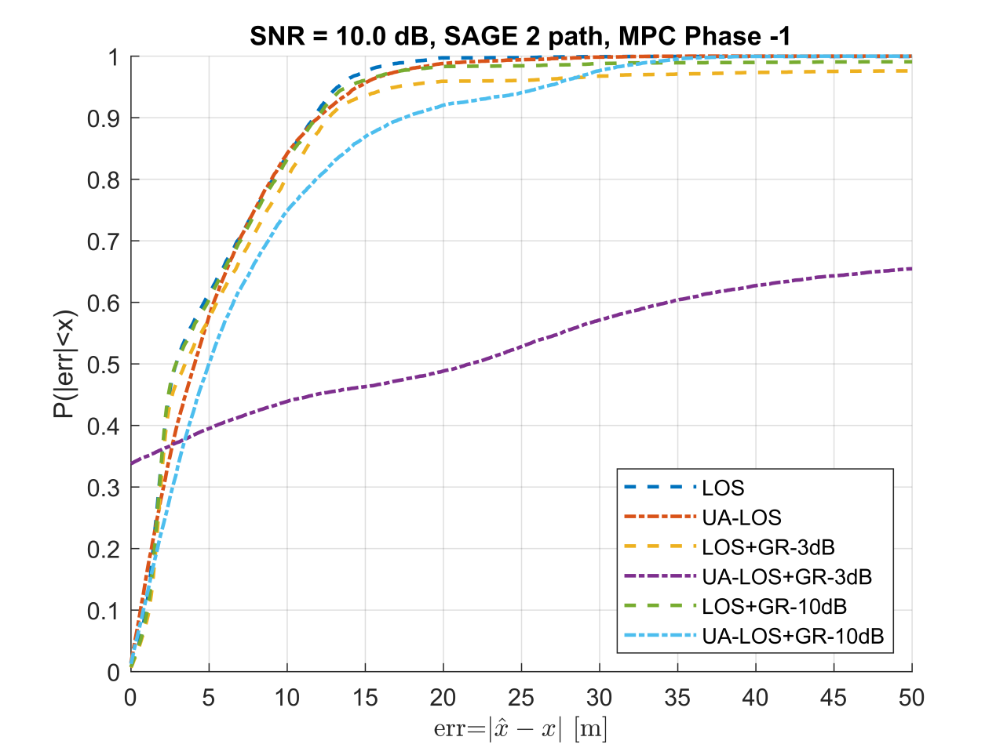
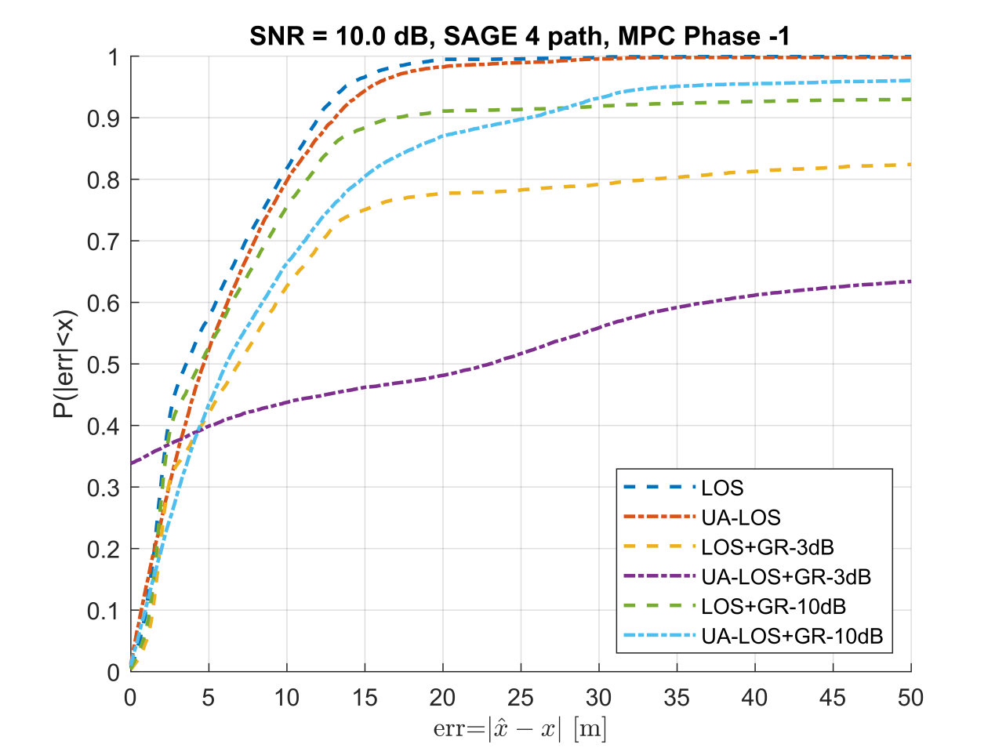
BW=10MHz, Out-of-Phase MPC, Antenna Height 1.5 m, SNR 10 dB

Slide 12
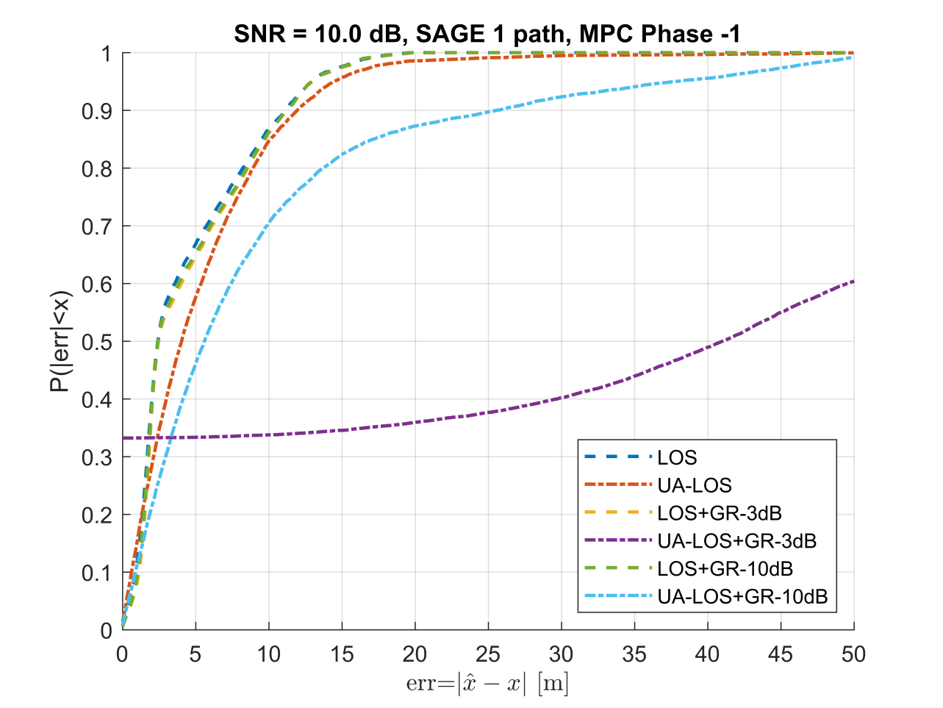
BW=10MHz, Out-of-Phase MPC, Antenna Height 1.5 m, SNR 10 dB

Slide 13
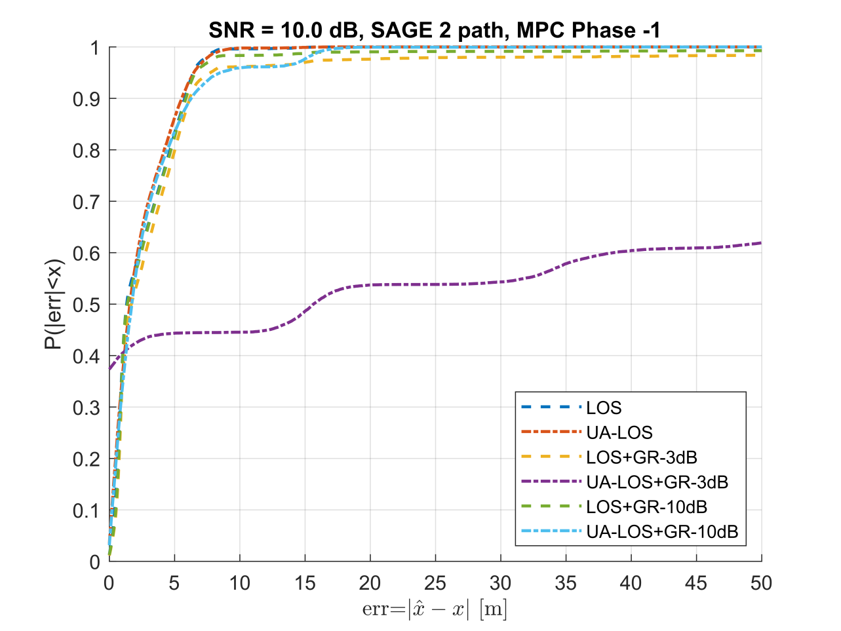
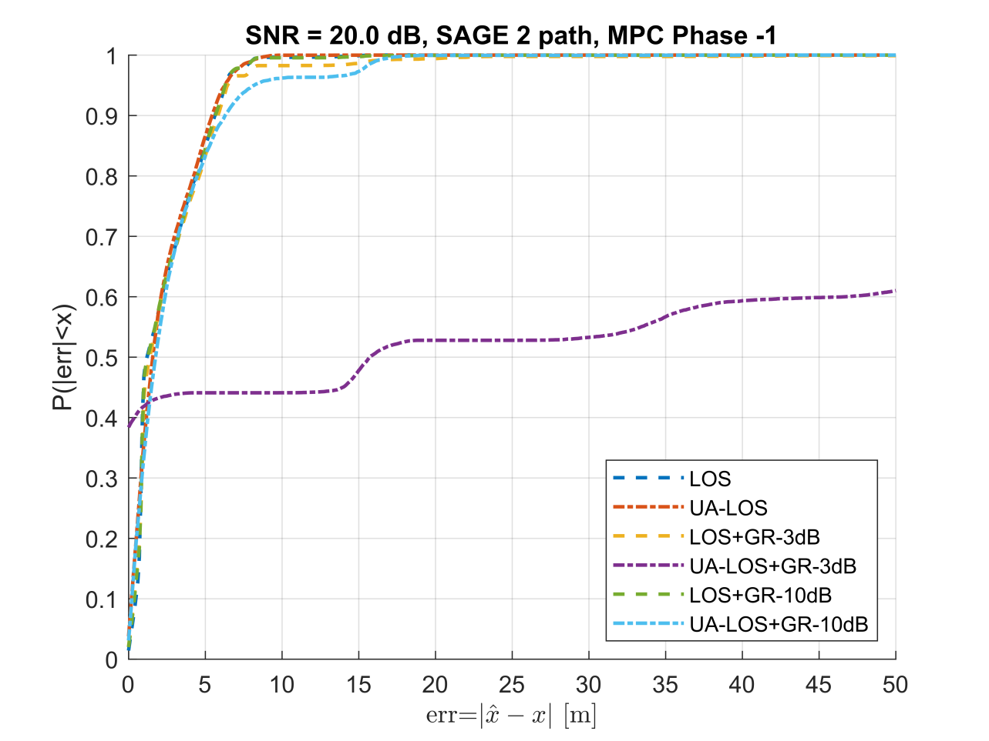
BW=20MHz, Out-of-Phase MPC, Antenna Height 1.5 m, SNR 10 dB, 20 dB

Slide 14
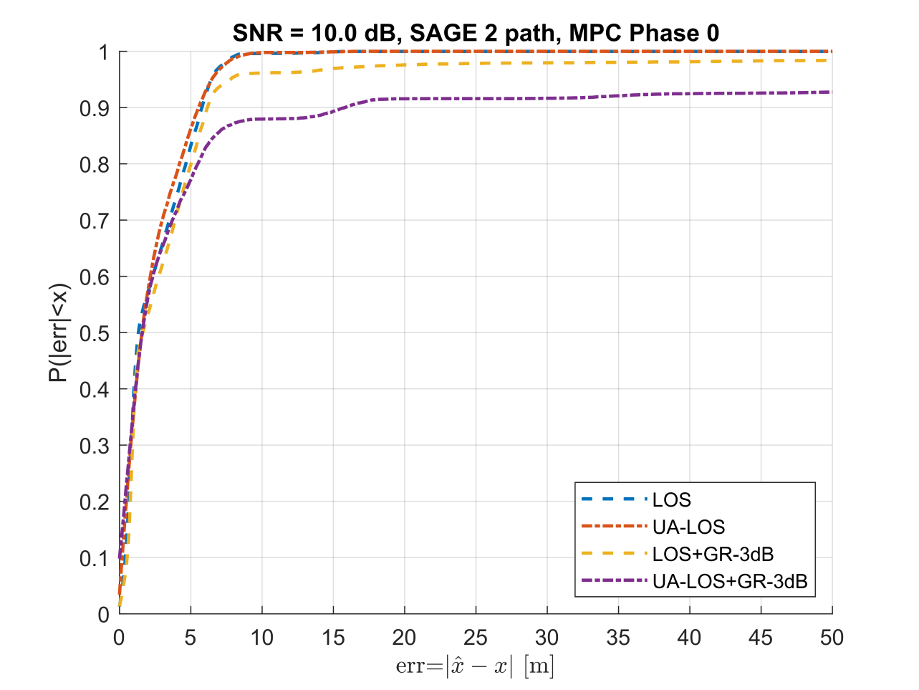
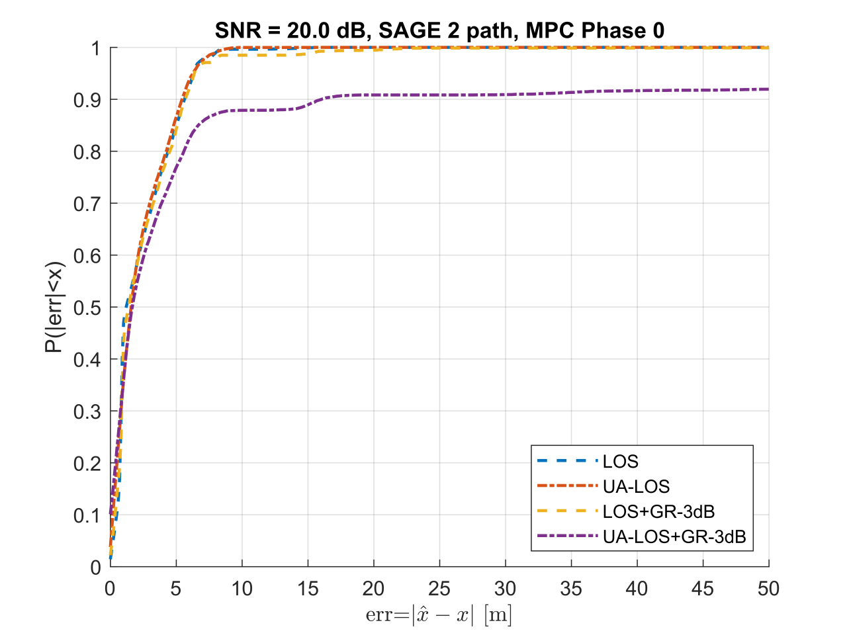
BW=20MHz, Random Phase MPC, Antenna Height 1.5m, SNR 10 dB, 20 dB

Slide 15
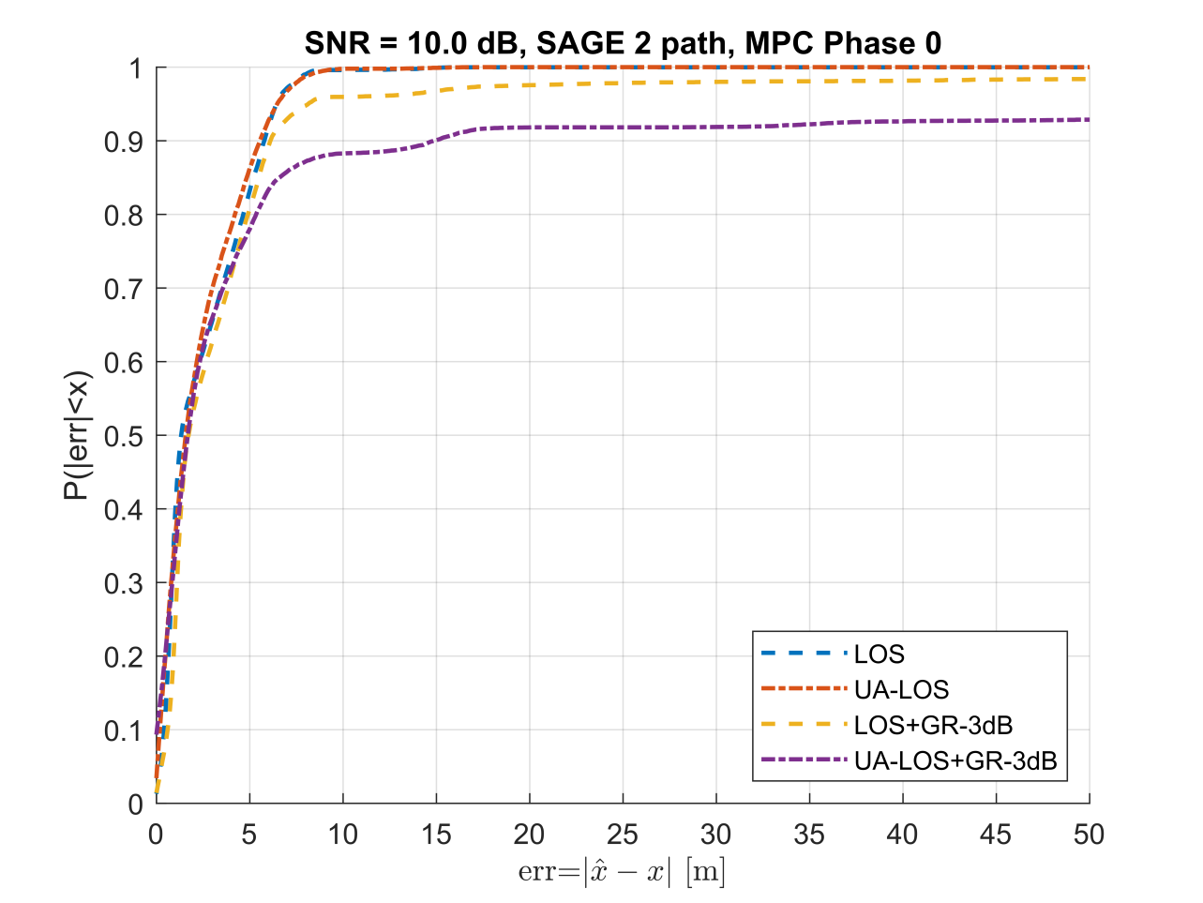
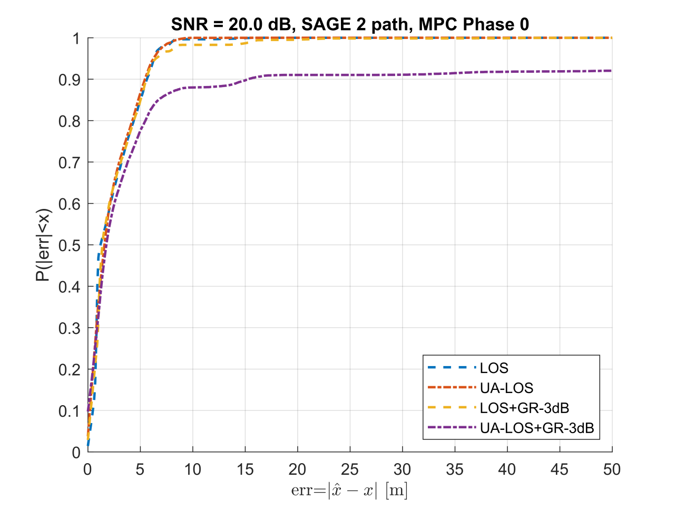
BW=20MHz, Random Phase MPC, Antenna Height 4 m, SNR 10 dB, 20 dB

Slide 16
Conclusion
Influence of BW = 10 MHz or 20 MHz to resolve delay-close MPCs
Significant improvement by doubling the BW
Influence of channel models with delay-close MPCs (ground reflection)
Significant decrease of ranging accuracy
Optimistic results with standard tapped-delay line models [2]
Geometric stochastic channel models would give more realistic results [3]
Saftey critical applications [4] require 1% ranging accuracy ➔ 1m accuracy at 100 m ➔ P(|err|<1 m)< 40%
Larger bandwidth needed for improved ranging accuracy: 11bd 60 GHz mode with BW > 1 GHz

Slide 17
References
[1] IEEE 802.11-19/0788 Considerations on Ranging in NGV
[2] IEEE 802.11-19/0859 Ranging Performance in 11bd
[3] IEEE 802.11-19/0034 Considerations on Vehicular Channel Models
[4] IEEE 802.11-19/1342-r1 11bd Use Cases

