Slide 1
Multiple RU discussion
Date: 2019-11-06
Authors:
Name | Affiliation | Address | Phone | Email
Ross Jian Yu |  | F3-6A, Huawei Base, Bantian, Shenzhen |  | ross.yujian@huawei.com
Ming Gan

Slide 2
Background
In [1], it is mentioned, multiple RUs for one user should be supported to enhance spectral efficiency, take advantage of frequency diversity.
This proposal discusses several aspects regarding multiple RUs for one user transmission:
  PPDU format
  Transmission in Data field
  Signaling

Slide 3
Multiple RUs for one user - PPDU format
For EHT MU PPDU and EHT TB PPDU, since OFDMA is already supported, it is straightforward to support multiple RUs for one user.
  How many RUs can one STA support needs to be further evaluated, depending on the complexity and cost
For EHT SU PPDU, if 11be supports preamble puncture for SU PPDU. Because of puncture, there will be several discontiguous channels. If the discontiguous channels are seen as different RUs, and since SU is targeted for one user, then multiple RUs for one user should also be supported.

Slide 4
Multiple RUs for one user –
Transmission in Data Field
There can be several ways to transmit the data in multiple RUs:
 | Method | Pro | Con
Opt1 | act as transmit the data to two different users, each RU is encoded, interleaved separately | Can reuse existing Tx procedure. Full flexibility regarding MCS, NSS. | Robustness is not fully achieved Require parallel MAC processing
Opt2 | The bits are encoded together, and parse to different RUs, separate interleaver/tone mapper | Similar procedure as 160/80+80MHz transmission | Robustness is not fully achieved May need to define new encoding parameters
Opt3 | Opt1/Opt2+interleaver across RUs | Pro of Opt1/Opt2 Fully utilize the robustness | Need interleaver across RUs
Opt4 | Act as one big continuous RU | Can reuse existing Tx procedure if big RU is already defined RU | Need new parameters for encoding, interleaver if big RU is not defined

Slide 5
Multiple RUs for one user - Signaling
Regarding signaling, for EHT MU PPDU and EHT TB PPDU, the simplest way is to enable the same AID for multiple user fields.
  May affect the procedure of parsing. Previously, the STA can stop decoding once its own AID is detected. May need some signaling to tell the STAs when to stop parsing.
With some restriction, for example, same MCS, NSTS, some further optimization regarding overhead can be considered.

Slide 6
Simulations
We ran simulations on Opt 2 and Opt 4. The simulation settings are as follows:
  ChD
  MPDU length: 1600 bits
  Single BCC encoder, 4Tx, 3Rx, 3SS or 1Rx, 1 SS, MCS5
  Opt2: bits are parsed into one 26-tone RU and one 52-tone RU, reuse existing interleaver for each RU separately
  Opt4: one interleaver for 78-tone RU (new defined interleaver)
  No CFO, no PN, perf CHEST

Slide 7
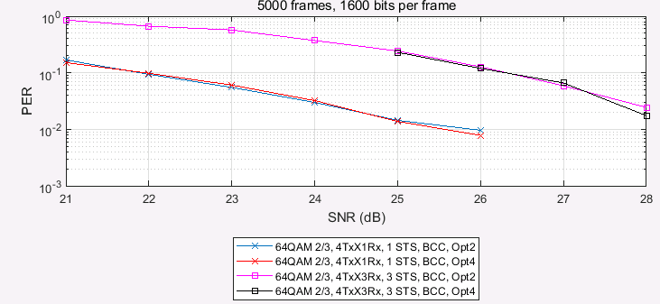
Simulations
Opt2:Separate interleaver
Opt4: single interleaver

Slide 8
Wrap up
Several aspects regarding multiple RUs for one user transmission have been discussed regarding:
  PPDU format
  Transmission in Data field
  Signaling
Regarding transmission in the data field:
  Opt2 and Opt4 show similar performances. A tradeoff between reusing existing interleaver and single interleaver per combined RU can be further considered.
  Opt3 will be further studied and evaluated.
  Opt1 is not preferred regarding complexity

Slide 9
Straw Poll 1
Do you support that for LDPC coding, for combined RUs sent to a user with RU size less than 242-tone, a single tone mapper shall be used?

Slide 10
Reference
1. https://mentor.ieee.org/802.11/dcn/19/11-19-1126-00-00be-enhanced-resource-unit-allocation-schemes-for-11be.pptx

