Slide 1
Multi-RU Support
Date: 2020-01-13
Authors:
Name | Affiliations | Address | Phone | email
Ron Porat | Broadcom |  |  | ron.porat@broadcom.com
Sundar Vanka | Broadcom |  |  | sundar.vanka@broadcom.com

Slide 2
Abstract
In the September meeting the group motioned that 11be shall allow more than one RU to be assigned to a single STA
In this contribution we propose a set of RU combinations to be supported by STA
This set of combinations should cover the allowed punctured BW modes supported by a single STA
We focus here on BW<=160MHz.
In r1 we add one more RU combination for non-OFDMA 160MHz (slide 7)

Slide 3
Design Considerations and Goals
We divide RU sizes into small {26,52,106} and large {242,484,996} and propose that no mixing of small and large RUs is supported as each 20MHz can either be assigned to one large user or be split among small users
For non-OFDMA cases (SU or MU-MIMO across the BW) assume a minimum RU resolution of 20MHz due to current preamble BW and a desire to keep CCA on a 20MHz resolution
For non-OFDMA cases punctured BW modes shall occupy at a minimum 50% of the non-punctured BW
Support for RU combinations in OFDMA is preferably less than in non-OFDMA modes since the spectrum is now split among multiple STA.

Slide 4
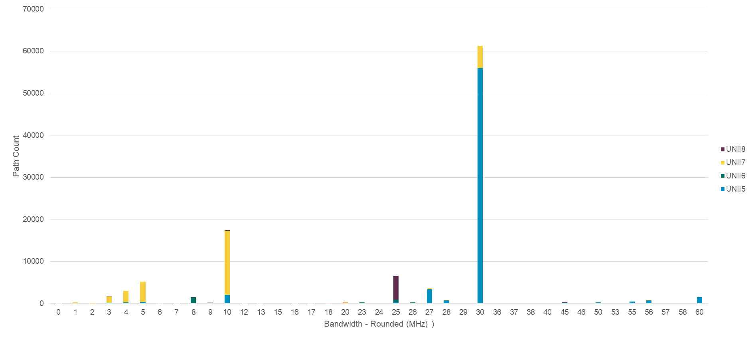
Cont.
Minimize the RU combinations supported to only those that will be made mandatory (conditional on support for puncturing)
Puncturing modes should support:
20MHz channels to accommodate Radars in 5GHz, 10MHz incumbent links in 6GHz and LBT failures on one or more 20MHz subbchannels
40MHz and 60 MHz channels to accommodate 30MHz incumbent links which are the most common incumbent BW in 6GHz

Slide 5
Large RU combinations in non-OFDMA for BW<80MHz
484+242 supports contiguous 60MHz and non-contiguous 60MHz
Puncturing one 20MHz anywhere in the 80MHz channel
For 242+242 we only propose to support the case where both 242 RUs are the outer ones in the 80MHz (a [1001] configuration) since:
Supporting the proposed configuration allows working around one 30MHz incumbent link in the middle of the 80MHz channel
Supporting a [0110] configuration creates a 40MHz not aligned with the 40MHz channelization → not a good idea
Supporting a ‘on-off’ [1010] configuration is difficult with 11ax [1212] SIG-B design
RU size | Agg. BW
242+242 | 40 MHz
484+242 | 60 MHz

Slide 6
Large RU combinations in OFDMA for BW<=80MHz
Note that by OFDMA we mean a PPDU carrying information to at least two STA so the available BW can be split among them
Compared to the previous slide, no need for 242+242 since that configuration can be split among 2 STA
RU size | Agg. BW
484+242 | 60 MHz

Slide 7
Large RU combinations in non-OFDMA for 80MHz<BW<160MHz
Building on the 80MHz design we view the following configurations as important and sufficient:
100MHz covers cases where a 30MHz incumbent sits on three 20MHz subchannels
120MHz cover many cases for two 20MHz punctured subchannels or one 40MHz subchannel
First configuration – 30MHz incumbent occupies part of 40MHz on one side of one 80MHz
Second configuration – 30MHz incumbent occupies part of 40MHz in the middle of one 80MHz (242+242 is limited as described for 80MHz)
Third configuration – 30MHz incumbent occupies the middle of 160MHz (with 484+242 used as contiguous 60MHz on the outer sides). Many other cases of two punctured 20MHz subchannels are supported with all other configurations of 484+242
140MHz represents a likely case where just one 20MHz is punctured
80MHz RU size | 80MHz RU size | Agg. BW
484 | 484+242 | 100 MHz
484 | 996 | 120 MHz
242+242 | 996 | 120 MHz
484+242 | 484+242 | 120 MHz
484+242 | 996 | 140 MHz

Slide 8
Large RU combinations in OFDMA for 80MHz<BW<=160MHz
Note again that by OFDMA we mean a PPDU carrying information to at least two STA so the available BW can be split among them
40 MHz and 80 MHz can already be achieved with one RU → focus on adding support for the other aggregate BW values between 20 and 120
(484+242) = means combination allowed only within 80MHz
RU size | Agg. BW
(484+242) | 60 MHz
484+(484+242) | 100 MHz
484+996 | 120 MHz

Slide 9
Small RU {26,52,106} Combinations in OFDMA
Prefer to only add support for contiguous 26+52 and 26+106 within a 20MHz.
These modes enable better usage of a 20MHz by allowing 2 users to share it even if an edge 26RU is punctured out
For full 20MHz use 106+26 for one user and 106 for another → efficient support for 8 users in 80MHz or 16 users in 160MHz
For punctured edge 26RU (if that 20MHz is split among small users) use 106+26 for one user and 52+26 for another
We don’t see the need to support non-contiguous small RU combinations since typical MIMO configurations of AP and STA already provide sufficient diversity and CQI feedback may be used to choose good locations for small RU.

Slide 10
Summary
Proposed a conditional mandatory list of supported large RU combinations for BW up to 320MHz
Proposed a list for small RU combinations within 20MHz
Proposed not to mix small and large RU

Slide 11
Straw Poll 1
Do you support the conditional mandatory (conditional on supporting puncturing) large RU combinations for 80MHz non-OFDMA as described below:
484+242 supports contiguous 60MHz and non-contiguous 60MHz
Puncturing one 20MHz anywhere in the 80MHz channel
For 242+242 we only support the case where both 242 RUs are the outer ones in the 80MHz (a [1001] configuration)
Note: several tones at the edge may be punctured
RU size | Agg. BW
242+242 | 40 MHz
484+242 | 60 MHz

Slide 12
Straw Poll 2
Do you support the large RU combinations for 80MHz OFDMA as described below?
Y
N
A
RU size | Agg. BW
484+242 | 60 MHz

Slide 13
Straw Poll 3
Do you support the large RU combinations for 160MHz non-OFDMA as described as described below?
CM – conditional mandatory on supporting puncturing
O- optional
80MHz RU size | 80MHz RU size | Agg. BW | Notes
484 | 996 | 120 MHz | CM
484+242 | 484+242 | 120 MHz | O
484+242 | 996 | 140 MHz | CM

Slide 14
Straw Poll 4
Do you support the large RU combinations for 160MHz OFDMA as described in slide 8?
() means within 80MHz
Y
N
A
RU size | Agg. BW
(484+242) | 60 MHz
484+(484+242) | 100 MHz
484+996 | 120 MHz

Slide 15
Straw Poll 5
Do you support the small RU combinations of 26+52 and 26+106?
Y
N
A

