Slide 1
16 Spatial Stream Support
Date: 2020-01-14
Authors:

Slide 2
Introduction
In this contribution, we showed the benefit of supporting 16 streams for MU-MIMO and SU-MIMO

Slide 3
MU-MIMO 16 Spatial Stream Support
MU-MIMO
16 antenna AP vs 8 antenna AP
10 STAs each STA has 2 antenna
16 antennas AP almost double the throughput of 8 antenna AP
16ss support is a promising
feature to significantly increase
peak throughput
Sounding feedback overhead is the challenging problem. But there is an effective way to reduce overhead [2-3, and more]
Results from [1]

Slide 4
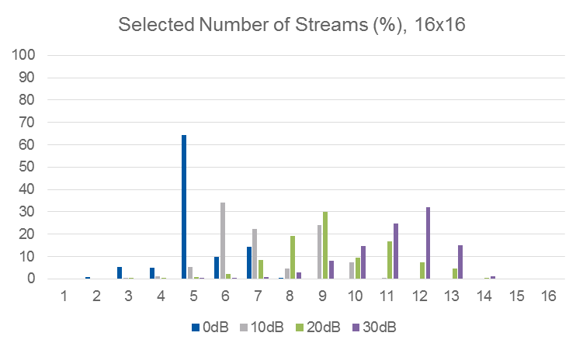
SU-MIMO 16 Spatial Stream Support
SU-MIMO
Maximum 8 vs 16 spatial streams
Assume 16 antennas at both transmitter and receiver
There is clear performance benefit of supporting 16 spatial streams
As shown in [3], performance impact of increased feedback overhead is not critical in SU-MIMO case

Slide 5
Straw Poll #1
Do you support that 11be defines a maximum of 16 spatial streams for SU-MIMO?

Slide 6
Straw Poll #2
Do you support maximum 16 spatial streams for MU-MIMO in 11be?

Slide 7
Reference
[1] 11-18/1575r0, “Further study on potential features”
[2] 11-19/1018r1, “Feedback Overhead Reduction”
[3] 11-19/1495r0, “Further Discussion on Feedback Overhead Reduction”
[4] 11-19/0719r1, “TGbe channel model document”

