Slide 1
AR/VR on EHT: Design Considerations
Date: 2019-11-11
Authors:

Slide 2
Outline
Use cases
KPI/Timing diagram
Simulation results
Comparison with 5GNR
Source of Latency in 802.11
Design Considerations
Few Suggestions
Straw poll

Slide 3



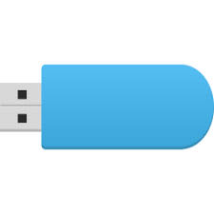
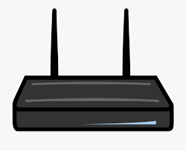
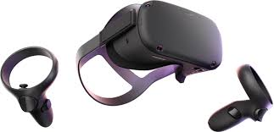

Use Cases
AR/MR
VR
P2P
(Rendering from phone or other device)
Router
(Enterprise rendering)
P2P
(Remote rendering on PC)
Router
(Remote rendering on server)
ISP
Notes:
(A/M/V)R – (Augmented/Mixed/Virtual) Reality
Processing/heavy lifting offloaded to systems that can handle higher workload and dissipate higher power.
Router services both AR/VR traffic as well as regular/legacy devices.
Coex is a major concern, especially when multiple low latency devices are in close proximity to each other.

Slide 4
KPIs
Use Case | Throughput | Latency | Power
VR P2P | >100Mbps | ~5ms | ~ 1W (HMD)
VR Router | >50Mbps | ~2ms | ~ 1W (HMD)
AR/MR Glasses | >100Mbps | 2-5ms | << 1W (Glass)
High throughput
  Traffic is primarily video post-compression. Periodic/deterministic traffic (1 burst per video frame)
  Refresh rate: ~100Hz, Resolution: >4K (x2 eyes)
Video frame latency objective at ~99.99 percentile
  Downlink wireless added latency, measured as latency experienced by a frame while it transits the wireless subsystem
  Overall motion to photon (M2P) latency target < 20ms.
Almost lossless, Video frame reliability: ~99.99 percentile
Power consumption
  VR: sustained high throughput for ~ 1hour.
  AR: whole day active
Coex among multiple AR/VR links. Throughput down scaling in high density scenario
Notes:
HMD – Head mounted display
M2P latency is defined as time when an action is performed (head movement/controller input or movement) to when the modified frame is displayed by the head mounted display (HMD).
UL is also latency critical, but the data rates are typically lower relative to downlink data rate.

Slide 5
Typical timing diagram
Pipelined architecture in order to minimize latency
Either wireless link should be
  allowed to transmit on demand (Instantaneous transmission)
  or scheduled (wireless access locked to system time or system time locked to wireless schedule)
Controller/Head pose Uplink
POSE
WIRELESS TXN
RENDER CPU/GPU
Wireless added Latency
< 5ms P9999
Video Frame Downlink
COMPRESSION
WIRELESS TRANSFER
DECOMPRESSION
SCANOUT/DSIPLAY
Frame Interval
True Motion to Photon Latency (M2P)

Slide 6
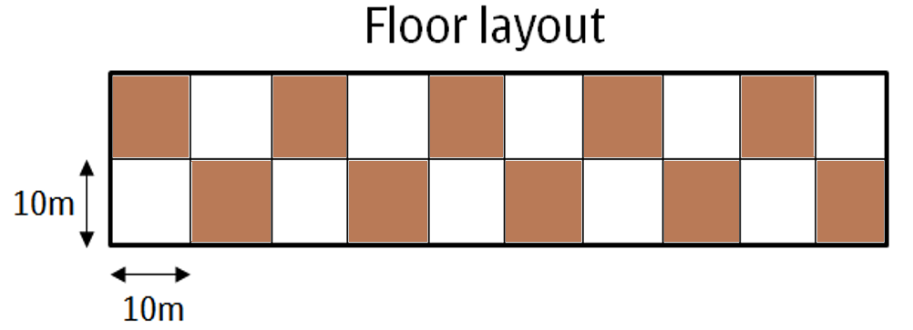
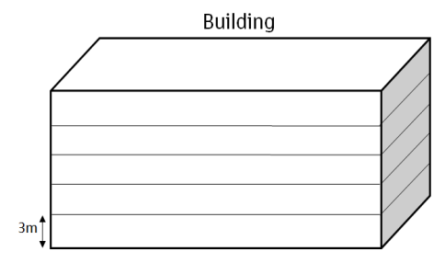
Meeting KPI
KPIs can be easily met with 802.11 if channel is interference free
Presence of other users in the same band causes large latency tail depending on the traffic condition
X
X
  VR USER
MDU scenario (5x2x5) [1]
Alternate apt. uses same channel
100Mbps desired, 10Mbps interferers
No optimization → Same AC among all users
With optimization → Preferential access for Low latency application
  ~2 orders of magnitude
  latency improvement for VR user
  but almost NO (< 3%) impact to OBSS throughput performance
Notes:
Same AC → AC-VI. Assume all apartments playing HD-1080p videos (Netflix/Youtube) at peak time.
Preferential access → VR packets choose IFS such that there is no collision with other AC class, and contention in minimized. VR packets yields only to SIFS/PIFS based transmissions.

Slide 7
Comparison between 5GNR and 802.11
802.11ax/be and 5GNR are competing technologies when it comes to meeting specs such as IMT2020 [2] or other KPIs
While the OFDM numerology (FFT size, symbol duration etc.) in 802.11 and immediate ACK favors low latency application, the CSMA/CA logic greatly impacts low latency performance in moderate to high density scenarios.
5GNR has made a lot of headway relative to 802.11 in standardizing low latency constructs, because of the emphasis it put for those use cases.
  5GNR supports both QoS (~4ms) and URLLC (sub-ms latency)
  URLLC pre-empts scheduled traffic to transmit low latency traffic instantaneously and out of turn, by puncturing the tones of the scheduled traffic.
  Licensed operation might be a deterrent in terms of cost to support high bandwidth VR but features like D2D feature along with high spatial reuse might help in making the use case feasible.
Notes:
Unlicensed operation of 5GNR however, because of its CSMA/CA like protocol may not be any better than 802.11.

Slide 8
Source of Wireless latency in 802.11
The source of latency can be classified under
Protocol
  Insufficient flexibility in channel access.
    No provision for guaranteeing low latency.
    Limited TXOP duration for lower contention traffic tradeoff
  Inadequate protocol to coordinate among independent BSS
  Channel switching reliability and latency
  Collision between UL and DL (can be solved by triggering)
Hardware/Implementation related
  Recalibration related outages
  Channel scanning
  Packet reordering and stalling of northbound pipeline
  ARQ retransmissions as opposed to using FEC codes (outer codes/erasure codes)
  Head of line blocking, insufficient timeout/TTL control
  Poor link adaptation and precoding (not tuned for quick motion or low latency). Typically these are optimized for throughput alone, not latency.
  Cross layer adaptation, Queuing delay, software inefficiencies etc.

Slide 9
Current techniques being considered for latency mitigation
Multilink
  Techniques like multilink will help, but it is at the expense of burning more power (N PHY/MACs receivers operate in parallel)
Coordination
  Coordination among BSS helps in reducing latency, but coordination should be extended to allow OTA coordination among independent BSS. Being independent implies that there is no guarantee device would participate in the coordination. However, some additional framework in the standards can help enforce this.
We need more than just the above features to enable low latency use cases.

Slide 10
Some important considerations
How will latencies comparable to those defined in 3GPP 5GNR be achievable with 802.11be in moderately congested scenario?
  We require more deterministic (bounded) latency
How will we leverage the relatively new spectrum (6GHz) efficiently which need to support only 11ax/be and above protocol?
How will latency be lowered
  without impacting proper operation of other links (CoEx with legacy)?
  without impacting airtime fairness?
How multiple low latency links operating in the presence of each other? (CoEx with similar use cases)
  Can they all simultaneously achieve low latency? – In some cases, YES!

Slide 11
Suggestions: low latency techniques
New access category [3]
  Higher priority than AC-VO, minimize contention, avoid collision. No change to channel sensing, CCA etc.
  High priority access for low latency devices could potentially result in increased collisions with regular data packets. This should be avoided as it results in degradation of achievable throughput and latency.
  Collision with critical management frames Beacons, CSA etc. from OBSS should be avoided, in order to avoid disruption to OBSS links.
  Defining a new IFS (call it low latency IFS – LLIFS) is one scheme that can meet the requirements
    For example, a transmission that starts between PIFS (25us) and DIFS (34us). i.e. PIFS<LLIFS<DIFS
    No impact to Beacons and other PIFS based transmission. Better channel access than DIFS
    No collision with packets using either of the two legacy IFS.
  Ensures fairness in airtime by limiting duty cycle, for example
    Ensure own airtime occupancy less that some threshold
    Ensure overall (own + others) airtime less than some threshold – Adaptively avoid 100% channel utilization
  Like among other legacy ACs, there is no fairness in latency.
Notes:
Duty cycle rules can be brought into the standards.
PCF is not desirable because it could potentially disrupt traffic on other BSS
PIFS is used by Beacons, PCF/CFP, CSA frame, retransmit after TX failure within TXOP etc.
Reassigning xIFS will not work in 5GHz band. Also 11ax can operate in 6GHz, so reassigning may not be feasible.
Adding new IFS (LLIFS) allows new idea to operate in both 5 and 6GHz. Ascertain that the modems RX to TX turnaround is lower than the duration between PIFS and LLIFS (or LLIFS and DIFS)
Idea can be extended to define more xIFS between different legacy IFS for different use cases.

Slide 12
Suggestions: low latency techniques (cont…)
Coordination among devices that use the new AC [4][5]
  Share schedules among each other (Broadcast). Distributed and autonomous schedules → No master. Common structure/rules to be defined for schedules.
  Align transmissions among participating links, using over-the-air (OTA) sharing of TWT schedules among APs of independent BSS. Sufficient time synchronization accuracy is required to make sharing & usage of schedules feasible.
  Perform OFDMA among independent BSS for additional flexibility.
  Scheduling ensures that those devices that use LLIFS don’t collide with each other in a catastrophic manner. Some regulatory mechanism can ensure that devices that use LLIFS will follow certain strict rules to prevent disruption to both legacy and low latency use case/applications.
  Align upper layers to generate traffic in accordance with the agreed schedule, in order to pipeline effectively → All devices achieve low latency simultaneously.
Independent BSS1
OTA
coordination
Independent BSS2
Notes:
Alignment of data source to improve latency is applicable to Video/Audio data which can be generated & displayed on demand.

Slide 13
Straw Poll
Do you support studying low latency techniques (like those shown in slides 11/12) in addition to those being currently studied as part of 802.11be?
Yes
No
Abstain

Slide 14
References
11-14-0980 TGax Simulation Scenarios
11-18-0256-00-AANI-802-11ax-for-imt-2020
11-19-1524-00-00be-latency-enhancement-for-eht
Latency reduction:
  11-19-1287-01-00be-tsn-support-in-802-11-and-potential-extensions-for-tgbe
  11-19-1207-04-00be-views-on-latency-and-jitter-features-in-tgbe
Multi AP coordination
  11-17-0117-01-00ax-broadcast-twt-tim
  11-19-1019-00-00be-virtual-bss-for-multi-ap-coordination
  11-19-1117-02-00be-direct-link-mu-transmissions

Slide 15
Coordinated Scheduling among BSS
Frame Interval
…
COMPRESSION
BSS/User #1
WIRELESS TRANSFER #1
DECOMPRESSION
SCANOUT / DISPLAY
…
COMPRESSION
User/ BSS #2
WIRELESS TRANSFER #2
DECOMPRESSION
…
SCANOUT / DISPLAY
User/ BSS #3
COMPRESSION
WIRELESS TRANSFER #3
…
…
DECOMPRESSION
User/ BSS #4
COMPRESSION
…
WIRELESS TRANSFER #4
DECOMPRESSION
Wireless Schedule
Basic unit
Note: Subsystem schedules driven by wireless schedule
Notes:
Those systems that can adjust/offset the triggering of higher layer subsystems can take advantage of the pipelining
Those systems that have rigid timing on the upper layer ends up having upto a frame worth of delay, i.e. bounded latency.

