Slide 1
Discussion of Market Potential and Technical Feasibility about WLAN Sensing
Date: 2019-09-30
Authors:
Name | Affiliation | Address | Phone | Email
Meihong Zhang | Huawei Technologies Co., Ltd | F1, Huawei Base, Shenzhen, China |  | zhangmeihong@huawei.com
Yizheng Tang
Tony Xiao Han
DANNY TAN KAI PIN
Rui Du
Chenchen Liu
Baojian Zhou
David Xun Yang

Slide 2
Outline
1. Introduction
2. Broad Market Potential
3. Technical Feasibility
3.1 RF Sensing in academia
3.2 Comparison with other technologies
4. Summary
5. References

Slide 3
1. Introduction
In previous IEEE 802.11 meetings, progress achieved on WLAN sensing is shown as follow,
7 related contributions were presented [1-7].
TIG was established successfully.
In this contribution, based on the previous work, the following points will be further discussed:
Broad market potential of WLAN sensing
Technical feasibility from the perspective of academia and comparison with other technologies.

Slide 4
Outline
1. Introduction
2. Broad Market Potential
3. Technical Feasibility
3.1 RF Sensing in academia and industry
3.2 Comparison with other technologies
4. Summary
5. References

Slide 5
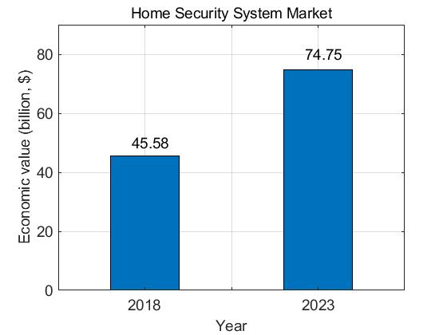
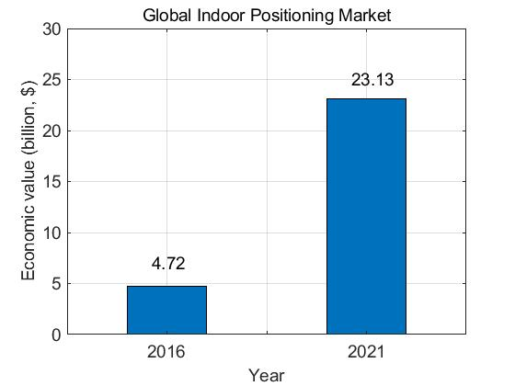
2 Broad Market Potential
Broad application market:
Home security systems [8] :
Indoor positioning [9]
Wide deployment and economic values of Wi-Fi
As of 2018, there are 340,846,887 Wi-Fi hotspots worldwide [10].
Economic values are shown below [10].
Economic Value of Wi-Fi
Global estimate
Selected markets
United States
Japan
2018
$499
billion
2023
$993
billion
2018
$171
billion
2023
$248
billion
2018
$ 1.96
trillion
Germany
U K
2018
$94
billion
2023
$132
billion
2018
$54
billion
2023
$71
billion
2023
$ 3.46
trillion
South Korea
France
2018
$68
billion
2023
$138
billion
2018
$44
billion
2023
$64
billion
Both Status of sensing applications and Wi-Fi market
pave a broad way for the combination of WLAN and sensing:
Advantage of RF based sensing: Sensing through RF signals can greatly protect privacy, and will not be affected by other factors such as weather, LOS which shows an advantage over other technologies.
Advantage of using Wi-Fi to realize RF sensing: Advantages (economic values, wide deployment) of Wi-Fi is beneficial for WLAN sensing since information (e.g., CSI) used for sensing can be extracted from Wi-Fi.
Vendors for WLAN sensing already exist and are growing.

Slide 6
Outline
1. Introduction
2. Broad Market Potential
3. Technical Feasibility
3.1 RF Sensing in academia
3.2 Comparison with other technologies
4. Summary
5. References

Slide 7
3 Technical Feasibility
Many presentations in previous IEEE meetings indicated that the proposed functions are technically feasible [1-7].
RF sensing (CSI-based and Radar-based) may not be a new concept in academia, since a lot of related work have been done by universities and industries worldwide.
Academia: Research on RF sensing showed that both schemes worked well in sensing and have acceptable performance (e.g., recognition accuracy, robustness,.. ).

Slide 8
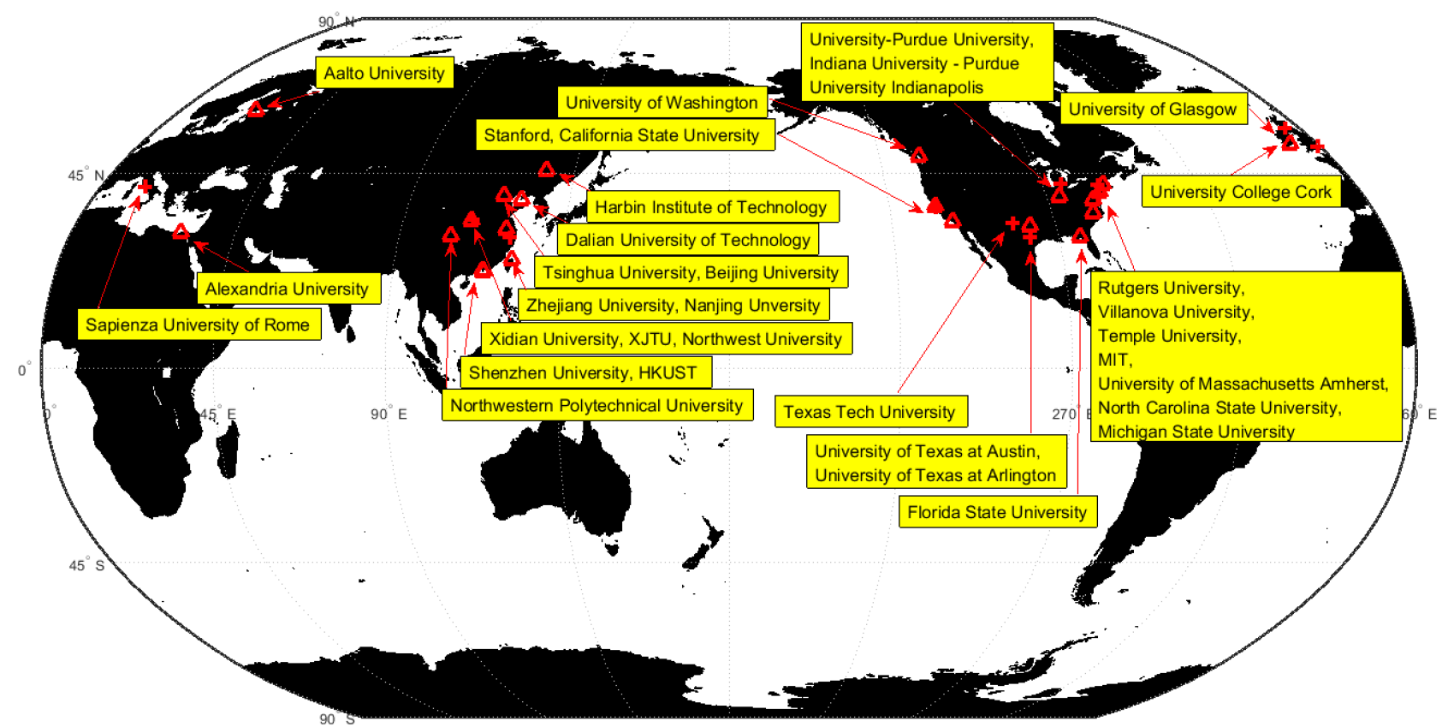
3.1 RF Sensing in Academia
Research map

Slide 9
3.1 RF Sensing in Academia
Details of teams:
University | Country | Team | Technology | Fined-grained | Middle-grained | Coarse- grained
MIT | USA | Dina Katabi, Fadel Adib | Radar, CSI | 1. Through heartbeat and respiration rate estimation, classify 4 kinds of motion: accuracy 87%; 2. Far range heartbeat and respiration estimation: Heartbeat median accuracy: 98.7%, Respiration median accuracy: 98.3% | (Wi-Vi)Gesture: accuracy at different distance: (93%, at 6-7m), (75%, at 8m), (0%, at 9m) | 1. Fall motion detection: 92%; 2. 3-D human skeleton detection: error resolution 4-6cm; 3. Multiple people motion detection: 85%-100%(3 people); 4. Multiple people localization: localization accuracy:11.7cm; 5. Emerald: Monitor indoor body movement, breathing, heart rate, falls, apnea, sleep detection
Texas Tech University | USA | Changzhi Li | Radar， Radar+ML | 1. Sleep: detect 4 sleep stages (78.6%) 2. Heartbeat detection (within 3m) 3. Identify identity based on heartbeat (70 people, 98.6%) 4. Respiration disorder recognition (1m): 95.1% 5. Blood pressure test: to achieve the accuracy of the sphygmomanometer | 2D gesture tracking Accuracy: ≈5mm | Identify people at different distances
University of Glasgow | UK | Francesco Fioranelli | Radar | Heartbeat measurement within 60cm distance | Gesture recognition | 1. Identification of persistent human movement (91.5%) 2. Identification gait classification (99%) 3. Motion recognition (81%) 4. Detect whether the human body carries weapons 5. Monitor the load of small drones

Slide 10
3.1 RF Sensing in Academia
Details of teams:
University | Country | Team | Technology | Fined-grained | Middle-grained | Coarse- grained
University College London | UK | Hugh Griffith, Kevin Chetty， Karl Woodbridge | Radar | Respiration detection; | six kinds of gesture recognition accuracy: 80%; | 1. Multi-person recognition: Only one receiver can be used to identify two targets moving in opposite directions and in the same direction (even if the relative speed is less than 0.5m/s) 2. Behavioral testing (falling, picking up things): 82%-94% 3. Through wall detection: 2 targets with a target position within ±1.25m can be distinguished
Sapienza University of Rome | Italy | Pierfrancesco Lombardo， Fabiola Colone | Radar, Radar and Wifi algorithms combination | / | / | 1. Human detection 2. Moving target detection (vehicle) 3. Vehicle classification 4. Private airport monitoring 5. Maritime monitoring
Temple University, Villanova University | USA | Fauzia Ahmad, Moeness G. Amin | Radar+Micro Doppler+PCA, Radar+DL | / | The accuracy of 15 kinds of gesture recognition: 96% | 1. Continuous motion detection: falling, walking, etc. 2. Five action classification algorithm accuracy: 97.2% 3. Gait detection: Through the classification and recognition of gait, detecting potential diseases of the human body, (4 persons, 5 types of gait) > 93.8%, disadvantages: need to consider the direction of motion. 4. Fall detection: 95.3%

Slide 11
3.1 RF Sensing in Academia
Details of teams:
University | Country | Team | Technology | Fined-grained | Middle-grained | Coarse- grained
California State University | USA | Youngwook Kim | Radar+Antenna inductance | Speech recognition by measuring vocal cord vibration | 1. Near field (15cm) gesture recognition: inductive method, 10 actions: 91% 2. Gesture recognition (15-60cm): 66.7%-90.5% 3. Swimming recognition (freestyle, backstroke, breaststroke, pulling a boat and rowing): 80.3% | Classification of moving objects (person/dog/horse/vehicle): 97%
Zhejiang University | China | Lixin Ran | Radar | Heartbeat detection: the maximum detectable distance is 1.5m without limb movement | 1. Gesture recognition (0.8m): separates interference breathing from gesture movement 2. Gesture recognition (0.2m): click, double click and move | Human activity detection
Michigan State University | USA | Jeffrey Nanzer | Radar | / | / | 1. Accuracy of classification identification of people and vehicles: 90%, 2. Vehicle speed measurement, 3. Use Wi-Fi to achieve spatial imaging
University of Texas at Austin | USA | Hao Ling | Radar | / | / | DOA detection of multiple moving targets

Slide 12
3.1 RF Sensing in Academia
Details of teams:
University | Country | Team | Tech. | Fined-grained | Middle-grained | Coarse- grained
Tsinghua University | China | Yunhao Liu Zheng Yang Chenshu Wu | CSI | Respiration rate estimation | Cross-scene gesture recognition: Accuracy: 89.7% (position), 82.6% (direction), 92.4% (environment), 88.9% (personal characteristics) | 1.Indoor positioning: 0.75m 2.Moving object detection: simultaneous detection of moving and stationary people, accuracy rate 96% 3. Classification of foot movement direction: 92% in 9 directions 4. Human detection: FAR<5%, MAR <4% 5.Widar human body tracking: positioning error 0.25/0.38m (with/without initial position)
Peking University; Massachusetts Amherst | China America | Daqing Zhang Jie Xiong | CSI | 3 breathing detection methods: Detectable distance: 2.9m, 3.7m, 5m Accuracy at 5m: 1.4%, 7.7%, 100% | First Fresnel zone small action recognition: 8 finger movements (81%), identify the number of syllables in the sentence from the movement of the chin, the accuracy rate is 92.8% | 1. Repeatability recognition: 9 actions (92%) 2. Indoor positioning (accuracy 0.38m) 3.Direction determination (accuracy <10°) 4.RT-Fall (fall detection): TP (91%), TF (92%) 5.AR-Alarm motion detection 98.1%, intrusion detection 97.7%
Rutgers University, Florida State Universi | America | Yingyingchen, Hongbo Liu Yang Jie | CSI | Sleep heartbeat detection: 1 or 2 people Heartbeat: 80% error <0.5bpm Breathing: 90% error <4bpm | Gesture recognition: 8 categories, 93% | 1. Indoor motion recognition: 5 actions 97% 2. Walking direction: 96.6% in 3 directions 3. Fitness classification: 93% of fitness activities, 97% of individual recognition 4. Multi-person motion recognition and positioning: 6 actions 92% 5. Attack detection: 92% 6. Authentication: 91% (still) 70.6-93.6% (mobile)
Alexandria University | Egypt | Moustafa Youssef, Heba Abdelnasser | CSI/RSSI | 1. Respiration frequency estimation error: 1bpm 2 apnea estimate: 96% | WiGest gesture recognition: 1AP, 87.5% 3APs, 96% | Indoor positioning: In the 629m² environment, error：2.64m In the 65m² environment, error：1.21m

Slide 13
3.1 RF Sensing in Academia
Details of teams:
University | Country | Team | Tech. | Fined-grained | Middle-grained | Coarse- grained
Hong Kong Polytechnic University | China | Jiannong Cao Xuefeng Liu | CSI | 1.Heartbeat detection: multi persons Accuracy: 0.5 - 1bpm 2. Respiratory test: 1 person Accuracy: 6 sleeping positions, >85% | / | 1.Number of people passing through the door and walking direction Accuracy: Direction Detection 95% , Number of people detected 92% 2. Shopping group Accuracy: detect more than 90% of the group, the accuracy rate is 91.2%
Shenzhen University, Hong Kong University of Science and Technology | China | Kaishun Wu; Mingxuan Ni | CSI | / | 1.WiHear lip recognition: can recognize 14 syllables,33 words and sentences of less than 6 words, Accuracy: 91% (1 person), 74% (3 people at the same time) Wall penetration accuracy: 26% (1 receiver), 32% (3 receivers) 2. Four gestures: left, right, push, pull Accuracy: 92% (LOS), 88% (NLOS) | Fall detection: Falling accuracy: 94%, (can also detect several daily actions: walking, sitting, standing up, falling): 89%-98% (three scenarios)
Aalto University | Finland | Stephan sigg | CSI/RSSI | Emotional recognition: anger Driving environment: 98% accuracy In the indoor: accuracy rate is 82.9% | Gesture recognition: 41.7%-67.8% | Behavior recognition: locate behavior within 1m (lie, crawl, stand and walk)
Nanjing University; Michigan State University | China | Wei Wang Alex Liu | CSI | / | 1.Key recognition (30cm): single button recognition rate 96% 2. Quantitative measurement of gesture movement distance: Error 3cm Direction of movement accuracy: >95% | 1. Motion recognition (10*7m): 9 actions 96% 2. WifiU pedestrian recognition based on gait detection: 50 people, Accuracy: top3 is 93.05%

Slide 14
3.1 RF Sensing in Academia
Details of teams:
University | Country | Team | Tech. | Fined-grained | Middle-grained | Coarse- grained
Washington University | America | Neal Patwari | CSI/RSSI | 1. Heartbeat detection (receiver antenna distance 1m): Accuracy: 1.57bpm (lying) 3.67bpm (sitting) 2. Respiratory test: >95% | Gesture recognition: The required hardware conditions are lower than others (BW: 0.01MHz, single antenna, low power (1mW), distance: 1.5m) Accuracy: 85% | /
University of California, University of Washington | America | Qifan Fu; Shyamnath Gollakota | CSI/RSSI | / | WiSee: 9 gestures with an average accuracy of 94%. | Wi-Fi imaging: Median Localization Accuracy: 26cm (static human); 15cm (metal object)
Northwestern Polytechnical University | China | Bin Guo; Zhiwen Yu | CSI/RSSI | Number of people: 2 Accuracy: >88% Disadvantages: obviously affected by the environment | / | Behavior recognition: can locate behavior within 1m (lie, crawl, stand and walk)
Stanford | America | Sachin Katti， Manikanta Kotaru | CSI | / | / | 1. Indoor positioning (3 antennas to calculate AOA): Median error (40cm) 2. Human body tracking: error 0.88cm (1 person), error 7cm (<5 people)
University of Science and Technology of China | China | Wei Yang | CSI | / | Gesture recognition: 9 categories, 90.4% | 1.Walking detection: 96.41% 2. Step detection: 90.2%, 87.59% (lab/classroom)

Slide 15
3.1 RF Sensing in Academia
Details of teams:
University | Country | Team | Tech. | Fined-grained | Middle-grained | Coarse- grained
University of Electronic Science and Technology | China | Rui Zhou | CSI | / | / | Human detection and positioning: accuracy (>97%) Positioning error 1.22m / 1.39m (lab / conference room)
Dalian Institute of Technology | China | Lei Wang; Bingxian Lu | CSI | / | / | 1.Motion detection: 90.89% 2.Motion recognition: 16 categories, 93%
North Carolina State University | America | Muhammad Shahzad | CSI | / | Gesture recognition: 2, 3, 4, 5, 6 gestures simultaneously Accuracy: 95, 94.6, 93.6, 92.6, 90.9% | /
University College Cork, Ireland | Ireland | Dirk Pesch | CSI | / | / | FallDeFi (fall detection): 93% / 80% (same / Different test environment)
University of Maryland College Park | America | Beibei Wan | CSI | / | / | WiSpeed: 95% fall detection Average speed estimation error: Device free 4.85% Device-based 4.62%
University of Texas at Arlington | America | Sheheryar Arshad, Liu yonghe | CSI | / | / | 1.Multi-person motion detection: (1-3 people) Accuracy: 96.1% (action), 97.21% (number of people detected), 98.04% (abnormal detection), 2. Driver gesture and motion detection: accuracy rate 98.04%

Slide 16
3.1 RF Sensing in Academia
Different deployments of devices, measurement environment, frequency bands and other parameters cause different simulation results. Following are the general current status of some scenarios in academia:
Coarse-grained:
Fall detection: >90% (Recognition rate of this category is generally high.)
Indoor positioning: <1m (MIT, 11.7cm[11] ; Tsinghua University: 025/0.38m [12])
Activity recognition: >95% (Peking University: AR-alarm 98.1%[13];
Nanjing University: 9 types 96% [14])
Middle-grained:
Gesture recognition: >80% (mainly depend on the distance between target and device, e.g., recognition rate of close range scenario can achieve >90%)
Fine-grained:
Respiration rate estimation: >95% (MIT: 98.7%, 8m [15] )
Heartbeat estimation:>95% (MIT:98.3%, 8m [15]; Peking University:100%, 5m [16])
Note: Conclusions above were surveyed by September 2019.

Slide 17
3.3 Comparison with other similar technologies
Here we listed three other technologies, and the comparison results are shown as below.
Compared with other technologies, WLAN sensing has a series of advantages such as NLOS, device-free, low cost, easy deployment, independent of weather conditions, and strong scalability.
Technology | Device | LOS/NLOS/Other | Cost | Computation complexity | Accuracy | Disadvantage
Wi-Fi | Wi-Fi hotspots | LOS/NLOS | Low | Moderate | Moderate/High | Need Standard modification
Video | Camera | LOS | High | High | Moderate/High | Privacy violation, Limited coverage
Infra-red | Infrared motion sensor | LOS | High | High | Moderate/High | Poor penetration
Dedicated sensor | Dedicated sensor | Close to the target | High | Moderate | Moderate/High | Expensive

Slide 18
4. Summary
In this presentation, the following topics are discussed
Broad market potential
Three arguments are presented showing the broad market potential of WLAN sensing.
Technical feasibility (academia, comparison results)
To some extent, the results shown in academia have proven the technical feasibility of WLAN sensing;
The combination of WLAN and sensing still need further exploration, and standard support.

Slide 19
5. References
[1] 11-19-1164-00-0wng-wi-fi-sensing.pptx
[2] 11-19-1293-00-0wng-wi-fi-sensing-usages-requirements-technical-feasibility-and-standards-gaps.pptx
[3] 11-19-1416-00-0wng-wi-fi-sensing-cooperation and standard.pptx
[4] 11-19-1500-00-0wng-wi-fi-sensing-follow-up.pptx
[5] 11-19-1551-00-0wng-wi-fi-sensing in 60GHz band.pptx
[6] 11-19-1580-00-0wng-wi-fi-sensing-application-multipath-enhanced-device-free-localization.pptx
[7] 11-19-1626-00-0wng-802-11-sensing-applications-feasibility-standardization.pptx
[8] http://news.eeworld.com.cn/afdz/2018/ic-news082912004.html
[9] https://www.sohu.com/a/119477667_465945
[10]The Economic Value of Wi-Fi: A Global View (2018 and 2023), October 2018
[11] Fadel Adib, et.al., “Multi-person localization via RF body reflections”, Proceedings of the 12th USENIX Conference on Networks Systems Design and Implementation, pp. 279-292, May, 2015.
[12] Kun Qian, Chenshu Wu, Zheng Yang, Yunhao Liu, and Kyle Jamieson. 2017. Widar: Decimeter-Level Passive Tracking via Velocity Monitoring with Commodity Wi-Fi. In Proceedings of the 18th ACM International Symposium on Mobile Ad Hoc Networking and Computing (Mobihoc '17). ACM, New York, NY, USA, Article 6, 10 pages.
[13] Li S., Li X., Niu K., Wang H., Zhang Y., Zhang D. (2017) AR-Alarm: An Adaptive and Robust Intrusion Detection System Leveraging CSI from Commodity Wi-Fi. In: Mokhtari M., Abdulrazak B., Aloulou H. (eds) Enhanced Quality of Life and Smart Living. ICOST 2017. Lecture Notes in Computer Science, vol 10461. Springer, Cham
[14] W. Wang, A. X. Liu, M. Shahzad, K. Ling and S. Lu, "Device-Free Human Activity Recognition Using Commercial WiFi Devices," in IEEE Journal on Selected Areas in Communications, vol. 35, no. 5, pp. 1118-1131, May 2017.
[15] Fadel Adib, et.al., “Smart homes that monitor breathing and heart rate”, In Proceedings of the 33rd Annual ACM Conference on Human Factors in Computing, pp. 837–846. ACM, Apr. 2015.
[16] Youwei Zeng, Dan Wu, Jie Xiong, Enze Yi, Ruiyang Gao, and Daqing Zhang. 2019. FarSense: Pushing the Range Limit of WiFi-based Respiration Sensing with CSI Ratio of Two Antennas. Proc. ACM Interact. Mob. Wearable Ubiquitous Technol. 3, 3, Article 121 (September 2019), 26 pages.

