Slide 1
Proposed TIG on WLAN sensing
Date: 2019-09-16
Authors:
Name | Affiliation | Address | Phone | Email
Carlos Cordeiro | Intel | USA |  | Carlos.cordeiro@intel.com
Tony Han | Huawei | China
Hui-Ling Lou | Marvell | USA

Slide 2
Abstract
Proposal for a Topic Interest Group (TIG) to discuss use cases, requirements and technical concepts related to WLAN sensing (WSS) and provide input on formation of a Study Group (SG) at a future 802.11 meeting.

Slide 3
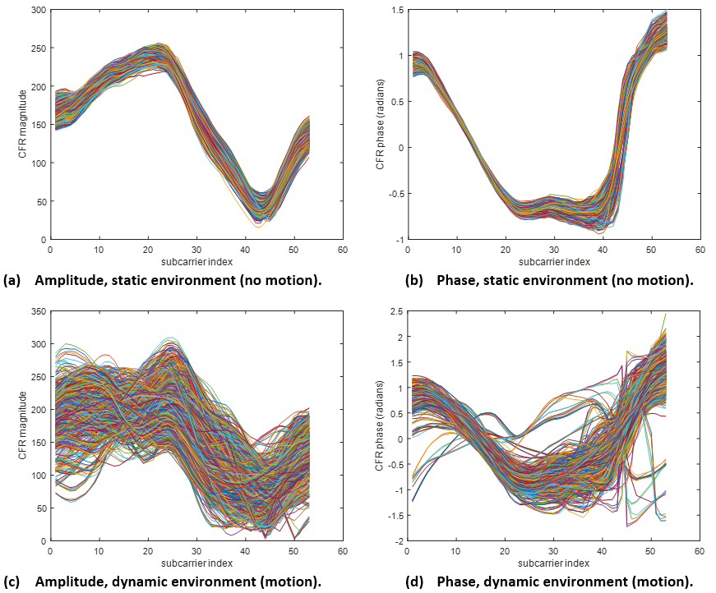
WLAN sensing: background and what it is
Figures show the amplitude and phase of channel estimates obtained with multiple PPDUs over time (~3 minutes). Each curve corresponds to one PPDU.
WLAN sensing uses features obtained from 802.11 waveform propagation (e.g., CSI, Doppler) to detect changes in the environment
  ML and/or signal processing can analyze features changes to infer the cause (e.g. human presence, given activity, gesture, etc.)
In WLAN sensing, correctly decoding the application data carried in the Data field of a 802.11 PPDU is not the primary goal
Different frequency bands supported by 802.11 (2.4, 5-7, 60 GHz) can be used to support different WLAN sensing application requirements
  Devices supporting lower frequency bands widespread
  Better sensing resolution achieved with higher frequency bands
No motion
Motion

Slide 4
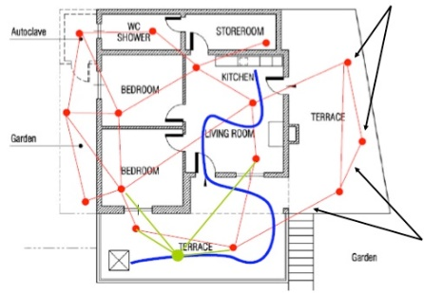
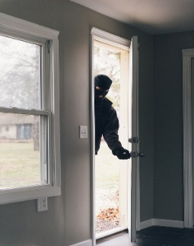

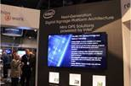

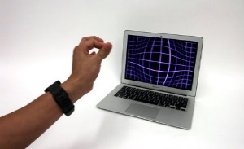
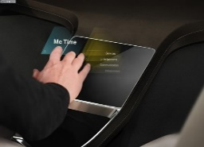
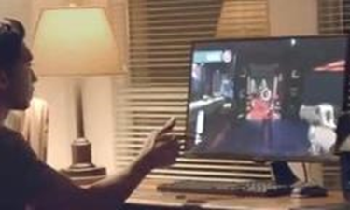
WLAN sensing: exemplary applications
Human activity sensing:
Retail and digital signage:
Smart spaces
(Occupancy, personalized environment control)
Customer interaction, people counting
Home security (intrusion detection)
Patient, elderly monitoring
(fall detection, activity tracking)
Human proximity detection:
Gesture recognition:
Wake on approach, walk away lock
PC/Tablet
Automotive
Gaming
Applications include a mix of single and multiple STA scenarios

Slide 5
WNG presentations (1/2)
Several presentations have been made to WNG on WSS
  At the July session (2): 19/1293r0, 19/1164r0
  At the September session (5): 19/1416r0, 19/1551r1, 19/1500r0, 19/1626r0, 19/1580r0
These presentations have demonstrated the feasibility and usefulness of WSS, as well as justified the need for 802.11 standard changes to support WSS
Straw poll results showed strong support to start an activity in 802.11 on WSS (see next slide)

Slide 6
WNG presentations (2/2)
July straw poll results:
  SP #1: do you think “Wi-Fi sensing” would be an interesting topic for 802.11 to Study?
    Yes: 77; No: 0; Need more info: 27; Need to be done in another group: 2l; No opinion: 0
  SP#2: what is your preference for the proper venue for future work/presentations for “Wi-Fi sensing” technologies?
    Study Group (SG): 15; Topic Interest Group (TIG): 47; Continue the presentations in WNG before creating a TIG/SG: 75; No interested in further work/presentations in 802.11: 0; No opinion: 1
September straw poll results:
  SP: what is your preference for the proper venue for future work/presentations for “Wi-Fi sensing” technologies
    Topic Interest Group (TIG): 105; Study Group (SG): 8; Continue the presentations in WNG before creating a TIG/SG: 18; No interested in further work/presentations in 802.11: 0; No opinion: 6

Slide 7
WLAN sensing: scope of work
Discuss contributions in the areas of, but not limited to:
  Use cases and requirements
  Key performance indicators
  Channel models
  Technical approaches and 802.11 standard gaps in the areas such as protocol for coordination across 802.11 STAs, support of different frequency bands, measurement and reporting, etc.
  Alternative solutions
These discussions will inform the TIG on the need and timing of requesting formation of a SG at a future 802.11 meeting

Slide 8
WSS TIG Formation motion
“ Approve formation of a WLAN sensing (WSS) TIG to investigate use cases, requirements, technical approaches and changes to the 802.11 standard to support WSS.
The TIG is to bring a recommendation to the 802.11 WG at the November 2019 session to either
  Continue with the TIG on WSS until the next session; or
  Terminate the TIG with no further work on WSS; or
  Terminate the TIG and request formation of a SG to develop a PAR and CSD on WSS”

