Slide 1
Multi-AP Transmission Procedure
Date: 2019-09-05
Authors:
Name | Affiliation | Address | Phone | Email
Dan Yang | ZTE Corporation | No.9 Wu Xing Section Xi Feng Road Xi’an, Shaanxi Province P.R.China |  | yang.dan10@zte.com.cn
Bo Sun
Sang Sun
Nan Li
Qichen Jia
Notes:
doc.: IEEE 802.11-yy/xxxxr0
Month Year
John Doe, Some Company
Page

Slide 2
Introduction
The Multi-AP transmission has been discussed as one of the candidate features for 802.11be. [1]
This contribution discusses a transmission procedure to support the Multi-AP transmission in TGbe.

Slide 3
Background
Several proposals [2][3][4] have discussed various Multi-AP transmission procedure.
In proposal [2], the conception of Master AP and Slave AP was introduced.
A Master AP is an AP who can coordinate the APs which may participate in Multi-AP transmission.
A Slave AP is one of the candidate APs who can hear the Master AP and join the multi-AP transmission.

Slide 4
Motivation
In a more general use scenario, APs that can join the DL multi-AP transmission are not necessarily requested to be heard by the STA’s associating AP on air interface, e.g. those APs may have DS connection with the STA’s associating AP.
In this condition, the associating AP cannot sync the DL multi-AP transmission with a trigger frame.
The APs that can join the multi-AP transmission may not hear the associating AP
The associating AP may not be in the good position to sync all possible APs
A multi-AP transmission is aiming at one specific STA and the STA is the natural center to sync the multi-AP transmission.

Slide 5
STA Triggered Multi-AP Transmission
We propose to allow STA-triggered synchronous Multi-AP transmission.
The STA triggered Multi-AP transmission is the Multi-AP transmission follows a frame sent form the intended STA.
As part of the proposal, we suggest to define following terms:
Master AP (M-AP)
the AP which a STA is associated with.
Slave AP (S-AP)
An AP that participates in the Multi-AP transmission to a specific STA but is not associating with the STA.
To explain the implementation of the above proposal in concrete scenario, we will discuss the Multi-AP data transmission procedure triggered by STA.

Slide 6
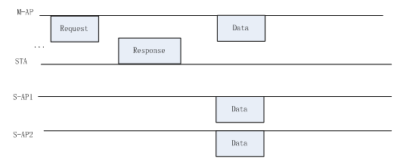
Multi-AP data transmission procedure
Case 1: The M-AP sends a multi-AP transmission request frame and the STA responds with a frame to trigger the following Multi-AP data transmission.
The response frame from the STA could sync S-APs that cannot hear M-AP on the air interface in the following joint transmission.
The response frame from the STA guarantees that STA is ready for receiving and protects the following joint transmission.

Slide 7
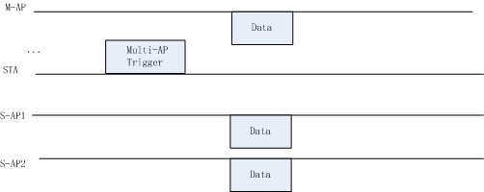
Multi-AP data transmission procedure
Case 2: The STA initiates a Multi-AP data transmission with a trigger frame.
The STA is informed of the DL data buffer in previous message.
The overhead for M-AP and S-APs synchronization is saved.

Slide 8
Conclusion
In this contribution, we proposed a STA triggered Multi-AP transmission procedure.
Allow APs that cannot hear the STA’s associating AP to join the multi-AP transmission
Protect the following Multi-AP transmission.

Slide 9
Straw Poll 1
Do you agree that it’s not necessary for S-APs to hear M-AP on the air interface?
Y/N/A=

Slide 10
Straw Poll 2
Do you agree that the STA could send an unsolicited frame or a response frame to trigger the Multi-AP transmission?
Y/N/A=

Slide 11
Straw Poll 3
Do you agree that the M-AP could request a Multi-AP transmission and indicate in the request frame that the Multi-AP transmission follows the intended STA’s response to the request frame?
Y/N/A=

Slide 12
References
[1] IEEE 802.11-18-1231-04-0eht-eht-draft-proposed-par
[2] IEEE802.11-19-0804-00-00be-multi-ap-transmission-procedure
[3] IEEE802.11-19-1134-01-00be-consideration-of-multi-ap-sounding
[4] IEEE802.11-19/103r0, AP-Coordination-in-EHT, Jason Yuchen Guo

Slide 13
Thank you!

