Slide 1
PHY Signaling for Adaptive Repetition of 11p PPDU
Date: 2019-11-11
Authors:
Notes:
Introduction:
In motion #19, the TGbd has agreed that “ 11bd shall support adaptive repetition of 11p PPDU when operating on OCB broadcast mode in 10MHz bandwidth. The signaling of the adaptive repetition is TBD. The time between repeated 11p PPDUs is TBD.”
In this contribution, we propose a PHY scheme for signaling the repetition
Motivation
In 802.11ax, RL-SIG (repeat L-SIG) is introduced
RL-SIG field is not just simply a repetition of L-SIG field. It has “extra subcarrier insertion” at subcarrier {-28, -27, 27, 28} for channel estimation purpose and the value on these four extra subcarriers are {-1, -1, -1, 1}, respectively.
802.11ax allows 3 dB power boost to those subcarriers if transmission an HE ER SU PPDU.
(including a picture showing different size in frequency between {L-STF, L-LTF and L-SIG} and RL-SIG
PHY signaling for repetition Tx
Methods of using extra tones
Which fields could have extra tones
Benefits
Why it is better to signaling the repetition in PHY?
?
Impact to 11p receiver
Design criteria
Allow Non-coherent detection
Pros and Cons
Miss detection level
Pros and Cons
False alarm level
Pros and Cons
Design options
Allocation of extra tones
Power level of extra tones
?
Simulation
Simulation assumptions
Simulation setup
Simulation results
Discussion
Conclusion
SP

Slide 2
Introduction
TGbd has agreed that [1]
  “ 11bd shall support adaptive repetition of 11p PPDU when operating on OCB broadcast mode in 10MHz bandwidth. The signaling of the adaptive repetition is TBD. The time between repeated 11p PPDUs is TBD.”
In this document we present a possible PHY layer signaling to enable the adaptive repetition of 11p PPDU

Slide 3
Recap: the benefit of 11p PPDU adaptive repetition
In [2], adaptive repetition of 11p PPDU transmitted from 11bd devices was introduced
The benefits of this approach are
  Improve performance while maintaining interoperability, coexistence, and proven backward compatibility with 802.11p equipment
  Provide substantial improvements for communication between NGV stations and some improvement for communication to and from 802.11p stations that do not implement NGV
  Do not increase channel load in congested environments
  Do not require changing higher layers of the ITS protocol stack
This scheme was agreed in May 2019 meeting
Two of the remaining issues are how a NGV receiver knows an 11p PPDU received is from NGV transmitter and if repetitions of the PPDU are transmitted

Slide 4
Motivation: Extra subcarriers at L-SIG/RL-SIG in 11ax
In 802.11ax, RL-SIG (repeated L-SIG) field is placed after L-SIG
In both L-SIG and RL-SIG fields of a 20 MHz HE PPDU, values [-1, -1,-1, 1], modulated in BPSK, are mapped to the extra subcarriers [-28, -27, 27, 28] for channel estimation purpose
802.11ax also allows for a 3dB power boost of the extra subcarriers when transmitted in a HE ER SU PPDU.
11a/g/n/ac receivers will simply ignore those subcarriers
28
26
Data
L-STF
L-LTF
L-SIG
RL-SIG
frequency
-26
time
-28

Slide 5
11p PPDU Transmission from 11bd devices
Inspired by the 11ax L/RL-SIG design, we propose that 11bd devices transmit 11p PPDUs with additional edge subcarriers in the preamble and/or possibly in some data field symbols
Non-zero energy of those extra edge subcarriers can be used to indicate the transmission of 11p PPDU from a 11bd device. The symbols in those extra edge subcarriers can also carry a few bits information related to the repetition
Those extra edge subcarriers should have little or no impact to legacy 11p devices in the same channel and in the adjacent channel
An example:
4μs
4μs
4μs
4μs
26
28
L-STF
L-LTF
L-SIG
Data
frequency
-26
-28
time

Slide 6
A Possible Repetition Transmission Procedure
Assume that the symbols in those extra edge subcarriers carry one bit information and, for the purpose of this presentation, define a “Repetition State” variable, RepState, which has two values {0, 1}
  “0” means the first (new) transmission,
  “1” means retransmission
A possible 11bd receiver may do the following (next page)
RepState = 0
RepState = 1
RepState = 1
RepState = 0
RepState = 1
11p PPDU from 11p device
11p PPDU with extra tones from 11bd device

Slide 7
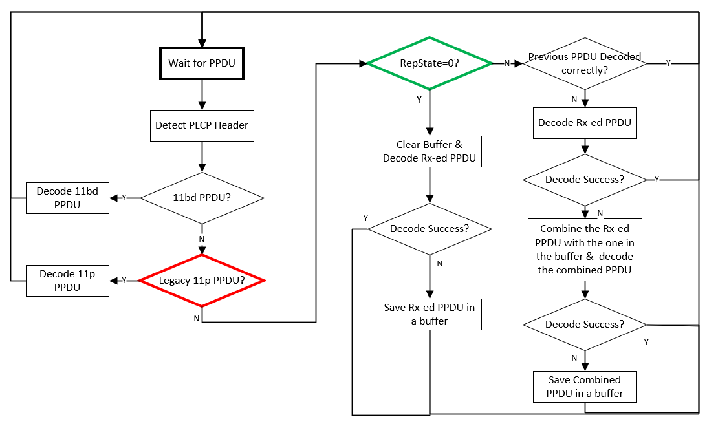
A Possible Receiving Procedure for 11bd Receiver

Slide 8
Potential Issues
Impact to the 11p receiver performance when PPDU has extra subcarriers
  Extra subcarriers will take some energy in one OFDM symbol
False Alarm & Miss Detection for detecting of 11p PPDU transmitted from a 11bd device
  False Alarm: The actual PPDU is legacy 11p, but the receiver detects it has extra tones
  Miss Detection: The actual PPDU is from 11bd device, but receiver detect it as legacy PPDU
New transmission vs retransmission detection error rate, given received 11p PPDU is from a 11bd device
Inter-channel interference

Slide 9
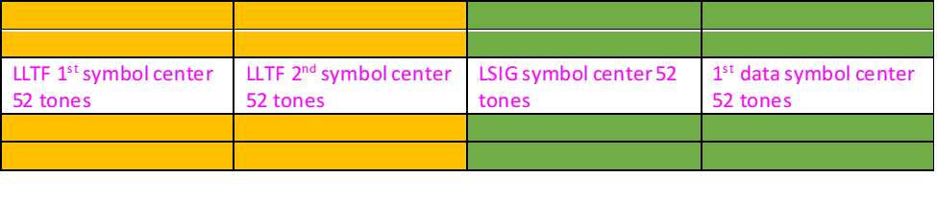


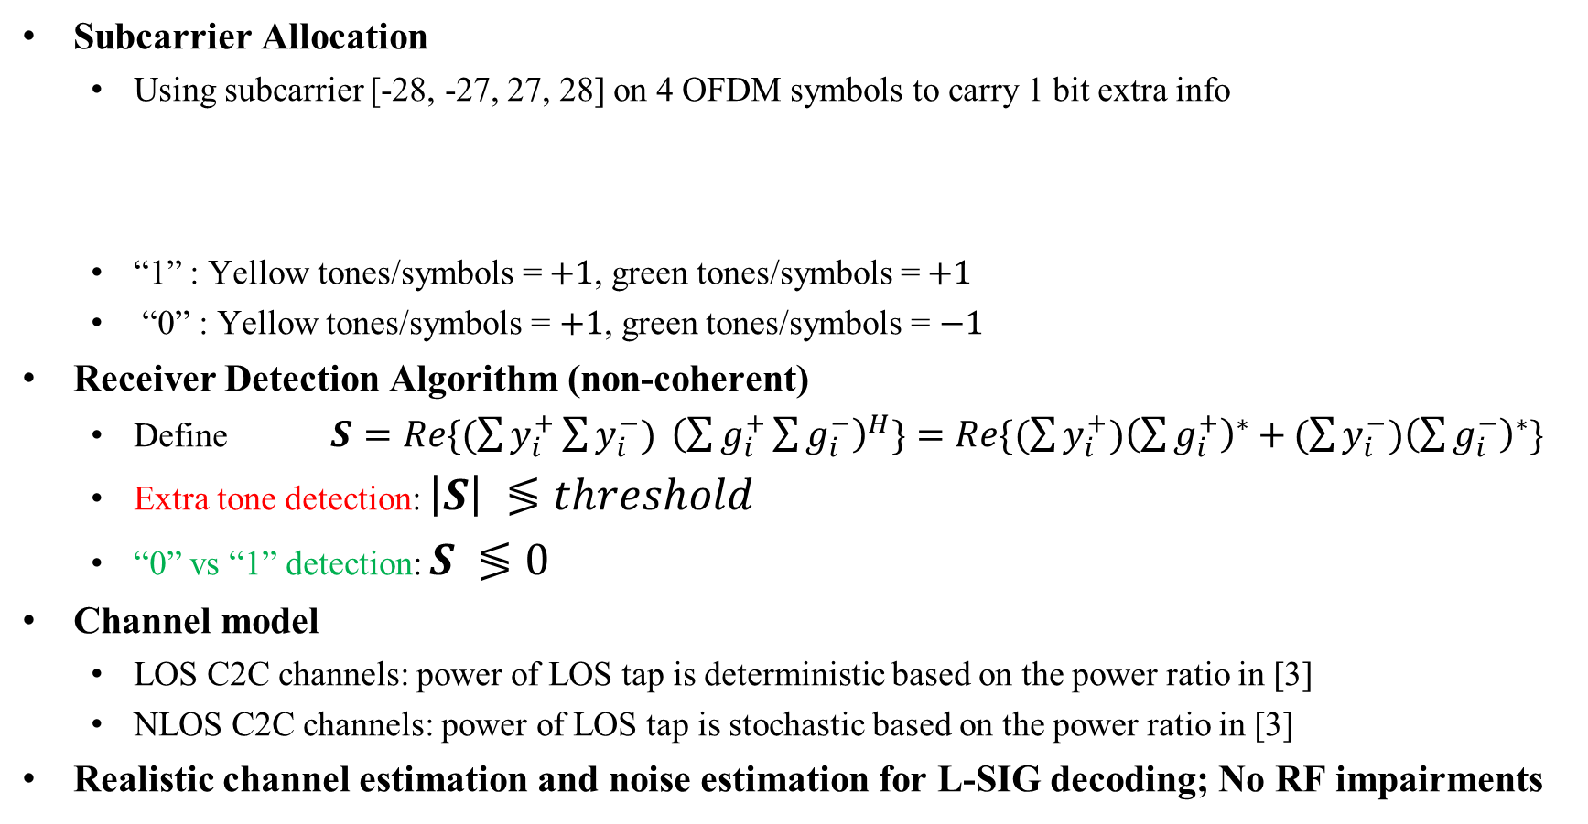



Simulation Assumptions and Setup
Subcarrier Allocation
  Using subcarrier [-28, -27, 27, 28] on 4 OFDM symbols to carry 1 bit extra info
  “1” : Yellow tones/symbols =$+1$, green tones/symbols =$+1$
  “0” : Yellow tones/symbols = $+1$, green tones/symbols = $−1$
Receiver Detection Algorithm (non-coherent)
  Define $S=Re\{(\sum{y_{i}^{+}}\sum{y_{i}^{−}) }{\left(\sum{g_{i}^{+}}\sum{g_{i}^{−}}\right)}^{H}\}=Re\{(\sum{y_{i}^{+}){\left(\sum{g_{i}^{+}}\right)}^{∗}+}(\sum{y_{i}^{−}){\left(\sum{g_{i}^{−}}\right)}^{∗}}\}$
  Extra tone detection: $\left|S\right| ≶threshold$
  “0” vs “1” detection: $S ≶0$
Channel model
  LOS C2C channels: power of LOS tap is deterministic based on the power ratio in [3]
  NLOS C2C channels: power of LOS tap is stochastic based on the power ratio in [3]
Realistic channel estimation and noise estimation for L-SIG decoding; No RF impairments
$$y_{i}^{−}$$
$$g_{i}^{−}$$
$$i=1,2,3,4$$
$$y_{i}^{+}$$
$$g_{i}^{+}$$

Slide 10
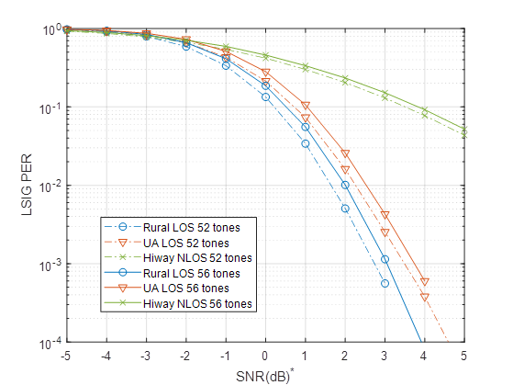
Impact to 11p receiver performance
Observation:
The impact from adding extra tones on L-SIG decoding is very small (<0.4dB)
*SNR in symbols without extra tones

Slide 11
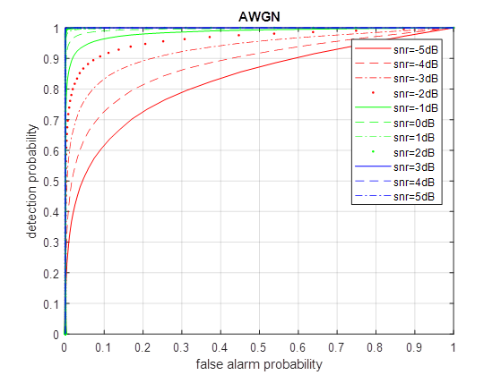
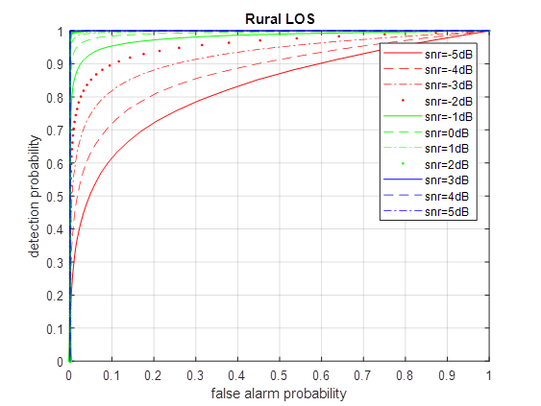
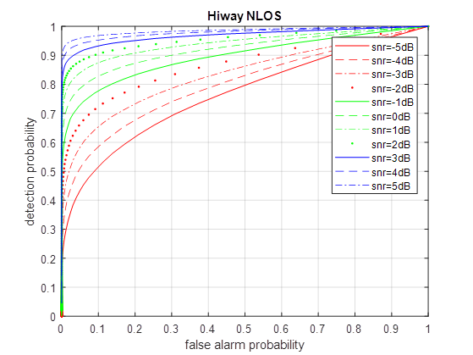
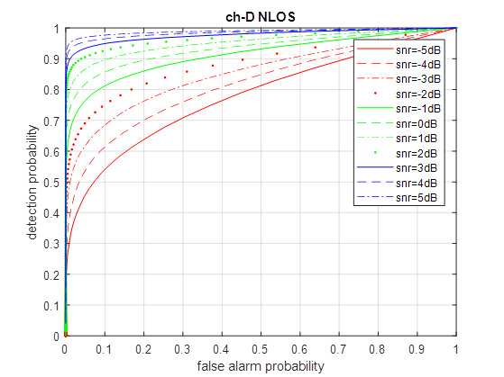
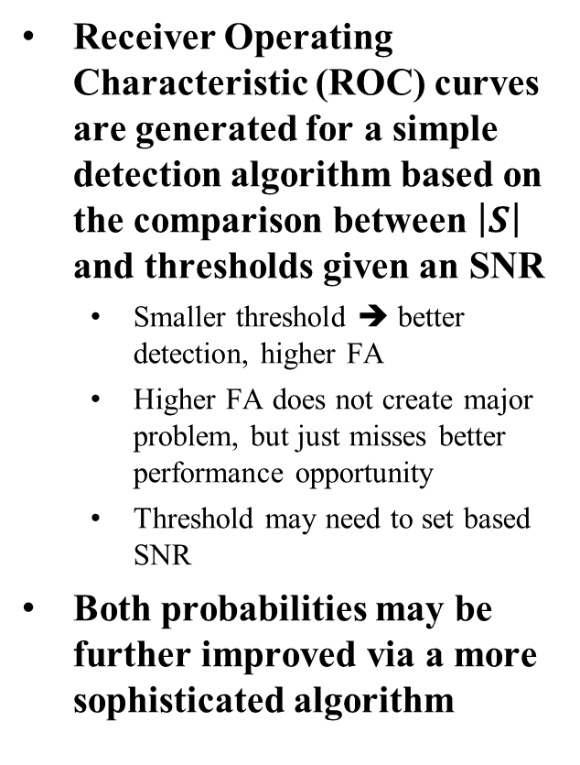
False Alarm vs Detection for legacy 11p PPDU
Receiver Operating Characteristic (ROC) curves are generated for a simple detection algorithm based on the comparison between $\left|S\right|$ and thresholds given an SNR
  Smaller threshold ➔ better detection, higher FA
  Higher FA does not create major problem, but just misses better performance opportunity
  Threshold may need to set based SNR
Both probabilities may be further improved via a more sophisticated algorithm
Slide 11

Slide 12
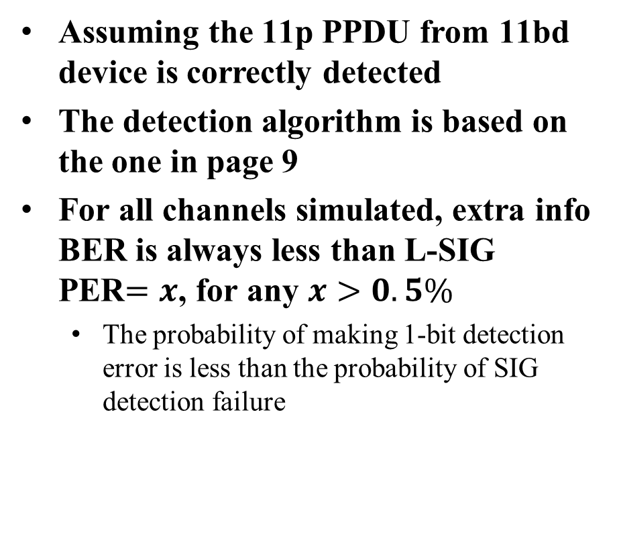
New transmission vs Retransmission Detection Error Rate
Assuming the 11p PPDU from 11bd device is correctly detected
The detection algorithm is based on the one in page 9
For all channels simulated, extra info BER is always less than L-SIG PER$=x$, for any $x>0.5\%$
  The probability of making 1-bit detection error is less than the probability of SIG detection failure
0.5%

Slide 13
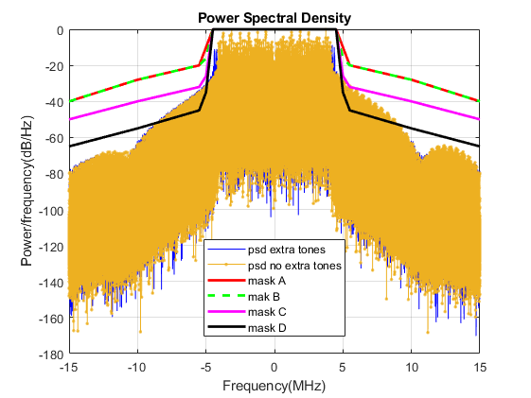
Inter-Channel Interference
Evaluating Out of band leakage
MCS0, 8 Byte payload
  Small payload emphasizes the symbols with extra tones
No significant difference between PSDs with or without 4 extra tones on 4 symbols

Slide 14
Other Alternatives*
Using the extra tones in data field only (see the next page)
Populate these extra tones only in case of repetition, meaning that:
  In case of “RepState=0”, one would not populate these extra subcarriers.
    This would avoid L-SIG decoding performance degradation
  In case of “RepState=1”, one would populate these extra subcarriers
Using lower power for those extra tones
Using less than 4 OFDM symbols
* Thank Alessio Filippi (NXP) for the offline discussion

Slide 15
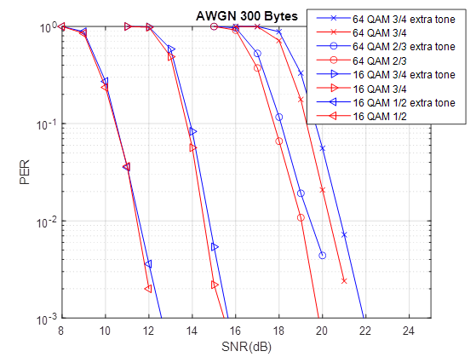
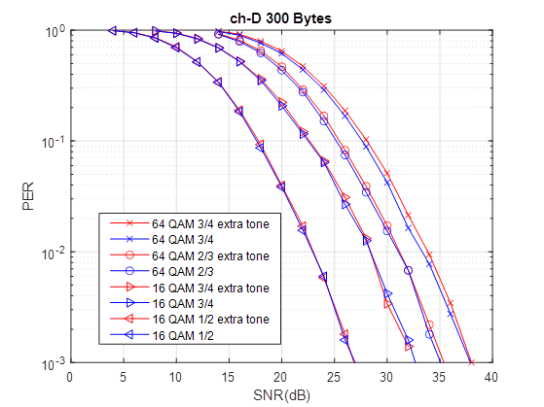
Using the extra tones in data field only
28
4μs
4μs
4μs
4μs
26
L-STF
L-LTF
L-SIG
Data
frequency
-26
-28
time
Payload size: 300 bytes
This approach will not impact on the quality of channel estimation and L-SIG detection performance
It impacts on data PER performance with a fraction of dB degradation for high data rate MCSs
Receiver needs to buffer multiple symbols before making decision on PPDU type detection

Slide 16
Conclusion
An example of using extra edge subcarriers in 11p PPDU for repetition transmission is shown
Symbols allocated to those extra subcarriers and corresponding detection algorithms may be further studied

Slide 17
References
[1] 11-19/514r4, 802.11bd FRD SFD motion booklet
[2] 11-19/784r0, Adaptive Repetition Scheme for NGV
[3] 11-19/0017r4, Simulation of NGV Channel Models

Slide 18
SP
Do you support using extra edge subcarriers of 11p PPDU transmitted from 11bd devices as a way to signal adaptive repetition?
- Specific location of the those extra subcarriers and the meaning of the signal are TBD
Y/N/A:

