Slide 1
Simulation results with bit-loading for the LC-optimized PHY
Date: 2019-09-16
Authors:

Slide 2
Abstract
This contribution contains simulation results in support of the bit-loading feature supported by the LC-optimized PHY.

Slide 3
Overview
Adaptive bit-loading is a new feature in the LC-optimized PHY.
In this contribution, “flat” bit-loading using fixed MCS over all subcarriers is compared to adaptive bit-loading (according to [1])
Target: PER < 10⁻³
Approach:
  Same data rate in both, fixed and adaptive modes of operation
  What is the required SNR for fixed bit-loading?
  What is the required SNR for adaptive bit-loading?
[1] Fischer, R. F., & Huber, J. B. (1996, November). A new loading algorithm for discrete multitone transmission. In Proceedings of GLOBECOM'96. 1996 IEEE Global Telecommunications Conference (Vol. 1, pp. 724-728). IEEE.

Slide 4
LC-optimized PHY configuration
Base configuration:
G.9991 PHY, sub-carrier spacing 195.3125 kHz, sample rate 1 GHz, OFDM symbol duration 5120 ns, CP length 320 ns, DC gap 4.59 MHz
Bandwidth settings:
  942 active subcarriers (183.98 MHz used bandwidth)
  410 active subcarriers (80.32 MHz used bandwidth)
  205 active subcarriers (40.39 MHz used bandwidth)
Mean number of bits/active subcarrier: 4 and 6 for both, fixed and adaptive mode
FEC: LDPC, rate: 5/6, block length: 4320 (960) bits

Slide 5
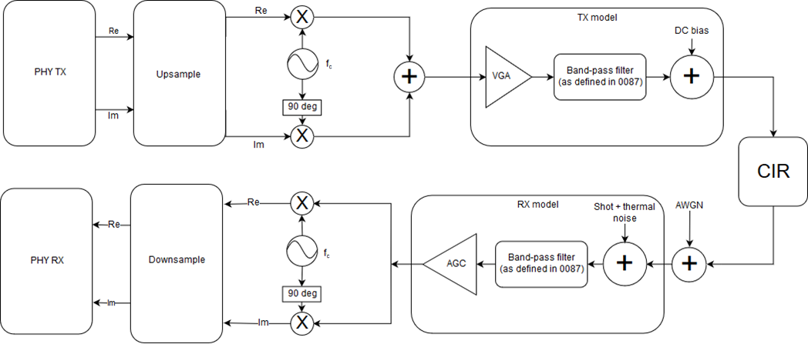
Simulation setup
+ LED model
(low pass filter)
Frontend models (band-pass filter):
See doc. 11-19/187r4
Additional narrow-band LED
model for some simulations
Signal power is measured at the red circle. SNR is set by adjusting noise power in the following AWGN block accordingly. The impact of the Rx model on SNR is assumed to be neglibible, as the used bandpass cutoff frequency exceeds the signal bandwidth.

Slide 6
Channel Models – Time Domain
Enterprise Conference Room S3-D1
  Pronounced LOS peak
  Some diffuse multi-path components
Industrial Wireless D7 (overall)
  No pronounced peak
  Energy spread over 3 main components

Slide 7
Channel Models – Frequency Domain
Enterprise Conference Room S3-D1
  Low pass <45 MHz
  Flat with some ripple >45 MHz
Industrial Wireless D7 (overall)
  Low pass <30 MHz
  Deep fades >30 MHz

Slide 8
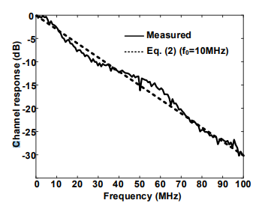
Additional LED model
Measurement (solid) and approximation (dashed) as presented in doc. 19-1208r0
Approximation from left figure (dashed red) and digital filter fit (solid blue)
Second order IIR filter
Matlab code (SOS form):
g_led = 0.003078294298992;
sos_led = [1,2,1,1,-1.83703636178762,0.849349538983590];

Slide 9
Enterprise Conference room channel, 184 MHz, 4 bits/SC
Bit error rate
Block error rate
Simulation length: 10,000 FEC blocks

Slide 10
Industrial Wireless channel, 184 MHz, 4 bits/SC
Bit error rate
Block error rate
Simulation length: 10,000 FEC blocks

Slide 11
Enterprise Conference room channel, 184 MHz, 4 bits/SC, FEC block length 960 bits
Bit error rate
Block error rate
Simulation length: 10,000 FEC blocks

Slide 12
Industrial Wireless channel, 184 MHz, 4 bits/SC, FEC block length 960 bits
Bit error rate
Block error rate
Simulation length: 10,000 FEC blocks

Slide 13
Enterprise Conference room channel, 184 MHz, 6 bits/SC
Bit error rate
Block error rate
Simulation length: 10,000 FEC blocks

Slide 14
Industrial Wireless channel, 184 MHz, 6 bits/SC
Bit error rate
Block error rate
Simulation length: 10,000 FEC blocks

Slide 15
Enterprise Conference room channel, 80 MHz, 4 bits/SC
Bit error rate
Block error rate
Simulation length: 5,000 FEC blocks

Slide 16
Enterprise Conference room channel, 80 MHz, 4 bits/SC
+ LED model
Bit error rate
Block error rate
Simulation length: 5,000 FEC blocks

Slide 17
Enterprise Conference room channel, 40 MHz, 4 bits/SC
Bit error rate
Block error rate
Simulation length: 2,000 FEC blocks

Slide 18
Enterprise Conference room channel, 40 MHz, 4 bits/SC
+ LED model
Bit error rate
Block error rate
Simulation length: 2,000 FEC blocks

Slide 19
Overview of results
Scenario |  | Bitloading Gain
Enterprise Conference room channel | 184 MHz, 4 bits/SC, FEC block length 4320 bits | ~ 1 dB
 | 184 MHz, 4 bits/SC, FEC block length 960 bits | < 1 dB
 | 184 MHz, 6 bits/SC | ~ 1 dB
 | 80 MHz, 4 bits/SC | 1 dB
 | 80 MHz, 4 bits/SC + LED model | > 8 dB
 | 40 MHz, 4 bits/SC | 1 dB
 | 40 MHz, 4 bits/SC + LED model | 6 dB
Industrial Wireless channel | 184 MHz, 4 bits/SC, FEC block length 4320 bits | ~ 3 dB
 | 184 MHz, 4 bits/SC, FEC block length 960 bits | 5~6 dB
 | 184 MHz, 6 bits/SC | 2 dB

Slide 20
Summary
We have studied the benefits of adaptive bit-loading in the LC-optimized PHY by means of simulations according to the evaluation framework in TGbb.
In the conference room scenario, there is minor gain.
But in the industrial scenario, there is significant gain (around 3 and 5 dB with long and short block size) for adaptive compared to fixed bitloading.
When using an additional LED model, which is realistic for energy-efficient operation of non-AP STAs, with 80 MHz BW, only adaptive bitloading allows error-free operation.
Reducing the bandwidth helps with LED model, but 6 dB loss is still significant.
Adaptive bitloading enables efficient operation of LC over critical channels, like in industrial scenario or when using low-energy LED frontends.

