Slide 1
Lean PHY for EHT
Date: 2019-09-13
Authors:

Slide 2
Abstract
This contribution discusses the relevance of a so-called Lean PHY for EHT in 6 GHz, which is an efficient, low overhead PHY intended for management, control and short data PPDUs. The potential losses in spectrum efficiency associated with inefficient PHYs are illustrated by means of measurements in 5 GHz, and it is pointed out that such inefficiencies are undesirable and should be avoided in 6 GHz.

Slide 3
Recap
The contribution [1] highlighted the need for a low overhead PHY for EHT in 6 GHz, fulfilling a role similar to the 802.11a PHY in 5 GHz,
A PHY for management, control, and short data frames is needed.
[1] also explains why using 802.11a in 6 GHz is undesirable, and proposes an alternative PHY called “Low Throughput PHY” (LT PHY)
[1] states that the LT PHY should be mandatory in 6 GHz and forbidden in 2.4 GHz and 5 GHz
[1] describes in some detail the LT PHY. It utilizes the 802.11ac PHY for the data portion of the PPDU and has a very short preamble
[2] provides a comparison among 802.11a, HE and LT PHYs for short PPDUs. It shows the impact and usefulness of short preambles
LT PHY results in a substantial reduction of airtime utilization
[3] shows that small frame size dominates in typical WLAN deployments

Slide 4
Introduction
Measurements were performed in order to gauge the utilization of the 802.11a PHY and its impact on radio resource utilization
Network traces were recorded using a network sniffer
Although the actual usage of the 802.11a PHY is vendor and use case specific, the examples in the following 4 slides capture common, relevant use cases of 802.11 and illustrate why it is important to have a low overhead PHY in 6 GHz

Slide 5
Measurement setup
Experiment 1: Home environment (Germany)
Streaming video from IEEE 802.11ac AP to IEEE 802.11ac STA
Channel 42 (80 MHz @ 5.21 GHz)
Experiment 2: Large meeting (IEEE 802.11 plenary)
IEEE 802.11ac AP(s), many associated STAs
Channel 44 (20 MHz @ 5.22 GHz)
Measurement Device
MacBook Pro 2017, set to promiscuous mode, all (successfully received) frames on a fixed channel are analyzed
Count number of frames
Frame type / subtype
Payload size, rate

Slide 6
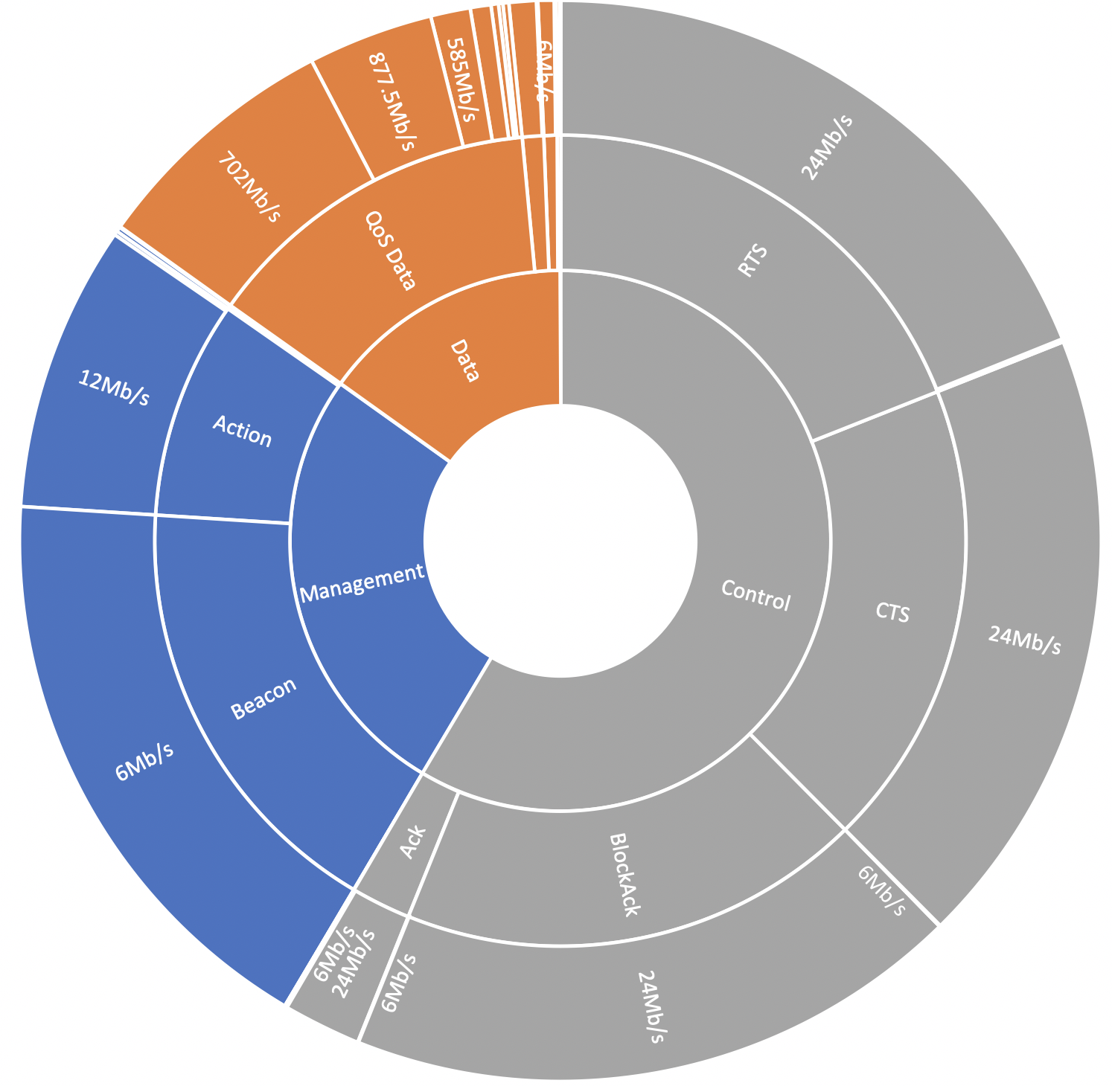
Measurement results: home environment
170806 received frames
25847 Data
99931 Control
45028 Management
Observation:
even though the link supports data rates of several hundreds of Mb/s, a significant fraction of the PPDUs have data rates from 6 Mb/s to 24 Mb/s

Slide 7
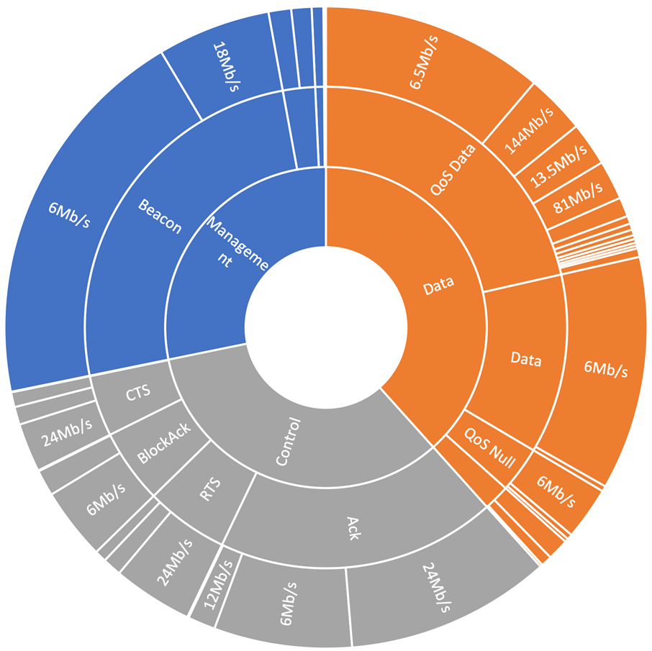
Measurement results: Large meeting
14690 received frames
5637 Data
4909 Control
4144 Management
Observations:
Control and management frames are a substantial part of the traffic and have data rates from 6 Mb/s to 24 Mb/s.
The 6 Mb/s rate is often used for data

Slide 8
Radio resource consumption
We estimate the consumption of radio resources in the time-frequency plane as follows.
rate R [bits/s]
B [Hz]
RR consumption = B$×$N_{b}/R [Hz$∙$s]
N_{b} [bits]
Experiment 1 (home environment):
802.11a PHY RR consumption = 596.2 $×{10}^{6}$Hz$×$s
QoS data (VHT) PHY RR consumption = 12.7 $×{10}^{6}$Hz $×$ s
→ RR consumption of management/control (802.11a) is 47 times that of VHT

Slide 9
Discussion
The use of an inefficient PHY for management/control/short data PPDUs could lead to a very high radio resource consumption when compared to EHT data PPDUs
→ In certain scenarios, the spectrum efficiency improvements stemming from EHT become irrelevant because of said inefficient PHY
→ The use of an inefficient PHY for management/control/short data PPDUs leads to very high radio resource consumption when compared to EHT data PPDUs
It is desirable to define a Lean PHY for management, control and short data PPDUs
The LT PHY introduced in [1] is an example of Lean PHY.

Slide 10
Lean PHY for 6 GHz
Reference [1] lists some desirable properties of the LT PHY for 6 GHz (e.g. it is not compatible with legacy STAs, a PPDU could have very large bandwidth, etc.)
In addition, we propose the following for the Lean PHY
The data part in a Lean PHY PPDU should use the HE/EHT OFDM numerology (i.e. 78.125 kHz subcarrier spacing, tone plans from HE/EHT etc.)
HE utilizes the available radio resources more efficiently than VHT.
The PHY preamble should be as short as practically possible

Slide 11
Straw poll #1
Do you agree that 802.11be should standardize a Lean PHY intended for management or control or short data PPDUs in 6 GHz?
Y/N/A

Slide 12
Straw poll #2
Do you agree that the data part of the Lean PHY PPDUs should use either HE or EHT OFDM numerologies?
Y/N/A

Slide 13
Straw poll #3
Do you agree that the duration of the Lean PHY PPDU preamble should be less than the duration of the shortest HE preamble ?
Y/N/A

Slide 14
References
[1] B. Hart et al., “EHT Candidate Technology Review” https://mentor.ieee.org/802.11/dcn/18/11-18-1549-00-0eht-candidate-technology-review.pptx, Sep 2018
[2] B. Hart et al, “6 GHz Principles” https://mentor.ieee.org/802.11/dcn/18/11-18-1897-00-00ax-6ghz-principles.pptx, Nov 2018
[3] C. Lukaszewski and L. Li, "In Situ Frame Size Measurements" https://mentor.ieee.org/802.11/dcn/15/11-15-0343-01, Mar 2015

