Slide 1
Simulation Evaluation of 802.11ax for IMT-2020 eMBB Dense Urban Scenario
Date: 2019-11-07
Authors:

Slide 2
Abstract
Dense urban is a test environment in IMT-2020 eMBB use scenario, defined as “an urban environment with high user density and traffic loads focusing on pedestrian and vehicular users [1]”.
This presentation encompasses results from simulations on evaluating 802.11ax performance in terms of meeting IMT-2020 requirements for eMBB Dense Urban scenario for both UL and DL, in accordance with the methodology specified by ITU-R ([1] and [2]).
Our results show that 802.11ax in its current configuration satisfies the IMT-2020 eMBB Dense Urban requirements for both 5th percentile, average spectral efficiency and mobility, in accordance with independent simulations done in ([3] and [6]).

Slide 3
Background
IMT-2020 self-evaluation criteria specifies the following performance requirements for a candidate RAT for eMBB Dense Urban scenario:
  Analysis based performance evaluation
    Peak Data Rate
    Peak Spectral Efficiency
    User Experienced Data Rate (Derived from 5%ile User Spectral Efficiency)
  Simulation based performance evaluation
    Average Spectral Efficiency
    5th Percentile User Spectral Efficiency
    Mobility
The analytical performance evaluation has been presented in earlier meetings by different groups ([7]).
In this presentation, we focus on simulation based performance evaluation.

Slide 4
Simulation setup
The simulations are based on ITU-R self-evaluation methodology ([1] and [2]).
The simulator is calibrated with respect to salient channel model parameters such as the geometry SINR, coupling loss, singular values, delay spread, spread of azimuth/elevation departure/arrival angles ([3]).
IMT-2020 simulation data presented by multiple companies in 3GPP ([5], [8]) was used as the calibration benchmark and parameter setup is similar to an independent study already presented in ([6]).
Dense Urban environment key specifications:
      Longer distance and higher transmission power than indoor hotspot scenario
      80% indoor users (3 km/h) and 20% outdoor users (30 km/h)
      Simulation parameters:
        Distance between macro-cell: 200m
        BS height: 25m
        Number of clients per TRxP: 10
        Macro BS Tx Power: 44 dBm, UE Tx Power: 23 dBm

Slide 5
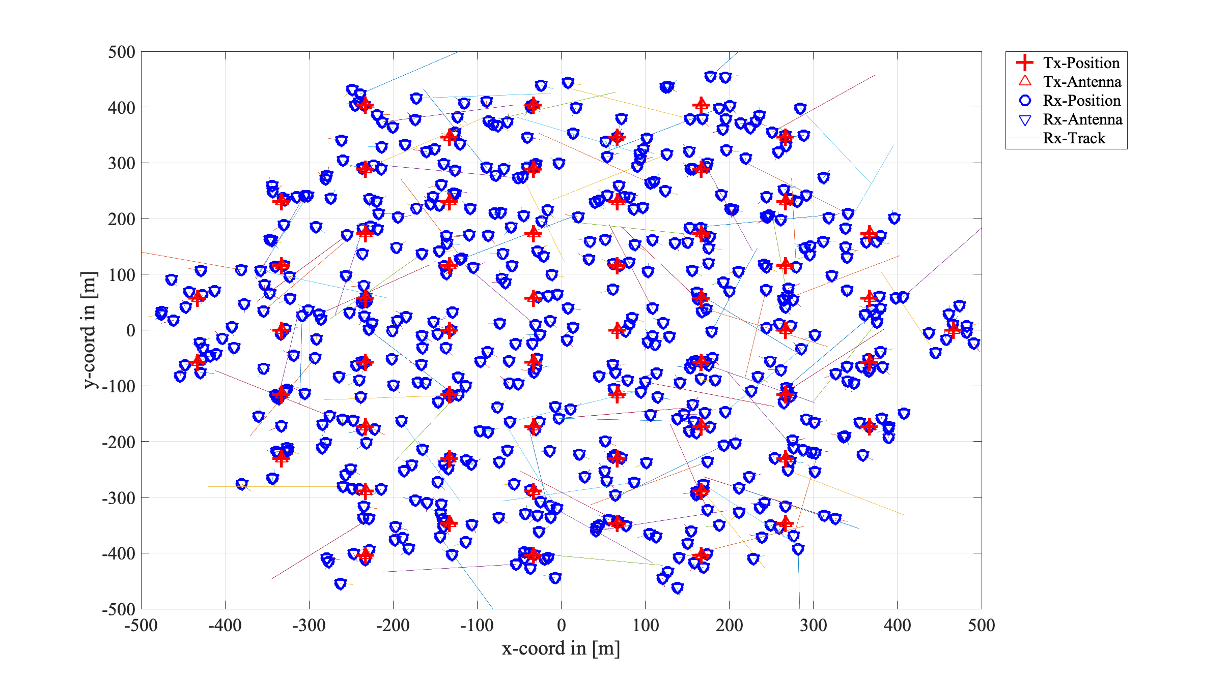
Network Topology
The eMBB Dense Urban network topology (Configuration A) consists of a single layer of Macro cells ([2]). The macro layer base stations are placed in a regular grid, following hexagonal layout with 3 TRxPs each.
Model 19 macro-cell area (4GHz)
  3 TRxPs per Macro Cell
  200m inter-macro cell distance
  Uniformly randomly distributed clients

Slide 6
Evaluation Metrics
Average DL and UL user spectral efficiencies
  Definition: Average spectral efficiency is the aggregate throughput of all users (the number of correctly received bits, i.e., the number of bits contained in the SDUs delivered to Layer 3, over a certain period of time) divided by the channel bandwidth of a specific band divided by the number of TRxPs and is measured in bit/s/Hz/TRxP.
  Requirements for eMBB Dense Urban scenario:

Slide 7
Evaluation Metrics
Average DL and UL user spectral efficiencies
5th percentile DL and UL user spectral efficiencies
  Definition: 5th percentile user spectral efficiency is the 5th percentile point of the cumulative distribution function (CDF) of the normalized user throughput, estimated from all possible user locations.
  Requirements for eMBB Dense Urban scenario:

Slide 8
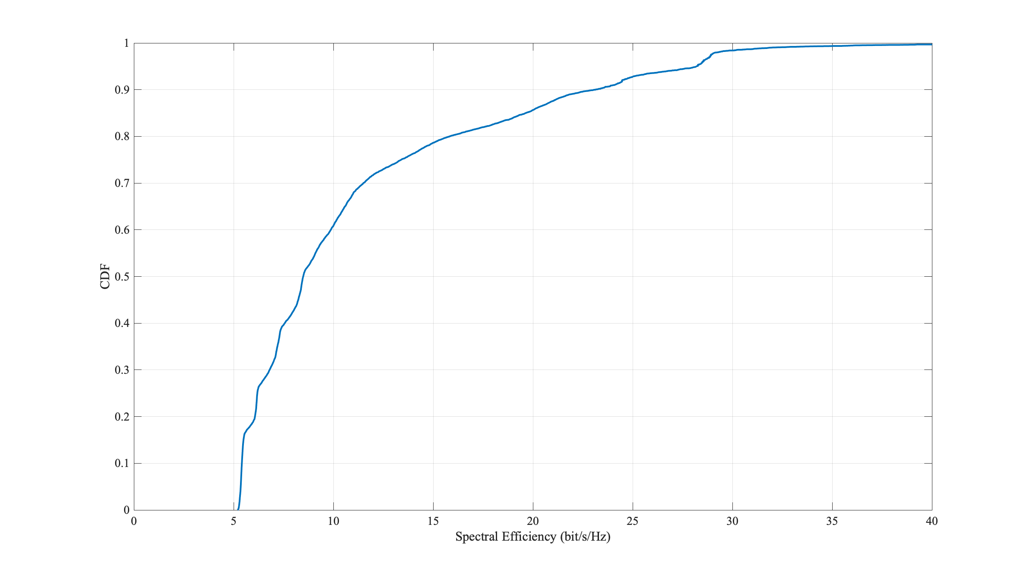
Results: Downlink Performance (MU-MIMO)
Average spectral efficiency – 9.61 bits/s/Hz (requirement – 7.8 bps/Hz)
5th percentile user spectral efficiency – 0.49 bits/s/Hz (requirement – 0.225 bps/Hz)
Conclusion: 802.11ax in its current configuration satisfies the IMT-2020 eMBB Dense Urban DL 5th percentile and average spectral efficiency requirements of 0.225 bps/Hz and 7.8 bps/Hz respectively.

Slide 9
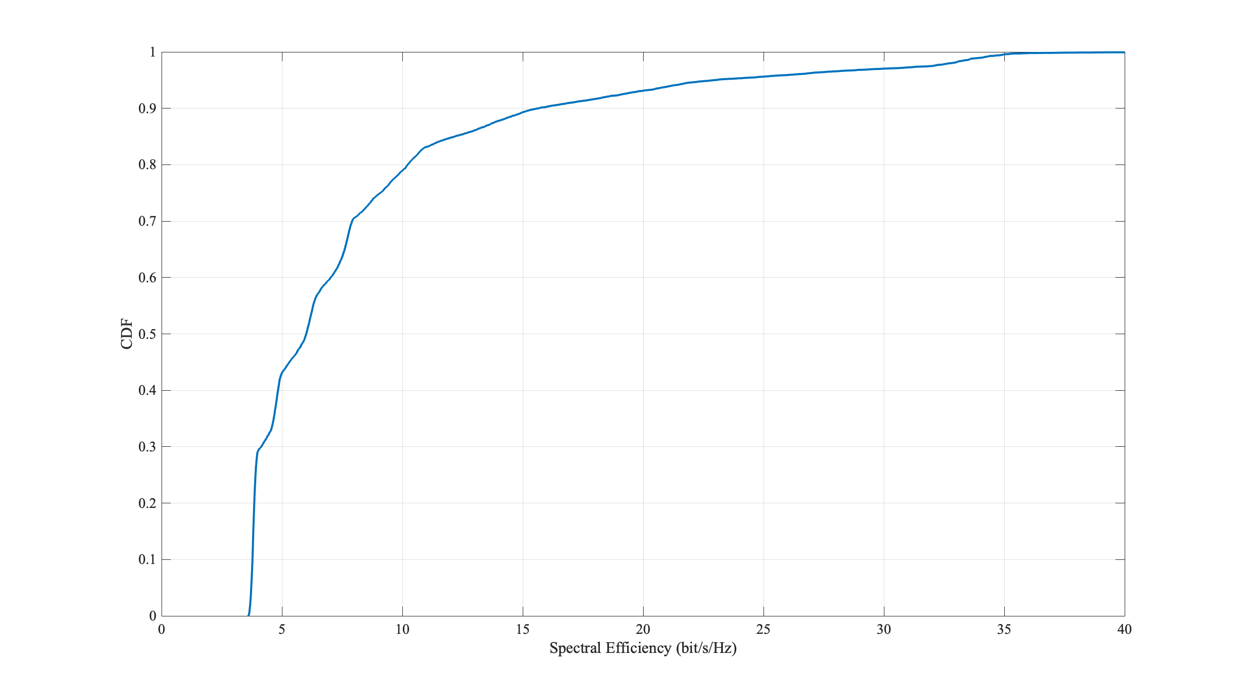
Results: Uplink Performance (MU-MIMO)
Average spectral efficiency – 7.34 bits/s/Hz (requirement – 5.4 bps/Hz)
5th percentile user spectral efficiency – 0.327 bits/s/Hz (requirement – 0.15 bps/Hz)
Conclusion: 802.11ax in its current configuration satisfies the IMT-2020 eMBB Dense Urban UL 5th percentile and average spectral efficiency requirements of 0.15 bps/Hz and 5.4 bps/Hz respectively.

Slide 10
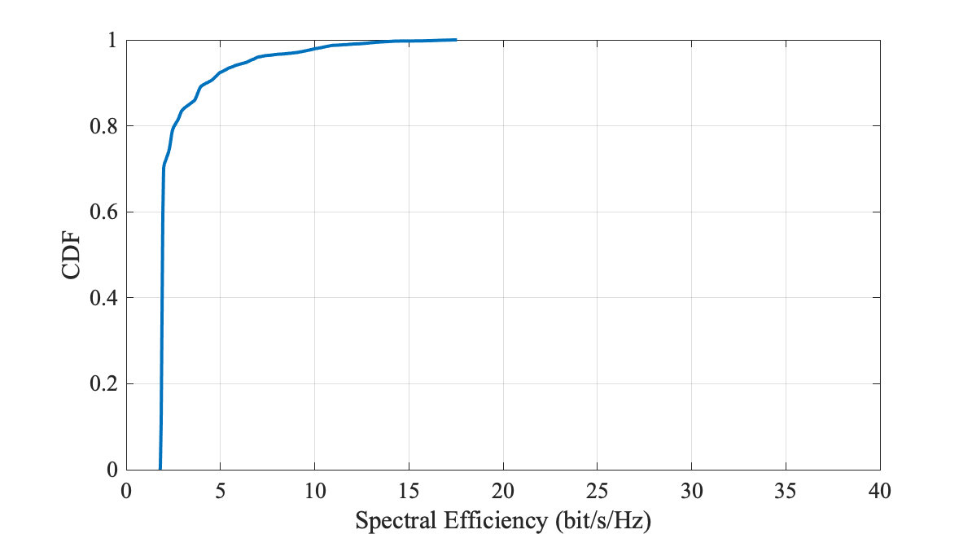
Results: Mobility (Single Uplink Spatial Stream)
Mobility requirement for eMBB Dense Urban is met if at the 50%ile SINR CDF for Dense Urban at 30 kmph, the technology satisfies a UL spectral efficiency of 1.12 bps/Hz and the residual decoded packet error ratio is less than 1% ([2],[6]).
Evaluated performance: 1.54 bps/Hz
Conclusion: 802.11ax in its current configuration satisfies the IMT-2020 eMBB Dense Urban Mobility requirements of 1.12 bps/Hz at 50%ile SINR CDF

Slide 11
Summary
In this work, we present 802.11ax simulations encompassing performance in terms of meeting IMT-2020 requirements for eMBB Dense Urban scenario, in accordance with the methodology specified by ITU-R ([1] and [2]).
Our simulations encompass both UL and DL for eMBB Dense Urban scenario and evaluate 5th percentile, average spectral efficiencies and Mobility scenario.
Our results show that 802.11ax in its current configuration satisfies the IMT-2020 eMBB Dense Urban requirements for both 5th percentile and average spectral efficiency and also the Mobility requirement.

Slide 12
References
[1] Report ITU-R M.2412-0 (10/2017), Guidelines for evaluation of radio interface technologies for IMT-2020
[2] Report ITU-R M.2410-0 (11/2017), Minimum requirements related to technical performance for IMT-2020 radio interface(s)
[3] IEEE 802.11-19/0871r0, 802.11ax for IMT-2020 eMBB Dense Urban, May, 2019
[4] IEEE P802.11ax™/D3.0, “Draft Standard for Information technology Tele-communications and information exchange between systems Local and metropolitan area networks— Specific requirements Part 11: Wireless LAN Medium Access Control (MAC) and Physical Layer (PHY) Specifications; Amendment 6: Enhancements for High Efficiency WLAN” – June 2018
[5] RT-170019, “Summary of email discussion “[ITU-R AH 01] Calibration for self-evaluation”, Huawei, December 2017
[6] IEEE 802.11-19/1283r0, 802.11ax evaluation for IMT-2020 eMBB Dense Urban test environment, July, 2019.
[7] IEEE 802.11-18/0517r2, 802.11ax for IMT-2020 EMBB Indoor Hotspot and Dense Urban, September, 2018
[8] 3GPP TR 37.910 , Study on self evaluation towards IMT-2020 submission

