Slide 1
Multi-link acknowledgment
Date: 2019-09-10
Authors:
Name | Company | Address | Phone | Email
Rojan Chitrakar | Panasonic Corporation |  |  | rojan.chitrakar@sg.panasonic.com
Lei Huang
Yanyi Ding
Yoshio Urabe

Slide 2
Overview
Multi-link transmission is being considered as one of the key technology to achieve the peak throughput goal of 802.11be.
In [1], we shared our opinions on some of the topics related to multi-link transmissions.
In this contribution, we will discuss the topic of acknowledgment for multi-link transmissions in more detail and propose the concept of multi-link block ack.

Slide 3
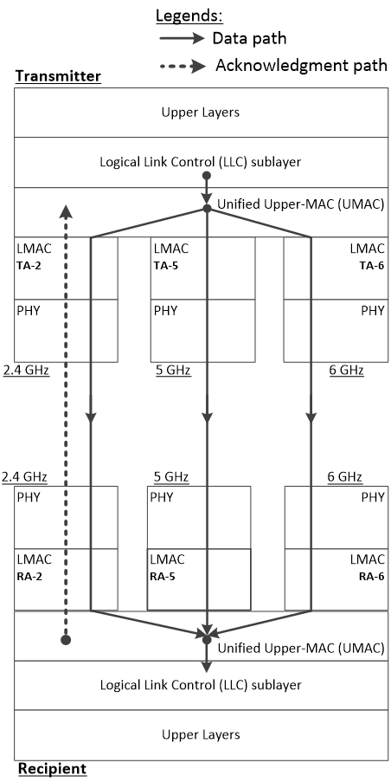
Recap: Multi-link transmission [1]
In order to improve the peak throughput, MPDUs belonging to the same TID may be simultaneously transmitted over multiple links.
At TX side UMAC performs the allocation of MPDUs to different links. The same SN space is used across all links.
At RX side UMAC consolidates the MDPUs arriving over the different links, performs BA scoreboarding, MPDUs reordering etc.
A consolidated acknowledgment may be transmitted over one of the links.

Slide 4
Existing block ack setup mechanism
Block ack mechanism is setup between an originator STA and a recipient STA by exchanging ADDBA Request/Response frames.
If existing block ack setup mechanism is used for multi-link transmissions, one possible option is to perform block ack setup (in each direction) between each pair of STAs between two Multi-link Entities.

Slide 5
Existing Block Ack setup mechanism
The parameters of the block ack mechanism is negotiated by exchanging ADDBA Request/Response frames:
TID: TID for the block ack mechanism
Buffer Size: number of buffer for this particular TID
Block Ack Timeout Value: duration in TUs after which the block ack setup is terminated.
Block Ack Starting Sequence Control: sequence number of the first MSDU to be sent under this block ack agreement.
Once setup, each block ack agreement is uniquely identified by a tuple of Address 1 (RA), Address 2 (TA), and TID.

Slide 6
Proposal 1: Multi-link block ack Setup
A single Multi-link block ack agreement is setup between two Multi-link Entities for a multi-link TID.
Example: Multi-band elements in the ADDBA Request/Response frames can indicate the links for which the Multi-link block ack applies:
The block ack parameters apply to all the involved links. Buffer Size needs to account for all involved links.
A common sequence number space is used for MPDUs of the same TID transmitted over multiple links; the Block Ack Starting Sequence Control field specifies the same sequence number for all links.

Slide 7
Per-link block ack
Per-link block ack may be preferred for Multi-link transmissions.
However, since the BA bitmaps of different links may cover the same sequence number range:
Many of the bits of the BA bitmap can be expected to be ‘0’:
Duplication/waste of bitmaps
May cause confusion for the originator
Reception of BlockAck frame may fail (E.g. if the multi-link originator is affected by in-device coexistence interference.)

Slide 8
Proposal 2: Multi-link BlockAck frame
A single Multi-link BlockAck frame may be used to acknowledge the MPDUs received over multiple links:
The BlockAck bitmap consolidates the receipt status of the MPDUs received over multiple links.
A Multi-link BlockAck Request frame may be transmitted over any one link to solicit the Multi-link BlockAck frame. E.g. the Multi-link BlockAck frame may be solicited on a link that does not cause in-device coexistence interference or on the links suffering from in-device coexistence interference in a delayed manner.

Slide 9
Multi-link BlockAck frame
Example: A “Multi-link” bit in the BA Control field may be used to denote a Multi-link BlockAckReq/BlockAck frame.
The length of the BlockAck Bitmap of a Multi-link BlockAck frame may be increased (e.g. 128 octets (1024 bits) or 256 octets (2048 bits)) to acknowledge the higher number of MPDUs transmitted over multiple links.

Slide 10
Conclusion
In this contribution, we discussed the setup mechanism of Multi-link Block Acks.
To simplify the setup process, we propose that a single Multi-link Block Ack agreement is setup between two Multi-link Entities for a multi-link TID.
We also discussed the acknowledgements for multi-link transmissions.
We propose that a single Multi-link BlockAck frame may acknowledge the MPDUs received over multiple links.

Slide 11
Reference
IEEE 802.11-19/1128r0 – Multi-link transmission
IEEE 802.11-19/818r0 - Discussion on Multi-band operation
IEEE 802.11-19/773r1 - Multi-link Operation Framework
IEEE 802.11-19/823r0 - Multi-link aggregation
IEEE 802.11-19/979r0 - EHT Multi-link Operation Follow-up
IEEE 802.11-19/1291r1 - Performance aspects of Multi-link operations
IEEE 802.11-19/1213r0 – Discussion on Multi-link Operations

Slide 12
Straw Poll 1
Do you support that a single block ack agreement is negotiated between two Multi-link devices (MLDs) for a TID that may be transmitted over multiple links?
Note: The format of the setup frames is TBD.
27Y/1N/11A

Slide 13
Straw Poll 2
Do you support assigning sequence numbers from a common sequence number space shared across multiple links of a Multi-link device (MLD) for a TID transmitted to peer Multi-link device.
29Y/1N/15A

Slide 14
Straw Poll 3
Do you support that a single BlockAck frame may indicate the receipt status of MPDUs of a TID received over multiple links?
Note: The format of the BlockAck frame is TBD.
deferred

Slide 15
Motion 1
Move to add the following text into IEEE 802.11be SFD:
A single block ack agreement is negotiated between two Multi-link devices (MLDs) for a TID that may be transmitted over one or more links.
Note: The format of the setup frames is TBD.
Y/N/A

Slide 16
Motion 2
Move to add the following text into IEEE 802.11be SFD:
Sequence numbers are assigned from a common sequence number space shared across multiple links of a Multi-link device (MLD), for a TID that may be transmitted to a peer Multi-link device over one or more links.
Y/N/A

