Slide 1
Multi-link Channel Access Discussion
Date: 2019-09-15
Authors:

Slide 2
Introduction
Multi-link Operation
  Candidate feature being discussed in TGbe group
  Several aspects
    Transmission of frames of a TID over multiple links [1]
    Minimizing negotiation overhead for fast link switching [2]
Multi-link Channel Access
  Several discussions on multi-link channel access, asynchronous and synchronous operations
  A few contributions have considered multi-link operation with single primary
    Similar to 80 + 80 operation in which all devices perform backoff only one link
In this presentation, we focus on multi-link channel access with per-link backoff

Slide 3
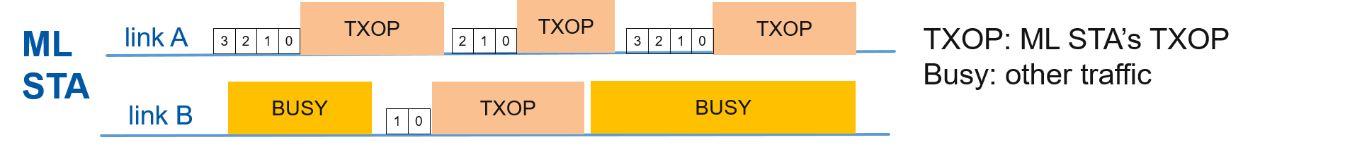
Asynchronous Operation
Asynchronous multi-link channel access
  Per-link backoff procedure with no synchronization of multi-link transmissions
  Single link STAs and legacy STAs can operate on any link
  Simultaneous transmit and receive operation (STR)
  Shall be the default multi-link access mode
STR Constraint
  STA may not be capable due to in-device power leakage from insufficient frequency separation
  Example: Lower 5 GHz and upper 5 GHz

Slide 4
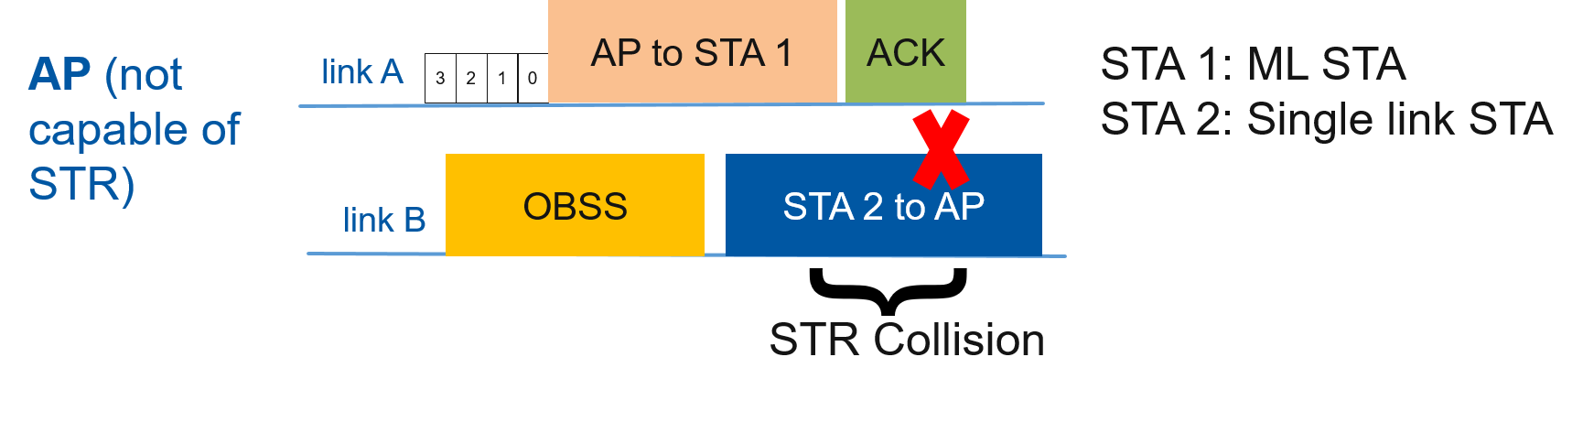
STR Constraint at AP
STR collision example
  AP is not capable of STR and hence fails to receive STA 2’s transmission
  Several collision scenarios present in multi-link BSS with AP not capable of STR
  Challenging to perform complete synchronized operation due to legacy devices, single link STAs, OBSS traffic, etc.
Therefore, AP that establishes multi-link BSS for EHT multi-link operation shall have STR capability for all link pairs

Slide 5
Non-AP STA’s STR Capability
Multi-link STAs indicate STR capability to AP
  Dynamic indication by ML STA based on operating links
In this context, classification of non-AP STAs on a link pair
  STR STA
    ML STA operating on both links and capable of STR on that link pair
  Non-STR STA
    ML STA operating on both links and not capable of STR on that link pair
  Single link STA
    STA operating only on one of the links of the link pair

Slide 6
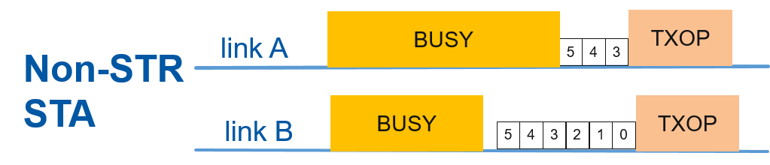
Multi-link Aggregation for Non-STR STAs
Multi-link aggregation [5,6]
  Per-link backoff
  Link with backoff countdown to 0 can aggregate second link if idle (e.g. for PIFS)
  Per-link PPDU
Multi-link aggregation shall be enabled by AP for non-STR STAs
  To boost channel access opportunities

Slide 7
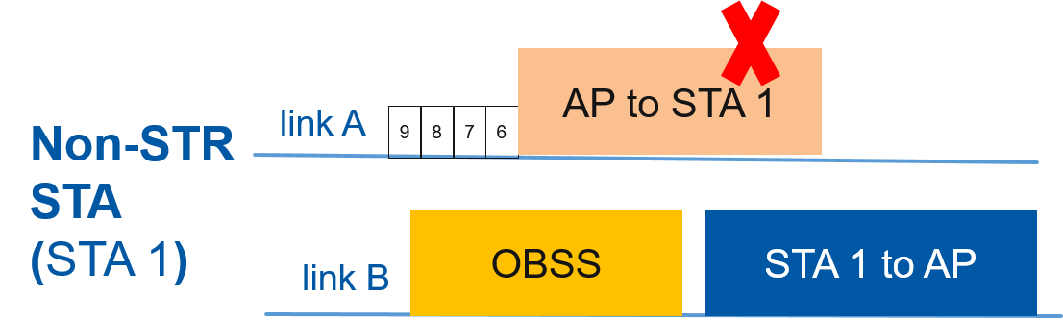
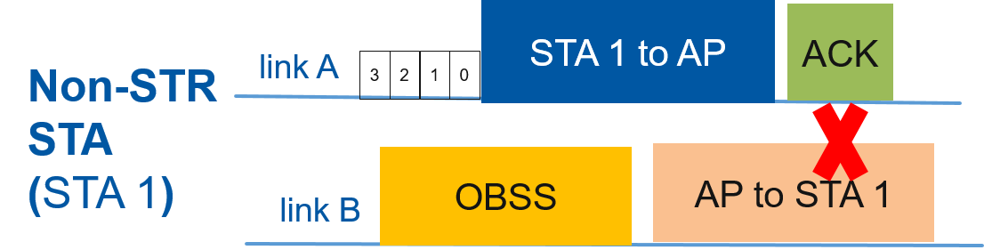
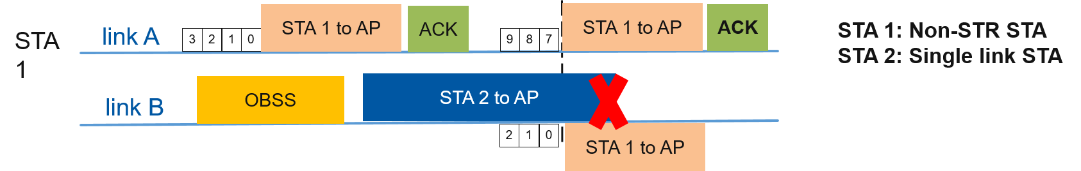
Challenging Scenarios for Non-STR STAs
Problem 1
  Non-STR STA transmits while receiving a
  frame destined to it, collision at STA 1
Problem 2
  AP transmits to non-STR STA while receiving from
  the same non-STR STA, collision at STA 1
Problem 3
  Non-STR STA does not detect STA 2’s transmission by ED check, collision at AP

Slide 8
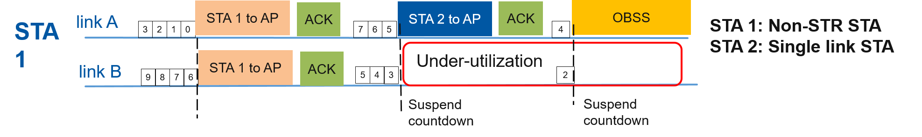
Collision Prevention with Non-STR STAs
Conservative approach at non-STR STA
  Suspend backoff countdown on link A when RX on link B
  Suspend backoff countdown on link A when TX on link B
Conservative approach at AP
  Shall not transmit to non-STR STA when receiving an intra-BSS PPDU
Prevents STR collisions at non-STR STAs without any additional information
Despite aggregation, there can be significant multi-link under-utilization
Objective: To improve multi-link utilization of non-STR STAs with the constraint of preventing STR collisions

Slide 9
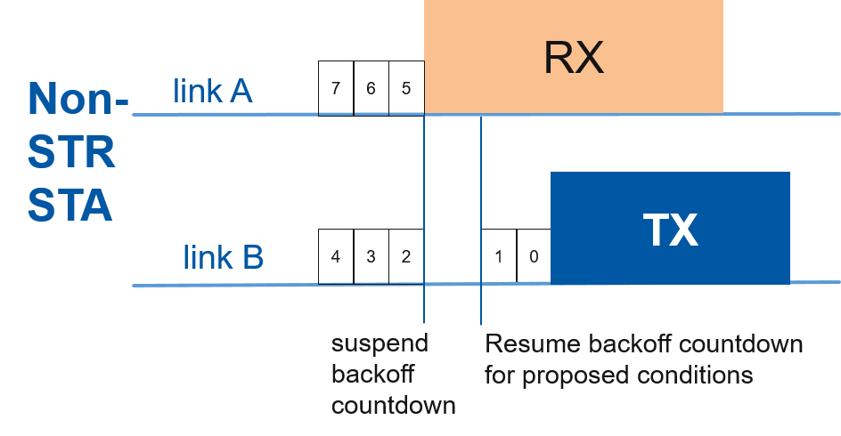
Opportunistic Backoff Countdown Resume at non-STR STA
For certain conditions, non-STR STA resumes countdown on link B during busy state on link A
Similar to 802.11ax SRP-based spatial reuse backoff procedure
Inter-BSS PPDU (e.g. BSS Color)
  Backoff countdown can be resumed
Intra-BSS Uplink PPDU
  Backoff countdown can be resumed
  UL/DL bit in HE-SIG-A for HE SU PPDU/ER SU PPDU
  UL MU identified by HE TB PPDU or preceding Trigger
Intra-BSS Downlink PPDU
  Backoff countdown can be resumed if PPDU identified to be not destined to itself
  STA ID in HE-SIG-B for HE MU PPDU or unable to decode HE-SIG-B of HE MU PPDU
  No STA ID info in PHY preamble for SU PPDU and MAC header decoding can take long
  Proposal: STA ID info in EHT PHY preamble for SU PPDU

Slide 10
Non-STR STA indication in Uplink
Preventing AP from transmitting to any non-STR STA while receiving any intra-BSS PPDU may be too conservative
Trigger-based PPDU
  AP knows which non-STR STAs are transmitting (except random RUs)
SU PPDU
  STA ID info in EHT PHY preamble (same as in previous slide)

Slide 11
Multi-link Busy State Feedback
Non-STR STA misses PHY preamble on link B during its TX on link A
Performs ED check on link B after its link A TXOP and cause collision at AP on link B
AP knows ML STA’s non-STR constraint and AP’s current reception of intra-BSS PPDU
Proposal: When non-STR STA completes transmission in link A, if AP is currently receiving intra-BSS PPDU on link B, then AP indicates Busy Status in feedback (ACK in figure) to non-STR STA on link A. Accordingly, non-STR STA suspends backoff procedure until the occurrence of an intra-BSS PPDU reception or aPPDUMaxTime countdown expiry

Slide 12
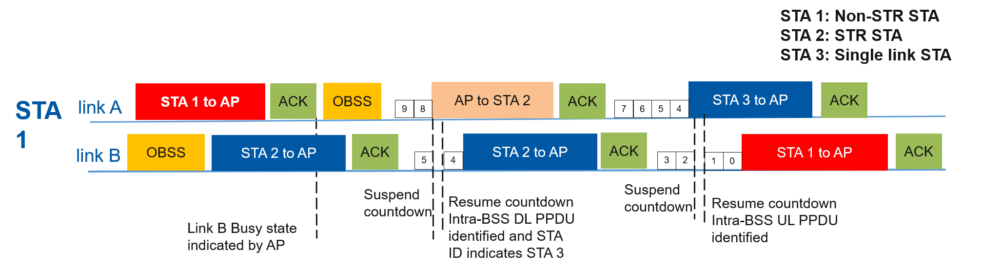
Multi-link Channel Access with Proposed Enhancements
Proposed methods can be applied by non-STR STAs
Increased multi-link utilization compared to default behavior for non-STR STAs
Snapshot from a multi-link BSS timeline from non-STR STA’s perspective

Slide 13
Multi-link Channel Access Rules
Rules for STR STAs and AP
  Follows EDCA channel access protocol on each link
  We can further consider aggregation [6]
  Additionally, if AP, shall not transmit to a non-STR STA from which it is receiving frame(s)
Rules for Non-STR STAs
  Aggregation shall be enabled
    More details on potential access rules [6]
  EDCA channel access protocol on each link with following restrictions
    Suspend backoff countdown when RX on link A and vice versa
    Perform Opportunistic Backoff Countdown Recommencement
    Suspend backoff countdown on link A when TX on link B and vice versa
    Suspend backoff countdown on link B when AP indicates Busy State of link B

Slide 14
Summary
Multi-link BSS AP shall have simultaneous transmit and receive (STR) capability
Non-AP STAs may or may not have STR capability and indicate this info to AP
Problem scenarios for asynchronous multi-link operation with non-STR STAs
Conservative approach may lead to significant under-utilization
Potential mechanisms to address the problems
  Opportunistic backoff countdown recommencement
  STA ID indication in EHT PHY preamble
  Secondary link busy status in feedback to non-STR STA

Slide 15
Straw Poll #1
Do you support 802.11be have mechanisms to enable multi-link operation for non-AP STAs without simultaneous transmit and receive capability?

Slide 16
Straw Poll #2
Do you agree that STAs without simultaneous transmit and receive capability require different channel access rules for multi-link operation compared to STAs with simultaneous transmit and receive capability?

Slide 17
Straw Poll #3
Do you agree that 802.11be AP establishing multi-link operation shall always have simultaneous transmit and receive capability? (refer to slide 4)

Slide 18
References
[1] 11-19/979, “EHT Multi-link Operation Follow-up”
[2] 11-19/822, “Extremely Efficient Multi-band Operation”
[3] 11-19/1116, “Channel Access in multi-band operation”
[4] 11-19/1144, “Channel Access for Multi-link Operation”
[5] 11-19/764, “Multi-link Aggregation Gain Analysis”
[6] 11-19/1505, “Multi-link Aggregation Considerations”

