Slide 1
LC MAC submission – follow up
Date: 2019-07-15
Authors:
Name | Affiliation | Address | Phone | Email
Suhwook Kim | LG Electronics | 19, Yangjae-daero 11gil, Seocho-gu, Seoul 137-130, Korea |  | suhwook.kim@lge.com
Jinsoo Choi |  |  |  | js.choi@lge.com
Jeongki Kim |  |  |  | jeongki.kim@lge.com
HanGyu Cho |  |  |  | hg.cho@lge.com

Slide 2
Abstract
This submission is follow-up of 757r2 [1]
We propose several MAC features for supporting PHYs and satisfying PAR
We also evaluate it with MAC simulator

Slide 3
RTS/CTS
STAs cannot hear each other in normal LC BSS, which can lead to collision at UL transmission
  We may use RTS/CTS to resolve UL collision
However, RTS/CTS has some disadvantages such as overhead and latency
  Transmission for RTS and CTS frame consumes over 100 usec
We evaluate RTS/CTS performance in LC environment

Slide 4
Simulation result for RTS/CTS in LC
Simulation Setting
  STAs are hidden each other
  Single BSS (No OBSS interference)
Simulation parameter
  BW: 20 MHz
  AP-STA distance: 5 meters
  MCS is fixed: MCS 7 (65 Mbps)
  MPDU size: 1500 bytes
  Number of STAs: 2 ~ 8 STAs
Traffic model
  Constant Bit Rate
  DL: 5 ~ 20 Mbps, UL: 1 Mbps
Metric
  Throughput
  Latency: Time taken for frame to enter the queue and successfully send out

Slide 5
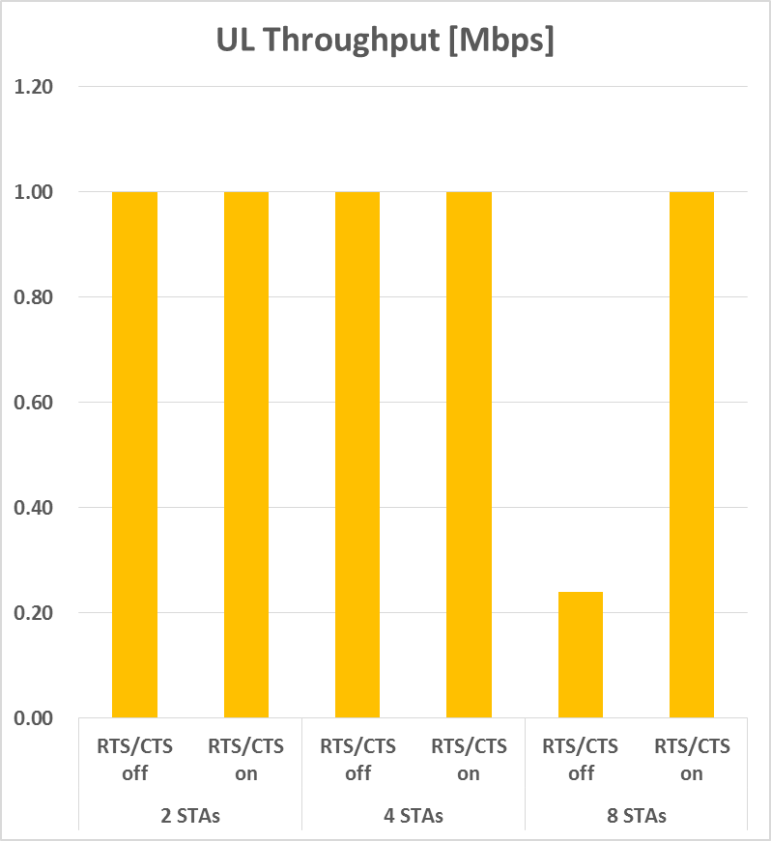
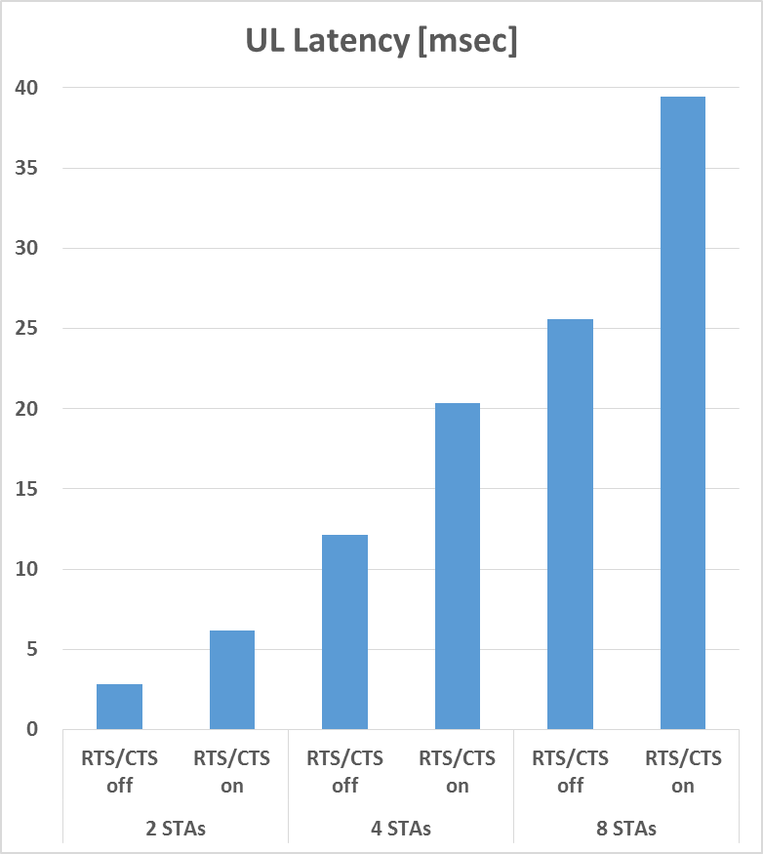
Simulation results

Slide 6
Simulation results
 |  | Tput [Mbps] |  | Latency [msec]
 |  | No RTS/ CTS | RTS/ CTS | No RTS/ CTS | RTS/ CTS
DL | 2 STAs | 20.0 | 20.0 | 1.59 | 2.16
 | 4 STAs | 10.0 | 10.0 | 3.47 | 4.07
 | 8 STAs | 4.4 | 5.0 | 663 | 10.3
UL | 2 STAs | 1.0 | 1.0 | 2.81 | 6.18
 | 4 STAs | 1.0 | 1.0 | 12.1 | 20.4
 | 8 STAs | 0.24 | 1.0 | 25.6 | 39.5
RTS/CTS shows enhanced performance in only 8 STAs case
However, RTS/CTS only increases latency in 2 STAs and 4 STAs case
  Latency increase is even greater in UL

Slide 7
RTS/CTS signaling
As we can see in simulation results and well-known fact, RTS/CTS has advantages only in dense environments
  RTS/CTS can increase latency in sparse network without any performance enhancement and latency increase is even greater in UL
It is desirable to use RTS/CTS in UL transmission only in dense environments
  However, it is difficult for a STA to recognize the current environments because the STAs are hidden each other
We may need to define a MAC signal for the AP to decide whether to use RTS/CTS on the STA

Slide 8
RTS/CTS signaling
A STA shall use RTS/CTS before receiving any RTS/CTS signal for the AP
  This could protect the UL transmission from other associated STAs
If the STA received any RTS/CTS signal, it shall follow the RTS/CTS rule as indicated
If the AP determines that the current network is sparse, the AP can make STAs use RTS/CTS optionally
If the AP determines that the current network is dense, the AP can make STAs use RTS/CTS all the time
There are two methods for this signal
  Option 1: Broadcast method
  Option 2: Unicast method

Slide 9
RTS/CTS signaling: Option 1
Signal for RTS/CTS usage in UL is transmitted in Beacon frame
Beacon period is divided into two durations
  RTS/CTS duration: A STA shall use RTS/CTS in UL
  Non-RTS/CTS duration: A STA can transmit a data frame without RTS/CTS
Duration setting can be changed in per a beacon or multiple of it

Slide 10
RTS/CTS signaling: Option 2
AP can transmit signal for RTS/CTS off in MAC header of DL data
  The STA that received the signal can transmit a data frame without RTS/CTS
Signal for RTS/CTS on is similar way

Slide 11
Support two PHYs
We have discussed two PHYs so we may have to define MAC procedure which incorporates with the two PHYs
  Option 1: No incorporation
    Each PHY operates independently
  Option 2: Low-level incorporation
    Scanning and association is performed though one specific PHY
    Management frame (for example, beacon frame) shall be only carried in one specific PHY
  Option 3: High-level incorporation
    Time-division access
    The beacon period is divided into two sections available for each PHYs

Slide 12
Multi-color operation
Followings are defined in other spec for efficient operation in wide-band and multiple channels
  BSS channel selection in TGac
  Social channels in WFA
If we define some channels with particular purposes, it would be helpful for LC to operate in wide-band
  Discovery channel
  Channel for specific PHY
  High data rate only channel

Slide 13
Summary
We addressed and reviewed several MAC features for designing LC MAC
  RTS/CTS signal
  Support two PHYs
  Multi-color operation

Slide 14
References
[1] 11-19-0757-02-00bb-lc-mac-submission.pptx

Slide 15
Straw poll
Do you agree to define a MAC signal for the AP to decide whether to use RTS/CTS on the STA
Y N A

Slide 16
Appendix

Slide 17
Supporting two PHYs: Option 1, 2
Option 1: No incorporation
  Each PHY operates independently
  How the two PHY-enabled AP operate is an implementation issue
Option 2: Low-level incorporation
  Scanning and association is performed though one specific PHY
    After association, a STA can transit to other PHY and transmit data frame
  Management frame (i.e., beacon frame) shall be only carried in one specific PHY
  All AP/STA shall be implemented with the specific PHY

Slide 18
Supporting two PHYs: Option 3
Option 3: High-level incorporation
  AP assigned specific durations for each PHY
  Duration assign information is delivered in each beacon frame
  A STA shall transmit a frame in a duration that matches its PHY
LCO-PHY: LC Optimized PHY, 11B-PHY: IEEE 802.11 Based PHY

