Slide 1
P802.11ay Report to EC on Unconditional Approval to go to SA Ballot
Date: 2019-11-10
Author:

Slide 2
Introduction
This document contains the report to the IEEE 802 Executive Committee (EC) in support of a request for unconditional approval to send IEEE P802.11ay Draft 5.0 to Standards Association (SA) Ballot
  Note: The SA ballot will be started only after the opening of the TGmd and TGax SA ballots
This document was approved during the plenary session of the IEEE 802.11 working group on November 15, 2019.
  Results: TBD yes, TBD no , TBD abstain

Slide 3
IEEE 802.11 WG Letter Ballot Results – P802.11ay
Ballot ID | Ballot Close Date | Title | Ballot Type | Pool | Return | %Return | Abstain | %Abstain | Approve | Disapprove | %Approve
234 | Aug 31 2018 | Technical Letter Ballot for P802.11ay Draft 2.0 | Technical | 322 | 265 | 82 | 29 | 9 | 219 | 17 | 93
239 | Feb 28 2019 | First Recirculation Ballot for P802.11ay Draft 3.0 | Recirculation | 322 | 288 | 89 | 26 | 8 | 247 | 15 | 94
242 | Jul 8 2019 | Second Recirculation Ballot for P802.11ay Draft 4.0 | Recirculation | 322 | 287 | 89 | 25 | 8 | 256 | 6 | 98
246 | Nov 8 2019 | Third Recirculation Ballot for P802.11ay Draft 4.0 | Recirculation | 322 | 288 | 89 | 25 | 8 | 260 | 3 | 99

Slide 4
IEEE 802.11 WG Letter Ballot Comments – P802.11ay
Ballot ID | Ballot Close Date | Title | Total Number of Comments received (Yes and No voters)
234 | Aug 31 2018 | Technical Letter Ballot for P802.11ay Draft 2.0 | 742 (431 T, 282 E, 29 G)
239 | Feb 28 2019 | First Recirculation Ballot for P802.11ay Draft 3.0 | 478 (338 T, 133 E, 7 G)
242 | Jul 8 2019 | Second Recirculation Ballot for P802.11ay Draft 4.0 | 64 (21 T, 43 E, 0 G)
246 | Nov 8 2019 | Third Recirculation Ballot for P802.11ay Draft 5.0 | 7 (2 T, 5 E, 0 G)
Total |  |  | 1291 (792 T, 463 E, 36 G)

Slide 5
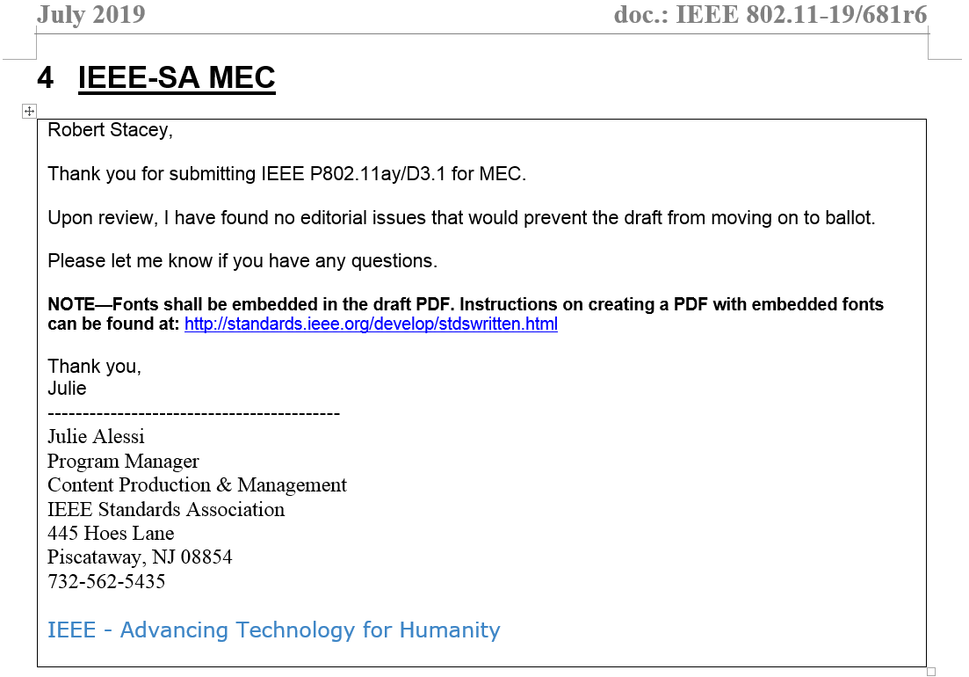
IEEE-SA Mandatory Editorial Coordination
(https://mentor.ieee.org/802.11/dcn/19/11-19-0681-06-0000-tgay-mdr-report.docx)

Slide 6
Unsatisfied comments by commenters
(No must-be-satisfied comments received in LB246)
Voter | LB234 | LB239 | LB242 | LB246 | Total
James Yee | 1 | 0 | 0 | 0 | 1
Yongho Seok | 1 | 0 | 0 | 0 | 1
Yunsong Yang | 0 | 3 | 5 | 0 | 8
SUB-TOTAL | 2 | 3 | 5 | 0 | 10

Slide 7
Unsatisfied comments by topics
(No must-be-satisfied comments received in LB246)
Topic | PHY | MAC (frame formats) | MAC (others) | Total
TDD channel access | 0 | 0 | 2 | 2
Security | 0 | 4 | 1 | 5
Beamforming | 0 | 1 | 1 | 2
QMF policies | 0 | 1 | 0 | 1
SUB-TOTAL | 0 | 6 | 4 | 10

Slide 8
Unsatisfied comments
The composite of all unsatisfied comments and the resolutions approved by the comment resolution committee received during working group ballot may be found in the embedded document on the right:
  Double click on the icon to the right to open this.

Slide 9
TGay Timeline
 | Open | Close
First SA ballot | Mar 2, 2020 | Mar 31, 2020
Second SA ballot | Jun 1, 2019 | Jun 15, 2019
Third SA ballot | Jul 27, 2020 | Aug 10, 2020
Fourth SA ballot (unchanged draft) | Aug 31, 2020 | Sep 14, 2020
EC to RevCom (RevCom submittal deadline: October 13, 2020) | October 6, 2020
RevCom to Standards Board | December 2020

