Slide 1
Study of False L-STF Detections Triggered by MC-OOK
Date: 2019-07-09
Authors:

Slide 2
Abstract
CIDs 3304 and 3305 in [1] state that
STAs operating in non-WUR mode will often falsely detect an L-STF during the reception of the MC-OOK part of a WUR PPDU
False detections can have a negative impact on the operation of the STAs
In this contribution we study the false detection problem in legacy STAs and describe an alternative way to generate MC-OOK without impacting the performance of the WURx or triggering false detections in other STAs

Slide 3
Recap
L-STF Detection
The L-STF consists of 10 repetitions of a 0.8 μs short symbol.
L-STF detection can be performed by correlating the received signal with a delayed version of itself. A packet is detected when the autocorrelation exceeds a threshold
MC-OOK On symbol design
The use of random MC-OOK On symbols may lead to degraded performance since the channel coding in the WUR PPDUs is very weak and many waveforms generate small eye diagram openings
Because of this, optimized waveforms are recommended in Annex AC of 802.11ba D3.0

Slide 4
Study of the behaviour of legacy 802.11a STAs (1)
Simulation settings:
Utilized the packet detection algorithms implemented in a legacy 802.11a STA
LDR: MC-OOK generated according to Example 1 in Annex AC of Draft 802.11ba D3.0
HDR: MC-OOK generated according to Example 3 in Annex AC of Draft 802.11ba D3.0
Noiseless WUR PPDU (High SNR is more challenging than low SNR)

Slide 5
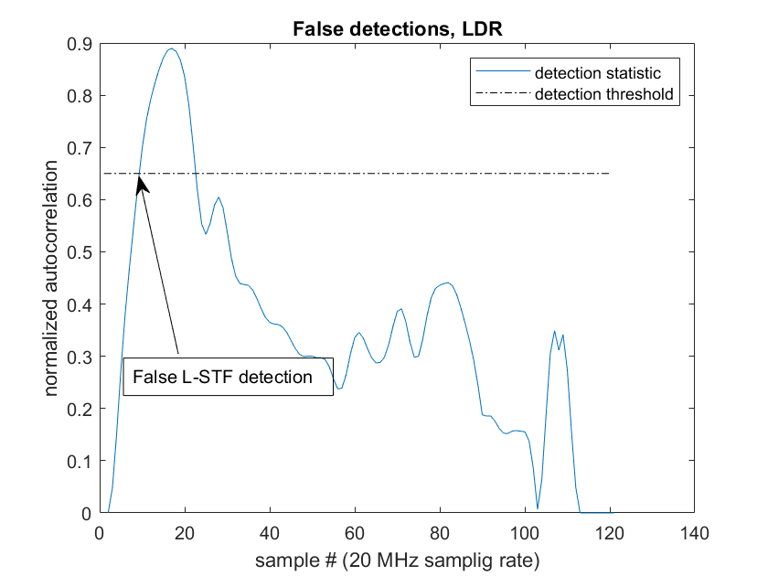
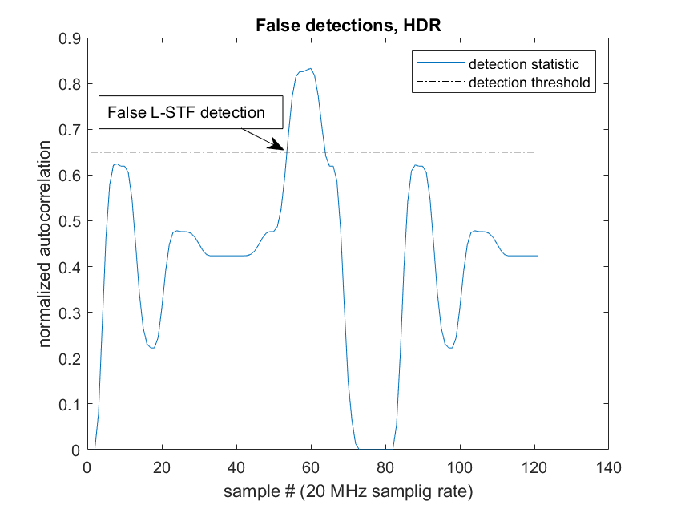
Study of the behaviour of legacy 802.11a STAs (2)
The possibility of recurrent false detections is confirmed

Slide 6
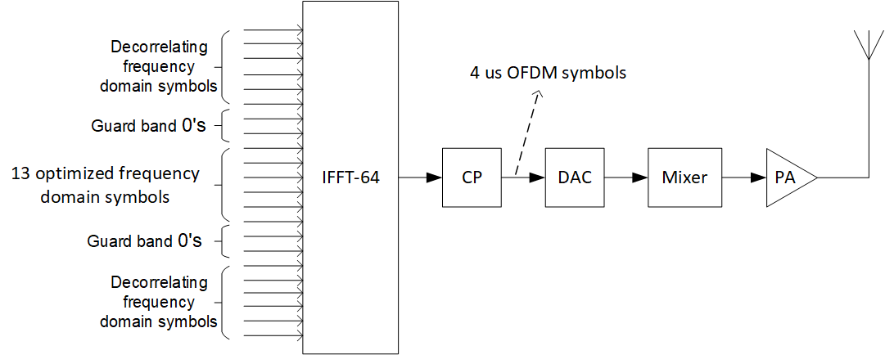
Alternative MC-OOK generation
Populate some of the muted subcarriers with decorrelating frequency domain symbols
These are symbols specifically designed to decorrelate the MC-OOK On symbols (and their cyclically shifted versions generated by the symbol randomizer)
We call the corresponding subcarriers decorrelating subcarriers
Leave a guard band around the center 4 MHz
Example of generation of one SymLDROn

Slide 7
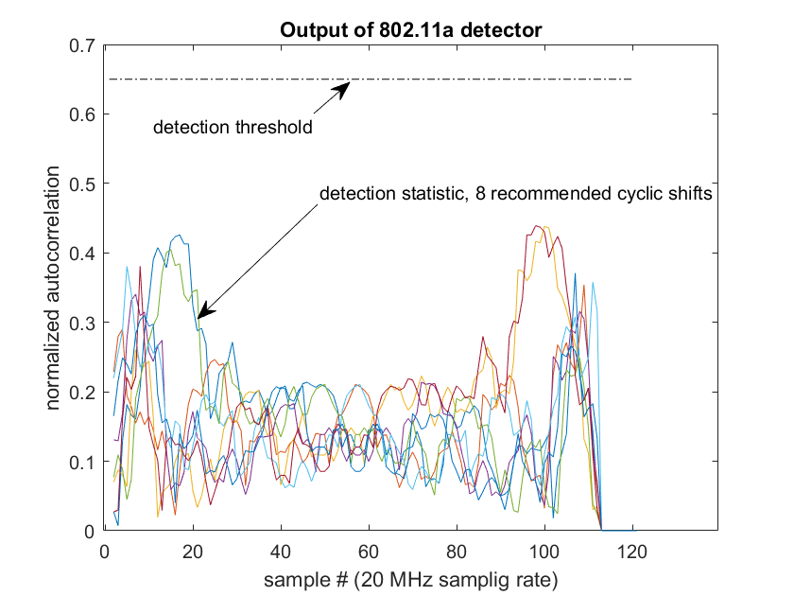
Example, LDR
MC-OOK On symbol: ${S_{−6:6}=S}^{LDR}=\left\{\text{1 1 1 −1 −1 −1 0 −1 1 −1 −1 1 −1}\right\}$, (Example 1, Table AC2 in 802.11ba D3.0)
Decorrelating frequency domain symbols: $S_{−17:−15, 15:17}=\left\{\text{1 −1 1 1 1 1 }\right\}$
The SymLDROn symbols generated by the symbol randomizer do not trigger false L-STF detections

Slide 8
Observations (1)
An alternative way to generate MC-OOK has been described. It employs so-called decorrelating subcarriers
The CSF in the WURx filters out the decorrelating subcarriers → the Tx can avoid the use of MC-OOK waveforms that produce small eye diagram openings
The CSF in STAs operating in non-WUR mode does not dampen the decorrelating subcarriers → low autocorrelation MC-OOK waveform won’t trigger a false L-STF detection

Slide 9
Observations (2)
In geographical regulatory domains where there are limitations on the PSD, decorrelating subcarriers can be introduced without the need to decrease the power of the 4 MHz in the center of the RF channel
The alterative method to generate MC-OOK shown in slide 6 does not fulfil the transmit spectrum mask requirement described in Section 30.3.12.1 of 802.11ba D3.0

Slide 10
References
[1] IEEE 802.11 19-1016-06-00ba Comments on TGba D3.0

